Slide 2
William Brothers, Ed.S.
Southwestern Community College

Slide 3
Janice Brumit
Board Chair
Dogwood Health Trust

Slide 4
Sarah Thompson
Director
Dogwood Health Trust

Slide 5
OUR VALUES: Values define the core identity of Dogwood Health Trust.
Compassion with Courage. We will be bold in pursuing our commitment to the people and communities of Western North Carolina by taking smart risks and investing in opportunities for profound impact.
Sustainability with Integrity. We will bring transparency and humility in stewarding resources to support and strengthen Western North Carolina for generations to come.
Partnering with Purpose. We will foster collective impact by promoting collaboration and advancing shared learning.
OUR GUIDING PRINCIPLES: Guiding principles define the behaviors that flow from Dogwood Health Trust’s values.
Keep People and Communities First. We honor the diversity of lived experiences across Western North Carolina by listening to understand before seeking to be understood.
Pursue Strategic and Systemic Change. We seek to catalyze transformative, multigenerational impact through data-informed and culturally competent decisions.
Be Accountable Stewards of Dogwood’s Resources. We assume responsibility for making decisions that marshal the Trust’s resources for maximum positive impact.

Slide 6
Antony Chiang, JD
Chief Executive Officer
Dogwood Health Trust

Slide 7
Notes:
Antony – crowdsourcing top three issues

Slide 8
Panelists
Rocco Perla, EdD
Rebecca Onie, JD
Elizabeth Cuervo Tilson, MD
Founding Partner
The Health Initiative
Founding Partner
The Health Initiative
State Health Director
Chief Medical Officer
Department of Health and Human Services

Slide 9
Rebecca Onie, JD
Rocco Perla, EdD
Founding Partners
The Health Initiative

Slide 10
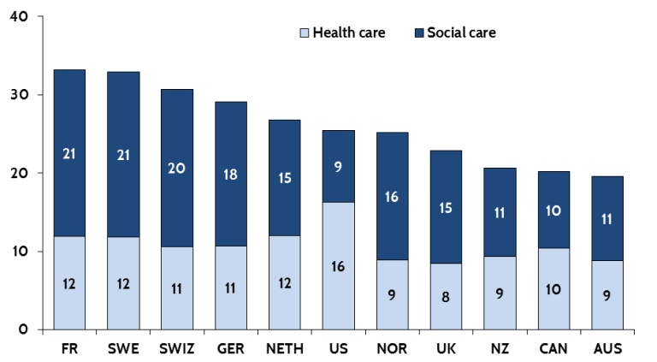
The US Spends More on Healthcare for Less Value
 | Life Expectancy at Birth, 2013 (age) | Infant Mortality, 2013 (per 1000 live births)
Japan | 83.4 | 2.1
Switzerland | 82.9 | 3.9
Germany | 80.9 | 3.3
Australia | 82.2 | 3.6
Sweden | 82.0 | 2.7
Norway | 81.8 | 2.4
Canada | 81.5 | 4.8
Netherlands | 81.4 | 3.8
New Zealand | 81.4 | 5.2
United Kingdom | 81.1 | 3.8
Germany | 80.9 | 3.3
Denmark | 80.4 | 3.5
United States | 78.8 | 6.1
OECD median | 81.2 | 3.5
%
Sources: Bradley, E., et al., (2011). Health and Social Services Expenditures: Associations with Health Outcomes, BMJ Quality & Safety. 20(10), 826-831.; OECD Health data 2015
© The Health Initiative – Do Not Distribute

Slide 11
Where Would You Invest for Health? Charlotte, NC
African American Democrat Women
White Republican Women
Food
Affordable Housing
Childcare, Transportation & Utilities
Healthcare
Source: Polling by Health Leads/The Health Initiative, with Public Opinion Strategies on August 23, 2017
© The Health Initiative – Do Not Distribute

Slide 12
Where Would You Invest for Health? NC Voters Agree
African American Democrat Women Charlotte, NC
White Republican Women
Charlotte, NC
African American Mixed Gender Democrats Raleigh, NC
Mixed Gender Middle Income White Republicans – Raleigh, NC
Lower Income White Democrat Women
Hendersonville, NC
Mixed Gender White Republican Seniors
Hendersonville, NC
Food
Affordable Housing
Childcare, Transportation & Utilities
Healthcare
Source: Polling by Health Leads/The Health Initiative, with Public Opinion Strategies on August 23, 2017
© The Health Initiative – Do Not Distribute

Slide 13
Where Would You Invest for Health? NC Physicians Agree
Physicians – Raleigh
Physicians – Asheville
Physicians – Specialists
Food
Affordable Housing
Childcare, Transportation & Utilities
Healthcare
Source: Focus groups conducted by The Health Initiative with the North Carolina Medical Society in Feb 2019
© The Health Initiative – Do Not Distribute

Slide 14
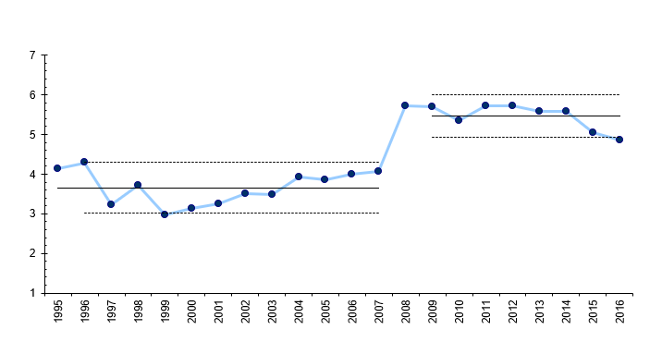
Healthcare vs. Health
Healthcare
Recession
Health
% families w/ very low food security
Drivers of Health
Food
Housing
Employment
Medical Homes
Meaningful Use – Stage 1
Triple Aim
MACRA
30% APM Target
Patient Safety
ACOs
ACA
Healthcare
Source: (USDA): https://www.ers.usda.gov/webdocs/publications/79761/err215_summary.pdf?v=42636,
Very low food security = Reports of multiple indications of disrupted eating patterns and reduced food intake.
© The Health Initiative – Do Not Distribute

Slide 15
Opioid Epidemic: Asking Different Questions
3 NC counties with highest opioid hospitalization rates
3 NC counties with lowest opioid hospitalization rates
Source: NC DHHS; Bureau of Labor Statistics
© The Health Initiative – Do Not Distribute

Slide 16
Elizabeth Cuervo Tilson, MD
State Health Director and Chief Medical Officer
Department of Health and Human Services

Slide 17
NC Department of Health and Human Services
All North Carolinians should have the Opportunity for Health
Elizabeth Cuervo Tilson, MD, MPH
State Health Director/Chief Medical Officer

Slide 18
We will succeed by living our values:
People-Focused
Teamwork
Proactive Communication
Transparency
Stewardship
Joy

Slide 19
Incorporate Health (not just healthcare) across unified agenda
Align and partner creatively
Develop shared strategic plans, infrastructure and tools that that can be leveraged by communities
Notes:
Access to high-quality medical care is critical to a person’s health, but…. Up to 80% of a person’s health is determined through social and environmental factors

Slide 20
Priority Domains
Food Security
Housing Stability
Transportation
Interpersonal Violence
Toxic Stress/
Early Brain Development
Employment

Slide 21
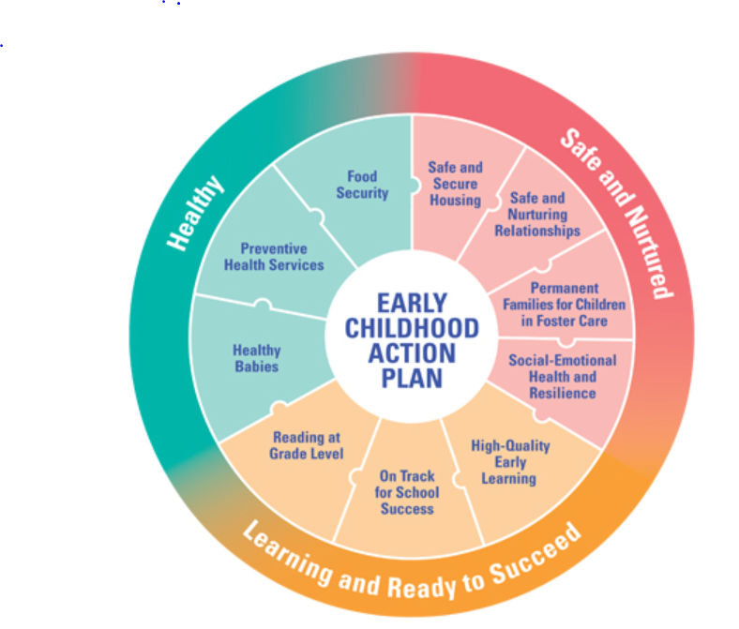
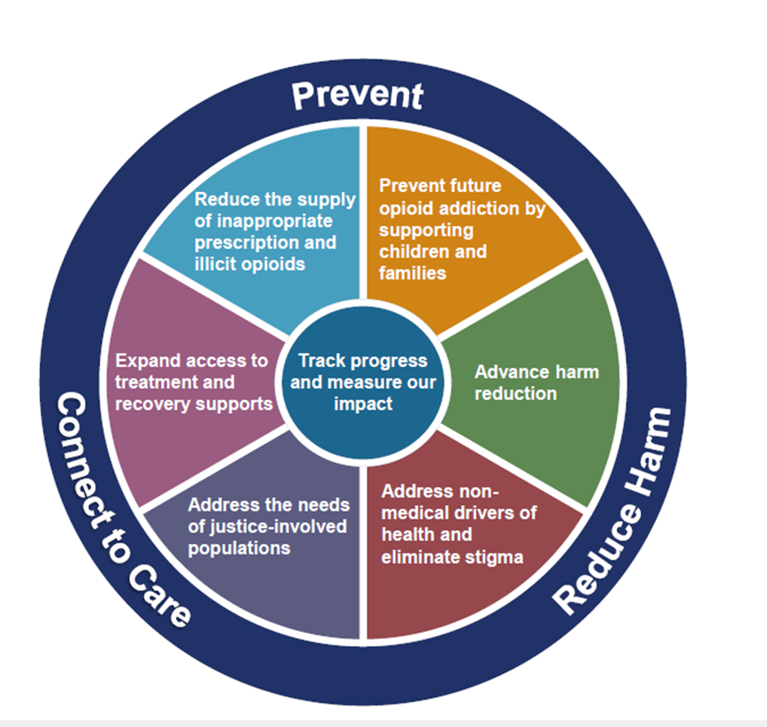
Early Childhood Action Plan
Opioid Action Plan

Slide 22
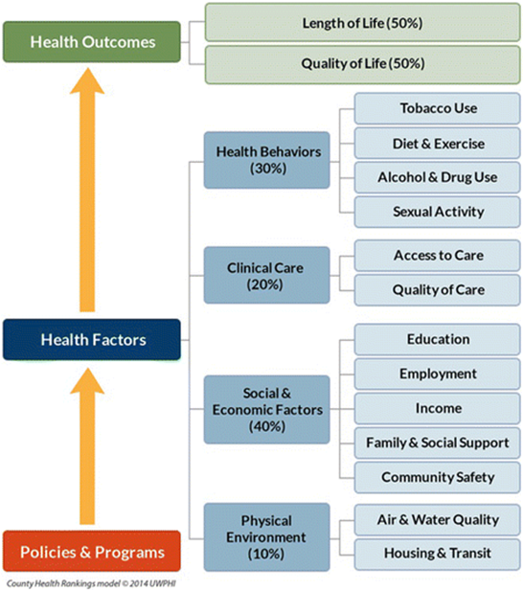
Healthy North Carolina 2030 Shift to a Population Health Framework
HNC 2020 Focus Areas (40 Objectives)
Tobacco Use
Nutrition and Physical Activity
Sexually Transmitted Diseases
Unintended Pregnancy
Substance Abuse
Environmental Risks
Injury and Violence Prevention
Infectious Disease and
Foodborne Illness
Mental Health
Oral Health
Maternal and Infant Health
Chronic Disease
Social Determinants of Health
Cross-cutting Measures
“We will use HNC 2030 to shift from a focus on individual health topics to a focus on health equity and overall drivers of health outcomes.”
CHR Model: University of Wisconsin Population Health Institute. County Health Rankings & Roadmaps 2018. www.countyhealthrankings.org. Image used with permission of UWPHI

Slide 23
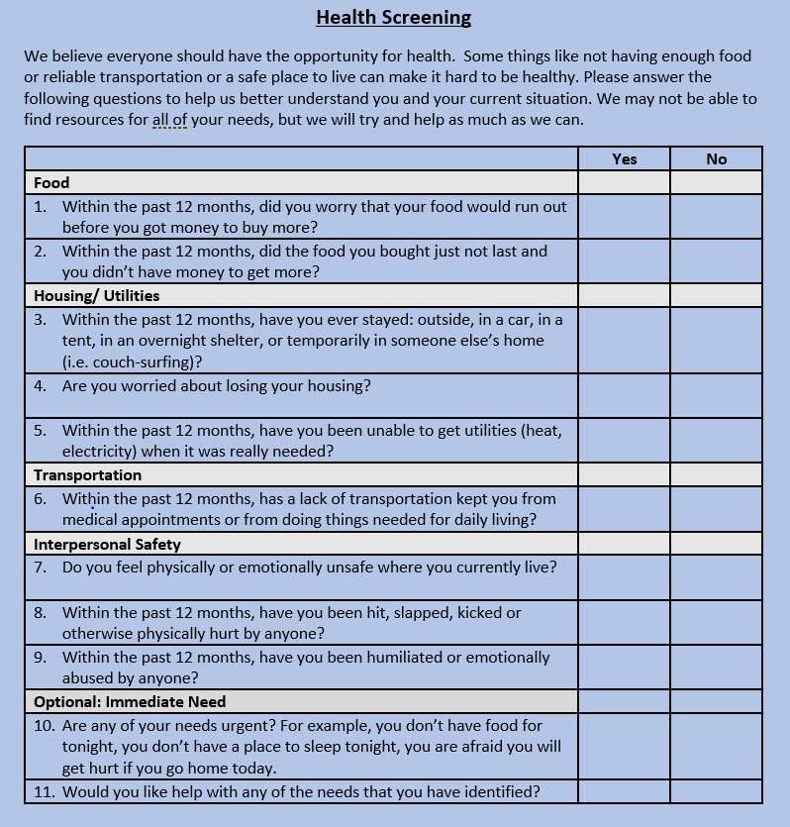

Slide 24
Operationalizing Interconnectivity
NCCARE360 is the first statewide coordinated network that includes a robust repository of shared resources and a shared referral technology platform to:
Knit together healthcare and human services providers
More efficient and effectively connect people to services
Securely share client information and follow a person’s journey together
Gain visibility and data into social service delivery and community resource gaps
NCCARE360 Partners
Notes:
NCCARE360 is the first statewide coordinated network that connects health and social service providers together to systemically address the SDOH in NC.
Give some background:
A series of 80 stakeholder interview shed light on the desire to better connect the healthcare and human services sector to serve all north Carolinians. In this process the stakeholders also reference numerous barriers to doing so.
That is why the state in partnership with FHLI, UU, UW/211, Expound built the network.

Slide 25
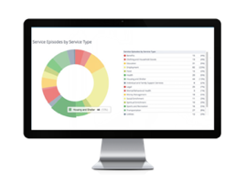
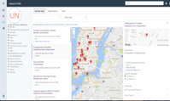
Network Model: No Wrong Door Approach
Housing Need Identified along with other needs
Additional Needs Identified
Referral
Referral
Employment
Provider
Client
Care Coordinator
Housing
Provider
PROPRIETARY & CONFIDENTIAL
Healthcare
Partner

Slide 26
North Carolina’s Vision for Medicaid Managed Care
“To improve the health of North Carolinians through an innovative, whole-person centered, and well-coordinated system of care that addresses both the medical and non-medical drivers of health.”
Notes:
Medicaid managed care implementation is required by legislation passed by GA in 2015. With that direction the Department will implement managed in a way that
will integrate physical, behavioral and pharmacy benefits into both Standard Plans and Tailored Plans.
improve population health…
Engage and support providers, and…
Establish a sustainable program with more predictable costs.

Slide 27
Buy Health within Medicaid Managed Care
Care Management for the whole person
Address 4 Priority Domains:
Housing
Food
Quality Strategy
accountable for population health
Financial Tools that promote buying health
Transportation
Interpersonal Violence/Toxic Stress
Healthy Opportunity Pilots that will evaluate the impact of using Medicaid dollars to pay for non-medical services (e.g. food, housing support)
4

Slide 28
Notes:
The top five results from crowdsourcing for top three issues

Slide 30
For more information and access to the material presented today please visit www.dht.org

Slide 31
Title

