Slide 1
Non-Narrative Requirements
A Complete Overview

Slide 2
Learning Objectives
Awareness and understanding of the critical, time-sensitive registrations required for developing and submitting a federal grant application
Understanding how to access and successfully complete non-narrative forms and comply with the general standards and agency-specific requirements
How best to develop a persuasive federal grant budget and budget narrative
Understanding the importance of creating clear, compelling non-narrative attachments to support and align with the project narrative
Successfully submitting a federal grant application, including addressing common submission pitfalls.

Slide 3
About
Innovative Funding Partners
IFP is a nationally recognized grants consulting firm highly regarded for an impressive overall grant success rate of 85%. Well known for their expertise in federal and other governmental grant writing, this success is based not only on technical expertise, but also on a foundational relationship-building approach. IFP’s team of over 20 highly experienced consultants are passionate about helping organizations meet the unique needs of their local communities and better serve their constituents by seeking and securing grant funding.

Slide 4
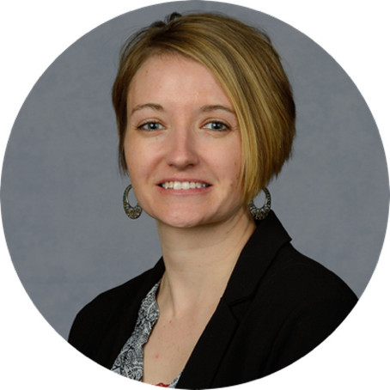
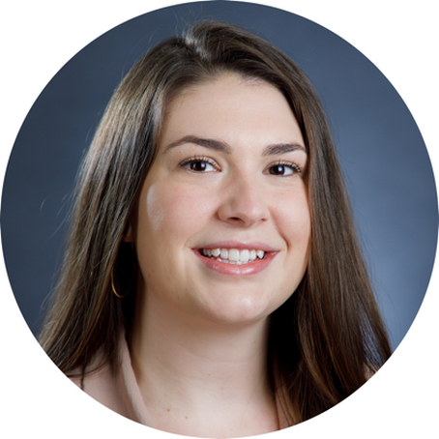
About the
presenters
Carrie Davis, IFP Senior Grants Consultant, is an experienced grant writer and project manager with a consistent track record of success working with organizations across diverse sectors and geographies. She provides project oversight, facilitation, and coordination at all levels of grant development. Carrie has successful experience with foundation, corporate and government grants including DOL, HRSA, SAMHSA, CDC, DOE, USDA and more.
.
3.
Carol Bartholomew, Grants Consultant, has experience writing foundation and federal grants for nonprofit entities within the health care, human services, faith-based, and criminal justice sectors. Carol specializes in supporting clients with the non-narrative portions of grant applications such as the budget, budget narrative, and additional attachments.

Slide 5
Why Is This So Important?
Non-narrative docs support the narrative and other pieces of the proposal – part of the big picture!
Missing a required non-narrative component can result in immediate disqualification.
Budget is often scored and is one of the most critical aspects of a grant application – shows your level of preparation and development.
Federal grants require the use of complex grant portals – Lack of registration and understanding can prohibit your ability to apply for federal grants.
This Photo by Unknown Author is licensed under CC BY-SA

Slide 6
What do we mean by “non-narrative?”
Required Registrations
Forms (SF-424, R&R, etc.)
Budget/Budget Narrative (justification)
Attachments (some)
Grant Submission

Slide 7
I. Required Registrations
Primary Registrations for all federal grants include:
SAM.gov (System for Award Management)
Grants.gov
Must complete SAM registration first (can take up to 6 weeks)
SAM.gov directly connects to Grants.gov (e-Biz POC, email addresses, etc.)
Both portals use Login.gov to access

Slide 8
I. Required Registrations (continued)
Additional Registrations (based on agency):
eRA Commons (NIH, SAMHSA, etc.)
JustGrants (BJA)
Fastlane (NSF)
These registrations/portals connect directly to grants.gov and require specific information to be included accurately in grants.gov forms.

Slide 9
Which registrations are required? How to register?
Information on what registrations are required will be found in the NOFO for each grant application.
Information on how to register, what information is required for registration, etc. can be found in the NOFO and online at each portal’s website.
Utilize help desk when needed for support, troubleshooting, etc.
Don’t forget to renew registrations, if required

Slide 10
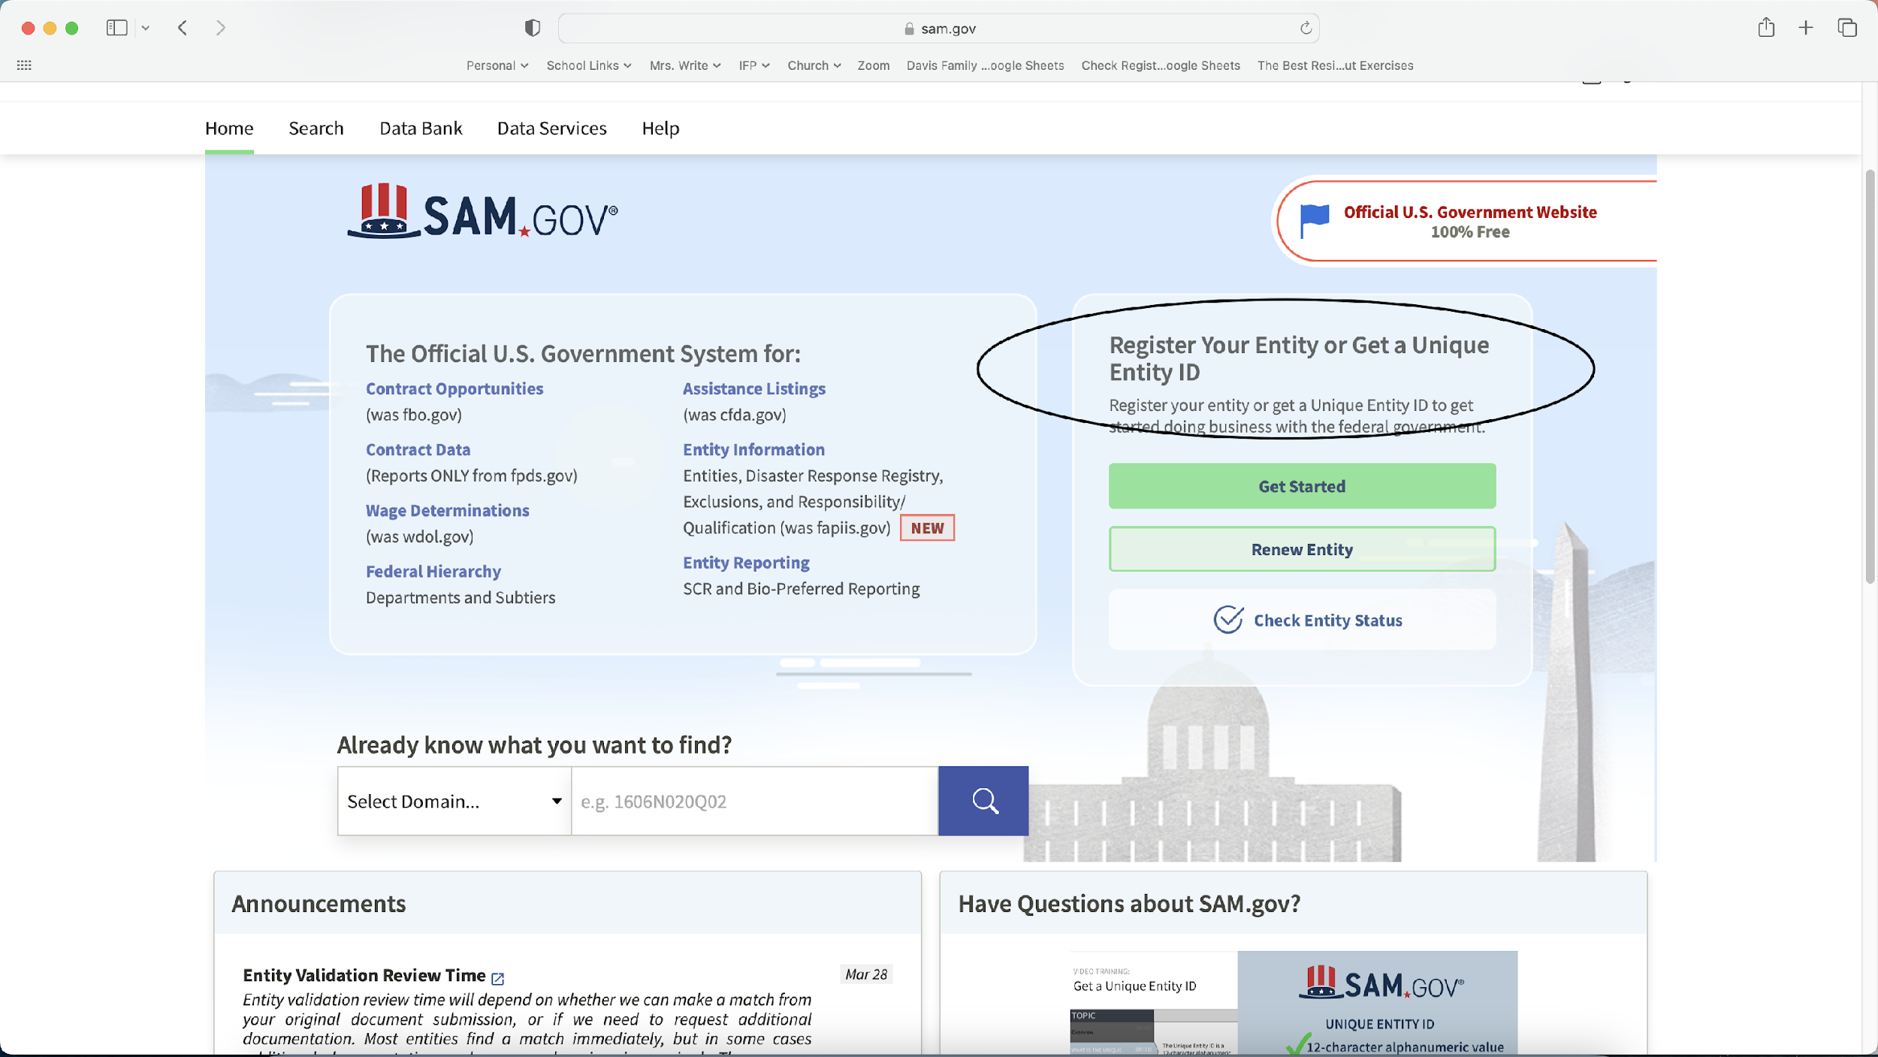

Slide 11
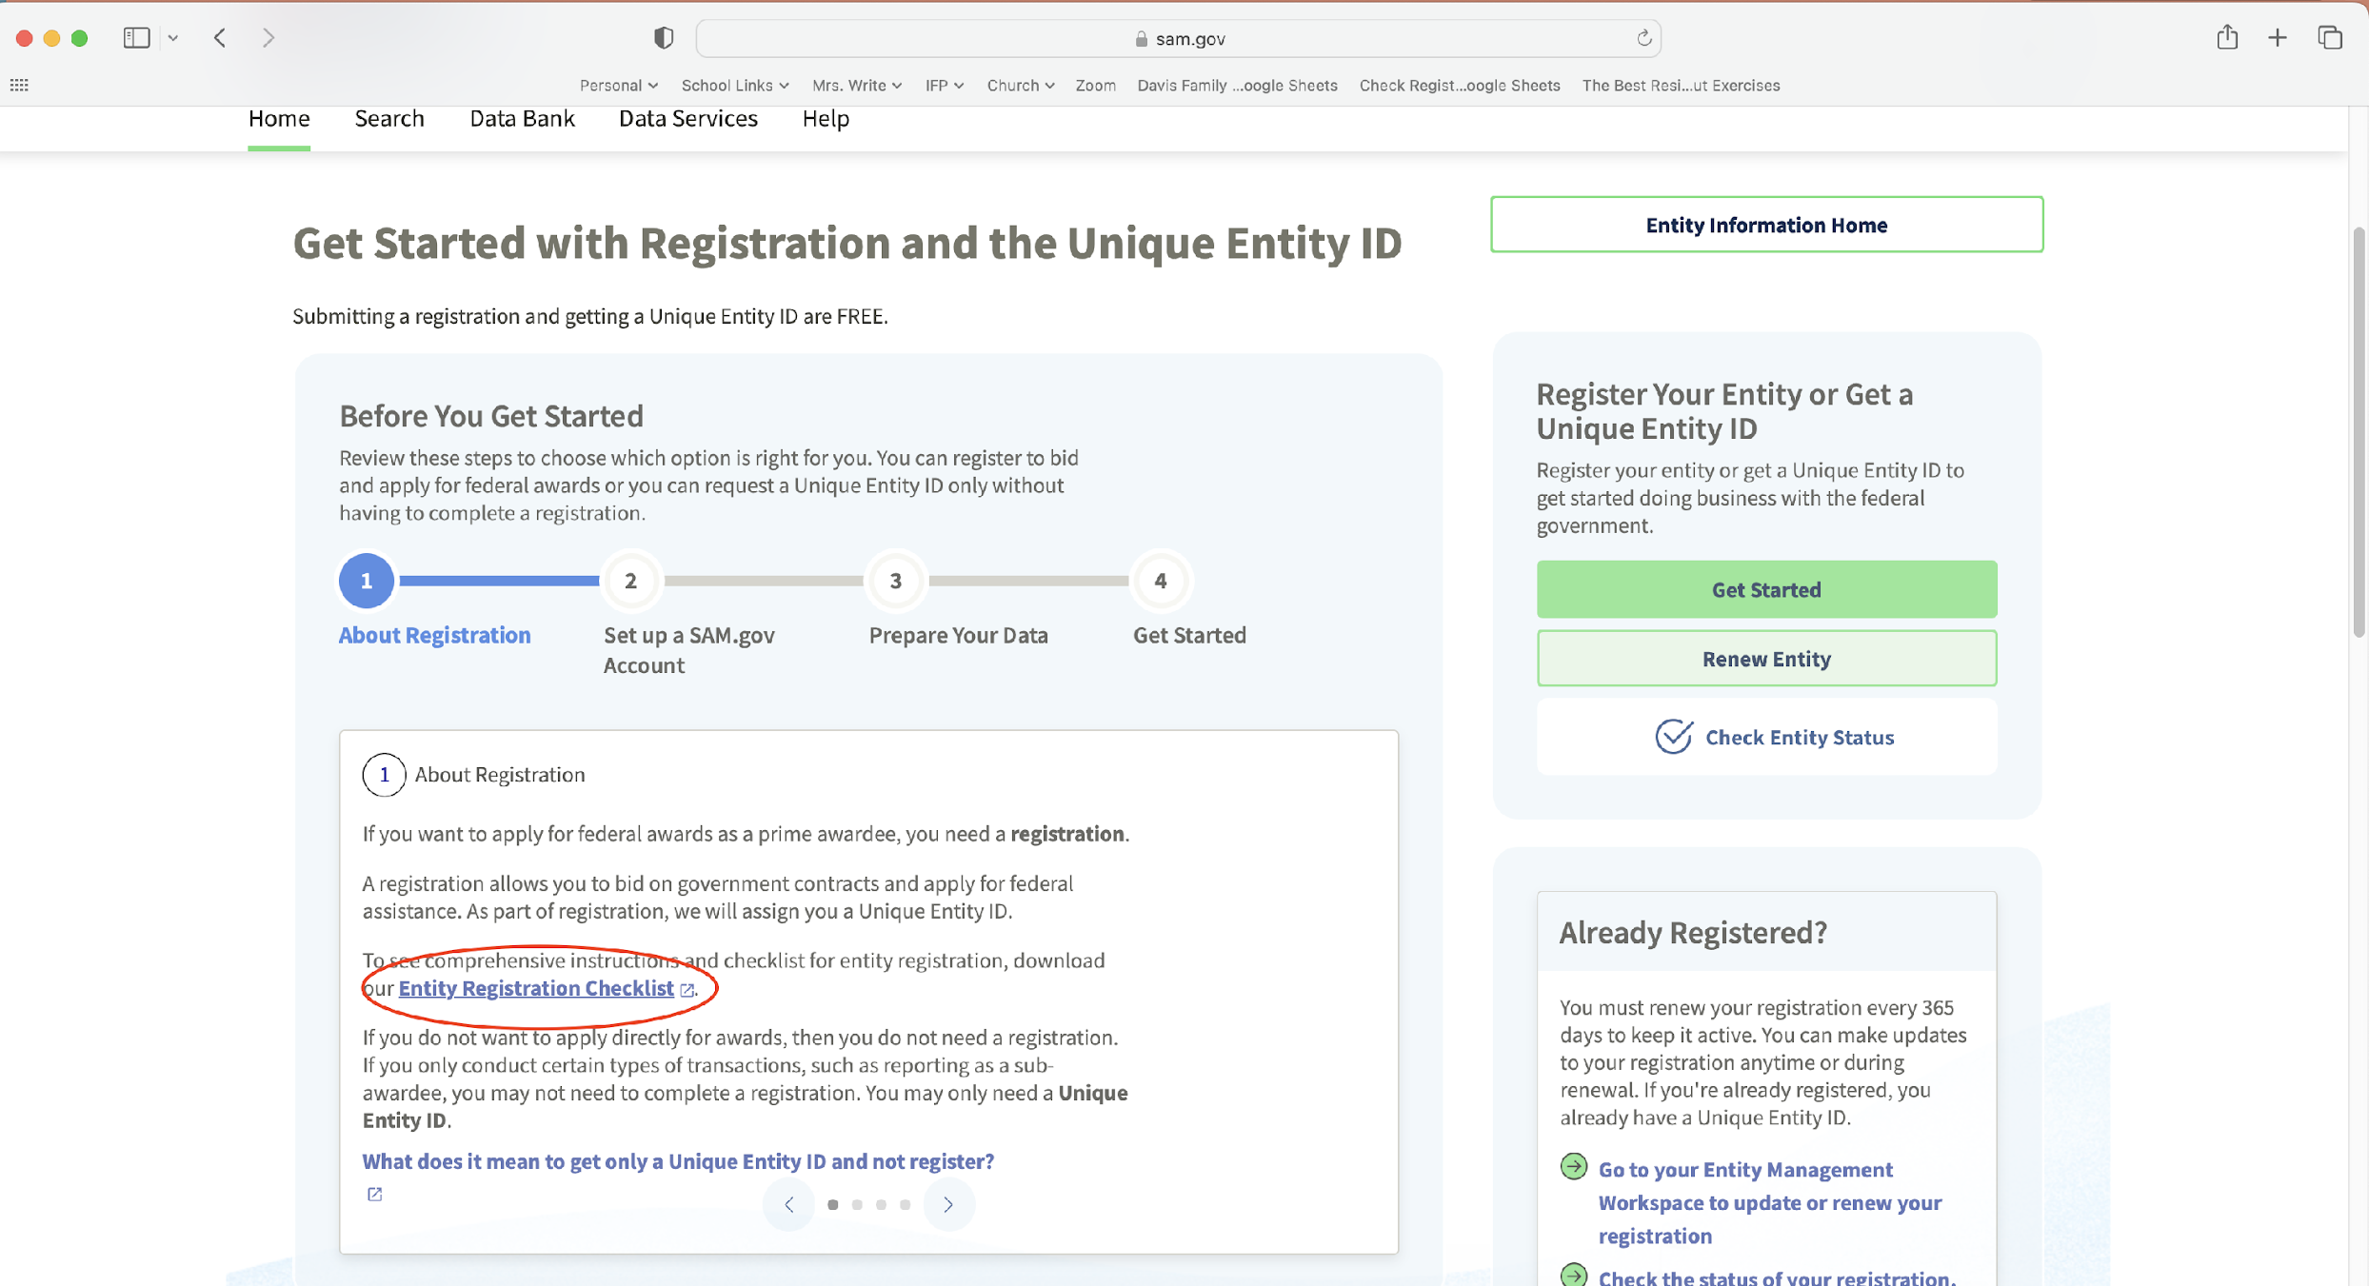

Slide 12
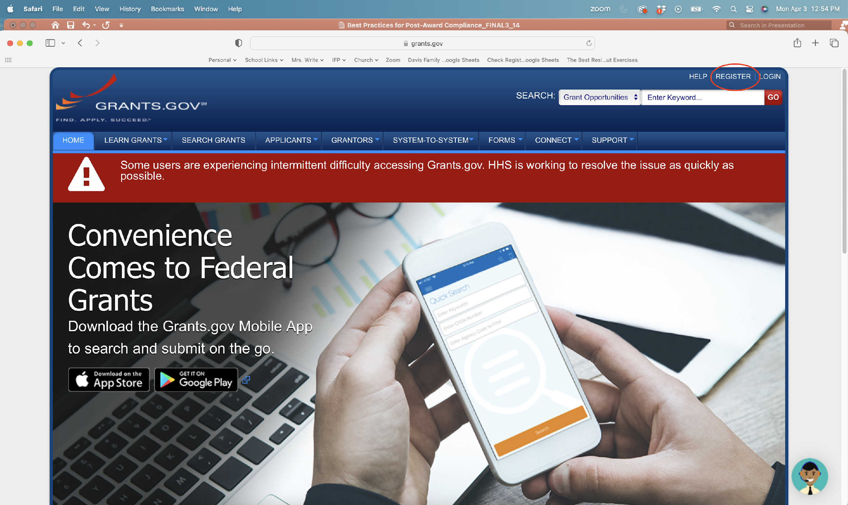

Slide 13
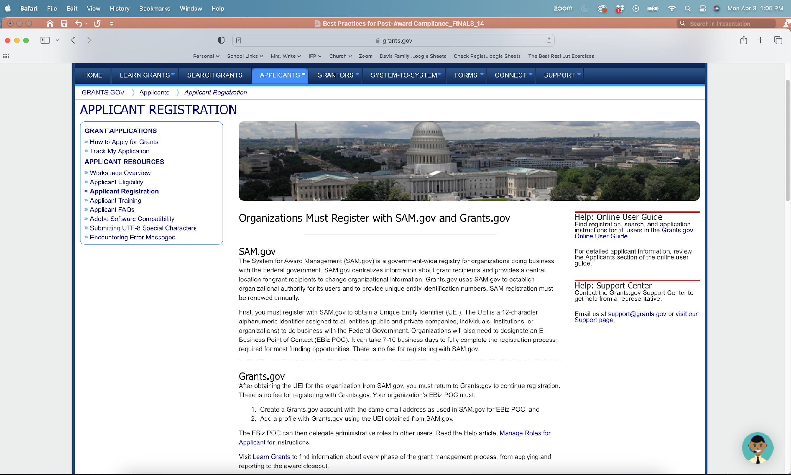

Slide 14
III. Completing Forms in Grants.gov
Accessing Forms in Grants.gov - Search and find grant opportunity on grants.gov

Slide 15
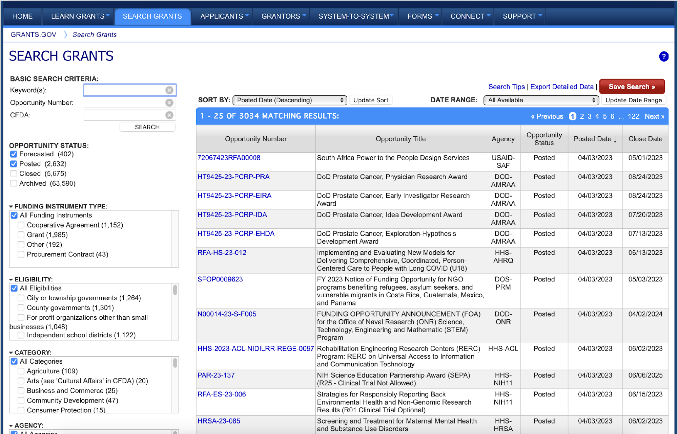
Search and Find Grant Opportunity on Grants.gov

Slide 16
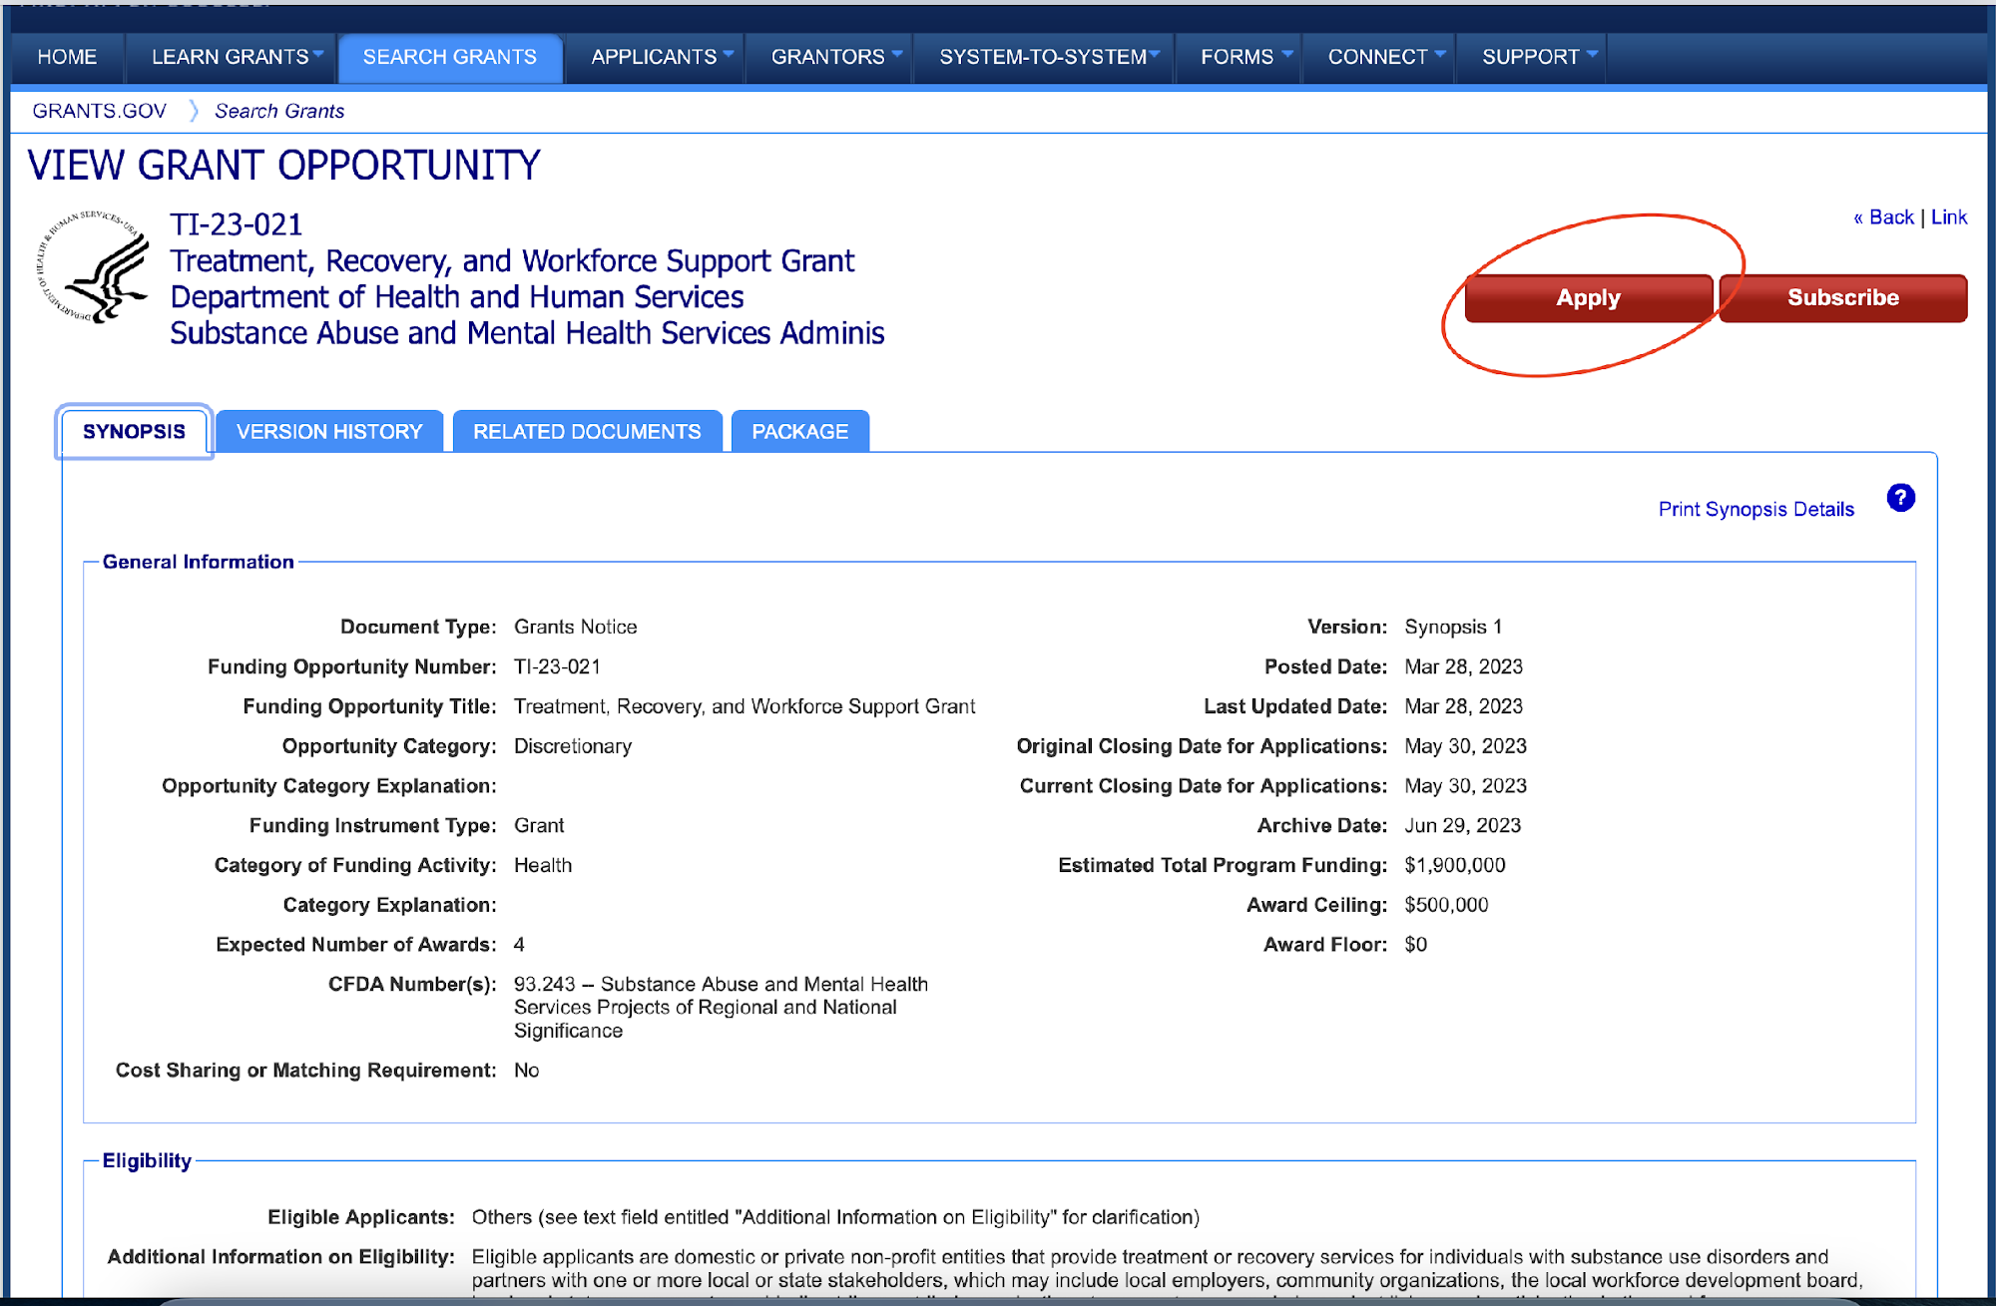
Apply for Grant

Slide 17
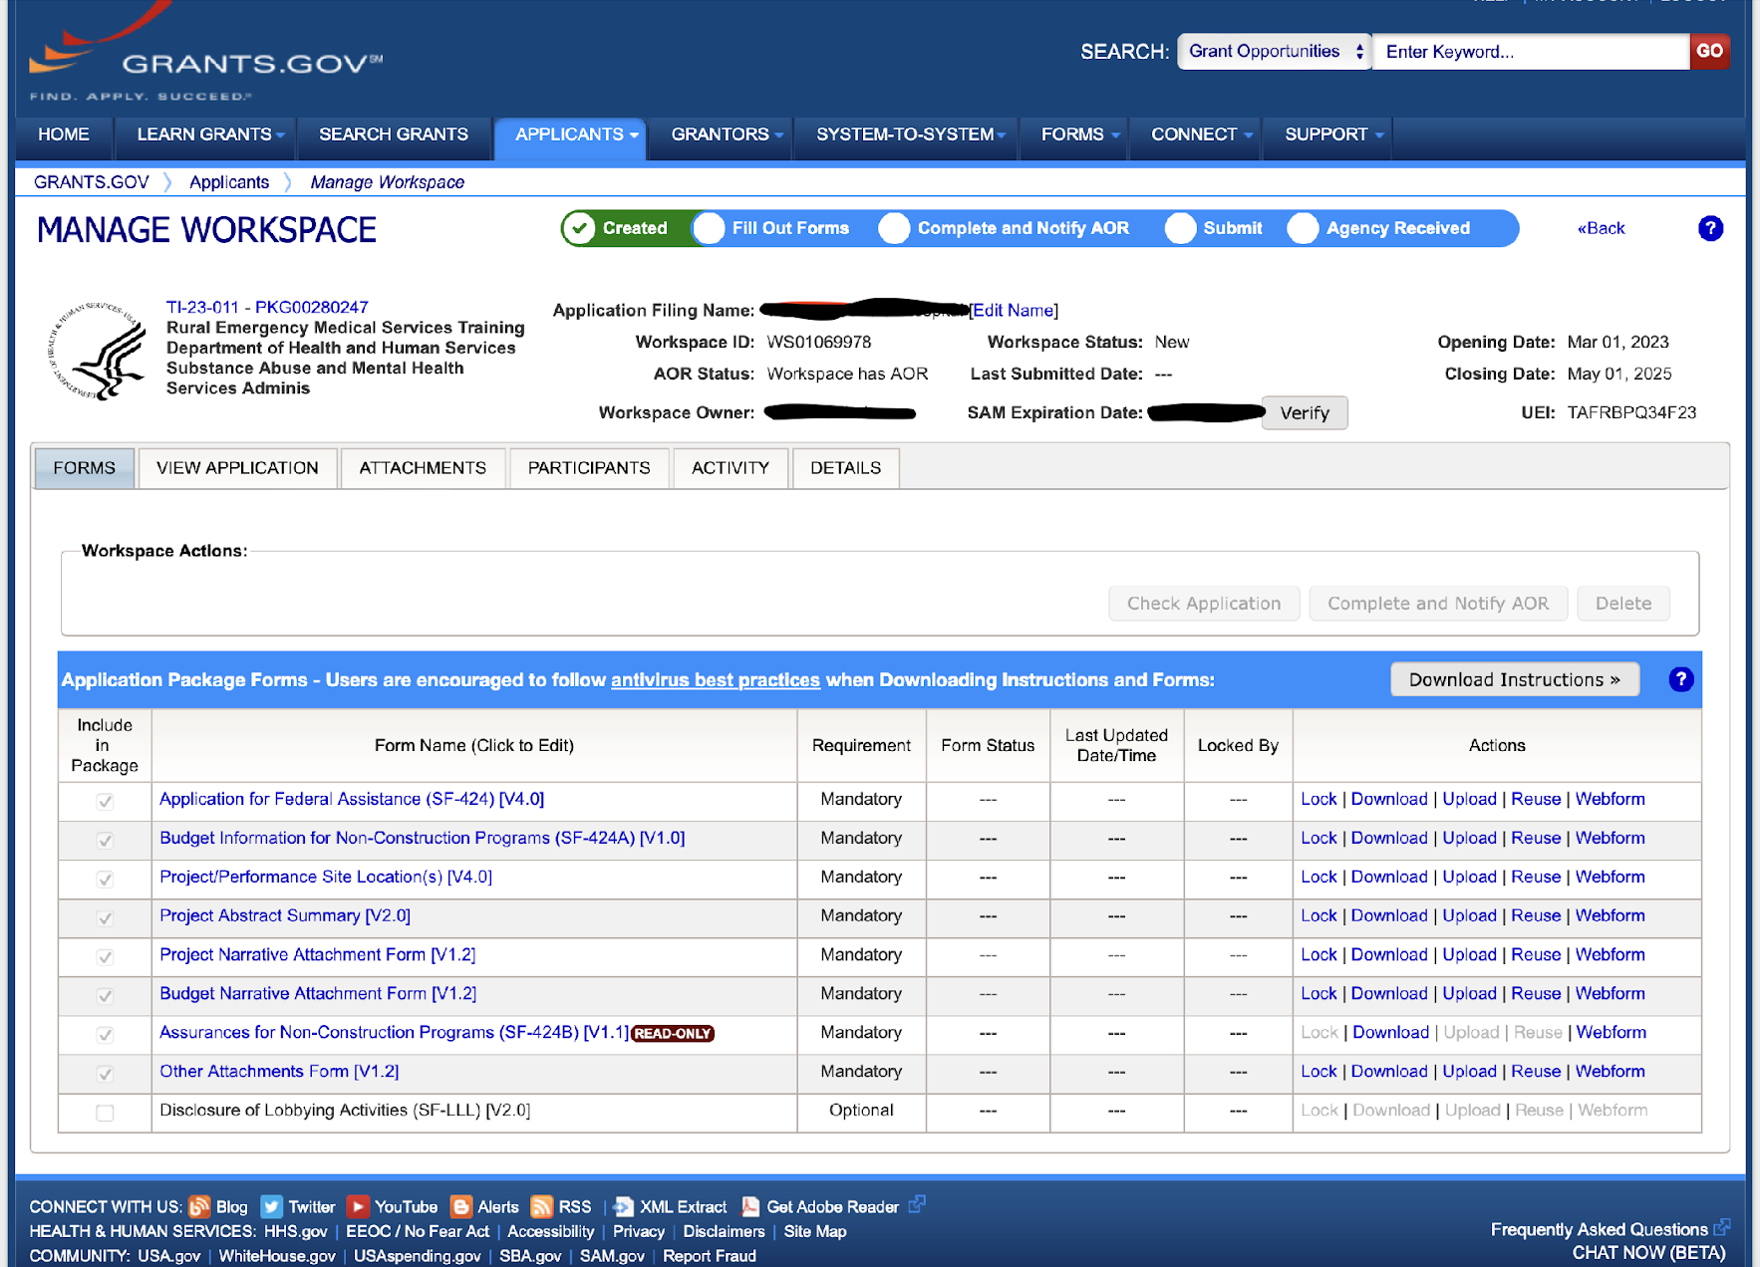
Create Workspace
Forms required for grant, forms to upload documents, etc.
Can add other participants (if they have a grants.gov acct)
Multiple options for completing forms

Slide 18
Forms can be found in Workspace

Slide 19
Grants.gov Forms
SF424 Family most common
General instructions on grants.gov
NOFO may provide additional/specific instructions
NOFO instructions supersede general instructions

Slide 20
SF-424 Family Typical Forms
SF-424 Application for Federal Assistance
SF-424A Budget Information for Non-Construction Programs
Abstract Form
Project Narrative Form
Budget Narrative Form
Assurances
SF-LLL Disclosure of Lobbying Activities (optional)

Slide 21
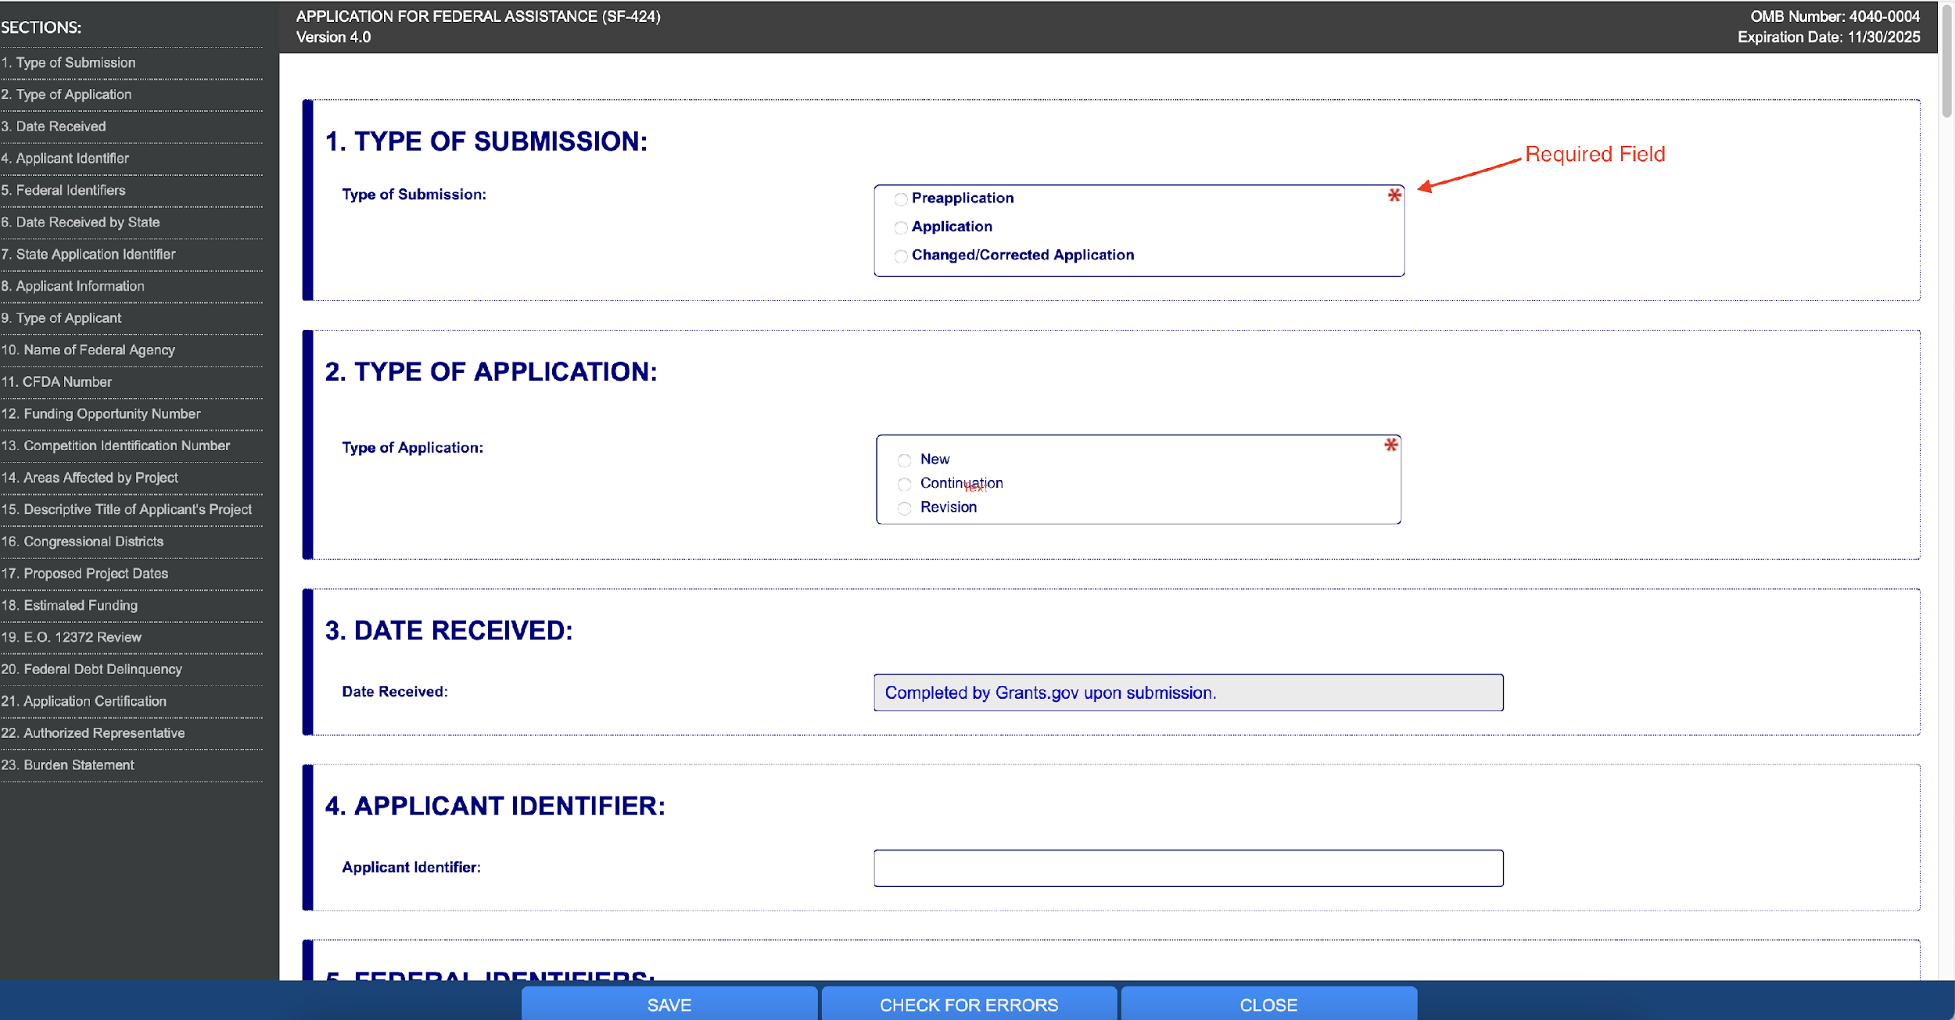
Red asterisk means required field
Some fields will be left blank
Some fields will already be filled in
Some fields may have specific instructions based on NOFO
Always save before closing
Check for errors once you think form is done
SF-424

Slide 22
Research and Related (R&R) Family
Forms typically used for research grants
Requests a lot of the same information as SF-424 but in different format/structure/order
Follows different budget structure than SF-424A
Separate budget forms for Subawards
Form specific to Senior/Key Personnel
Research forms including: human subjects information, research plan, research cover page, etc.

Slide 23
Uploading Documents into Grants.gov Forms
PDF Format (unless stated otherwise in NOFO)
May need to flatten PDF in order to upload – can result in errors (eRA Commons)
Cannot include hyperlinks (HRSA, SAMHSA, etc.)
File name requirements
Color vs. Black and White (grayscale)
Order documents according to NOFO (Other Attachments Form)

Slide 24
IV. Budget
Why is it Important to Start Early?
Budget Forms
Budget Categories
Indirect Costs
Common Funding Limitations
Cost-Sharing/Match
Budget Narrative

Slide 25
Why is it Important to Start Early?
The budget guides the activities and number of people the proposed project will serve
Develop the budget alongside the proposal – not after
Take into consideration funding limitations
Ensure the proposed project is doable with the grant funding amount
The budget and budget narrative is often scored by the reviewers

Slide 26
Budget Forms
SF-424A
Common grants.gov form
Standard instructions can be found on grants.gov but federal agencies may have specific instructions
JustGrants
Webform that auto-calculates
Research and Related (R&R)
Typically used with NIH or other research grants
Includes a category for Participant/Trainee Support Costs

Slide 27
Budget Categories
Personnel
Position title, % FTE, annual salary, and amount requested
Cannot use funds to pay the salary of an individual at a rate in excess of Executive Level II ($212,100); does not apply to consultants but does apply to all subawards and subcontracts
Fringe Benefits
Ex: costs of leave (vacation, family-related, sick, or military), employee insurance, pensions, and unemployment benefit plans
Equipment
A unit cost of $5,000 or more and a useful life of one or more years
Construction
May or may not be allowed

Slide 28
Budget Categories
Travel
Where, what, who, when, and for what purpose
Supplies
Tangible personal property other than those described in Equipment
Subaward/Contracts
Subawards are intended to carry out a significant portion of the activities funded by the federal award
Contracts are for the purpose of obtaining goods or services
Subrecipients need to register in SAM and have a UEI by time of award
Contracts may require a procurement process
Other
Costs that do not fit into any other category (rent, provider
licenses)

Slide 29
Indirect Costs
Examples: legal costs, administrative staff salaries, office expenses, etc.
Indirect Cost Options
Federally Negotiated Indirect Costs Rate Agreement (NICRA)
De Minimis – 10%
None
Other as specified in the NOFO
Modified Total Direct Costs - excludes equipment, capital expenditures, charges for patient care, rental costs, tuition remission, scholarships and fellowships, participant support costs and the portion of each
subaward in excess of $25,000.

Slide 30
Common Funding Limitations
Award funds may not be used to pay the salary of an individual at a rate in excess of Executive Level II or $212,100.
Maximum percentage of funding for specific costs like evaluation, subawards, wrap-around services, etc.
Vehicles
Construction vs. Renovation
Meals/Food and “swag” items
Giving federal funds directly to participants

Slide 31
Cost-Sharing/Match
Provide the same level of detail for matching line items
Obtain a Letter of Commitment from match sources
Match line items must be allowable expenses
You will be held to financially report on all match stated in the proposal, even if match is not required
Most federal grants will consider in-kind and cash match
In-Kind examples – staff time, fringe benefits, rent for office space, etc.
Other federal funding typically cannot be used to satisfy a match requirement

Slide 32
Budget Narrative Information
Where can I find an explanation of what to include in the budget narrative?
NOFO
Application Guide (HRSA, USDA, etc.)
Budget template – agency specific
Uniform Guidance
Webinars

Slide 33
Budget Narrative Formatting
Each agency has different formatting requirements
SAMHSA template
HRSA application guide
BJA webform
All will require a high level of detail
Some may only require one year of budget narrative and others may require the full project period

Slide 34
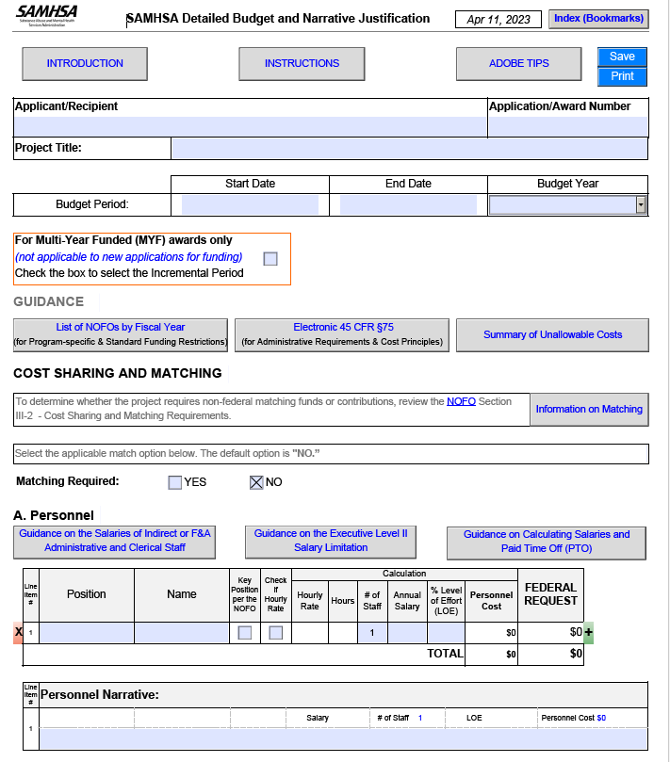
Budget Narrative Formatting Example: SAMHSA

Slide 35
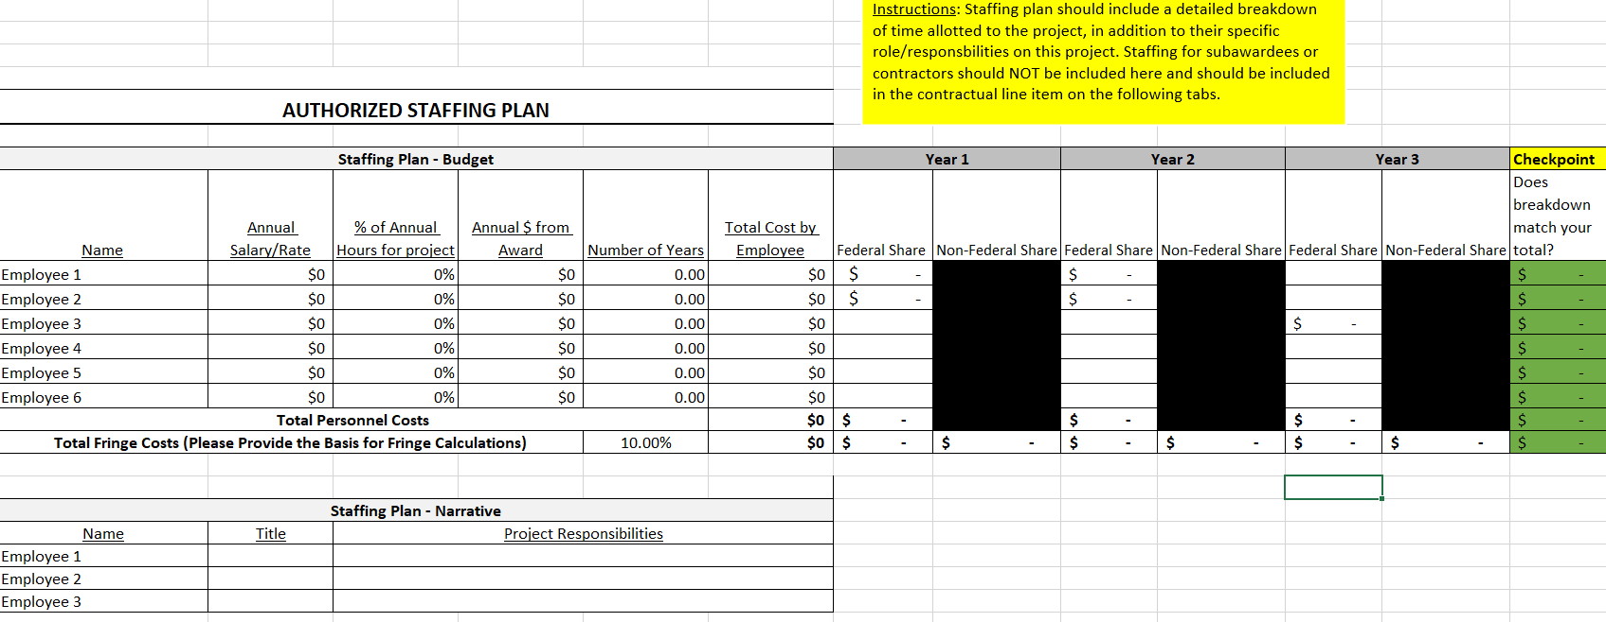
Budget Narrative Formatting Example: EDA

Slide 36
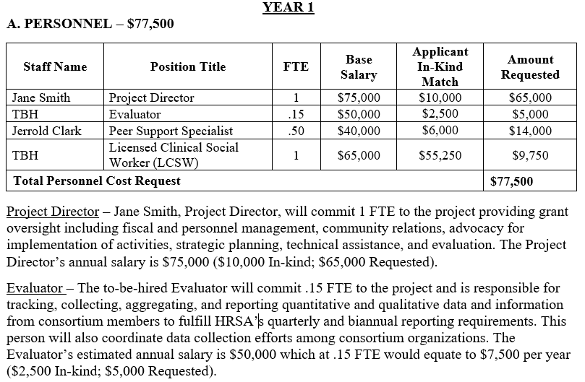
Budget Narrative Formatting Example: Match

Slide 37
Budget Narrative: Level of Detail
Professional Development Conference - $1,660
Three staff members will attend a professional development conference.
North Carolina Prevention Conference - $1,660
Lodging - $120 per night for 3 nights/3 people
Per Diem - $50 per day for 3 days/3 people
Mileage – 200 miles at $.65 per mile
The Project Director, Peer Support Specialist, and Social Worker will attend the 3-day North Carolina Prevention Conference located in Raleigh, NC. Lodging is estimated to be $120 per night/person totaling $1,080. Per Diem is $50 per day/person totaling $450. Mileage to drive to and from the conference is estimated to be 200 miles at $.65 per mile totaling $130. The total travel cost for attending the conference is projected to be $1,660.

Slide 38
V. Common/Typical Non-Narrative Attachments
Letters of Support/Commitment (pay close attention to definition in NOFO)
MOUs/MOAs (key partners, subaward entities, etc.)
Organizational Chart (applicant and/or program-specific)
Resumes/CVs/Biographical Sketches (biosketches)
Job/Position Descriptions
*pay attention to page limits, formatting requirements, etc.

Slide 39
VI. The Grant Submission Process
Submit early!!
Allow time for others on your team to review, make changes, etc.
Ensure you receive all confirmation emails from grants.gov (3-4 depending on agency process – may go to spam)
Addressing errors that may arise (grants.gov, eRA Commons, etc.)
The waiting game…see NOFO for award/project start date

Slide 40
Questions?

Slide 41
dht.org

