Slide 1


Evidence-Based (Best)
Practices
June 21, 2023

Slide 2

Learning Objectives
Describe what makes a practice evidence-based vs. a best practice
Understand the purpose of evidence-based practices as a tool
Describe how to adapt an evidence-based practice for your proposal
Describe the relationship between evidence-based practice and your grant proposal
Identify resources for finding evidence-based practices

Slide 3

About
Innovative Funding Partners
IFP is a nationally recognized grants consulting firm highly regarded for an impressive overall grant success rate of 85%. IFP is well known for its expertise in federal and other government grant writing, our success is based on technical expertise and a focus on a relationship-building approach. IFP’s team of over 25 highly experienced consultants is passionate about helping organizations meet the unique needs of their local communities and better serve their constituents by seeking and securing grant funding.

Slide 4

About the
presenters
  Brian Kelley, Ph.D., IFP Senior Partner, is an award-winning and widely-published psychologist and public health expert who supported his own community prevention/engagement projects through a variety of institutional, regional, and national grants. Dr. Kelley worked in academia for over two decades as well as served a variety of local governments, specifically town/county level, and community serving not-for-profit organizations as a consultant. All of these efforts were focused on creating high impact community programs and funded through a variety of foundation, city, state, and federal agencies. His broad background, spanning areas from community workforce collaboration and strategic/operational planning to community-wide prevention programs, has provided him with many unique opportunities to serve with a diverse group of dedicated and passionate professionals. Dr. Kelley’s highest priority in such work is to make sure the community is heard and engaged in their projects from start to finish. Dr. Kelley leverages the culmination of these experiences into an authentic and effective approach to grant development for community impact.
.
3.
Brian Kelley, Ph.D.
Senior Partner

Slide 5

About the
presenters
Tracy Zeeger, IFP Grants Consultant, is an experienced public health educator with over 18 years of training in the field of behavioral and community health. Tracy has experience writing foundation and government grants for nonprofit entities, primary, secondary and higher education, and local health departments. Tracy is involved in training new professionals on the many different aspects of grant writing including evidence-based program planning and the utility of theory in plan development. Tracy holds a Ph.D. in Behavioral and Community Health from the University of Maryland, College Park.
.
3.
Tracy Zeeger, Ph.D.
Grants Consultant

Slide 6
I. Describe what makes a practice evidence-based vs. a best practice

Slide 7
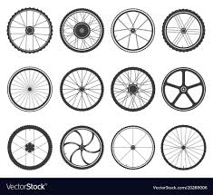

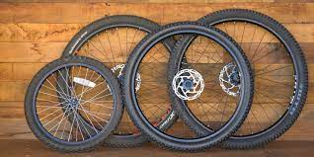
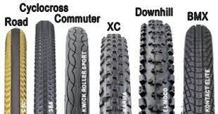
Evidence-Based Practices = Don’t Reinvent the Wheel
B

Slide 8
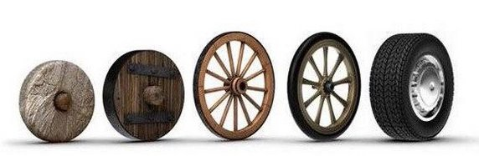
So, Please Reinvent the Wheel
(but with our specific, unclear guidance)
B

Slide 9
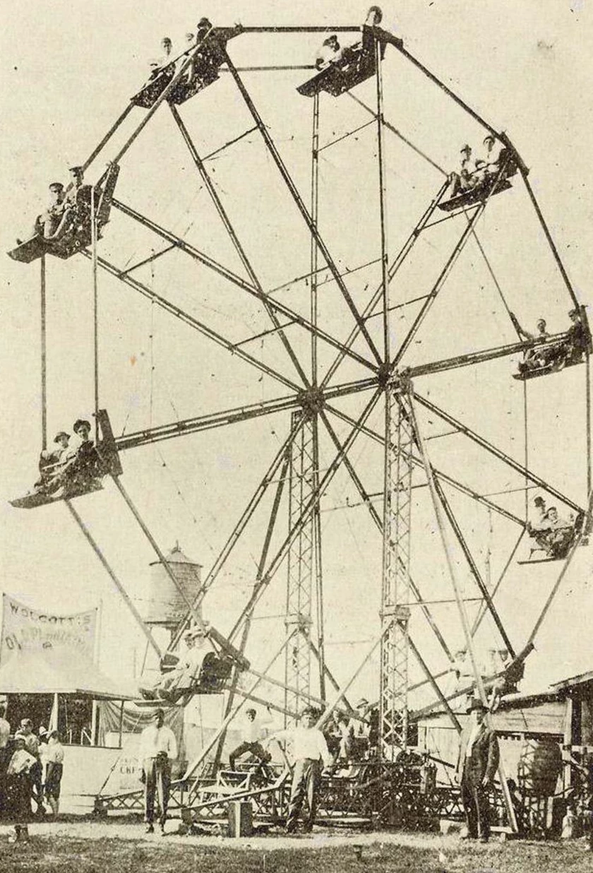

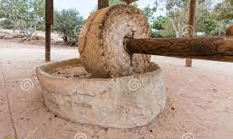


So, the Broader Question: What is a Wheel?
B

Slide 10
Defining Evidence-Based Practices & Best Practices
“Using the best available evidence for decision-making and providing efficient and effective care for patients on a scientific basis” (NIH, 2019)
“The integration of the best available research with clinical expertise in the context of patient characteristics, culture, and preferences,” and its purpose is “to promote effective psychological practice and enhance public health by applying empirically supported principles of psychological assessment, case formulation, therapeutic relationship, and intervention” (American Psychological Association, 2006)
Simply stated: an intervention/approach that has shown evidence of effectiveness in a particular setting and is likely to be replicable in other situations
T
Notes:
In terms of a definition of evidence-based practice this helps to clarify the broader scope of the general and habitual practice of using best evidence to find the best outcome rather than simply evaluating the potential effectiveness of a particular solution (is this a workable solution vs is this the best solution).

Slide 11
Why Evidence-Based Practice?
Improves our ability to make decisions
Evidenced justification for why we do things a certain way
Allows for continual improvement of a practice
Innovating a practice adds to knowledge
Demonstrates to the funder the likelihood of success
Removing bias, unfounded beliefs and subjective opinion
Consumer (patient, client, student, etc.) centered
T
Notes:
Essentially, evidence-based practice is about improving our decision-making by using clear, well-researched, and evidenced justifications for why we do things in certain ways, with the eventual goal of delivering continual improvements /innovations, learning, and excellence in our organization or business. In short, it is about developing and implementing best practice and thinking by looking at and critically considering the real evidence and data about an issue rather than just using personal subjective opinions or gut feel.
The aim of evidence-based practice is to remove as far as possible, subjective opinion, unfounded beliefs, or bias from decisions and actions in organizations and in businesses in order to achieve to goals of the organization but especially on behalf of the consumer (patient, client, student, etc.).

Slide 12
II. Understand the purpose of evidence-based practices as a tool

Slide 13
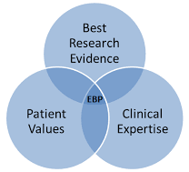
Basic Evidence-Based Practice Concept
But this becomes difficult to define, especially when the work expands into new conditions, different patients, new geographical locations, etc.
T

Slide 14
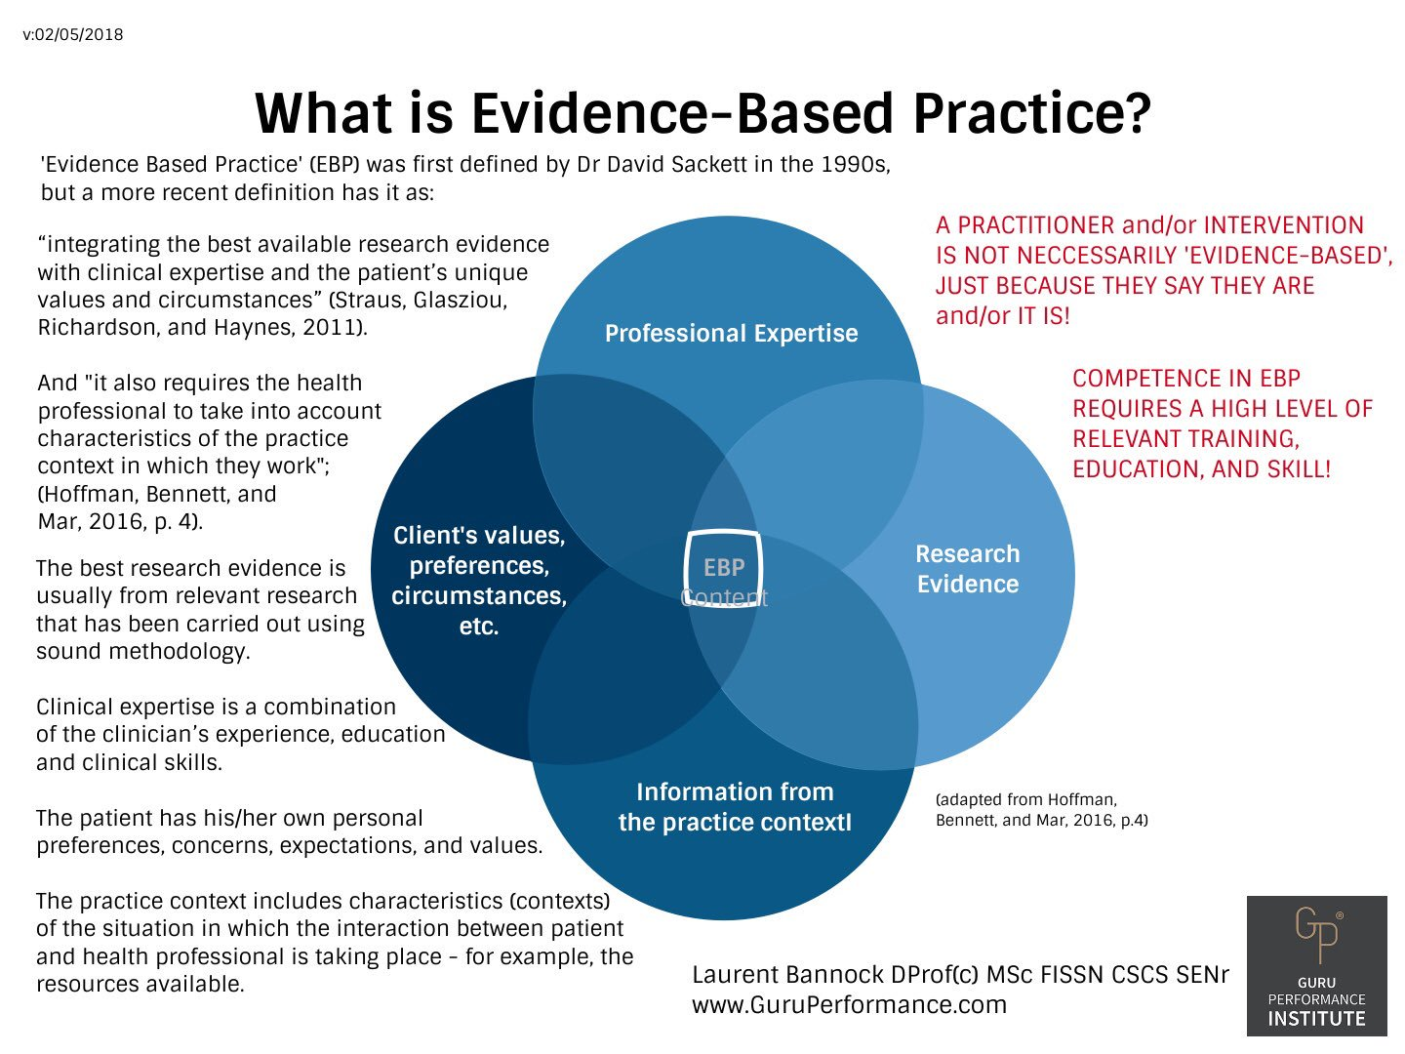
Basic Evidence-Based Practice Concept
T

Slide 15
Basic Evidence-Based Practice Concept
Six characteristics synthesized by Brown (2001, p. 1):
Patient centered
Scientifically based
Population outcomes based
Refined through quality improvement and benchmarking
Individualized to each patient
Compatible with system policies and resources
T
Notes:
Walk through starting with outcome desired.

Slide 16
Timeline and Steps for Evidence-Based
(Best) Practices
Benefit
Sample
Methods
Replication
Adaptation
Problem
Hypothesis
DV
Conclusion
Generalization
Empirical
Emerging
Practice
EBP
EB(B)P
Idea
Population
Confounds
Replication
Adoption
Research
Question
IV
Stats
Validation
B

Slide 17
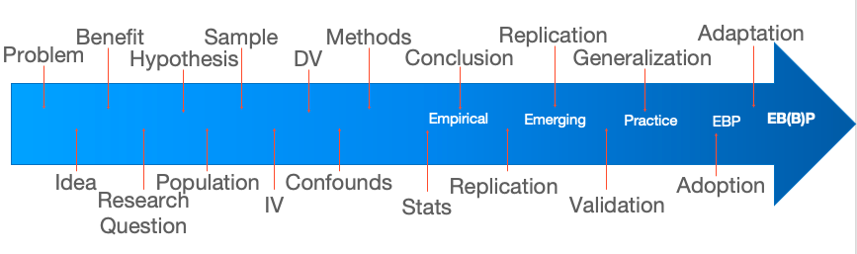
Timeline and Steps for Evidence-Based (Best) Practices (Cont.)
Implementation
Science
Practice
Science
Evaluative
Science
B

Slide 18
Timeline and Steps for Evidence-Based (Best) Practices (Cont.)
Implementation
Science
Research & Best Practice Guidelines
Practice
Science
Evaluative
Science
B

Slide 19
Timeline and Steps for Evidence-Based (Best) Practices (Cont.)
Implementation
Science
Research & Best Practice Guidelines
Practice
Science
Evaluative
Science
Comparative Effectiveness, Patient Centered Research
Continuous Quality Improvement
B

Slide 20
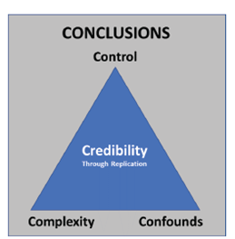
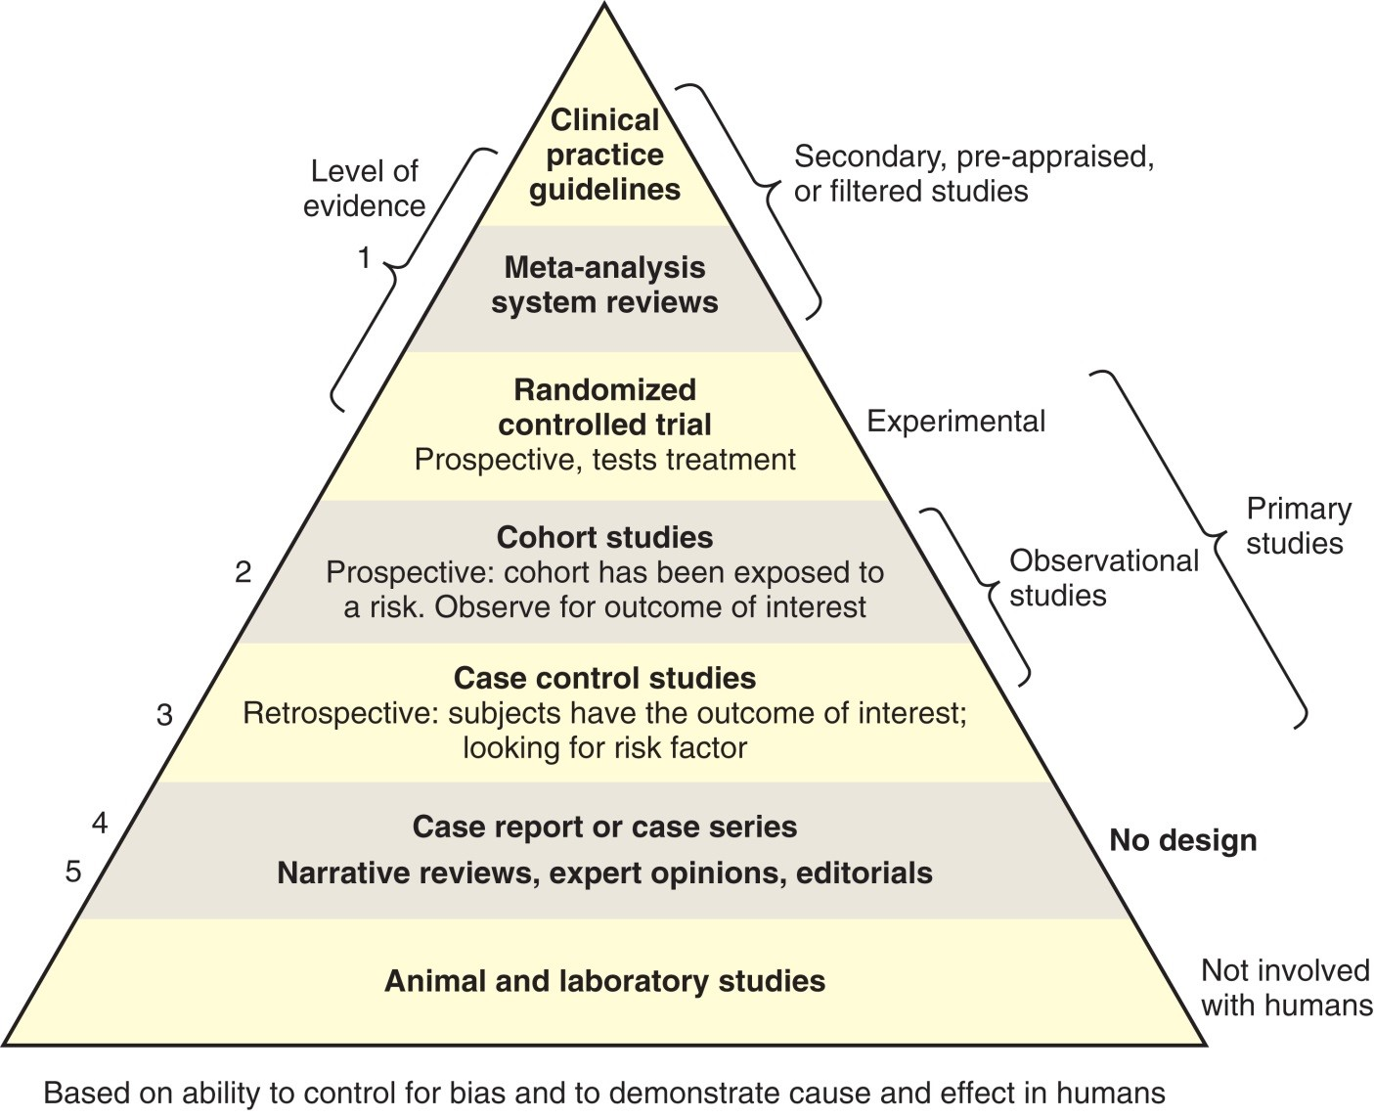
How and What Type of Evidence is in EBP?
T

Slide 21
Depression
What diagnostics technique/approach was used
What instrument was used
Was a translator used or needed
Was diagnostic criteria validated in this population
Was that instrument validated in this population
Was this the best instrument to use
Is the treatment effective for these conditions
Are there any contraindications with other drugs
Will medication make is diabetes worse
How will he pay for the treatment
How will he get to the treatment
Will he comply with treatment
Will treatment interfere with his work
Will treatment interfere with his relationships
Will treatment interfere with his hobbies
Will treatment conform with his religious beliefs
What is the rate of improvement/recovery
Primary Diagnosis of Depression
Black Male, originally from Haiti
ESL
Age 43
Lives alone
Has a “girlfriend”
Co-occurring diabetes
Frequent use of marijuana
Drinks alcohol regularly
Doesn’t have insurance
Lower SES
Previous TBI
Limited access to transportation
Lives in rural area
Works intermittently
Religiously involved
Hobbies include gaming and billiards
It is the bicycle tire problem but more complicated
T

Slide 22

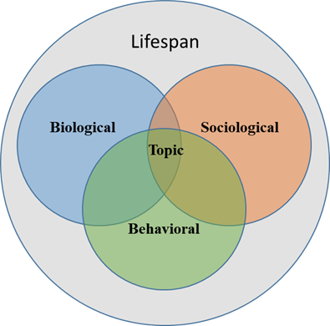
Evidence Based-Best Practices with a Biopsychosocial Model Across the Lifespan
?
Every professional issue should be addressed from the following perspective.
?
?
T

Slide 23
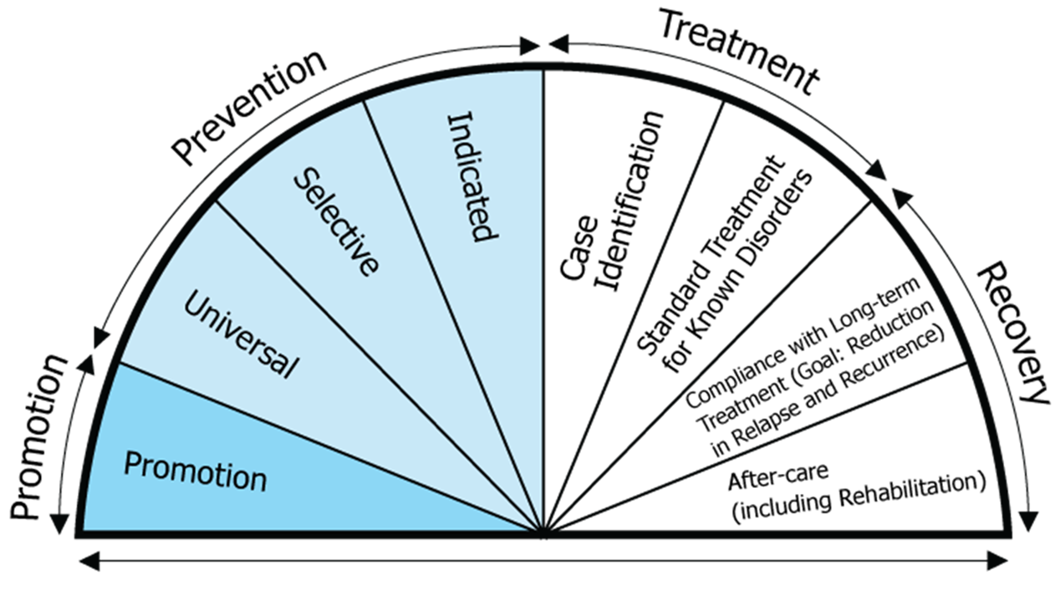
What is the best practice for each…
Now for each condition?
T

Slide 24
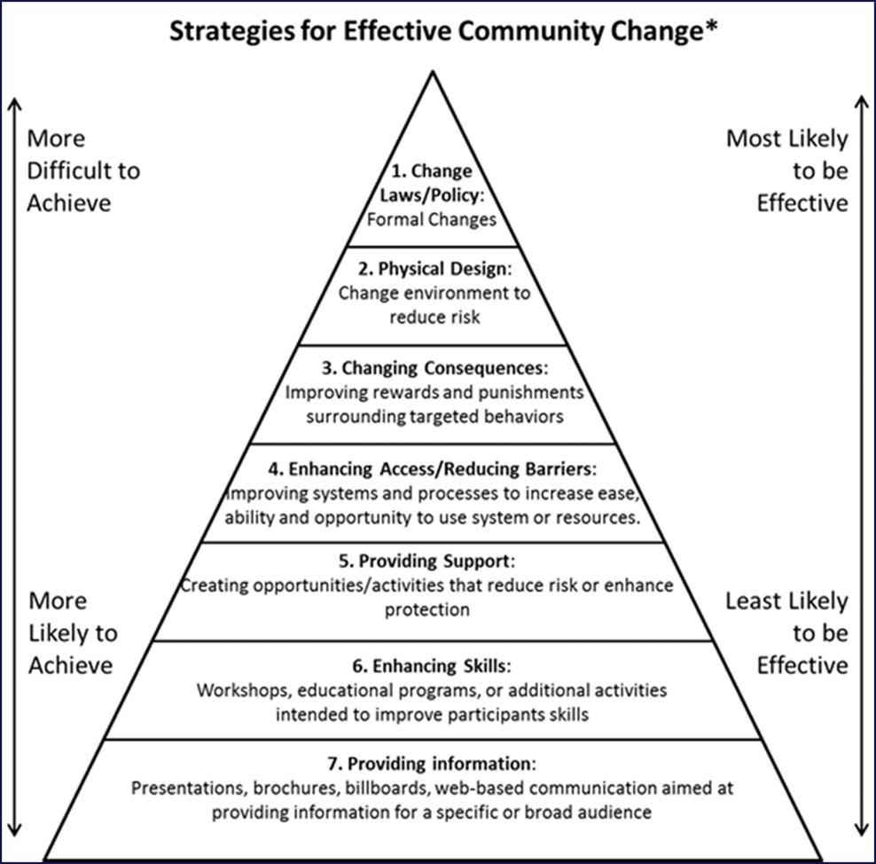
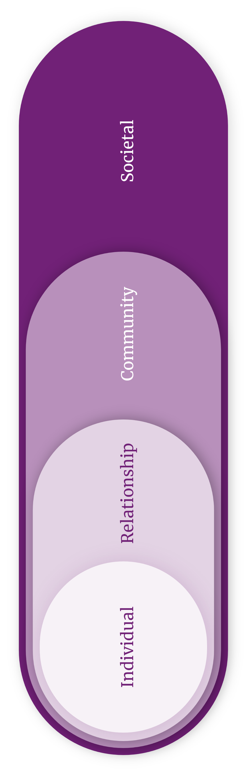
What is the evidence-based practice for each strategy and across each practice area?
B

Slide 25
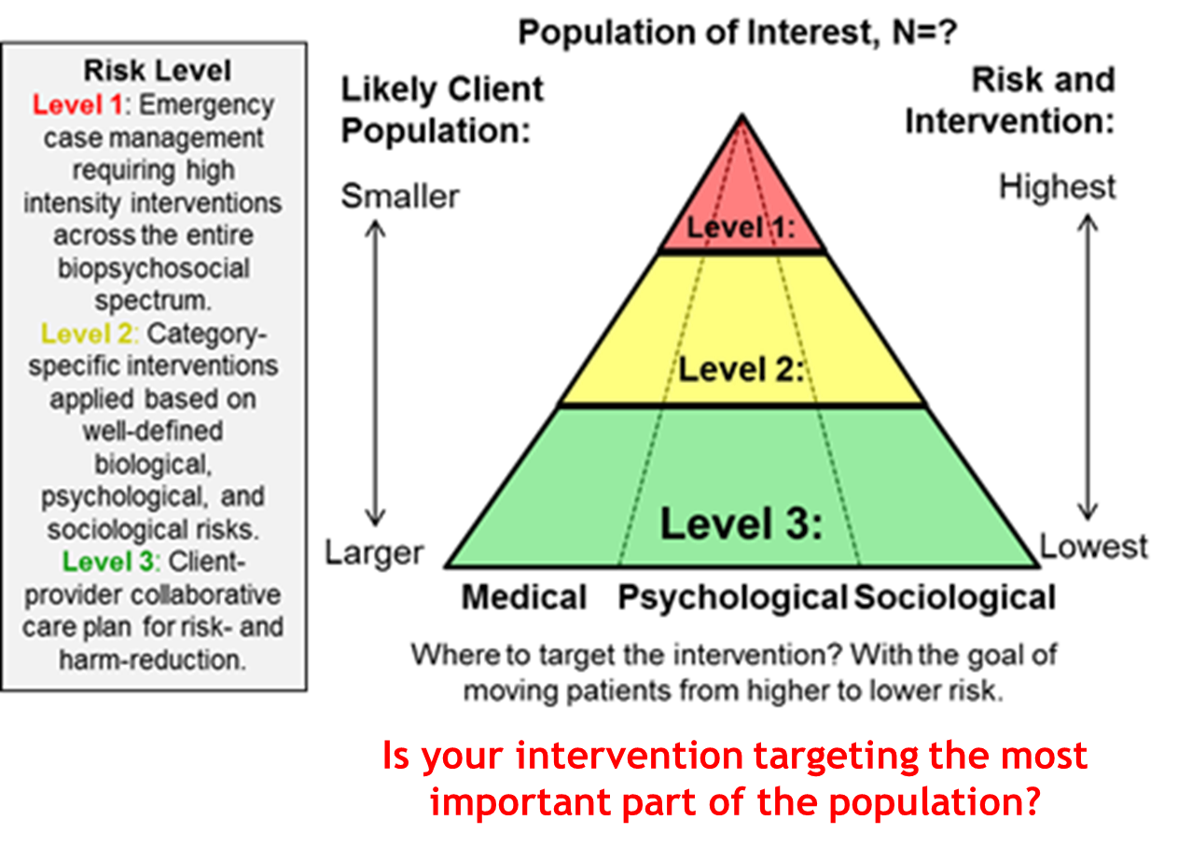
What Evidence-Based Practice are You Using and with Whom
B

Slide 26
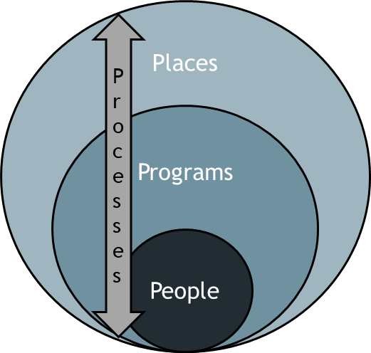
Evidence Based-Best Practices Applied: From Patients to Places
Where is the work being done (population)
How are costs being managed (payments)
What is the EB(B)P (practices)
Plans for access and barriers are present (plans)
Who is doing the work (providers)
Who is being served (patients)
B

Slide 27
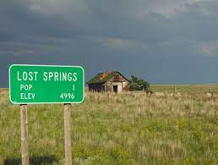
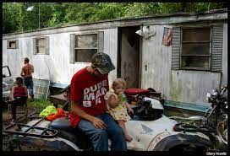


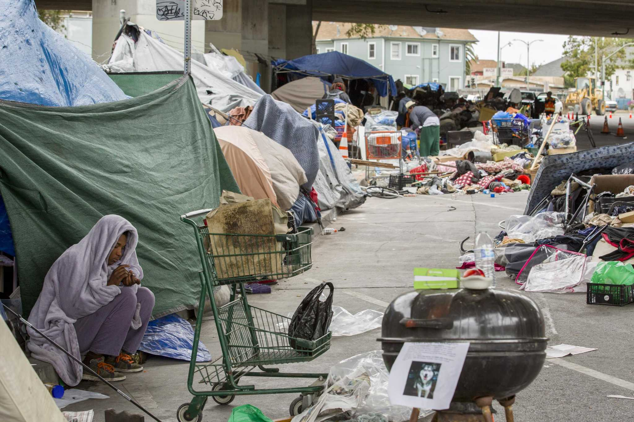



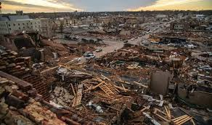
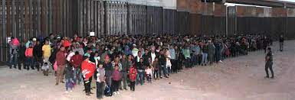
What Evidence-Based Practice are You Using and Where
Does it matter?
T

Slide 28
III. Describe how to adapt an evidence-based practice for your proposal
&
IV. Describe the relationship between evidence-based practice and your grant proposal

Slide 29
Dr. Kelley’s 4Ds of the Dependent Measure
Define
Describe
Direction
Degree
B

Slide 30

Assess fit of EBP and plan adaptations
Consider how well the EBP fits your logic model
What needs to be changed to make it more relevant to your population
Cultural relevance
Health literacy
What is essential to the EBP that you need to keep
Will you combine 2-3 EBP’s to make a new intervention?
T

Slide 31
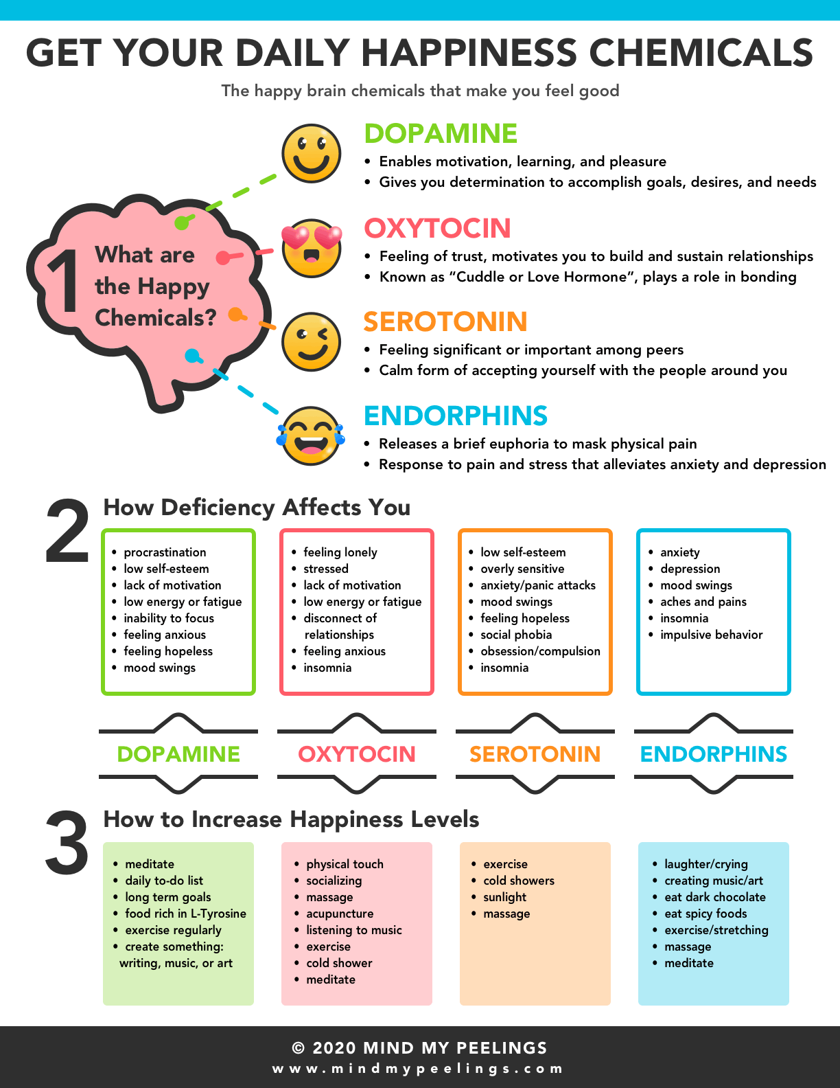
What if your client comes in with this?

Slide 32

What if your client comes in with this?
Insel claims such therapies are “eminence-based care” in contrast to “evidence-based” [pg 103], and that psychoanalysis is “not by itself a treatment for mental illness” [pg 51]. He believes that traditional psychotherapy blames parents and families for mental illness and that only by discarding these outmoded approaches, families can now be part of a patient’s support team. He derides analytic therapy as dwelling on childhood, not current life. By contrast, according to Insel, evidence-based therapy focuses on learning skills:
That’s not what you get with talk therapy that’s not focused. It doesn’t have an evidence base. So I’m a huge proponent of psychotherapy, but it has to be psychotherapy that actually involves those kind of skills learning that has a kind of scientific basis to it with people trained to do it in the way that works.

Slide 33
What if your client comes in with this?
Molecular Psychiatry
www.nature.com/mp
SYSTEMATIC REVIEW OPEN
The serotonin theory of depression: a systematic umbrella review of the evidence
Joanna Moncrieff^{1,2} ^{✉, Ruth E. Cooper3}, Tom Stockmann⁴, Simone Amendola⁵, Michael P. Hengartner⁶ and Mark A. Horowitz^{1,2}
© The Author(s) 2022
The serotonin hypothesis of depression is still inﬂuential. We aimed to synthesise and evaluate evidence on whether depression is associated with lowered serotonin concentration or activity in a systematic umbrella review of the principal relevant areas of research. PubMed, EMBASE and PsycINFO were searched using terms appropriate to each area of research, from their inception until December 2020. Systematic reviews, meta-analyses and large data-set analyses in the following areas were identiﬁed: serotonin and serotonin metabolite, 5-HIAA, concentrations in body ﬂuids; serotonin 5-HT_{1A} receptor binding; serotonin transporter (SERT) levels measured by imaging or at post-mortem; tryptophan depletion studies; SERT gene associations and SERT gene- environment interactions. Studies of depression associated with physical conditions and speciﬁc subtypes of depression (e.g. bipolar depression) were excluded. Two independent reviewers extracted the data and assessed the quality of included studies using the AMSTAR-2, an adapted AMSTAR-2, or the STREGA for a large genetic study. The certainty of study results was assessed using a modiﬁed version of the GRADE. We did not synthesise results of individual meta-analyses because they included overlapping studies. The review was registered with PROSPERO (CRD42020207203). 17 studies were included: 12 systematic reviews and meta-analyses, 1 collaborative meta-analysis, 1 meta-analysis of large cohort studies, 1 systematic review and narrative synthesis, 1 genetic association study and 1 umbrella review. Quality of reviews was variable with some genetic studies of high quality. Two meta-analyses of overlapping studies examining the serotonin metabolite, 5-HIAA, showed no association with depression (largest n = 1002). One meta-analysis of cohort studies of plasma serotonin showed no relationship with depression, and evidence that lowered serotonin concentration was associated with antidepressant use (n = 1869). Two meta-analyses of overlapping studies examining the 5-HT_{1A} receptor (largest n = 561), and three meta-analyses of overlapping studies examining SERT binding (largest n = 1845) showed weak and inconsistent evidence of reduced binding in some areas, which would be consistent with increased synaptic availability of serotonin in people with depression, if this was the original, causal abnormally. However, effects of prior antidepressant use were not reliably excluded. One meta-analysis of tryptophan depletion studies found no effect in most healthy volunteers (n = 566), but weak evidence of an effect in those with a family history of depression (n = 75). Another systematic review (n = 342) and a sample of ten subsequent studies (n = 407) found no effect in volunteers. No systematic review of tryptophan depletion studies has been performed since 2007. The two largest and highest quality studies of the SERT gene, one genetic association study (n = 115,257) and one collaborative meta-analysis (n = 43,165), revealed no evidence of an association with depression, or of an interaction between genotype, stress and depression. The main areas of serotonin research provide no consistent evidence of there being an association between serotonin and depression, and no support for the hypothesis that depression is caused by lowered serotonin activity or concentrations. Some evidence was consistent with the possibility that long-term antidepressant use reduces serotonin concentration.
Molecular Psychiatry; https://doi.org/10.1038/s41380-022-01661-0
¹Division of Psychiatry, University College London, London, UK. ²Research and Development Department, Goodmayes Hospital, North East London NHS Foundation Trust, Essex, UK. ³Faculty of Education, Health and Human Sciences, University of Greenwich, London, UK. ⁴Psychiatry-UK, Cornwall, UK. ⁵Department of Dynamic and Clinical Psychology, and Health Studies, Faculty of Medicine and Psychology, Sapienza University of Rome, Rome, Italy. ⁶Department of Applied Psychology, Zurich University of Applied Sciences, Zurich,
Switzerland. ^{✉email: j.moncrieff@ucl.ac.uk}
Received: 21 June 2021 Revised: 31 May 2022 Accepted: 7 June 2022

Slide 34
V. Identify resources for finding evidence-based practices

Slide 35

Evidence-Based Practices Repositories
https://ies.ed.gov/ncee/WWC
https://www.samhsa.gov/resource-search/ebp
https://www.cdc.gov/dhdsp/pubs/guides/best-practices/about.htm
https://www.ahrq.gov/prevention/guidelines/index.html
https://ojjdp.ojp.gov/evidence-based-programs
https://nicic.gov/projects/evidenced-based-workforce-training-series
https://preventionactionalliance.org/learn/about-prevention/the-best-kind-of-prevention-evidence-based-prevention/
Pick Your
Wheel Carefully,
Because it Drives
Your Entire project or proposal

Slide 36
Additional Resources on EB(B)P
Additional Resources
Overview - Introduction to Evidence-Based Practice - Research Guides at Loyola / Notre Dame Library (lndlibrary.org)
https://www.ncbi.nlm.nih.gov/books/NBK2659/
https://www.ncbi.nlm.nih.gov/books/NBK2651/
https://www.apa.org/practice/resources/evidence
Evidence Base Update of Psychosocial Treatments for Child and Adolescent Depression
https://www.tandfonline.com/doi/full/10.1080/15374416.2016.1220310?casa_token=6oVFIBu5hdgAAAAA%3AQ1cGX5v8Df9Fg1ZD9An9uDCOx_piGTbShSq4JQJVU9S-NA3WiJP-Ayz401hn4kKTE6hcGfpG4u8wxQ
Evidence-Based Psychosocial Treatments for Child and Adolescent Depression
https://www.researchgate.net/publication/5408450_Evidence-Based_Psychosocial_Treatments_for_Child_and_Adolescent_Depression
Child and Adolescent Depression: A Review of Theories, Evaluation Instruments, Prevention Programs, and Treatments
https://www.frontiersin.org/articles/10.3389/fpsyg.2019.00543/full

Slide 37
More Resources for Evidence-Based Practices
Model Practice DatabaseLinks to an external site. (National Association of County and City Health Officials) – Collection of projects from around the United States highlighting successful public health projects.
National Registry of Evidence-Based Programs and Practices (NREPP)Links to an external site. (Substance Abuse and Mental Health Services Administration) – Searchable online registry of interventions supporting mental health promotion, substance abuse prevention, and mental health and substance abuse treatment.
Promising Practices NetworkLinks to an external site. (RAND Corporation) – Collection of summaries of successful projects, programs and practices addressing the needs of children and youth.
Research-tested Intervention Programs (RTIPs)Links to an external site. (National Cancer Institute) – Searchable database of cancer control interventions and program materials that have been shown to be effective, published in peer-reviewed journals, and reviewed by a panel of experts in the field.
Canadian Best Practices PortalLinks to an external site. (Public Health Agency of Canada) – Compendium of community interventions related to chronic disease prevention and health promotion that have been evaluated, shown to be successful, and have the potential to be adapted and replicated by other health practitioners working in similar fields.
Community Toolbox
Guide to Community Prevention Services
Cochrane Collection of systematic reviews
National Guideline Clearinghouse for clinical guides

Slide 38
Questions?
IFP Contact Information:
Dr. Brian Kelley, Senior Partner
Brian.kelley@innovativefundingpartners.com
(202) 809-3399

Slide 39
dht.org

