Slide 1


Enhancing Grants through a Force Multiplier Perspective:
Creating Meaningful Partnerships and Describing their Role in a Proposal.
May 17, 2023

Slide 2

Learning Objectives
I. Understanding why community partners are becoming increasingly important to local, state, and federal grantors.
II. Understanding how to use the force multiplier concept to produce effective community partnerships with the potential for lasting and evidence-based impact.
III. Develop familiarity with the barriers that often prevent effective community partnerships and the best approaches to engaging partners in the research process throughout the entire experience.
IV. Understanding how to develop a plan that will be synergistic and optimal for creating a long-lasting relationship and foundation for success for both entities.

Slide 3
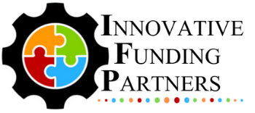
About
Innovative Funding Partners
IFP is a nationally recognized grants consulting firm highly regarded for an impressive overall grant success rate of 84%. Well known for their expertise in federal and other governmental grant writing, this success is based not only on technical expertise, but also on a foundational relationship-building approach. IFP’s team of over 20 highly experienced consultants are passionate about helping organizations meet the unique needs of their local communities and better serve their constituents by seeking and securing grant funding.

Slide 4
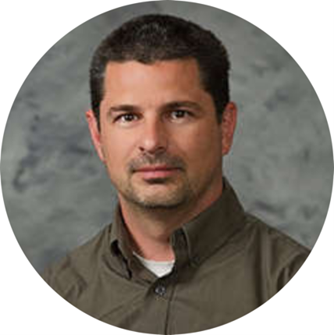
About the
presenters
Brian Kelley, IFP Grants Consultant, is a grant writer with a proven track record of securing federal and foundation grants across multiple sectors, including health care, workforce development, and education. He has worked in academia for over two decades as well as served a variety of not-for-profit organizations and medical centers as a consultant to help create innovation and secure foundation, city, state, and federal funds to support biomedical, education, prevention research, and workforce development and has served as a grant reviewer for several granting agencies. Dr. Kelley leverages the culmination of these experiences into an authentic and effective approach to grant development for community impact.
.
3.
Brian Kelley, Ph.D.
Senior Partner

Slide 5
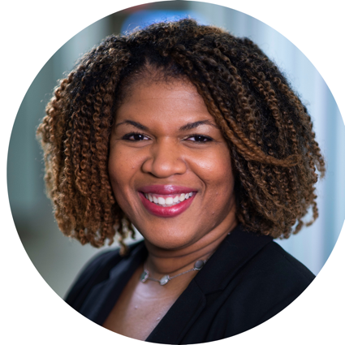
About the
presenters
Sylvette La Touche-Howard, IFP Grants Consultant, is an experienced therapist and public health specialist in the behavioral and community health sector with specializations in mental health, health equity, community engagement and program evaluation. She brings to the IFP team more than 20 years of experience in the academic, for profit and nonprofit arenas. She has served on several curriculum development teams that have had state and national impacts. Her passion lies in proactively working with organizations and communities to bridge behavioral health, research and social impact to create a sustainable and equitable future through policy, systems and environmental change initiatives. Sylvette holds a Ph.D. in Behavioral and Community Health from the University of Maryland, College Park.
.
3.
Sylvette La Touche-Howard, Ph.D.NCC, CHES
Grants Consultant

Slide 6
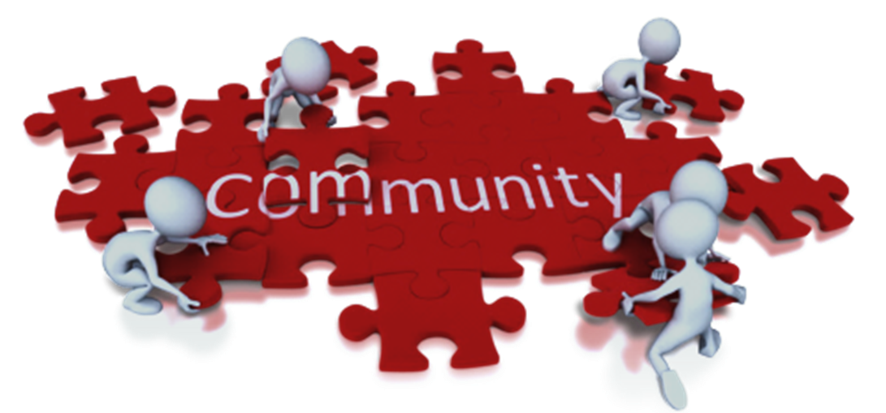
I. Understanding why community partners are becoming increasingly important to local, state, and federal grantors.

Slide 7
THE GOAL
SUSTAINED
IMPACT
ENGAGED COMMUNITY MEMBERS
MUTUAL INTEREST & RESPECT
INSTITUTIONS
Goal:
Making progress with your community
and not to your community

Slide 8
Why is Community Engagement ESSENTIAL?
It promotes sustainable decisions by recognizing and communicating the needs and interests of ALL participants-including decision makers
It increases acceptance of decisions and community commitment to outcome as local knowledge from diverse groups shapes and creates inclusive, effective solutions.
It drives social transformation
It promotes advocacy that not only works to raise awareness, but passionate, locally-informed voices can be heard.
Source: https://granicus.com/blog/why-is-community-engagement-important/#:~:text=It%20promotes%20sustainable%20decisions%20by,and%20creates%20inclusive%2C%20effective%20solutions.

Slide 9
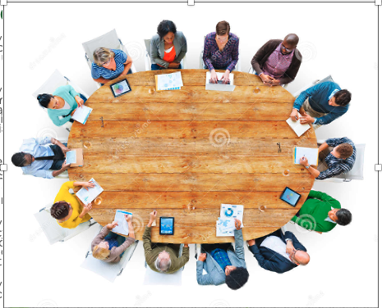
Reasons why you should engage your community
Community participation makes it more likely that you’ll come up with effective policies.
Community participation leads to community ownership and support of whatever initiatives come out of a social planning effort.
Policy makers – particularly hospital leaders– can gain politically and by brand recognition from involving the community.
Community members can inform policy makers about changes in circumstances that demand changes in policy over time.
Community participation can create community relationships and partnerships among diverse groups who can then work together.
Community participation helps keep efforts moving forward and sustainable.
Community participation contributes to institutionalizing the changes brought about by changes in policy.
Community participation energizes the community to continue to change in positive directions.

Slide 10
Even more reasons why…
Participation provides the opportunity to educate policy makers to the community’s real needs and concerns.
Participation allows community members to help create policy that really works to meet their needs.
Participation affords community members the respect they deserve.
Participation puts community members in control of their own fate.
Participation builds community leadership from within.
Participation energizes the community to take on other issues or policy decisions in the future, and to see itself as in control of its future.
The organization can communicate to participants the challenges faced in maintaining cutting-edge care.

Slide 11
Coalition Building: New Community Mandate?
So, who is going to be charged with serving as the coalition lead/bridge organization?

Slide 12
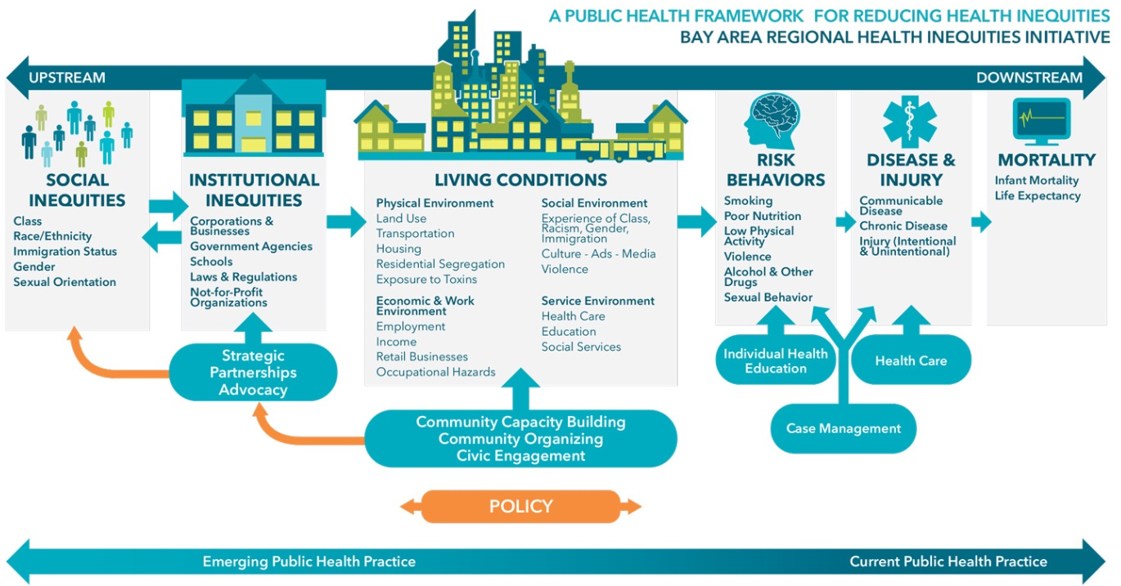
Emerging Expectations (501)(c)(3)

Slide 13
II. Understanding how to use the force multiplier concept to produce effective community partnerships with the potential for lasting and evidence-based impact.

Slide 14
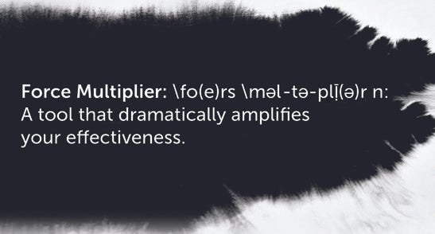
What is a Force Multiplier?
Image Source: https://www.linkedin.com/pulse/moving-world-mainframe-force-multiplier-christopher-o-malley/

Slide 15
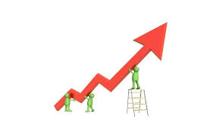
HOW DO WE GET THERE?
A Force Multiplier is a program, a policy, or an approach to a challenge that dramatically increases—or multiplies—effectiveness or impact.
For our discussion, force multiplication is primarily about community engagement and capacity building.
Force Multipliers allows us the opportunity to exponentially change our environment by working together.
Image Source: https://www.modlar.com/blog/2012-research-shows-dramatic-increase-in-use-of-bim-in-north-america/
Notes:
When you are trying to reach those in the community to provide assistance, it may make more sense and may be far more efficient to employ the use of force multipliers rather than trying to reach out to each individual that has been affected. (Fema.gov)

Slide 16
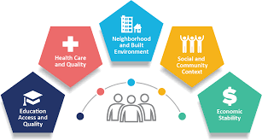
Social Determinants of Health

Slide 17
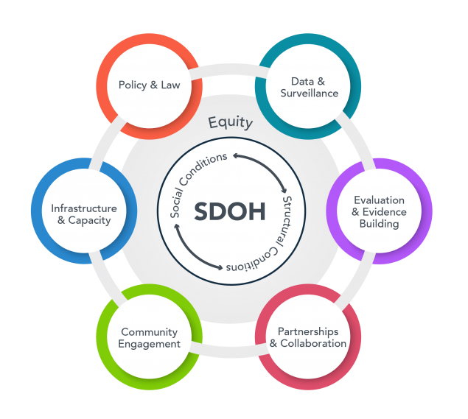
6 Pillars to Address the Social Determinants of Health
Source: https://www.cdc.gov/about/sdoh/cdc-doing-sdoh.html
Notes:
Data and surveillance: Embed a consistent SDOH approach to standardization, collection, analysis, and dissemination of data across the agency.
Evaluation and evidence building: Advance evaluation and build evidence for strategies that address SDOH to reduce disparities and promote health equity.
Partnerships and collaboration: Establish criteria, actionable steps, and strategies for partnerships, collaborations, and relationshipsthat result in improved health outcomes over the long term.
Community engagement: Foster meaningful, sustained community engagement across all phases of CDC intervention planning and implementation.
Infrastructure and capacity: Strengthen and sustain infrastructure such as workforce, training, and access to financial resources required to address SDOH and reduce health disparities.
Policy and law: Identify evidence, tools, and resources to enhance communication about policies that affect SDOH with policy makers and other stakeholders.

Slide 18
Who are your Community Stakeholders
Often Community Involvement Can be Conceptualized Across Multiple Sectors:
Age/Demographic Specific Groups: Youth (18 or younger), New Mothers, Elderly, Latinos, Blacks, etc.
Parents, Care Givers, Patients, etc.
Businesses
Media
Schools
Youth or Elderly (or other specialty)-serving organizations
Law enforcement/Courts
Religious/Fraternal organization
Civic/Volunteer groups
Healthcare (as a sector)
Transportation Departments
State, local, or tribal governmental agency
Recreation Departments and/or athletic groups
Other organization involved in community health
Increase Social Capital
Increase Efficacy
Empowerment
To Bring about Change

Slide 19
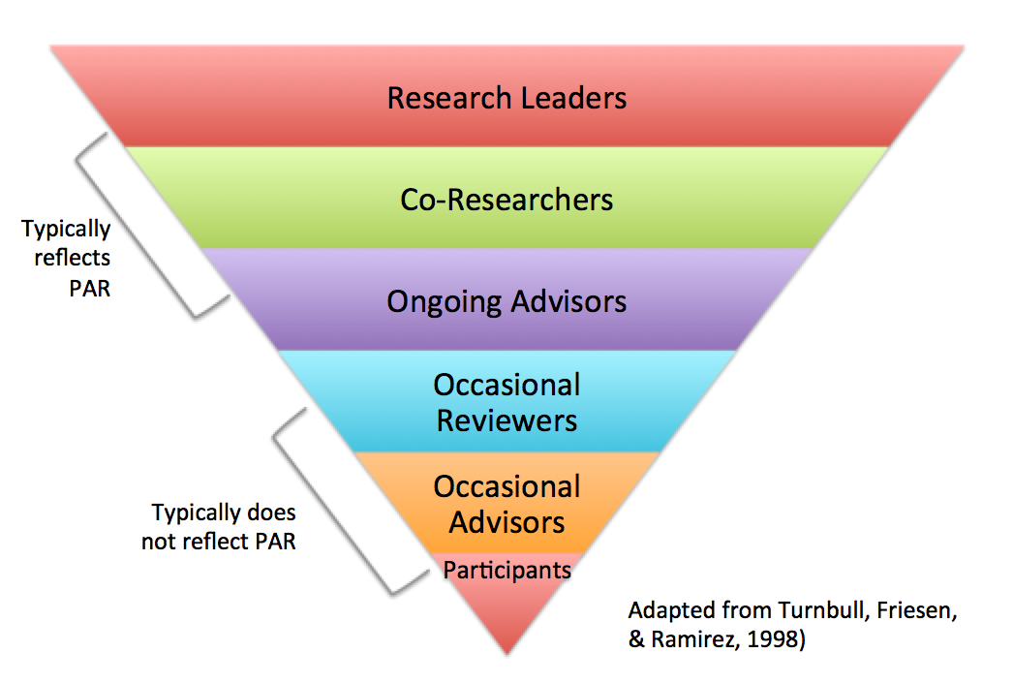
Levels of Involvement of Patient and Family Stakeholders in Research
Participatory Action Research

Slide 20
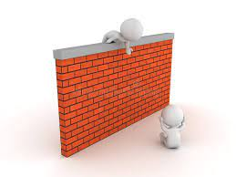
III. Develop familiarity with the barriers that often prevent effective community partnerships and the best approaches to engaging partners in the research process throughout the entire experience.

Slide 21
Why Programs Fail: Top 10
Poor communication especially around defining the problem/solution
Turf/Silo issues (e.g., this is how we have always done it, this is not my issue, and/or this is my issue and we don’t need you).
Bad history—poor brand recognition, starting but not completing projects, and/or leading without listening.
Domination by "professionals" or some other perceived elites.
Poor links to the community (i.e., doing things to the community instead of with the community).
Minimal organizational capacity (e.g., understaffed and wrongly staffed). Insufficient Funding.
Poor vision for the program/intervention (see 80/20 rule).
Failure to provide and create leadership within the prevention effort.
Failure to expand community stakeholders and engaged leaders
The costs of working together outweigh the benefits for many stakeholders.

Slide 22
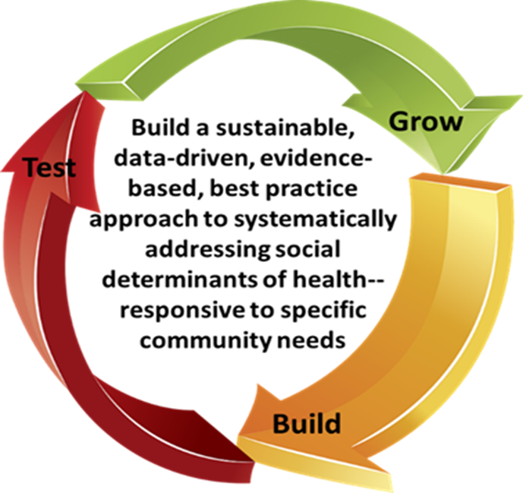
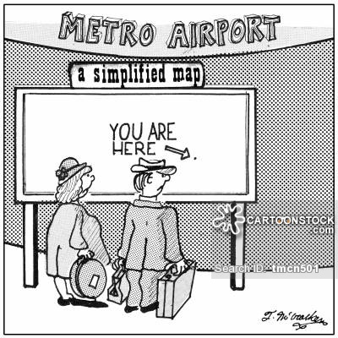
Community Collaboration Requires Clear Communication
Sometimes, even when things are clear, the point is missed.

Slide 23
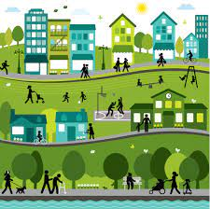
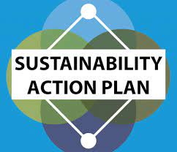
IV. Understanding how to develop a plan that will be synergistic and optimal for creating a long-lasting relationship and foundation for success for both entities.

Slide 24
Grants Require Collaborative Models and Full and Authentic Participation
Which health problems/social issues areas are the highest priorities?
Which health problems/social issues have the best likelihood of responding to an intervention?
Are there any community groups working on the same problem/issue?
What is the biggest obstacle for those community groups to make progress?
How can the organization lead and support these efforts?
What stakeholders would be interested in being engaged in developing a solution? Why/why not?
How will you track data on the above to demonstrate a commitment to inclusivity and consumer engagement?

Slide 25
First, start off on the “right foot”, by asking some critical questions
Which health problems/social issues areas are the highest priorities?
Which health problems/social issues have the best likelihood of responding to an intervention?
Are there any community groups working on the same problem/issue?
What is the biggest obstacle for those community groups to make progress?
How can the organization lead and support these efforts?
What stakeholders would be interested in being engaged in developing a solution? Why/why not?
How will you track data on the above to demonstrate a commitment to inclusivity and consumer engagement?
Grants Require Collaborative Models and Full and Authentic Participation

Slide 26
Second…Develop an effective strategy
Developing an effective strategy is the next step in community prevention. Your strategy will vary greatly, depending on type of prevention efforts. However, in most types of prevention, members of your community will want to come together and develop agreed-upon answers to the following questions.
What are your long- and short-term goals?
Collectively and individually, what are your organizational strengths and weaknesses? What do you bring to this problem?
Who cares about this problem (the so what question)?
Who are your allies/supports/key stakeholders?
Who has the power to give you what you want (e.g., funding, change in policy, etc.)?
How can we make our work enjoyable/effective for community members?
What barriers are preventing engagement?
Accomplish Goals
Develop Strategies (logic model)
Mobilize Resources
Identify Common Goals

Slide 27
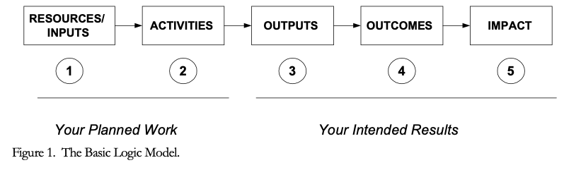
Understanding why community partners are becoming increasingly important to local, state, and federal grantors.
Notes:
Developing a logic model at the beginning of program planning gives you a framework for charting the links between your program’s resources, activities, and outputs and its intended outcomes. It enables you to evaluate your program once it begins. And it helps you communicate to your stakeholders what you want to accomplish, how you intend to reach your goals, and how you will track your progress.
Logic models represent INTENTION; shows connection between the planned work and what you hope to achieve. THIS is informed by the theory of change.
These components illustrate the connection between your planned work and your intended results.
Visual representation, etc. purpose in sharing ,etc.
Start with identifying the impacts and outcomes (relationship to backwards design) then can select the activities

Slide 28
Thirdly, Commit to the 4 Pillars of Community Engagement
Improving Outcomes
Ensuring Access and Community Empowerment
Promoting Sustainable Decisions
Driving Social Transformation

Slide 29
Questions?
IFP Contact Information:
Dr. Brian Kelley
Brian.Kelley@innovativefundingpartners.com
Dr. Sylvette A. La Touche-Howard
slhoward@innovativefundingpartners.com

Slide 30
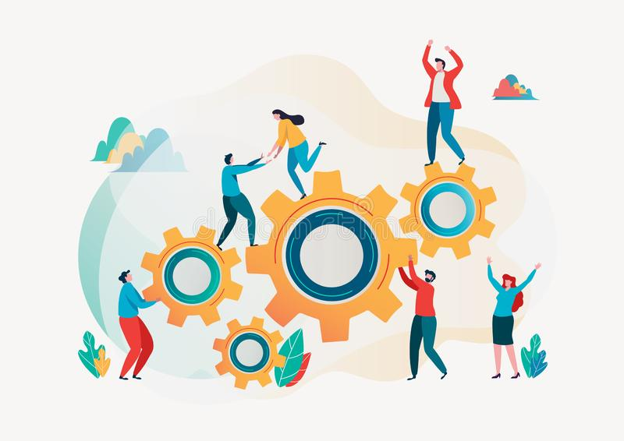
Save the Date
Wednesday, June 21st
12pm EST
Utilizing Evidence-Based
Best Practices

Slide 31
dht.org

