Slide 1
Forestry Perspectives on the Closing of the Canton Paper Mill
Barry New, Technical Development Branch Head
Lynn Jenkins, Markets & Utilization Forester
North Carolina Forest Service
September 21, 2023
The North Carolina Forest Service is a division of the North Carolina Department of Agriculture and Consumer Services.
Steve Troxler, Commissioner
Notes:
Good afternoon and thank you for the invitation to participate in this webinar. My intent is to provide some context regarding the near-term impacts we’ve seen emerge within the broader forest sector since the Canton mill stopped receiving wood in early June, and to very briefly discuss some of the likely future effects that may play-out in the region’s forests as a result of this sudden loss of the only real market for pine and hardwood pulpwood in the region over the last century.
I would like to acknowledge my colleague Lynn Jenkins, Markets and Utilization Forester with the NC Forest Service, who co-developed the content I’ll be presenting.

Slide 2
Timberland in WNC within 75 miles of Canton
Ownership (3.3 mil ac.)
82% hardwood forest types
Notes:
To set the stage, there are a few key components that are important to understand about the forests of WNC
The data presented here comes from the USFS Forest Inventory & Analysis (or FIA) program.
The term Timberland is a subset forestland; and is defined as being capable of producing commercial timber and is not restricted or reserved from timber harvesting.
Therefore, timberland does not include the GSMNP or NF Wilderness areas.
This region contains about 3.3 million acres of timberland and forests are the predominant land cover
The region has more public ownership than other regions of the state but is still overwhelmingly in private ownership
The area of timberland has remained relatively stable over the past 5 years
And WNC forests are overwhelmingly comprised of hardwood forest types

Slide 3
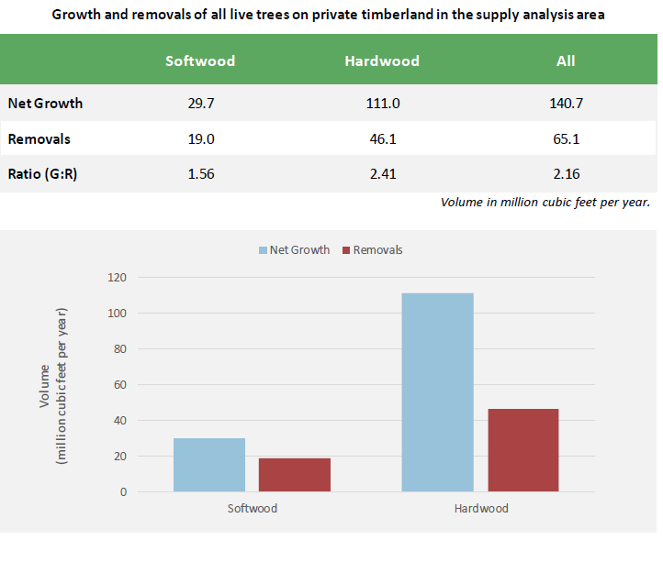
Notes:
One of the things we look at when assessing forest sustainability is the growth: removals ratio. Ratio’s greater that 1.0 indicate that timber volume is increasing over time. Ratios less that 1.0 indicate declining timber volumes.
In the chart above, you can see that net growth (blue bars) are greater than removals (red bars) for both softwoods and hardwoods.
In WNC, annual timber volume growth is over twice the rate of annual removals for the total of all live trees as well as for hardwoods.
For softwoods (mainly pines), growth exceeds removals by 56%
Putting it another way, each year, timber harvests plus any conversions of timberland to non-forest, are removing less than half the total annual volume growth.
This equates to a total annual volume growth of 1%, resulting in a total standing timber volume of over 10 billion cubic feet.
Because of this, WNC’s timberlands could support even greater levels of harvesting and still be considered sustainable from a timber inventory perspective.

Slide 4
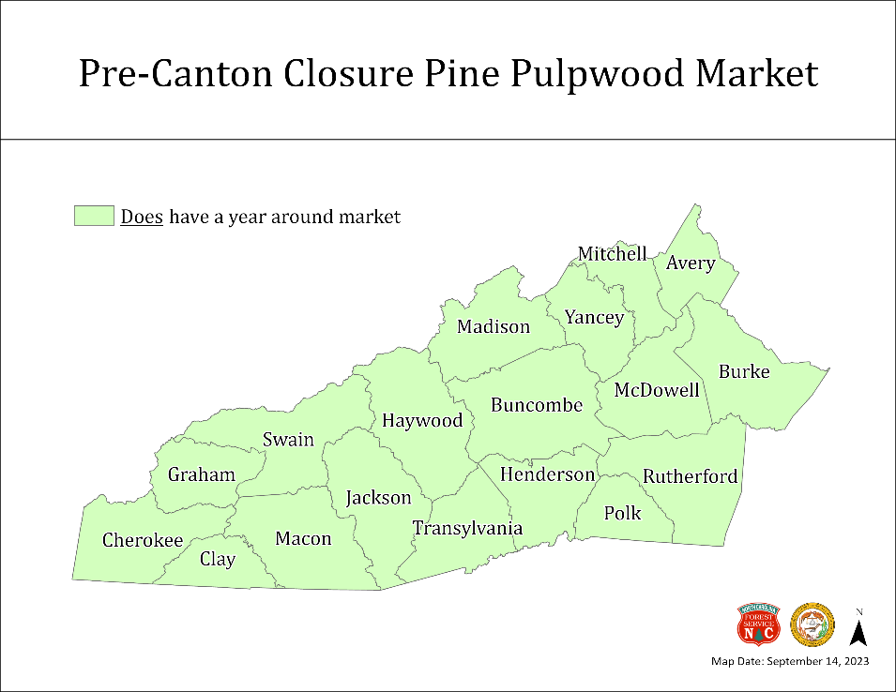
Notes:
Prior to closing (map on left), the Canton mill was being supplied with wood chips from 3 in-state satellite chip mills which procured pulpwood from throughout the region and thus a year-round market existed in all counties for pine pulpwood.
The mill also relied on out of state suppliers, most notably from upstate SC.
Since the mill’s closing in June (map on right), there is presently not a consistent year-round market for pine pulpwood in most WNC counties. Fortunately, other pine pulpwood markets do currently exist in a handful of counties along the eastern side of the study area.

Slide 5
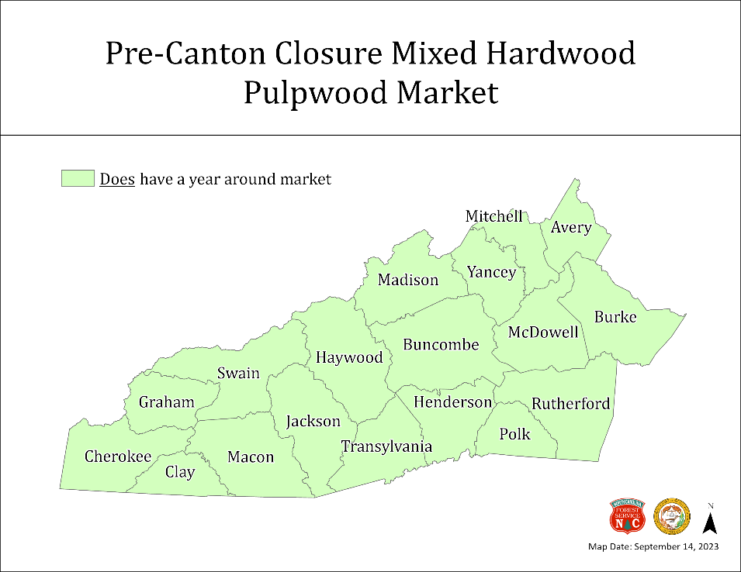
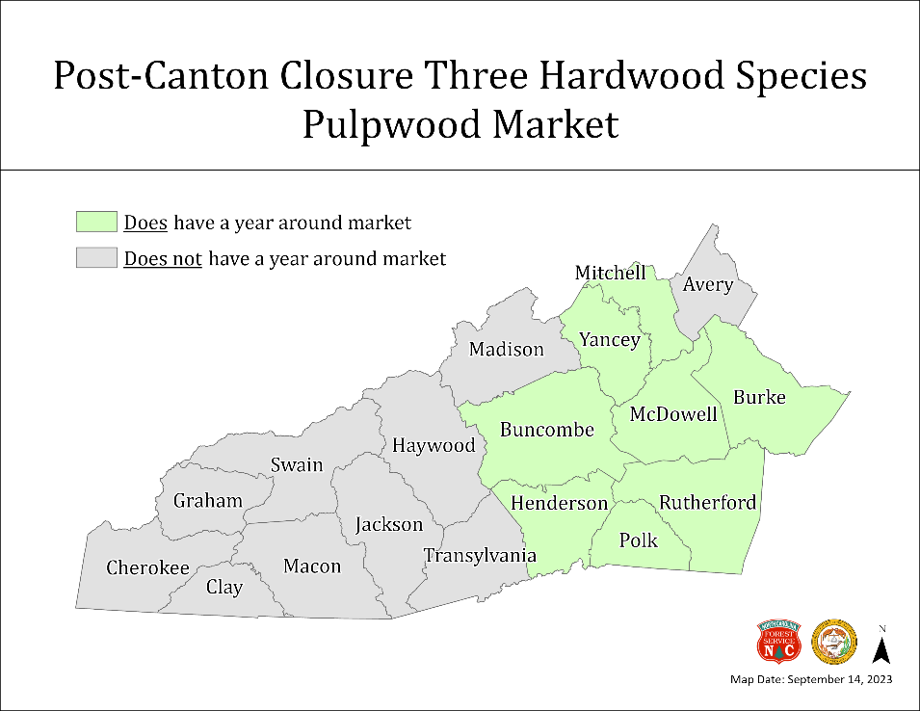
Red oak, Red maple, Yellow poplar only
Notes:
Prior to the mill’s closing the 3 NC chip mills previously mentioned also created a year-round market for hardwood pulpwood throughout the study area (map on left).
Presently, since the closing of the Canton mill, the market for hardwood pulpwood is much more limited and exists only in the eastern counties (map on right).
We are aware that the hardwood pulpwood market is further constrained to only 3 species within parts of the counties shaded in green, with those species being red oak, red maple, and yellow poplar.

Slide 6
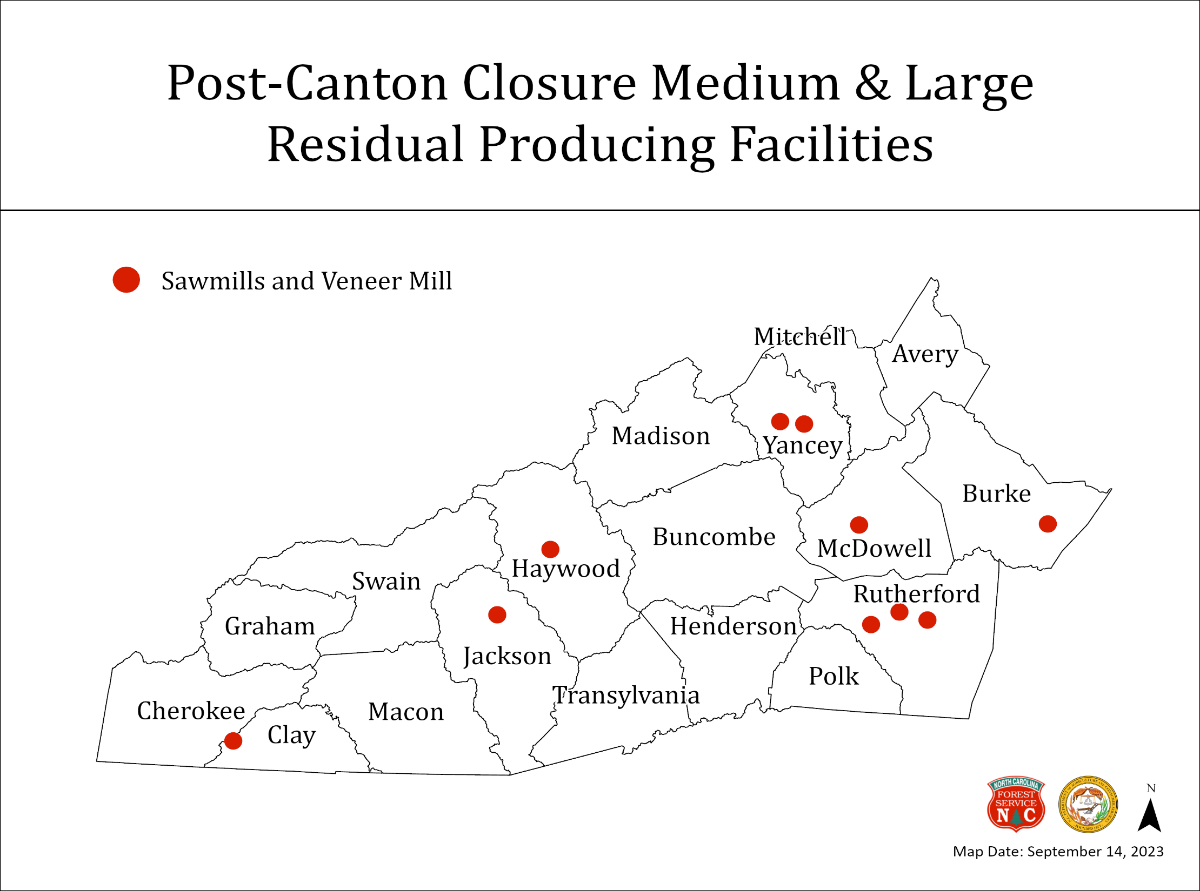
Notes:
There are currently 9 medium to large volume sawmills and 1 veneer mill operating within the region. There are many more small sawmills, firewood, mulch and other operations that are not shown on this map.
As these medium and large mills produce lumber and plywood, they generate considerable volumes of residual chips, shavings, sawdust, and bark as by-products.
Pactiv Evergreen was a buyer of some portion of these residuals which was used in addition to pulpwood chips as feedstocks in the manufacture of paper and packaging .
We are aware that these sawmills and possibly the veneer mill have been affected due to the loss of the Canton mill as a major buyer of these residual products.

Slide 7
Impacts to WNC forests in areas with weak or non-existent pulpwood markets
Harvesting will take the best and leave the rest
Leading to an increase in less desirable species and indiv. trees
Resulting in less valuable timber, lower wildlife diversity, and less healthy forests
Also, wildfire risk will increase
Thus, practicing forestry will become less economically viable
And increase the threat of forestland conversion to more profitable land uses, such as development, etc.
Notes:
So, how will the loss of this major market in WNC for small diameter and lower quality trees impact our forests and woodland owners?
High-grade harvesting and diameter limit cutting are expected to increase.
In this situation, only the best and highest value trees are harvested.
What remains are the less-desirable species, lower quality stems, and smaller suppressed trees, which in many cases are as old as the trees being harvested for sawlogs and veneer. These are the trees that used to supply the Canton mill.
Unless active forest management is applied, the forest that develops post-harvest, will have lower timber value, less value to wildlife, and will generally, be less healthy and resilient.
These remaining lower quality trees will also increase the wildfire risk due to increased fuel loads.
Lower timber sale revenues and increased management costs will make forestry a less favorable investment compared to alternatives.
Usually when this happens, we see forestland sold or converted to more profitable land uses, such as development.

Slide 8
Opportunities
Plenty of available wood to support new or expanded forest product markets
Logging and trucking capacity still exists, although on a smaller scale*
Many private and public landowners want to continue managing their woodlands
A prime opportunity to increase forest-sector recruitment & economic development
Notes:
In wrapping-up, I’d like to end on a positive note and focus on the opportunities we have in front of us.
First, WNC has plenty of wood available to support our existing industries and could support an expansion of new wood markets while still sustaining the many other values that make this region so special, such as…tourism, recreation, scenery, clean air and water, abundant wildlife habitats, along with ecological values.
The logging and trucking force has certainly been impacted heavily due to the mill’s closure, but capacity could ramp-up if new markets were to emerge.
Many private woodland owners in WNC will continue to see the value of investing in forest management and timber harvesting. On the public side, this certainly holds true for the National Forests as well as the State Forests, Game Lands, and others.
I’ve been extremely impressed with the interest the mill’s closing has generated from diverse groups who genuinely want to help WNC prosper and thrive into the future. I firmly believe that WNC’s natural resources hold the keys to its future, just as they have been in the past. I also believe that wise use of those natural resources is essential for the region’s future.
And finally, I would challenge all of you who are involved in the region’s economic development community to consider the forest products sector as one of your recruitment priorities. The NCFS would welcome the opportunity to part of those efforts.

Slide 9
Thank you for your time!
Barry New - Technical Development Branch Head
barry.new@ncagr.gov 919-857-4843
Lynn Jenkins - Markets & Utilization Forester
lynn.jenkins@ncagr.gov 919-857-4840
Notes:
Thanks for your attention and thank you very much for inviting me to be a part of this discussion.

