Slide 1
Summer Learning Recovery in Western North Carolina
Voices From the Field
Dogwood Health Trust Partner Convening
October 2023

Slide 2
Study Overview

Slide 3
Note: In practice, this means we may have data that takes four paragraphs to convey a theme, and data that lends itself to the same construct in one sentence. We choose our illustrative quotes because they hit on the essence of the theme in a “bite sized package.”
Covid Relief Investments in K-12 Education
North Carolina received $3.6 Billion in Elementary and Secondary School Emergency Relief funds for pandemic recovery efforts in K-12 schools
What is working, for whom, and under what conditions?
Investment in evidence-based interventions, including $35M in competitive grants for school extension programs
North Carolina Department of Public Instruction commissioned a series of short-cycle regional based qualitative studies with UNC System institutions to better understand implementation and experiences of key education stakeholders

Slide 4
Study Aims
Overarching aim was to capture “the voices behind the numbers” to better understand summer learning recovery efforts in high schools in Western North Carolina
RQ1
How are summer programs for learning recovery and acceleration implemented in high schools within the western region of the state?
RQ2
To what extent are these programs achieving their desired academic & social emotional learning outcomes?
RQ3
What factors are perceived to enable or inhibit the successful implementation of summer learning programs in high schools in Western NC?

Slide 5
Four Models of Summer Learning Programs
Summer 2021 ESSER programs required implementation for 150 hours or 30 days; otherwise autonomous in terms of curriculum, staffing, and student composition
Required number of days/hours lifted for
Credit Recovery
Tailored opportunities to supplant course failures or incompletes based on mastery from summer instruction
Summer Learning & Enrichment
Focus on core skill sets rather than credits
Summer Bridge
Support social emotional & academic transition into high school
Career Accelerator Explore novel career paths & connect w/CTE curriculum

Slide 6
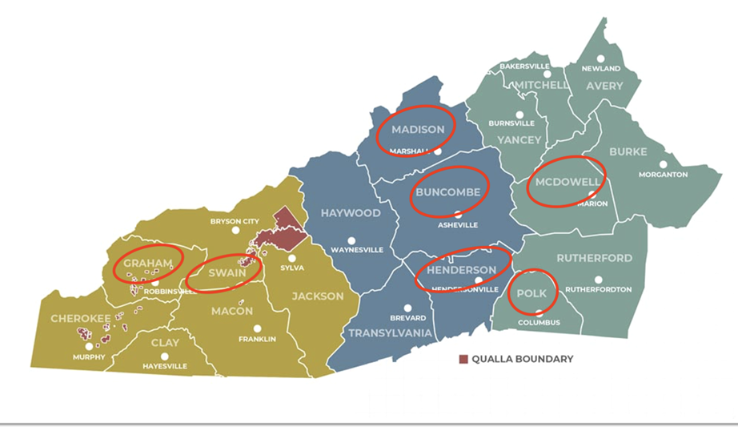
Study Design: Sample & Data collection
Study Sample: Ten districts in education regions 7 & 8
Data collection
Spring 2022: Virtual interviews with district administrators, school staff, and teachers - focus on summer 2021 Credit Recovery & Learning Extension programs
Fall 2022: In-person interviews and focus groups with school staff & students; student & staff surveys – focus on summer 2022 Summer Bridge, Career Accelerator, and Learning Extension programs.
Participating DHT partner districts
Notes:
7 Districts are via DHT connections – say at the outset or no?

Slide 7
RQ1: Implementation Findings

Slide 8
Credit Recovery- Implementation
Beyond Credits: All schools and districts spoke to the considerations of support beyond academics, particularly the first summer after return to in person learning
-Particular concern for the physical and mental health of their students who faced amplified challenges related to isolation and disengagement during remote learning
- Heightened among those residing in geographically dispersed and economically distressed communities
Some districts and schools acknowledged their admissions criteria included whether a student would benefit from the stability of spending time in a school over the summer
“We did tell principals if they felt like because of anxiety or social emotional issues that maybe a child who didn’t need the credits but they just need to be around people [or] it would be a safer environment, then we encourage them to include those students also.”
Notes:
7 Districts are via DHT connections – say at the outset or no?

Slide 9
Summer Bridge - Implementation
Increased focus on relationship building: Educators reported persistent and pervasive levels of heightened anxiety, particularly for cohort of students that were fully remote prior to starting high school
- Students also seemed notably less comfortable/confident talking with adults and asking for help as well as initiating social interactions with student peers.
“I think what I’ve noticed with this freshmen class…there’s a greater sense of fear, even from the larger schools of kids stepping out and advocating for themselves and being able to walk up to a teacher and say, I’m really struggling in math. That’s something that I think across the board, we’ve talked about is that our students lack the ability, in a new way, to just be able to say, I need help and they’re much more passive about it and the anxiety we’re seeing in students is through the roof. I can’t even describe to you the amount of time I’m spending in my days talking about anxiety.”
Notes:
7 Districts are via DHT connections – say at the outset or no?

Slide 10
Career Accelerator - Implementation
CTE staff spoke about two overarching goals for Career Accelerator Programs:
exposing students to opportunities and experiences they would likely not encounter on their own
2) helping students understand the importance of their decisions in high school as it relates to post-secondary options.
- Rural districts emphasized the value of the career accelerator programs to combat brain drain and highlight lucrative opportunities within their communities.
-CTE staff expressed that students either aren’t aware of different opportunities to build a career in their local community, or don’t realize how lucrative certain careers can be.
Notes:
7 Districts are via DHT connections – say at the outset or no?

Slide 11
Career Accelerator - Implementation
“I really feel like we’re pushing too many of our kids to the university system...especially kids that will come back to our county and have a career. Honestly, if you want to come back to (LEA) with a 4-year degree, you better go into education because that’s the one place you’re pretty much guaranteed to get a job. There aren’t that many jobs for those kids, so for many years, our biggest export in (LEA) is our young people and that is a shame.
“We have a huge shortage when it comes to plumbers, electricians, etc. There are so many areas in CTE where kids could be really successful and own their own business and have a great life if they were willing to go into those programs”.

Slide 12
RQ2: Outcome Findings

Slide 13
Perceptions of Student Impact
SEL Impacts
Teachers generally reported that students who participated in summer programming displayed stronger social skills than their peers that did not participate in summer programming.
Over two-thirds of teachers noted that participating students demonstrated greater engagement with teachers and self-confidence than their non-participating peers
Over half of respondents reported that participating students demonstrated more engagement with their peers
Academic Impacts
Nearly two-thirds of teachers reported higher levels of academic engagement and performance for participating students
Over half of teachers reported that participating students demonstrated fewer disciplinary issues than their non-participating peers
Staff perceptions of students participating in summer learning programs relative to non-participating students
 | Higher Level (%) | No Difference (%) | Lower Level (%)
Engagement with teachers | 68.75 | 31.25 | 0
Engagement with peers | 53.12 | 46.88 | 0
Self-confidence | 67.86 | 32.14 | 0
Academic Engagement | 62.5 | 34.38 | 3.13
Academic Performance | 62.5 | 34.38 | 3.13
Disciplinary Issues | 17.65 | 29.42 | 52.94
Notes:
When asking teachers to think broadly across all summer learning programs…..

Slide 14
Academic Outcomes – Dropout Prevention
School & district staff spoke to the danger of even falling one or two credits behind given stigma of grade retention, and thus the protective factor of credit recovery summer program
“It’s about seeing kids being able to be promoted. I think that’s a key in keeping students on track toward graduation. Once they get behind, it’s trying to dig out of a hole, whereas, if you can keep them on grade level and moving forward, the likelihood of seeing them cross that stage at graduation time is really increased….To come back that 5th year and everybody you hung around with is gone and you’re the old person on campus, that’s hard to entice those kids to come back, even if they’re one or two credits short. They’d rather walk away from it than go back and face that scenario of going back after having been there 4 years

Slide 15
Academic Outcomes – CTE
Students who participated in the Career Accelerator program sought out courses aligned with their professional interest.
- Also contributed to student academic engagement by providing a tangible link between school and careers. Several students described how the program helped them determine which classes specifically supported their career interest.
I think it also helped when they would talk to employers or our teachers at (community college), or even our faculty here, they were able to make a connection between this is why I need to make sure I’m at grade level in that Math class because if I want to do this as a career, I’ve got to be able to function in Math. The question, how am I ever going to use this? You might not use specifically what we’re talking about today, but in general, you’re going to use it throughout your whole career and I think they saw that quite a bit.

Slide 16
Social & Emotional Outcomes
-Students who successfully completed credit recovery courses were more engaged in the fall and had more confidence in their ability to succeed academically.
-Teachers and school staff observed that students who progressed through the Summer Learning program returned in the fall with more confidence and self-efficacy around their ability to continue progressing academically.
- School staff reported that students who participated in the Summer Learning program were much more engaged in the fall and had disproportionately lower rates of disciplinary actions
When they come in and they are behind and you’re saying, you do this summer program, you can come in and you’re right with your class, that is a whole new student that next go around because they’re not singled out…it’s like, we can fix that so you’re not in that class with sophomores again and that does give them a…I’ve seen that happen time and time again. It’s positive for them and they come back with a different attitude and sometimes, another life event slaps them, but usually, they do much better.

Slide 17
RQ3: Enablers / Inhibitors

Slide 18
Facilitating Factors
1.Optimize Recruitment Strategies - Utilize social media for high yield recruitment, and engage students from previous summer programs for ‘testimonials’ and more targeted recruitment efforts.
2. Facilitate relationship-building and trust - Develop program components that intentionally foster connection and build trust between students and educators can serve as a powerful catalyst for improving academic outcomes.
3. Integrate mental health supports - Ongoing supports for the heightened anxiety and pervasive mental health challenges of students is critical at the high school level, and should be incorporated into the design of all academic program planning.
Notes:
7 Districts are via DHT connections – say at the outset or no?

Slide 19
Facilitating Factors
4. Prioritize experiential learning - Prioritize activities where students can “do” rather than observe, e.g. hands-on experience at job sites.
5. Leverage student leadership - Engage upperclassmen in mentorship roles for high school Summer Bridge programs to reduce burden on staff, and heighten student self-efficacy and peer support structures across grade levels.
6. Extend supports across the school year - Extend summer programs throughout the school year to provide additional time for relationship-building, and serve as a foundation for student buy-in to academic supports provided across the year.
Notes:
7 Districts are via DHT connections – say at the outset or no?

