Slide 1
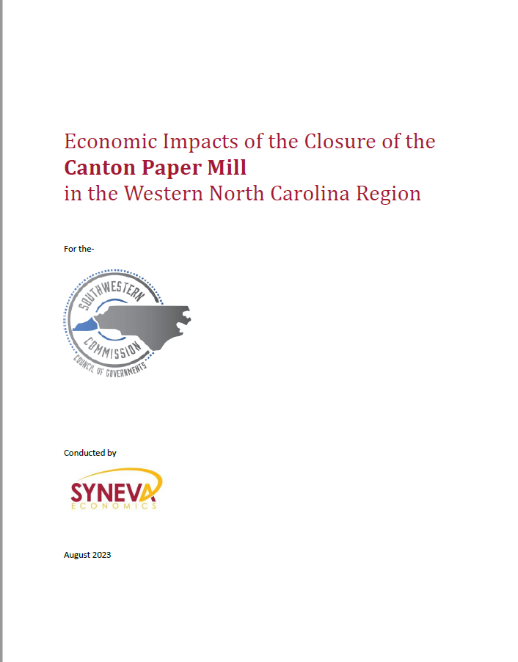

Slide 2
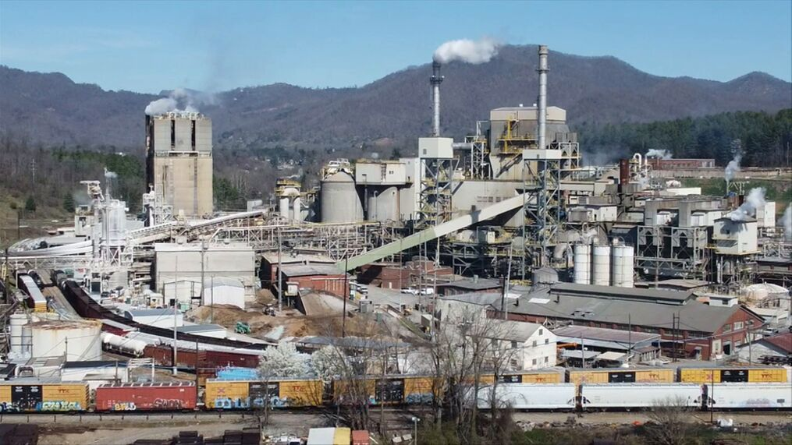

BRIEF BACKGROUND
Opened in 1908 as the Champion Fibre Company
Sits on 185 acres within the Town of Canton
Operations at the mill are manufacturing paper from pulp, including the conversion of the paper
Permanent closure on June 9, 2023, loss of 900 jobs

Slide 3

What an Economic Impact Analysis Is and Isn’t
Is an objective estimate of the results
of a change in the economy
Presents a worst-case scenario
Follows ripple effects through changes in:
  Supplier’s reduced sales
  Reduced spending by workers of the Mill &
  its suppliers
Does not address the Mill’s history, cultural or personal impacts

Slide 4
WNC IMPACTS OVERVIEW
 | Jobs | Income | Output
Mill
WNC Suppliers
WNC Worker Spending
Total
Multiplier

Slide 5
WNC IMPACTS OVERVIEW
 | Jobs | Income | Output
Mill | 900
WNC Suppliers | 1,055
WNC Worker Spending | 566
Total | 2,522
Multiplier | 1 → 1.8

Slide 6
WNC IMPACTS OVERVIEW
 | Jobs | Income | Output
Mill | 900 | $87.2 mil
WNC Suppliers | 1,055 | $54.4 mil
WNC Worker Spending | 566 | $23.6 mil
Total | 2,522 | $165.2 mil
Multiplier | 1 → 1.8 | $1 → $0.90

Slide 7
WNC IMPACTS OVERVIEW
 | Jobs | Income | Output
Mill | 900 | $87.2 mil | $615.8 mil
WNC Suppliers | 1,055 | $54.4 mil | $236.8 mil
WNC Worker Spending | 567 | $23.6 mil | $80.5 mil
Total | 2,522 | $165.2 mil | $933.2 mil
Multiplier | 1 → 1.8 | $1 → $0.90 | $1 → $0.52

Slide 8
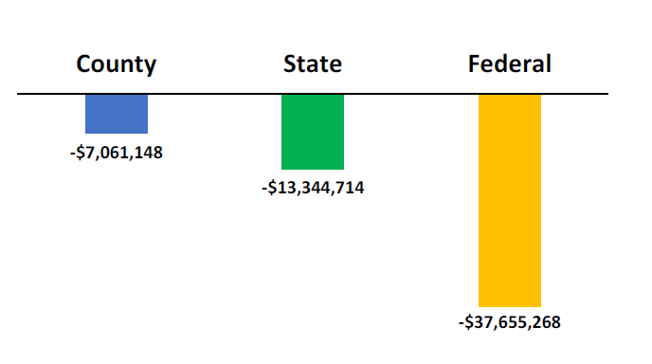
WNC TAX IMPACTS
Total WNC = $58 mil
Mill = $25.5 mil (49% of total)
Haywood (outside Mill) = $18.9 mil (33% of total)

Slide 9
Total WNC Jobs Lost or At-Risk
= 2,522
County | Jobs Lost or At-Risk | Percent of Total
Haywood | 1,883 | 74.7%
Buncombe | 193 | 7.7%
Rutherford | 158 | 6.3%
Jackson | 75 | 3.0%
Henderson | 71 | 2.8%
Cherokee | 25 | 1.0%
Transylvania | 23 | 0.9%
Swain | 17 | 0.7%
Macon | 16 | 0.6%
Polk | 16 | 0.6%
McDowell | 14 | 0.6%
Burke | 10 | 0.4%
Mitchell | 8 | 0.3%
Madison | 3 | 0.1%
Clay | 3 | 0.1%
Yancey | 3 | 0.1%
Graham | 2 | 0.1%
Avery | 0.3 | 0.01%
94.5%

Slide 10
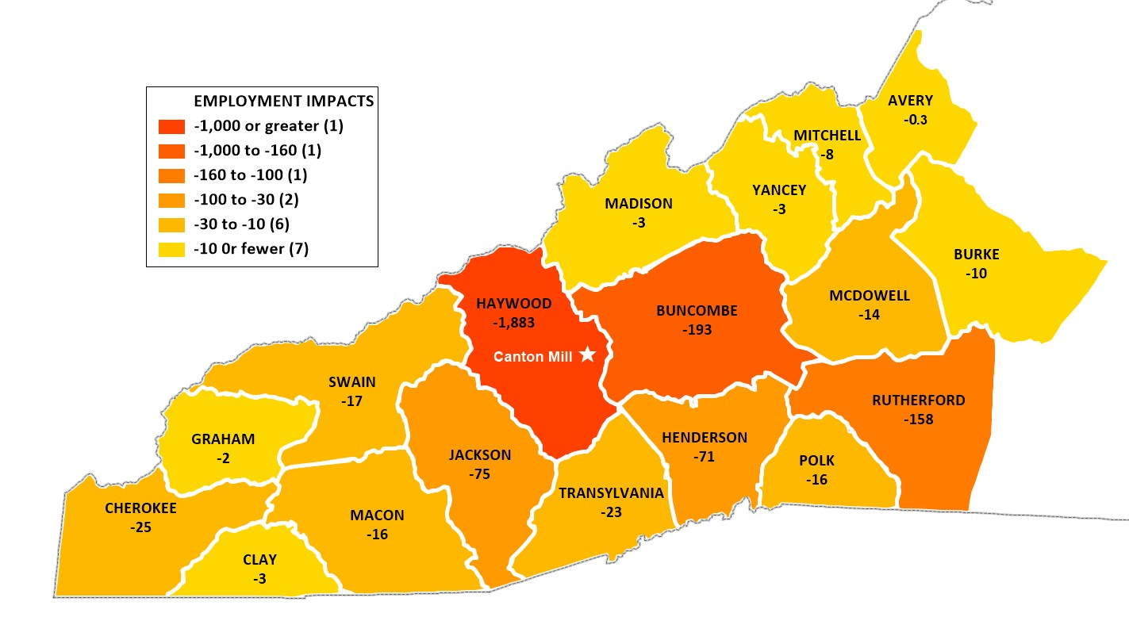
WNC JOBS LOST or AT-RISK

Slide 11
HOW SIGNIFICANT ARE THE IMPACTS?
Jobs
Income
Output
Haywood
All WNC

Slide 12

Ripple Effect: At-Risk Jobs by Industry

Slide 13
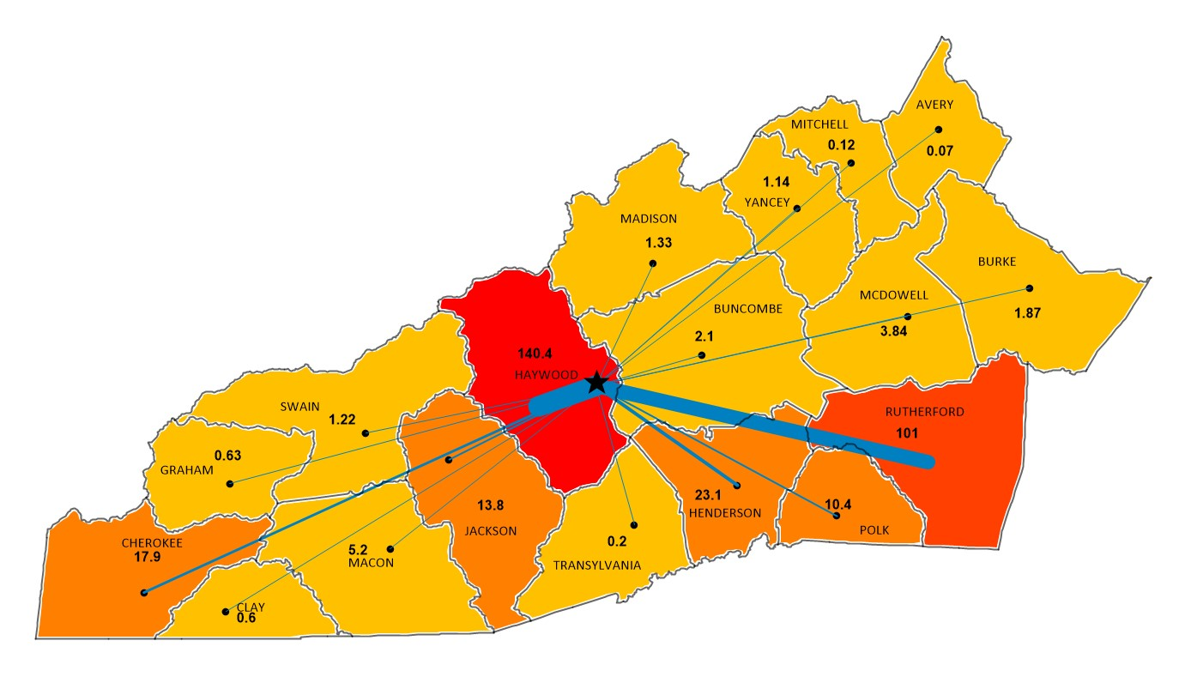
WNC Forestry & Sawmill Jobs At-Risk

