Slide 1
Finding Your Narrative Arc:
How to Sustain Reviewers’
Attention from Start to Finish
November 15, 2023

Slide 2
Learning Objectives
I. Developing familiarity with the federal review process: What does a review process look like?
II. Understanding how to create a competitive proposal: Tips from an experienced federal reviewer
III. Identifying opportunities to distinguish your application: Pivotal “moments” in a proposal

Slide 3
About
Innovative Funding Partners
IFP is a nationally recognized grants consulting firm highly regarded for an impressive overall grant success rate of 84%. Well known for their expertise in federal and other governmental grant writing, this success is based not only on technical expertise, but also on a foundational relationship-building approach. IFP’s team of over 20 highly experienced consultants are passionate about helping organizations meet the unique needs of their local communities and better serve their constituents by seeking and securing grant funding.

Slide 4
About the
p r e s e n t e r s
Susannah Williams, IFP Senior Grants Consultant, is a grant writer with a proven track record of securing federal and foundation grants across multiple sectors, including health care, workforce development, and education. She has extensive experience in supporting clients’ project design and development to meet complex grant requirements. Susannah has written multiple successful proposals for CDC, HRSA, DOE, DOJ, DOL, and USDA.
.
Susannah Williams, M.A.
Senior Grants Consultant
3.

Slide 5
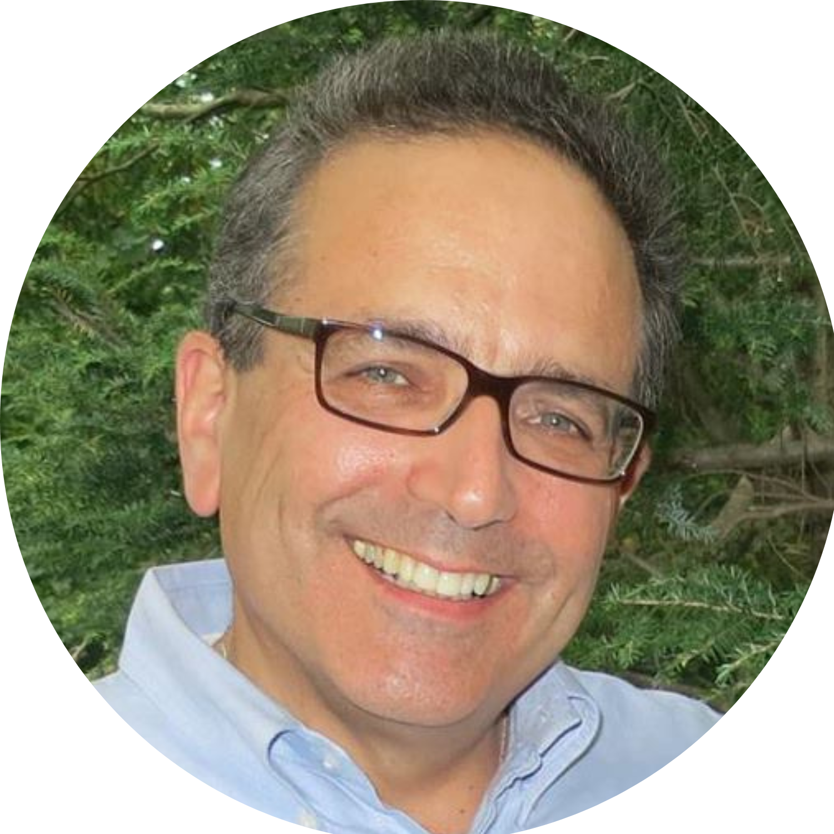
About the
p r e s e n t e r s
Spence Halperin, IFP Grants Consultant, is an experienced Licensed Master Social Worker who has spent over 30 years developing, managing, and fundraising for programs serving people with behavioral health challenges, LGBTQ+ communities, people living with HIV, those who are homeless, frail and elderly adults, and more. As a federal grant reviewer, Spence has developed considerable insight and expertise in helping a diverse portfolio of organizations access substantial government funds, including state and local, to expand the critically important work that they do. Spence has successful experience writing SAMHSA, HRSA, CDC, HHS, HUD, US Department of Veterans Affairs, US Department of Labor, US Small Business Administration, National Endowment for the Arts, and US Department of State grants as well as many New York State and New York City agency grants.
.
3.
Spence Halperin, LMSW
Grants Consultant

Slide 6
I. Developing familiarity with the federal review process: What does a review process look like?

Slide 7
A typical review process with the Substance Abuse and Mental Health Services Administration (SAMHSA)
The Division of Grant Review (DGR) will screen out applications that do not meet the administrative or programmatic requirements of the Notice of Funding Opportunity (NOFO) Announcement. These applications will not go forward to peer review.
First Level Review: Peer reviewers evaluate the grant applications through a fair, equitable, and objective process to provide SAMHSA with a sound basis for making funding decisions. A summary statement of the peer review evaluation will be sent to the business official identified in the application.
Second Level Review: In addition to the first level of peer review, some grant programs (where grants are over $250,000) are subject to review by a National Advisory Council (NAC). The NAC does not review individual applications but votes (usually en bloc) to concur or not concur with the peer review results.

Slide 8
The role of peer reviewers
The Division of Grant Review (DGR) chooses peer reviewers for their knowledge, skills, and expertise related to the particular grant program under review. The DGR also tries to develop peer review groups based on geographic, gender, and ethnic diversity.
Usually, 3 reviewers are assigned to each application.
When there is a great disparity between the scores for the same application, a reconciliation conference is held, and the “outlier” is expected to justify their scores.

Slide 9
Sample SAMHSA Peer Reviewer Expertise Questionnaire

Slide 10
Key features of the peer review
Pre-Review Conference Call: To provide an overview of the review process and give reviewers the opportunity to address with HRSA staff any questions or issues regarding review policies and procedures.
Each reviewer is assigned to read, evaluate, and score up to six applications. Reviewers are also required to read (but not score) all of the other applications assigned to other reviewers. All reviewers must attend a Quarterly Reviewer Training session.
Reviewer honoraria: $350/day (about 3 days) or $140/application (subject to change).
No conflicts of interest: To achieve the goal of a fair and objective review, reviewers must not carry any prejudices, biases or conflicts of interest into the review process. The reviewer is obligated to declare any and all potential or actual conflicts of interest.
All comments made by the Reviewer are treated as confidential information. All reviewer materials are expected to be deleted when the review process is completed.

Slide 11
Do the peer reviewers have the final say on awards?
The results of the peer review are of an advisory nature.
The program office and approving official make the final determination for funding.
The federal agency may make equitable distribution of awards in terms of geography (including urban, rural and remote settings) and balance among populations of focus and program size.

Slide 12
II. Understanding how to create a competitive proposal: Tips from an experienced federal reviewer

Slide 13
1. Ensure your organization meets the eligibility requirements of the NOFO (Notice of Funding Opportunity)
Each NOFO clearly specifies the entities that are eligible to apply.
Carefully review the Eligibility Section of the NOFO to ensure that you meet the requirements. Some NOFOs limit applications to States (or some States) while others are open to any domestic public or private non-profit organization.
Some NOFOs state that entities that received funding under previous grant announcements are not eligible to apply.
Some NOFOs have other requirements which you must meet. For example, the NOFO may state that you must provide a Memorandum of Understanding (MOU) with a required partner and if you do not submit this MOU in your application package, it will be rejected.

Slide 14
2. Ensure your organization has the capability to implement the grant project
What is the purpose and intent of the grant program?
Do you currently serve the population of focus? If not, how will you do so?
Do you have experience implementing the required services and activities, and do you have the data to prove it?
Does your organization have the fiscal infrastructure and experience to meet the financial management requirements and related tasks?

Slide 15
3. Determine the quality of your data
Are you able to provide data specific to your population(s) of focus – numbers served, demographic characteristics, number/type of services delivered?
How does your internal data compare or contrast with local, state, federal, and census data?
Have you been collecting outcome data on your current clients? (Data that measures specific results of a program or intervention.)
What data collection instruments and procedures do you currently use, and what does the NOFO require?
Do you have information on service gaps in your catchment area, i.e., why is this program needed here?
Have you, or another organization, conducted a community needs assessment related to the purpose of the NOFO?

Slide 16
4. Check that you have included all required information
Program/Organizational Information
Certifications/Licensure
Key community partnerships
Referral sources
Consent forms
Cultural competence materials/trainings conducted
Evidence-Based Practices (EBPs)
Description of EBPs being used
Research justifying use of the EBPs with
your population of focus
How staff are trained to implement the EBPs
How fidelity of the EBPs is monitored
Justification of any modifications that have been
made to the EBPs
Staff and Organizational Experience
Job descriptions of staff
Resumes of key management personnel and staff providing services
Experience of your organization managing grants and providing services
Data
Data specific to your population(s) of focus – numbers served, demographic characteristics, number/type of services delivered
Local statistics and census data
Outcome data
Data collection instruments and procedures
Information on service gaps

Slide 17
5. Review the evaluation criteria in the NOFO

Slide 18
Example 1.

Slide 19
Example 2.

Slide 20
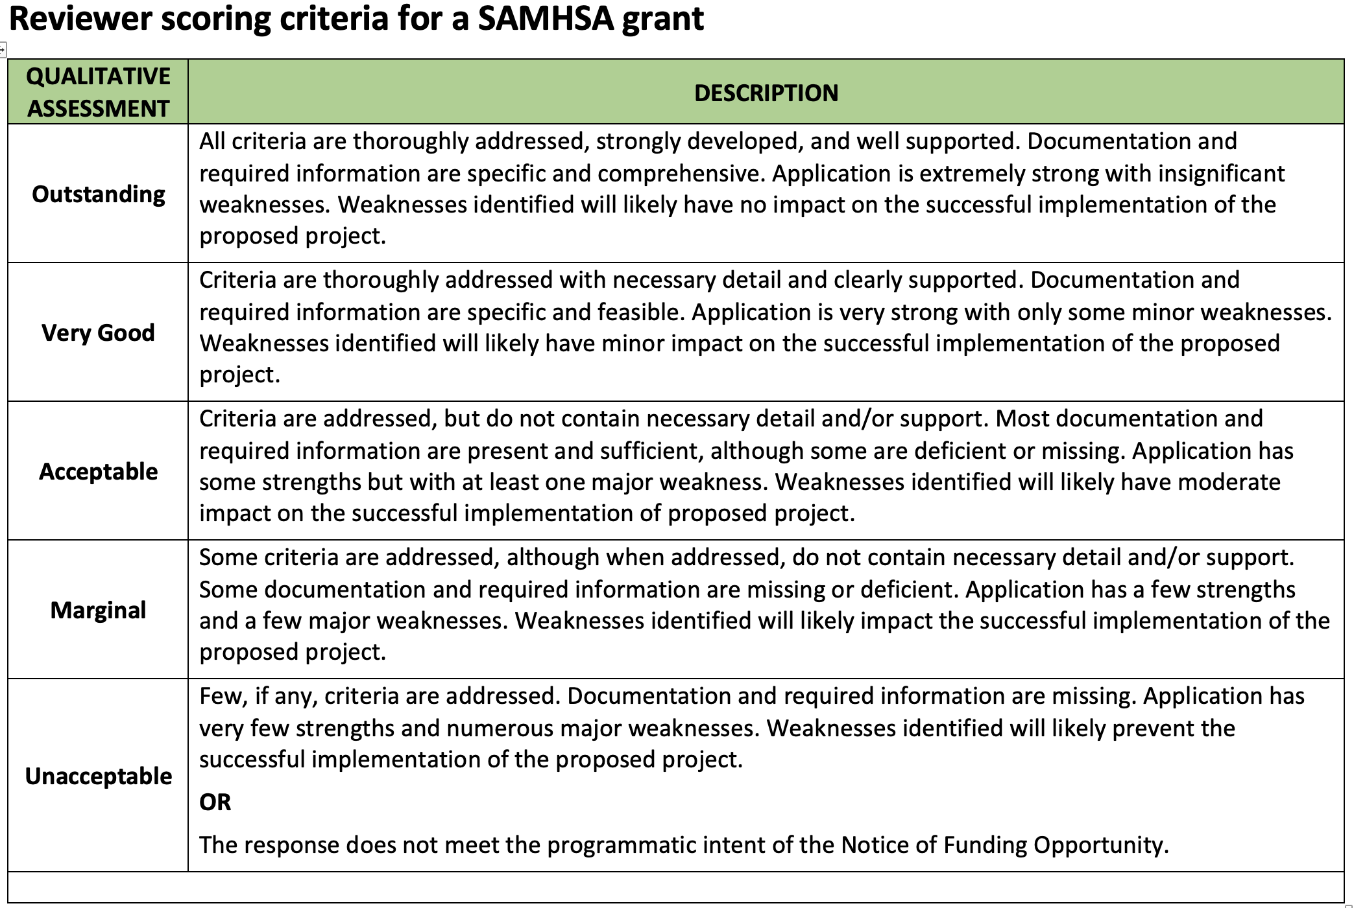

Slide 21
6. Understand how a reviewer reviews
The reviewer will consider only what is written in the application and make no assumptions.
The reviewer will only consider information found in the appropriate section and number heading as specified in the Notice of Funding Opportunity (NOFO) guidelines.
The reviewer will not consider information contained in Appendices that extend or replace any of the sections of the Project Narrative unless explicitly stated within the Project Narrative to do so.
The comments provided by the reviewer must be the strengths and weaknesses of the section.
When formulating strengths and weaknesses, the reviewer must critique not only whether an applicant addressed all of the criteria in a section, but also the quality of response.
The reviewer must clearly articulate in what way items were missing or incomplete from the application or in what way items were done exceptionally well in the application.
Reviewers must clearly understand the main purposes and expectations of the program and critique how each section connects to create a viable program that will accomplish the purpose and intent of the NOFO.

Slide 22
Lastly…
Even if your proposal contains 100% of the information required, you may still not receive an award.
Why?

Slide 23
Why?
Too many applications from your catchment area.
You are new to the funding agency.
Your project is less “exciting” than another with the same score.
You are a fairly new organization with a small budget.
You are a highly experienced organization and they want to bring in “new blood.”
You are a leader in the field, and your proposal has the scent of entitlement.
The other guy had better internal outcome data, and your data collection systems are out of date.
Your website does a poor job of communicating the work that you do.
When they google your organization, some surprising (negative) things pop up.
You did not pat the agency on the back in the narrative.
None of the above.

Slide 24
III. Identifying opportunities to distinguish your application: Pivotal “moments” in a proposal

Slide 25
Pivotal moments are those that allow your proposal to stand out from the competition
They are opportunities, at specific points over the course of a proposal, that connect the dots clearly for the reviewer. They create a story and build a unified argument.
They communicate to the reviewer: “Remember the issue I explained in the Need section? This is why we are the ones to address it, this is why this project will work, and this is why it matters.”
Notes:
Context:
Why are you proposing to do what you are proposing to do? What do the data say about community needs?
For example:
• Nonprofit hospitals are required to conduct a Community Health Needs Assessment (CHNA) once every three years. A CHNA describes a community’s population characteristics, demographics, health needs, health disparities, access to care, and more. References to a CHNA in a proposal for a healthcare program can build the case that your proposed activities are needed and provide a foundation for describing the program objectives and activities that you will use to meet those needs.
• Use credible data sources that are verifiable (Centers for Disease Control, US Census, Bureau of Labor Statistics, Climate and Economic Justice Screening Tool, etc.). If a government RFP provides suggested data sources, use them!
Building on successes:
As an organization our track record is one of your most important assets. You will need to make a solid connection between your accomplishments and your proposed project to show that you are well-positioned to meet your goals.

Slide 26
Pivotal Moments allow you to answer the major “WHY?” questions for the reviewer
WHY is this project able to address the need or problem?
(What is unique about your organization or your approach that makes you the best choice for addressing the need?)
WHY will this approach work?
(What evidence is there that suggests its potential?)
WHY does it matter?
(What is the projected impact?)
Notes:
Leadership:
To what extent do your leaders represent your clients or constituents (demographics, socioeconomics, lived experience). For example, if you are designing a mentorship program for justice-impacted youth, do you have leaders on the Staff or Board who have lived experience with justice system involvement?
It is helpful to have up-to-date resumes and bios of key staff (Directors, Managers) on hand to weave their qualifications into the narrative.
If a position, such as a Project Director, is “to be hired,” have a job description that describes that person’s required minimum qualifications.
Broader community input:
Both foundation and government funders will want to see that your solutions are designed to meet community needs as defined by the community members themselves. Questions to ask yourself: What are the mechanisms for community input? How will it be collected, and how often, and how will it be used (example: quarterly survey, focus groups)? How will community members be involved in the planning, implementation, evaluation, and ongoing quality improvement of your programs?
Partnerships:
Foundation funders want to see collaboration across organizations. LOSs may suffice.
Government funders often want to see or even require collaboration between nonprofits, public entities (ex: Workforce Development System), and industry. More formal: LOCs or MOUs may be needed as opposed to letters of support.
In general, foundation grants are more interested in Board and Staff, while government funders are more interested in structures, systems, and processes (Governance, Advisory Committee and who’s on it, how often they meet etc.

Slide 27
Where in a proposal do these moments usually occur?
WHY is the project able to address the need or problem? | At the end of the NEED section, often with a prompt such as “how will your project address the identified needs?” In the Introduction section or introductory paragraph to the proposal
WHY will this approach work? | Methodology section (even if the NOFO/RFP does not specifically request discussion of evidence-based practices, include it)
WHY does it matter? | Impact/Expected Results section If no specific Impact section, you can include it in Methodology or tie it into your discussion of outcomes
Notes:
Staffing:
Does your staff have the relevant qualifications?
Are there sufficient FTE allotments in the budget?
Do you need to hire anyone?
Scope: on slide
Timeline: on slide
Budget:
Are other funding sources secure? Can you meet the match requirement (if applicable)? Does your budget include adequate FTEs to carry out your scope of work?
Are your goals achievable given the amount of funding available via this opportunity and the larger project budget
No one wants to be the sole source of funding. What are your other sources? match, in-kind, other funders, etc.)?
External Factors:
“Risks and Challenges” question (HRSA). For example, many supply chain and logistics challenges arose during COVID. Challenges to procurement of equipment and materials. They will want to know that you have a plan for mitigating risks and external factors that could delay or threaten the project.

Slide 28
Let’s take a look at two examples…
Notes:
Outputs are your deliverables: Materials created, workshops delivered, policies and procedures created (example: data-sharing agreements across partner agencies).
Outcomes are the measurable changes that will result from your program. Can be at an individual, program, systemic levels.
Long-term Outcomes/Impacts align with your organization’s mission/vision. What are broader changes you hope to see? What
Logic model discussions at the very beginning of a project can help everyone get on the same page and get really clear with what you want to do, and why, and with what intended results.
Evaluation…trend toward incorporating evaluation planning into program design (including with community member participation).
Susannah will talk more about it…

Slide 29
Example 1: HRSA Rural Health Network Development (RHND)
Why is the project able to address the need or problem?
How this project is distinctive and unique
How this project utilizes existing strengths of the applicants and partners
How this project will establish infrastructure that makes long-term advancement and sustainability possible
Notes:
Funding Cycles
Some have a rolling deadline. For example, many foundations you can submit an LOI at any time. That doesn’t mean that an award will be made at any time, however. There may be full proposal deadlines (quarterly, annually) that coincide with Board meetings when funding decisions are made.
Foundation funders who award in multiple years may require a cycle off so you don’t become overly dependent on their funding
Government funding stems from legislation and budgeting cycles.
In both cases, you have some ability to predict. (“Forecasted” on grants.gov, or funding Rounds). Keep a spreadsheet, subscribe to updates. Many can be hard to keep up with, so subscribe to the IFP newsletter. ☺
What comes after your period of performance?
Continue service delivery – how/to what extent?
What sustainable systems changes will be maintained? How? By whom?
Diversify your funding sources:
Could do an entire workshop on each one of these topics.
Grant writing as a part of a well-rounded development program – creates institutional resilience.

Slide 30
Example 1: HRSA Rural Health Network Development (RHND)
Why will this approach work?
Project design reflects an evidence-based model
Documented outcomes of evidence-based model
Project design integrates approaches of an established program in a similarly rural area
Notes:
Funding Cycles
Some have a rolling deadline. For example, many foundations you can submit an LOI at any time. That doesn’t mean that an award will be made at any time, however. There may be full proposal deadlines (quarterly, annually) that coincide with Board meetings when funding decisions are made.
Foundation funders who award in multiple years may require a cycle off so you don’t become overly dependent on their funding
Government funding stems from legislation and budgeting cycles.
In both cases, you have some ability to predict. (“Forecasted” on grants.gov, or funding Rounds). Keep a spreadsheet, subscribe to updates. Many can be hard to keep up with, so subscribe to the IFP newsletter. ☺
What comes after your period of performance?
Continue service delivery – how/to what extent?
What sustainable systems changes will be maintained? How? By whom?
Diversify your funding sources:
Could do an entire workshop on each one of these topics.
Grant writing as a part of a well-rounded development program – creates institutional resilience.

Slide 31
Example 1: HRSA Rural Health Network Development (RHND)
Why does it matter?
The impact of collaboration between multiple partners on capacity building
The impact of collaboration between multiple partners on patient care and the ability to provide wraparound social determinants of health supports
Notes:
Funding Cycles
Some have a rolling deadline. For example, many foundations you can submit an LOI at any time. That doesn’t mean that an award will be made at any time, however. There may be full proposal deadlines (quarterly, annually) that coincide with Board meetings when funding decisions are made.
Foundation funders who award in multiple years may require a cycle off so you don’t become overly dependent on their funding
Government funding stems from legislation and budgeting cycles.
In both cases, you have some ability to predict. (“Forecasted” on grants.gov, or funding Rounds). Keep a spreadsheet, subscribe to updates. Many can be hard to keep up with, so subscribe to the IFP newsletter. ☺
What comes after your period of performance?
Continue service delivery – how/to what extent?
What sustainable systems changes will be maintained? How? By whom?
Diversify your funding sources:
Could do an entire workshop on each one of these topics.
Grant writing as a part of a well-rounded development program – creates institutional resilience.

Slide 32
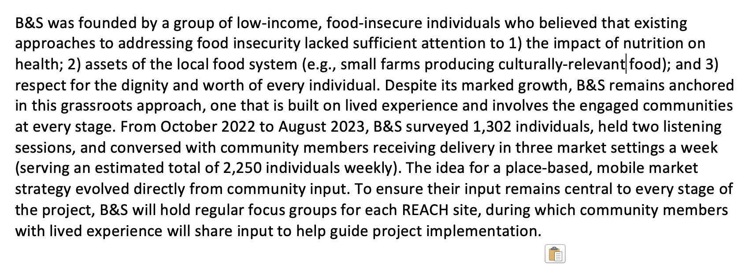
Example 2: USDA Community Food Projects
Why is this project able to address the need or problem?
Describes the unique grassroots history and approach of the applicant
Highlights deep engagement of target population in project design
Notes:
Self-explanatory ;-)

Slide 33
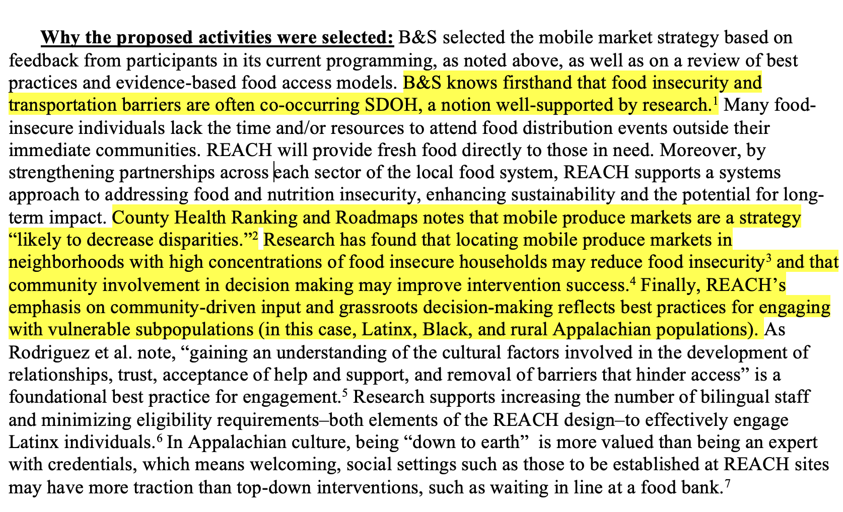
Example 2: USDA Community Food Projects
Why will this approach work?
Anchoring the project design in research
Clear linkages to evidence-based practices
Notes:
Self-explanatory ;-)

Slide 34
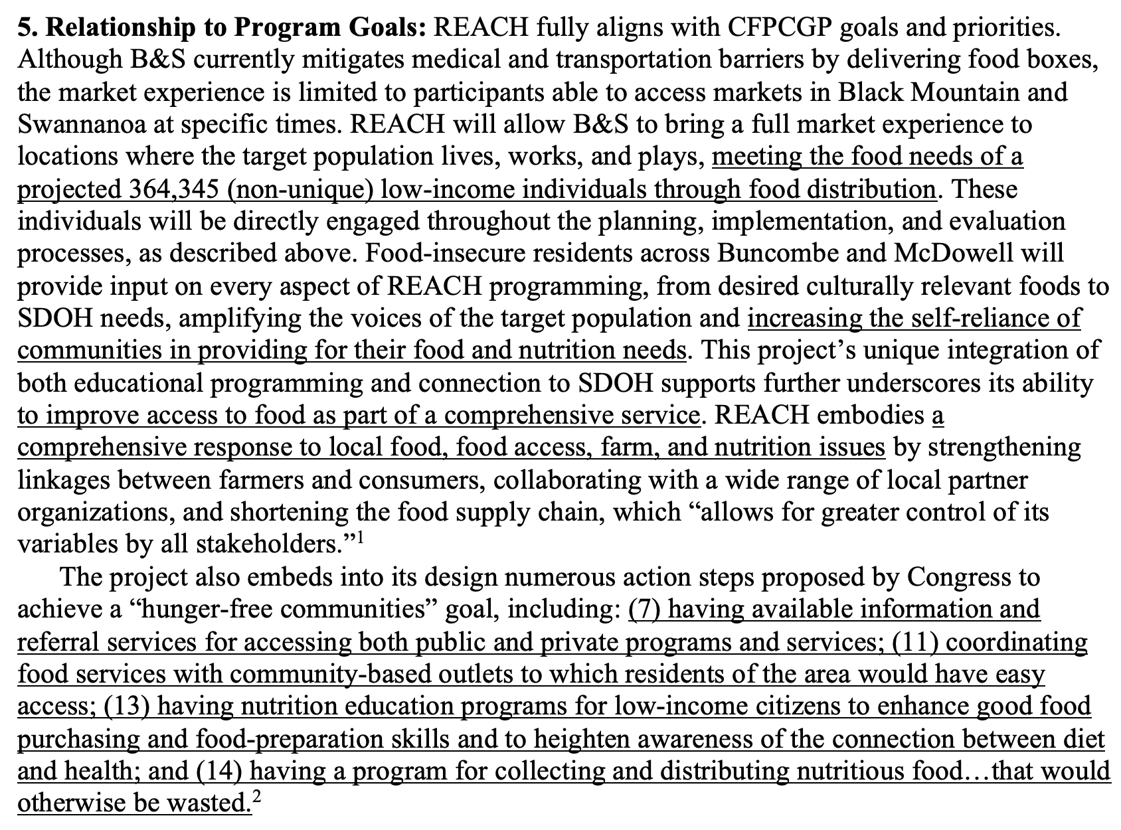
Example 2: USDA Community Food Projects
Why does it matter?
Describes how the project fits into the program’s overarching goals
References both quantitative and qualitative impacts
Situates the project within the ”big picture” by describing its alignment with USDA-related legislation
Notes:
Self-explanatory ;-)

Slide 35
Questions?
IFP Contact Information:
Dr. Brian Kelley, Senior Partner
Brian.kelley@innovativefundingpartners.com
(202) 809-3399

Slide 36
Save the Date
Equity and Grant Development:
When Real Understanding Produces Change
Wednesday, December 13th, 2023
12-1pm

Slide 37
dht.org

