Slide 1
Equity and Grant Development:
When Real Understanding Produces Change
December 13, 2023

Slide 2
Learning Objectives
Understanding the importance of recognizing diversity, equity,
and inclusion (DEI) in a grant proposal
II. Delineating the intersection between social justice and grant
development
III. Developing familiarity with data sources, EBPs, and guidance
to support recognition of equity to create meaningful social
change
IV. Implementing strategies to orient a project within a
national/global context

Slide 3
About
Innovative Funding Partners
IFP is a nationally recognized grants consulting firm highly regarded for an impressive overall grant success rate of 84%. Well known for their expertise in federal and other governmental grant writing, this success is based not only on technical expertise, but also on a foundational relationship-building approach. IFP’s team of over 20 highly experienced consultants are passionate about helping organizations meet the unique needs of their local communities and better serve their constituents by seeking and securing high impact grant funding.

Slide 4
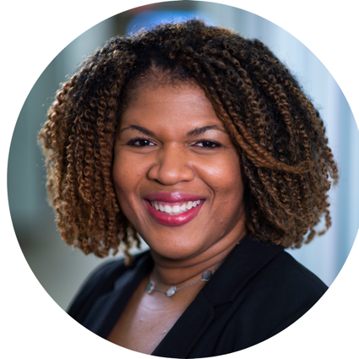
About the
presenters
Sylvette La Touche-Howard, Ph.D., IFP Grants Consultant, is an experienced therapist and public health specialist in the behavioral and community health sector with specializations in mental health, health equity, community engagement and program evaluation. She brings to the IFP team more than 20 years of experience in the academic, for profit and nonprofit arenas. She has served on several curriculum development teams that have had state and national impacts. Her passion lies in proactively working with organizations and communities to bridge behavioral health, research and social impact to create a sustainable and equitable future through policy, systems and environmental change initiatives. Sylvette holds a Ph.D. in Behavioral and Community Health from the University of Maryland, College Park.
.
3.
Sylvette La Touche-Howard, Ph.D.NCC, CHES
Grants Consultant

Slide 5
Understanding the importance of recognizing diversity, equity, and inclusion (DEI) in a grant proposal

Slide 6
Laying the Foundation:
Defining Diversity, Equity and Inclusion in Grant Making
Diversity
The intentional variety within a specific collection of people that takes into account intersectional elements of human difference, identity, and lived experience
Equity
The achievement and maintenance of just outcomes for all people within an organization or within a culture or society.
Inclusion
A process that gives all people especially communities full and meaningful participation in planning and decision making at all levels.
Source: https://www.opensocietyfoundations.org/publications/advancing-diversity-equity-and-inclusion-in-grant-making
Notes:
While recognizing that there is no universal definition of diversity, equity, or inclusion and that terms used vary considerably between contexts, the following understanding provides a framework:
Diversity: The intentional variety within a specific collection of people that takes into account intersectional elements of human difference, identity, and lived experience. We suggest paying particular attention to groups that are often subjected to structural forms of discrimination, exclusion, and oppression across the globe, including but not limited to: the intersections of racial and ethnic groups, LGBTI populations, people with disabilities, women, religious groups, and people of low socio-economic status. A diverse group is not necessarily inclusive or equitable.
Equity: The achievement and maintenance of just outcomes for all people within an organization or within a culture or society. Just outcomes are obtained when people address and dismantle imbalances in power dynamics (caused and upheld by structural systems of oppression and injustice) that are perpetuated in policies, processes, institutions, and the distribution of resources.
Inclusion: A process that gives all people—especially communities that have been systematically excluded or prevented from having a say in the structures of power— full and meaningful participation in planning and decision making at all levels within a group, organization, movement, or society. While a truly inclusive group is necessarily diverse, a diverse group is not necessarily inclusive.

Slide 7
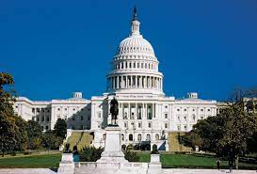
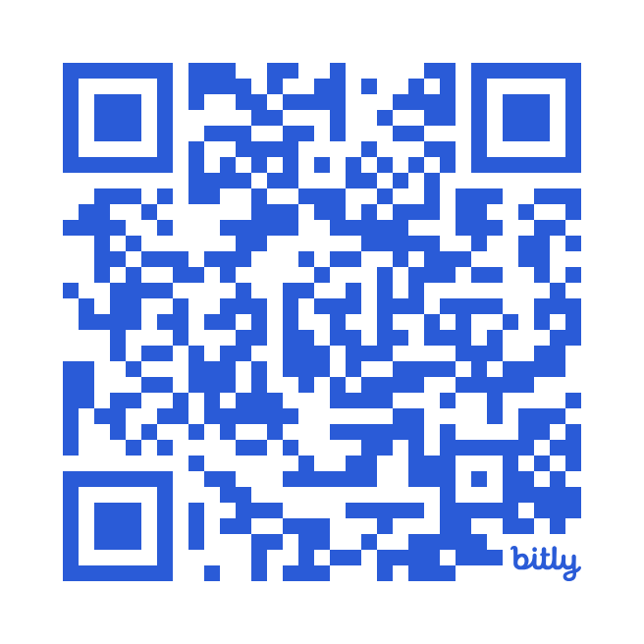
Laying the Foundation: Advancing Equity and Racial Justice Through the Federal Government
“It is therefore the policy of my Administration that the Federal Government should pursue a comprehensive approach to advancing equity for all, including people of color and others who have been historically underserved, marginalized, and adversely affected by persistent poverty and inequality. Affirmatively advancing equity, civil rights, racial justice, and equal opportunity is the responsibility of the whole of our Government.”
EXECUTIVE ORDER 13985
Scan here To Learn More:

Slide 8
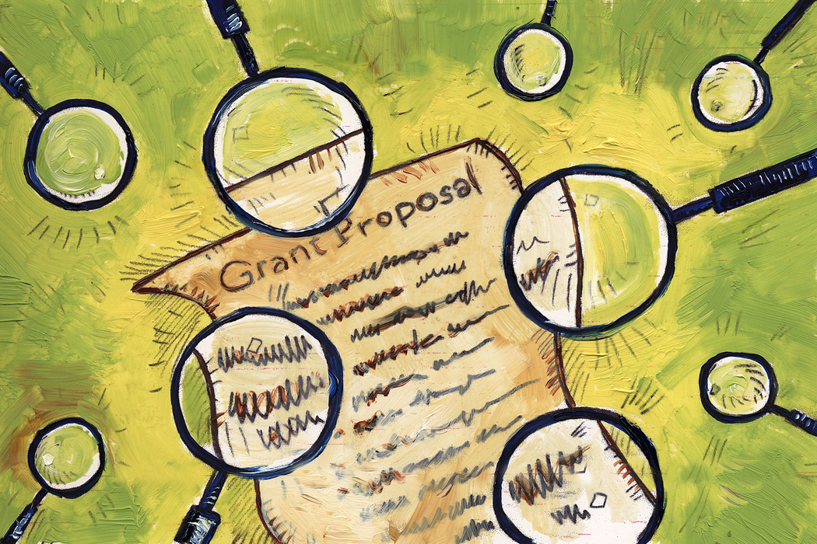
10 Important Reasons for Recognizing DEI in a grant proposal

Slide 9
10 Important Reasons for Recognizing DEI in a grant proposal
1. Alignment with Funder Values | 6. Credibility and Reputation
2. Social Impact | 7. Legal and Ethical Compliance
3. Community Engagement | 8. Long-Term Sustainability
4. Innovation and Creativity | 9. Stakeholder Trust
5. Mitigation of Bias | 10. Reflecting Real-world Complexity
Source: https://www.opensocietyfoundations.org/uploads/4bb34041-c499-49fd-92bf-5c82b8f285dc/advancing-diversity-equity-and-inclusion-in-grant-making-20210706.pdf

Slide 10
10 Important Reasons for Recognizing DEI in a grant proposal
1. Alignment with Funder Values
Many grantors have explicit commitments to diversity, equity, and inclusion. Aligning your proposal with these values increases the likelihood of securing funding.
2. Social Impact
DEI considerations enhance the social impact of projects by ensuring that they benefit all members of the community, irrespective of their background.
Source: https://www.opensocietyfoundations.org/uploads/4bb34041-c499-49fd-92bf-5c82b8f285dc/advancing-diversity-equity-and-inclusion-in-grant-making-20210706.pdf
Notes:
Many grantors have explicit commitments to diversity, equity, and inclusion. Aligning your proposal with these values increases the likelihood of securing funding.
DEI considerations enhance the social impact of projects by ensuring that they benefit all members of the community, irrespective of their background. It helps address disparities and promotes fairness.

Slide 11
10 Important Reasons for Recognizing DEI in a grant proposal
3. Community Engagement
DEI principles emphasize the importance of engaging and involving diverse communities in decision-making processes. Grantors often look for projects that actively involve and empower underrepresented groups.
4. Innovation and Creativity
Diverse perspectives bring innovation and creativity. A project that incorporates a variety of voices and experiences is more likely to generate unique solutions to complex problems.
Source: https://www.opensocietyfoundations.org/uploads/4bb34041-c499-49fd-92bf-5c82b8f285dc/advancing-diversity-equity-and-inclusion-in-grant-making-20210706.pdf
Notes:
3. DEI principles emphasize the importance of engaging and involving diverse communities in decision-making processes. Grantors often look for projects that actively involve and empower underrepresented groups.
4. Diverse perspectives bring innovation and creativity. A project that incorporates a variety of voices and experiences is more likely to generate unique solutions to complex problems.

Slide 12
10 Important Reasons for Recognizing DEI in a grant proposal
5. Mitigation of Bias
This ensures that the benefits of the project are distributed equitably and that unintended negative consequences are minimized.
6. Credibility and Reputation
Grantors are increasingly aware of the importance of DEI in creating positive social change. Including DEI elements in your proposal enhances your credibility and contributes to a positive reputation for your organization.
Source: https://www.opensocietyfoundations.org/uploads/4bb34041-c499-49fd-92bf-5c82b8f285dc/advancing-diversity-equity-and-inclusion-in-grant-making-20210706.pdf
Notes:
5. DEI considerations help to identify and mitigate bias in project design and implementation. This ensures that the benefits of the project are distributed equitably and that unintended negative consequences are minimized.
6. Grantors are increasingly aware of the importance of DEI in creating positive social change. Including DEI elements in your proposal enhances your credibility and contributes to a positive reputation for your organization.

Slide 13
10 Important Reasons for Recognizing DEI in a grant proposal
7. Legal and Ethical Compliance
Many funding organizations require grantees to adhere to legal and ethical standards related to diversity, equity, and inclusion. Incorporating these principles into your proposal demonstrates your commitment to compliance.
8. Long-Term Sustainability
DEI is not just a checkbox for grant applications. It's a fundamental aspect of building sustainable projects.
Source: https://www.opensocietyfoundations.org/uploads/4bb34041-c499-49fd-92bf-5c82b8f285dc/advancing-diversity-equity-and-inclusion-in-grant-making-20210706.pdf
Notes:
7.Many funding organizations require grantees to adhere to legal and ethical standards related to diversity, equity, and inclusion. Incorporating these principles into your proposal demonstrates your commitment to compliance.
8. DEI is not just a checkbox for grant applications. It's a fundamental aspect of building sustainable projects. A commitment to diversity and equity ensures that the benefits of your project are enduring and contribute to long-term positive change.

Slide 14
10 Important Reasons for Recognizing DEI in a grant proposal
9. Stakeholder Trust
DEI principles show that your organization is sensitive to the needs of diverse stakeholders, fostering trust and collaboration.
10. Reflecting Real-world Complexity
Acknowledging and addressing DEI in your proposal demonstrates an understanding of the complex social issues your project aims to address
Source: https://www.opensocietyfoundations.org/uploads/4bb34041-c499-49fd-92bf-5c82b8f285dc/advancing-diversity-equity-and-inclusion-in-grant-making-20210706.pdf
Notes:
9. DEI principles show that your organization is sensitive to the needs of diverse stakeholders, fostering trust and collaboration.
10. Acknowledging and addressing DEI in your proposal demonstrates an understanding of the complex social issues your project aims to address. It reflects a commitment to navigating the multifaceted nature of challenges.

Slide 15
In Summary
Recognizing DEI in a grant proposal
It helps to align with the values of funders
Not just a requirement
It’s a Strategic Decision
It enhances quality, impact and sustainability
It contributes to positive social change
Notes:
In summary, recognizing diversity, equity, and inclusion in a grant proposal is not just a requirement; it's a strategic decision that enhances the quality, impact, and sustainability of your project while aligning with the values of funders and contributing to positive social change.

Slide 16
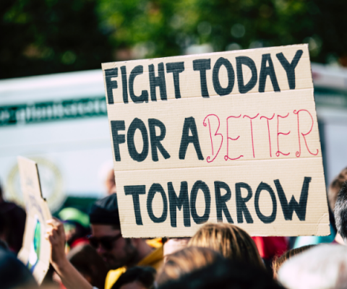
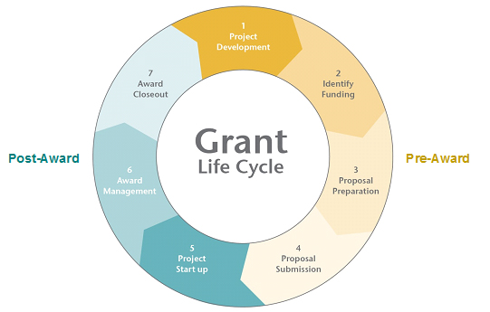
II. Delineating the intersection between social justice and grant development

Slide 17
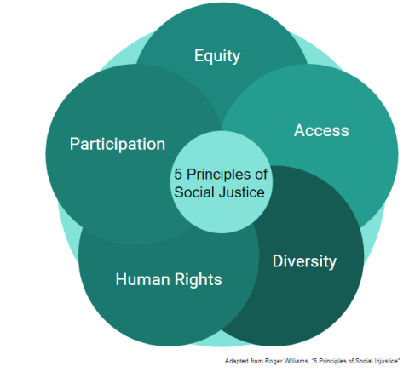
5 Principles of Social Justice
Notes:
Five Principles of Social Justice
There are five main principles of social justice that are paramount to understanding the concept better. Namely, these are access to resources, equity, participation, diversity, and human rights.
1. Access to Resources
Access to resources is an important principle of social justice and refers to the extent to which different socioeconomic groups receive equal access to give everyone an equal start in life. Many societies offer a multitude of resources and services for their citizens, such as healthcare, food, shelter, education, and recreational opportunities. However, unequal access to such services often exists.
For example, individuals from wealthy households among the upper and upper-middle classes are often better able to afford to attend good schools and access post-secondary education, which leads to a greater chance of obtaining jobs with higher income in the future. In contrast, those from the lower classes face fewer opportunities. It, in turn, limits access to education for future generations and continues the cycle of facing disadvantages.
2. Equity
Equity refers to how individuals are given tools specific to their needs and socioeconomic status in order to move towards similar outcomes. It contrasts with equality, where everyone is offered the same tools to move towards the same outcome.
As such, often, things that are equal are not equitable due to the more advanced needs of some individuals and groups. Social justice, integrated with addressing equity issues, might include advancing policies that provide support to overcome systemic barriers.
3. Participation
Participation refers to how everyone in society is given a voice and opportunity to verbalize their opinions and concerns and have a role in any decision-making that affects their livelihood and standard of living. Social injustice occurs when a small group of individuals makes decisions for a large group, while some people are unable to voice their opinions.
4. Diversity
Understanding diversity and appreciating the value of cultural differences are especially important because policymakers are often better able to construct policies that take into consideration differences that exist among different societal groups. It is important to recognize that some groups face more barriers in society, and by considering the inequities, policymakers and civil servants will be in a stronger position to expand opportunities for marginalized or disadvantaged groups.
Discrimination in employment on the basis of factors such as race, gender, ethnicity, sex, age, and other characteristics are constant issues in society, and enforcing policies to countermand discriminatory practices are one way in which diversity is taken into consideration.
5. Human Rights
Human rights are one of the most important principles of social justice and form a foundational part of the concept. Human rights and social justice are certainly interrelated, and it is impossible for one to exist without the other.
Human rights are fundamental to societies that respect the civil, economic, political, cultural, and legal rights of individuals and governments, organizations, and individuals must be held responsible if they fail to ensure the upholding of these rights. They are extremely important in many societies and are recognized internationally through institutions such as the International Criminal Court and the United Nations Human Rights Council.

Slide 18
Thought to Ponder…
“Advancing equity is not a one-year project – it is a generational commitment that will require sustained leadership and partnership with all communities.” (Whitehouse.gov)

Slide 19
Relationship between Social Justice and Grant Development
Social Justice
Creating a fair and equitable society
Grant Development
Process of seeking, obtaining and managing funding to support various projects
Notes:
The relationship between social justice and grant development is significant, as grant development often plays a crucial role in advancing social justice initiatives. Social justice is the concept of creating a fair and equitable society where all individuals, regardless of their background, have equal access to resources, opportunities, and rights. Grant development, on the other hand, involves the process of seeking, obtaining, and managing funding to support various projects and initiatives.

Slide 20
6 Key Aspects to the Relationship between Social Justice and Grant Development
Community Empowerment
Advocacy and Awareness
Policy Change
Collaborative Partnerships
Measuring Impact
Addressing Structural Inequities

Slide 21
6 Key Aspects to the Relationship between Social Justice and Grant Development
1. Community Engagement
2. Addressing Structural Inequities
Grant development can be a tool to fund projects and programs that specifically target and rectify these inequities
Grants can empower marginalized communities by providing resources for initiatives that address systemic issues and promote social justice.
Notes:
Community Engagement:
Social justice is often about empowering marginalized or disenfranchised communities. Grant development can provide the financial resources needed to empower communities by supporting initiatives that enhance education, healthcare, economic development, and social services. This empowerment helps to build the capacity of communities to advocate for their rights and address social injustices.
Addressing Structural Inequities
Social justice often involves addressing systemic inequities and disparities in access to resources and opportunities. Grant development can be a tool to fund projects and programs that specifically target and rectify these inequities. For example, grants might be sought to support education programs in underserved communities, healthcare initiatives for marginalized populations, or employment opportunities for disadvantaged groups.

Slide 22
6 Key Aspects to the Relationship between Social Justice and Grant Development
3. Advocacy and Awareness
4. Policy Change
Funding from grants may enable organizations to influence policymakers, conduct research on social justice issues, and develop evidence-based arguments for policy reform.
Grants can be instrumental in funding campaigns, events, and projects aimed at raising awareness about specific social justice issues
Notes:
Advocacy and Awareness: Many social justice issues require advocacy and awareness-building efforts. Grants can be instrumental in funding campaigns, events, and projects aimed at raising awareness about specific social justice issues. For instance, grants may support initiatives related to civil rights, environmental justice, gender equality, or racial equity.
Policy Change: Social justice often involves advocating for policy changes that promote fairness and equality. Grants can support organizations and projects engaged in research, advocacy, and policy development. Funding from grants may enable organizations to influence policymakers, conduct research on social justice issues, and develop evidence-based arguments for policy reform.

Slide 23
6 Key Aspects to the Relationship between Social Justice and Grant Development
5. Collaborative Partnerships
6. Measuring Impact
Both processes require rigorous evaluation and impact assessment to ensure that the intended outcomes are achieved
Collaborative efforts can enhance the impact of social justice initiatives and increase the likelihood of grant success.
Notes:
Collaboration and Partnerships: Both social justice initiatives and grant development often benefit from collaboration and partnerships. Organizations working towards social justice goals may seek grants to facilitate partnerships with other organizations, government agencies, or community groups. Collaborative efforts can enhance the impact of social justice initiatives and increase the likelihood of grant success.
Evaluation and Impact Assessment: Grant development involves planning and implementing projects, and social justice initiatives are no exception. Both processes require rigorous evaluation and impact assessment to ensure that the intended outcomes are achieved. Grants often come with reporting requirements, and demonstrating the impact of funded projects is crucial for sustaining support and promoting accountability.

Slide 24
In Summary
Social Justice
Grant Development
Symbiotic Relationship
Notes:
In summary, the relationship between social justice and grant development is symbiotic. Grants provide the financial means to implement social justice initiatives, while social justice goals often align with the mission and priorities of grant-making organizations. Together, they can contribute to positive social change and the pursuit of a more just and equitable society.
.

Slide 25
III. Developing familiarity with data sources, EBPs, and guidance to support recognition of equity to create meaningful social change
Notes:
Developing familiarity with data sources, evidence-based practices (EBPs), and guidance for recognizing equity is crucial for creating meaningful social change. The integration of these elements helps inform decision-making, shape policies, and guide interventions that promote fairness and justice. Being able to understand the similarities and differences can help to leverage the strengths of each of them.

Slide 26
Recommended Data Sources
Government Agencies
Often provide demographic, economic, and social data that can highlight disparities
Nonprofit Organizations
Conduct research and collect data on social issues
Academic Research
Scholarly articles and research papers can provide in-depth insights into specific equity-related topics
Community Data
Community-based participatory research ensures that data collection aligns with community needs and perspectives
(i.e. Census Bureau)
(i.e. World Bank, Urban Institute, Pew Research Center)
Source: https://researchguides.ben.edu/c.php?g=282050&p=7037027
Notes:
Equity Frameworks: Familiarize yourself with equity frameworks such as the Health Equity Framework or the Social Determinants of Health model. These frameworks guide the identification and addressing of root causes of disparities.
b. Guiding Principles: Develop or adopt guiding principles that prioritize equity. This could include principles like inclusivity, cultural competency, and a commitment to dismantling systemic barriers.
c. Intersectionality: Understand and apply the concept of intersectionality, recognizing that individuals may experience multiple forms of discrimination or advantage simultaneously.

Slide 27
Recommended Sources of Evidence Based Practices (EBP’s)
Literature Reviews
Look for Meta Analyses, systematic reviews, and evaluations of interventions.
Government Clearinghouses
Secure online database that contains compiled evidence on effective practices (i.e. SAMHSA)
Professional Organizations
Guidelines and Recommendations from professional organizations are a key source for EBP’s.
Source: https://researchguides.ben.edu/c.php?g=282050&p=7037027
Notes:
Literature Reviews: Conduct thorough literature reviews to identify EBPs in the field of interest. Look for meta-analyses, systematic reviews, and evaluations of interventions.
b. Government Clearinghouses: Agencies like the Substance Abuse and Mental Health Services Administration (SAMHSA) and the What Works Clearinghouse compile evidence on effective practices.
c. Professional Organizations: Explore guidelines and recommendations from professional associations related to your field. They often provide evidence-based standards and practices.

Slide 28
Guidance for Recognizing Equity to Create Meaningful Social Change
Equity Frameworks
Familiarize yourself with equity frameworks (i.e. H.Eq. Framework or the SDOH model)
Guiding Principles
Develop or adopt guiding principles that prioritize equity
Intersectionality
Understand and apply the concept of intersectionality as the lens to examine your work
Sources: https://www.un.org/esa/socdev/egms/docs/2009/Ghana/inclusive-society.pdf; https://www.whitehouse.gov/equity/; https://greenlining.org/wp-content/uploads/2019/08/Making-Equity-Real-in-Climate-Adaption-and-Community-Resilience-Policies-and-Programs-A-Guidebook-1.pdf
Notes:
3. Guidance for Recognizing Equity:
a. Equity Frameworks: Familiarize yourself with equity frameworks such as the Health Equity Framework or the Social Determinants of Health model. These frameworks guide the identification and addressing of root causes of disparities.
b. Guiding Principles: Develop or adopt guiding principles that prioritize equity. This could include principles like inclusivity, cultural competency, and a commitment to dismantling systemic barriers.
c. Intersectionality: Understand and apply the concept of intersectionality, recognizing that individuals may experience multiple forms of discrimination or advantage simultaneously.
d.

Slide 29
Guidance for Recognizing Equity to Create Meaningful Social Change
Cultural Competence
Community Engagement
Consider the unique needs, values and perspectives of diverse communities when developing and implementing interventions
Involve the communities affected by inequities in the decision-making process
Continuous Evaluation
Regularly evaluate the impact of interventions on equity indicators and adjust accordingly.
Sources: https://www.un.org/esa/socdev/egms/docs/2009/Ghana/inclusive-society.pdf; https://www.whitehouse.gov/equity/; https://greenlining.org/wp-content/uploads/2019/08/Making-Equity-Real-in-Climate-Adaption-and-Community-Resilience-Policies-and-Programs-A-Guidebook-1.pdf
Notes:
Cultural Competence: Ensure that your approach is culturally competent. Consider the unique needs, values, and perspectives of diverse communities when designing and implementing interventions.
e. Community Engagement: Involve the communities affected by inequities in the decision-making process. Collaborate with them to co-create solutions that are culturally relevant and contextually appropriate.
f. Continuous Evaluation: Regularly evaluate the impact of interventions on equity indicators. Adjust strategies based on ongoing assessment to ensure that interventions are effective and responsive to changing needs.

Slide 30
IN SUMMARY
By integrating data, evidence-based practices, and equity-focused guidance, you can develop a comprehensive understanding of the issues at hand and implement strategies that drive meaningful social change.
This holistic approach contributes to more effective, sustainable, and equitable interventions

Slide 31
IV. Implementing strategies to orient a project within a national/global context

Slide 32
9 strategies to orient a project within a national/global context
1. Conduct Comprehensive Research | 5. Scalability and Replicability
2. Stakeholder Analysis | 6. Local Capacity Building
3. Cultural Sensitivity and Adaptation | 7. Data Collection and Monitoring
4. Partnership Development | 8. Sustainability Planning
9. Periodic Evaluation and Adaptation
Source: https://wedocs.unep.org/handle/20.500.11822/26533;jsessionid=DD876EBB39B71328FF3580A52C93ACB3

Slide 33
9 strategies to orient a project within a national/global context
1. Conduct Comprehensive Research
2. Stakeholder Analysis
Identify and analyze key stakeholders at both the national and global levels.
Understand the social, economic, political, and cultural factors that may impact the success of your project.
Source: https://wedocs.unep.org/handle/20.500.11822/26533;jsessionid=DD876EBB39B71328FF3580A52C93ACB3
Notes:
Conduct Comprehensive Research:
Begin by conducting thorough research on the national and global context relevant to your project. Understand the social, economic, political, and cultural factors that may impact the success of your project.
Stakeholder Analysis:
Identify and analyze key stakeholders at both the national and global levels. This includes government agencies, non-profit organizations, businesses, and local communities. Understand their interests, needs, and potential contributions to your project.

Slide 34
9 strategies to orient a project within a national/global context
3. Cultural Sensitivity and Adaptation
4. Partnership Development
Form strategic partnerships with organizations and entities that have a strong presence in the national or global context.
Consider cultural nuances and adapt your project to fit within the cultural context.
Source: https://wedocs.unep.org/handle/20.500.11822/26533;jsessionid=DD876EBB39B71328FF3580A52C93ACB3
Notes:
Cultural Sensitivity and Adaptation:
Consider cultural nuances and adapt your project to fit within the cultural context. This includes language considerations, cultural norms, and customs. Adapting your approach can enhance local acceptance and effectiveness.
Partnership Development:
Form strategic partnerships with organizations and entities that have a strong presence in the national or global context. Collaborate with local NGOs, government bodies, and international organizations to leverage resources and expertise.

Slide 35
9 strategies to orient a project within a national/global context
5. Scalability and Replicability
6. Local Capacity Building
Invest in building local capacity by providing training and skill development opportunities
Consider how the project can be expanded to reach a larger audience or adapted to different cultural contexts.
Source: https://wedocs.unep.org/handle/20.500.11822/26533;jsessionid=DD876EBB39B71328FF3580A52C93ACB3
Notes:
Scalability and Replicability:
Design your project with scalability and replicability in mind. Consider how the project can be expanded to reach a larger audience or adapted to different cultural contexts. This increases the project's potential for long-term impact.
Local Capacity Building:
Invest in building local capacity by providing training and skill development opportunities. This empowers local communities to take ownership of the project and ensures sustainability beyond the project duration.

Slide 36
9 strategies to orient a project within a national/global context
7. Data Collection and Monitoring
8. Sustainability Planning
Develop a sustainability plan that considers the long-term impact of your project within the national or global context.
Use data to demonstrate the effectiveness of your project on both national and global levels, providing evidence for scalability and replicability.
9. Periodic Evaluation and Adaptation
Regularly evaluate the project's performance and adapt strategies based on feedback and changing circumstances.
Source: https://wedocs.unep.org/handle/20.500.11822/26533;jsessionid=DD876EBB39B71328FF3580A52C93ACB3
Notes:
Data Collection and Monitoring:
Implement robust data collection and monitoring systems to track the project's progress and impact. Use data to demonstrate the effectiveness of your project on both national and global levels, providing evidence for scalability and replicability.
Sustainability Planning:
Develop a sustainability plan that considers the long-term impact of your project within the national or global context. This may involve transitioning project ownership to local stakeholders or integrating the project into existing systems.
.

Slide 37
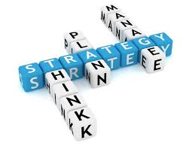
In Summary…
Orienting a project within a national or global context involves strategic planning and implementation to ensure that the project aligns with broader social, economic, and cultural dynamics.
Notes:
A statement of need communicates key information to donors about your organization and its work. After reading your statement of need, donors should come away feeling certain that their contributions will be supporting critical yet unmet public or community needs. Reading between the lines, donors should also be confident that your organization fully understands these needs and is prepared to meet them.
Data can come in many forms. For example:
Census or other government data
Community meetings
Stakeholder interviews
Surveys
Original analyses of existing datasets
Reports your organization or others have published
Polling
Case studies
Policy details and analysis
Requests for services your organization receives

Slide 38
Questions?
IFP Contact Information:
Dr. Sylvette A. La Touche-Howard
slhoward@innovativefundingpartners.com

Slide 39
Save the Date
Next Webinar:
January 17th, 2024
12-1pm EST
Grant Development for
Health and Wellness:
An Overview

Slide 40
dht.org

