Slide 1
The Similarities and Differences Between Foundation and Government Grant Proposals:
A Deep Dive
October 25, 2023

Slide 2
Learning Objectives
I. Understanding what competitive foundation and government grants have in common
II. Developing familiarity with what foundation reviewers vs. government reviewers are looking for
III. How to transition from foundation to federal grants and vice versa
IV. Delineating stylistic and content differences between foundation and government proposals
V. Understanding the basics of assessing your organization’s readiness for foundation vs. government grants

Slide 3
About
Innovative Funding Partners
IFP is a nationally recognized grants consulting firm highly regarded for an impressive overall grant success rate of 84%. Well known for their expertise in federal and other governmental grant writing, this success is based not only on technical expertise, but also on a foundational relationship-building approach. IFP’s team of over 20 highly experienced consultants are passionate about helping organizations meet the unique needs of their local communities and better serve their constituents by seeking and securing grant funding.

Slide 4
About the
p r e s e n t e r s
Susannah Williams, IFP Senior Grants Consultant, is a grant writer with a proven track record of securing federal and foundation grants across multiple sectors, including health care, workforce development, and education. She has extensive experience in supporting clients’ project design and development to meet complex grant requirements. Susannah has written multiple successful proposals for CDC, HRSA, DOE, DOJ, DOL, and USDA.
.
Susannah Williams, M.A.
Senior Grants Consultant
3.

Slide 5
About the
p r e s e n t e r s
Kimberly Scheer, IFP Grants Consultant, has written successful foundation and government grants for social services, K-14 education, healthcare, and workforce development programs since 2003. Her experience spans numerous foundations, DOL, HUD, OJP, H&HS Office of Minority Health, the California Department of Education, and various State and County agencies throughout California. Kimberly holds Bachelor of Arts degrees in English and Communication Studies from the University of California, Los Angeles, and a Certificate in Fund Raising Management from the Lilly Family School of Philanthropy at IUPUI.
.
3.
Kimberly Scheer
Grants Consultant

Slide 6
I. Understanding what competitive foundation and government grants have in common

Slide 7
Demonstrated Need (& how you will meet it)
Both foundation and government funders will want to see that you have thoughtfully created your program or project to fill a demonstrated need in your community.
Considerations:
Context – the why
What do the data say about community needs?
Building on successes – the why you and why now
How has your organization’s past work laid the groundwork for the success of this project? What successes and lessons learned are driving your program design?
Why is your organization or consortium the best one to address these needs?
Notes:
Context:
Why are you proposing to do what you are proposing to do? What do the data say about community needs?
For example:
• Nonprofit hospitals are required to conduct a Community Health Needs Assessment (CHNA) once every three years. A CHNA describes a community’s population characteristics, demographics, health needs, health disparities, access to care, and more. References to a CHNA in a proposal for a healthcare program can build the case that your proposed activities are needed and provide a foundation for describing the program objectives and activities that you will use to meet those needs.
• Use credible data sources that are verifiable (Centers for Disease Control, US Census, Bureau of Labor Statistics, Climate and Economic Justice Screening Tool, etc.). If a government RFP provides suggested data sources, use them!
Building on successes:
As an organization our track record is one of your most important assets. You will need to make a solid connection between your accomplishments and your proposed project to show that you are well-positioned to meet your goals.

Slide 8
Community Engagement – the Who
Who is involved in leadership, goal setting, implementation, and evaluation/refinement?
Leadership
Board of Directors, Key Staff
Representative leadership is important
Broader community input
Input and feedback mechanisms
Involvement in planning, implementation, evaluation, ongoing QI
Partnerships
Required vs. optional
In General, Foundation Funders are more interested in your Board/Staff.
Government funders are more interested in how community engagement is embedded in your structures, systems, and processes
Notes:
Leadership:
To what extent do your leaders represent your clients or constituents (demographics, socioeconomics, lived experience). For example, if you are designing a mentorship program for justice-impacted youth, do you have leaders on the Staff or Board who have lived experience with justice system involvement?
It is helpful to have up-to-date resumes and bios of key staff (Directors, Managers) on hand to weave their qualifications into the narrative.
If a position, such as a Project Director, is “to be hired,” have a job description that describes that person’s required minimum qualifications.
Broader community input:
Both foundation and government funders will want to see that your solutions are designed to meet community needs as defined by the community members themselves. Questions to ask yourself: What are the mechanisms for community input? How will it be collected, and how often, and how will it be used (example: quarterly survey, focus groups)? How will community members be involved in the planning, implementation, evaluation, and ongoing quality improvement of your programs?
Partnerships:
Foundation funders want to see collaboration across organizations. LOSs may suffice.
Government funders often want to see or even require collaboration between nonprofits, public entities (ex: Workforce Development System), and industry. More formal: LOCs or MOUs may be needed as opposed to letters of support.
In general, foundation grants are more interested in Board and Staff, while government funders are more interested in structures, systems, and processes (Governance, Advisory Committee and who’s on it, how often they meet etc.

Slide 9
Capacity to Implement the Project
= the who, what, when, and how much
Are your project goals achievable given:
Staffing plan: What positions (operations, data tracking and analysis, financial oversight) are required?
Scope of work: Are your objectives reasonable given the staffing, level of partner engagement, technology and equipment, etc.?
Timeline: Does your project have a logical series of milestones? Are you proposing measurable gains that are achievable within the period of performance?
Budget: Are your costs well-justified in the budget narrative? Have you allocated sufficient staff time to implement?
External Factors: PEST
Notes:
Staffing:
Does your staff have the relevant qualifications?
Are there sufficient FTE allotments in the budget?
Do you need to hire anyone?
Scope: on slide
Timeline: on slide
Budget:
Are other funding sources secure? Can you meet the match requirement (if applicable)? Does your budget include adequate FTEs to carry out your scope of work?
Are your goals achievable given the amount of funding available via this opportunity and the larger project budget
No one wants to be the sole source of funding. What are your other sources? match, in-kind, other funders, etc.)?
External Factors:
“Risks and Challenges” question (HRSA). For example, many supply chain and logistics challenges arose during COVID. Challenges to procurement of equipment and materials. They will want to know that you have a plan for mitigating risks and external factors that could delay or threaten the project.

Slide 10
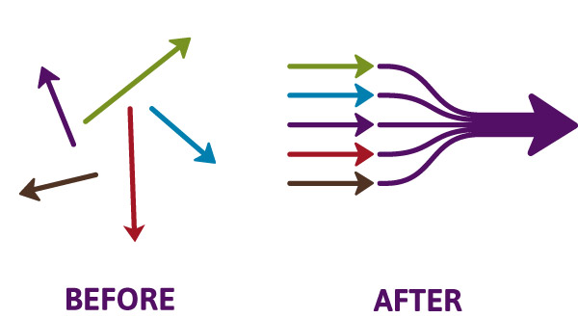
Impact
How will you know your project has been effective?
What impact will your project have on the problem/need?
Outputs vs. outcomes
Long-term impacts
Logic model development as a planning tool
Evaluation planning as a part of program design
Notes:
Outputs are your deliverables: Materials created, workshops delivered, policies and procedures created (example: data-sharing agreements across partner agencies).
Outcomes are the measurable changes that will result from your program. Can be at an individual, program, systemic levels.
Long-term Outcomes/Impacts align with your organization’s mission/vision. What are broader changes you hope to see? What
Logic model discussions at the very beginning of a project can help everyone get on the same page and get really clear with what you want to do, and why, and with what intended results.
Evaluation…trend toward incorporating evaluation planning into program design (including with community member participation).
Susannah will talk more about it…

Slide 11
Sustainability
What is your roadmap?
Understanding funding cycles:
Deadlines and award cycles
Foundations – relative to Board meeting schedule
Government – relative to legislation and Federal budgeting
After your project period of performance: How will you sustain the program?
Diversify your funding sources:
Grants, earned income/fee for service (if applicable), membership, individual gifts, major gifts, corporate gifts or employee gift-matching programs, planned giving.
Notes:
Funding Cycles
Some have a rolling deadline. For example, many foundations you can submit an LOI at any time. That doesn’t mean that an award will be made at any time, however. There may be full proposal deadlines (quarterly, annually) that coincide with Board meetings when funding decisions are made.
Foundation funders who award in multiple years may require a cycle off so you don’t become overly dependent on their funding
Government funding stems from legislation and budgeting cycles.
In both cases, you have some ability to predict. (“Forecasted” on grants.gov, or funding Rounds). Keep a spreadsheet, subscribe to updates. Many can be hard to keep up with, so subscribe to the IFP newsletter. ☺
What comes after your period of performance?
Continue service delivery – how/to what extent?
What sustainable systems changes will be maintained? How? By whom?
Diversify your funding sources:
Could do an entire workshop on each one of these topics.
Grant writing as a part of a well-rounded development program – creates institutional resilience.

Slide 12
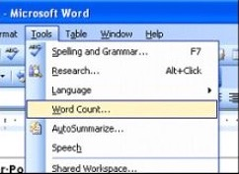
Say a lot with a little
Form fields:
Beware the Character counts. Count “characters with spaces” and check the submission portal well in advance.
Narrative page limits vs. total page limits:
Allocate page counts by points value when possible. For example, Narrative vs. Budget Narrative.
Government grants often ask for more than you can fit in, but you must!
The power of the table:
Check formatting requirements carefully.
Single-spaced and 10-point font is often accepted in narratives with double space and 12-point requirements
Good for demographics, trends, outcome targets, partner roles and responsibilities, and so much more!
Notes:
Self-explanatory ;-)

Slide 13
II. Developing familiarity with what foundation reviewers vs. government reviewers are looking for when they review proposals
Notes:
Developing a logic model at the beginning of program planning gives you a framework for charting the links between your program’s resources, activities, and outputs and its intended outcomes. It enables you to evaluate your program once it begins. And it helps you communicate to your stakeholders what you want to accomplish, how you intend to reach your goals, and how you will track your progress.
Logic models represent INTENTION; shows connection between the planned work and what you hope to achieve. THIS is informed by the theory of change.
These components illustrate the connection between your planned work and your intended results.
Visual representation, etc. purpose in sharing ,etc.
Start with identifying the impacts and outcomes (relationship to backwards design) then can select the activities

Slide 14
Competitive government and foundation proposals have each of these elements, but to different degrees
A compelling STORY with an
emotional hook
Foundation proposals
Government proposals

Slide 15
Competitive government and foundation proposals have each of these elements, but at different dosages
Responding to each and every requirement, in order and in a specific, prescribed manner
Foundation proposals
Government proposals

Slide 16
The Role of STORY in Foundation Proposals
Grant proposals to private foundations must not only inform but also inspire.
Use stories to embed your proposal in the mind of the reader. Highlight the difference to the story’s subject if the project is funded. Use vivid imagery and powerful quotes to put the reader in the story.
Remember that you’re writing for a real person (the Program Officer or Advisory Board member) who can be converted to belief and action.
The program officer will likely soon forget facts and figures—no matter how impressive they are.

Slide 17
The Role of STORY in Government Proposals
A competitive government grant proposal tells a story, but must weave in specific, detailed data to do so
A strong Needs section lays out the facts in a logical, convincing way rather than appealing to emotion
A good story—no matter how compelling—is secondary to fulfilling each and every requirement in the manner prescribed by the agency; the points you gain for a good story cannot make up for points lost to incomplete responses

Slide 18
Use of SMART objectives and Evidence-based practices
Both foundation and government proposals are strongest when they embed SMART objectives and evidence-based practices. However, the degree to which they are used is a bit like the difference between the skill level required to play a basic upright piano compared to that required to play a grand piano.
Foundation
Government

Slide 19
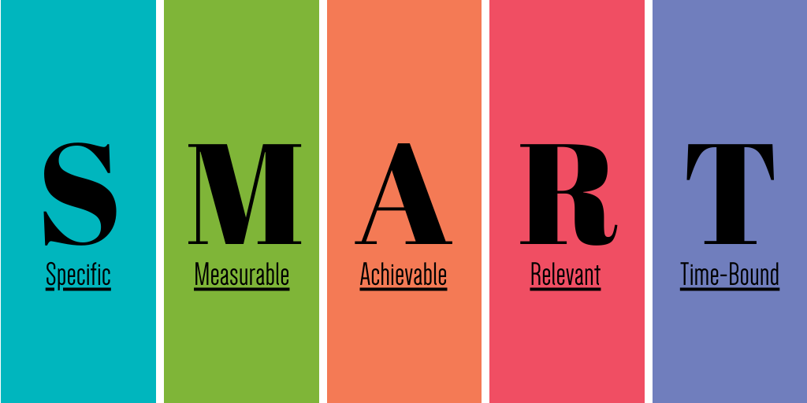
An example of government agency expectations for SMART objectives
From the Substance Abuse and Mental Health Services Administration (SAMHSA) “Developing a Competitive SAMHSA Grant Application” guide

Slide 20
An example of government agency expectations for referencing evidence-based practices
EBP “is the objective, balanced, and responsible use of current research and the best available data to guide policy and practice decisions, such that outcomes for (the target population) are improved.”
From a proposal for the Department of Education (DOE) Full Service Community Schools grant program

Slide 21
Why do government agencies want to see SMART objectives that reflect evidence-based practices?
Q:
A:
They are indicators of your organization’s ability to design, implement, and evaluate a complex project funded by a government grant

Slide 22
By formulating a SMART objective and situating your project within the context of EBPs, you demonstrate your ability to execute an evaluation plan like this:

Slide 23
III. How to transition from foundation to federal grants and vice versa
Notes:
Developing a logic model at the beginning of program planning gives you a framework for charting the links between your program’s resources, activities, and outputs and its intended outcomes. It enables you to evaluate your program once it begins. And it helps you communicate to your stakeholders what you want to accomplish, how you intend to reach your goals, and how you will track your progress.
Logic models represent INTENTION; shows connection between the planned work and what you hope to achieve. THIS is informed by the theory of change.
These components illustrate the connection between your planned work and your intended results.
Visual representation, etc. purpose in sharing ,etc.
Start with identifying the impacts and outcomes (relationship to backwards design) then can select the activities

Slide 24
Foundation
Federal
Assess your organization’s needs:
Personnel: Do you have the right staff for the job (both program and admin)?
Training: Does this project raise specific training needs (new equipment, software, etc.)?
Infrastructure: Are your facilities adequate for the number of students/clients/patients?
Systems: Do you have the data tracking and financial management systems in place?
Relationships: Do you have buy-in from everyone involved? Are their commitments to the project clearly documented? The work plan “person/entity responsible” should match both partnership documentation and narrative.

Slide 25
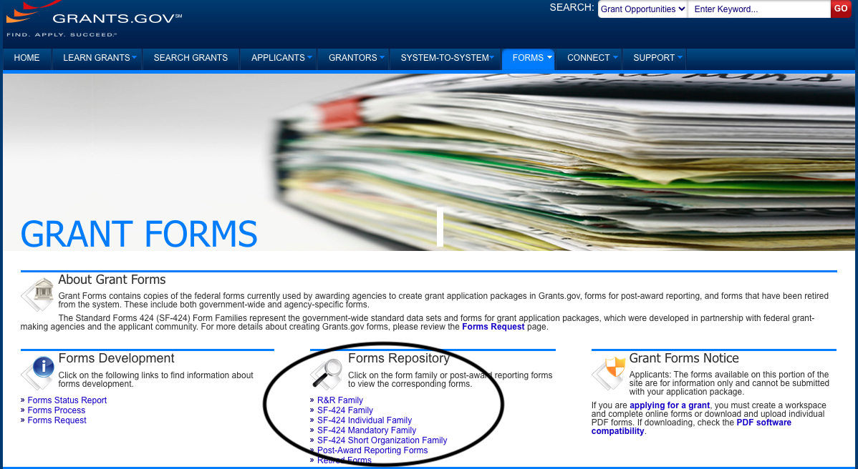
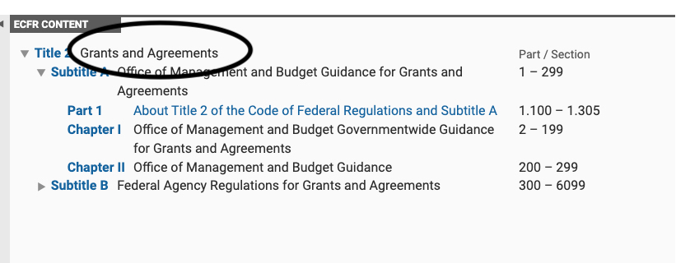
Foundation
Federal
Administrative & Fiscal Capacity: Is your accounting system set up to track grant funds separately from non-grant funds to make sure grant funds are not used for non-allowable costs? Are you set up to collect data in a way that aligns with the reporting requirements you will have to meet?
Notes:
Check the Code of Federal Regulations for allowable and non-allowable costs
Each agency may have their own guidelines
Instructions in the NOFO prevail in the event of any conflicting information

Slide 26
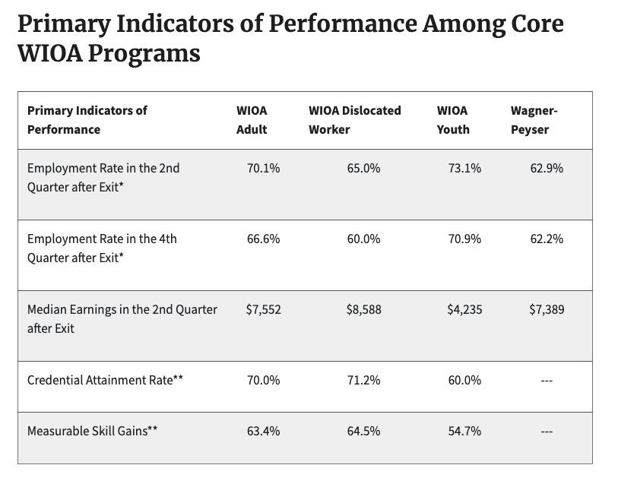
Foundation
Federal
Data Collection, Analysis, & Reporting Capacity:
Staffing: Who collects data? Who inputs it? Who reports on it programmatically (e.g., to the Advisory Committee) and to the funder?
Technology: Do you need a software/database upgrade?
Permissions: In the case of collaborative service delivery, do you have the appropriate cross-org data-sharing agreements? If not, do you have a plan to create them in time to execute the program?
External Evaluator?

Slide 27
Foundation
Federal
Importance of relationships:
To what extent is your project complementary to existing initiatives? These can be federal, state, regional, or sector-based.
Buy-in of diverse stakeholders: Who is at the table? Are you working together with other stakeholders who have shared goals?
Potential to formalize relationships: Project-specific MOUs are often required.
Trust among partners is essential.

Slide 28
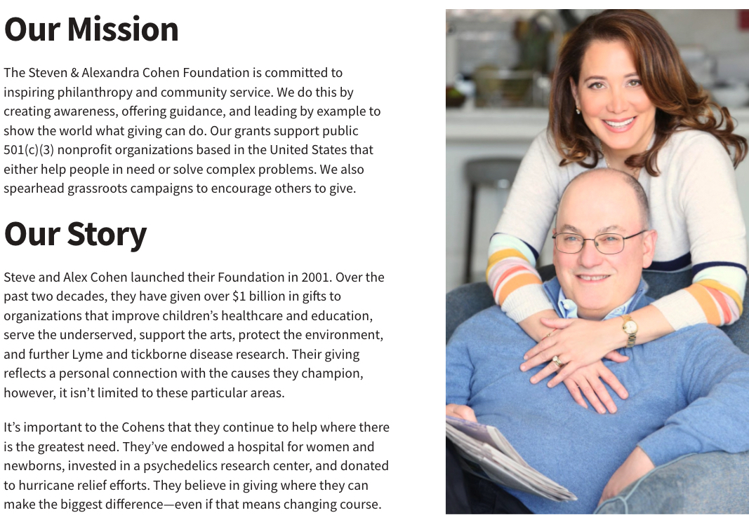
Federal
Foundation
It’s all about the mission:
Alignment with funder’s mission
Focus on how your work will advance their vision
Notes:
Many foundations were created by individual philanthropists. Connect to their own mission with your inspiring story.

Slide 29
Federal
Foundation
Importance of relationships:
Community Foundations: These manage many funds (such as donor-advised funds) and can play a key role in connecting you with funders who may have an interest in your work.
Meet Program Officers when possible: Rare in federal, but possible for smaller/regional foundations. Larger foundations may host convenings and conferences.
Be ready to discuss your project by phone or in person
Partnering on allies’ grants can familiarize funders with your work, build trust and goodwill, and prepare them for your own request.
Learn from “warm rejections”: A funder may offer to give you feedback on your proposal, introduce you to potential teaming partners for future applications, introduce you to other funders, or offer guidance on your funding search. Say yes! Be willing to learn and try again.

Slide 30
IV. Delineating stylistic and content differences between foundation and government grant proposals
Notes:
Developing a logic model at the beginning of program planning gives you a framework for charting the links between your program’s resources, activities, and outputs and its intended outcomes. It enables you to evaluate your program once it begins. And it helps you communicate to your stakeholders what you want to accomplish, how you intend to reach your goals, and how you will track your progress.
Logic models represent INTENTION; shows connection between the planned work and what you hope to achieve. THIS is informed by the theory of change.
These components illustrate the connection between your planned work and your intended results.
Visual representation, etc. purpose in sharing ,etc.
Start with identifying the impacts and outcomes (relationship to backwards design) then can select the activities

Slide 31
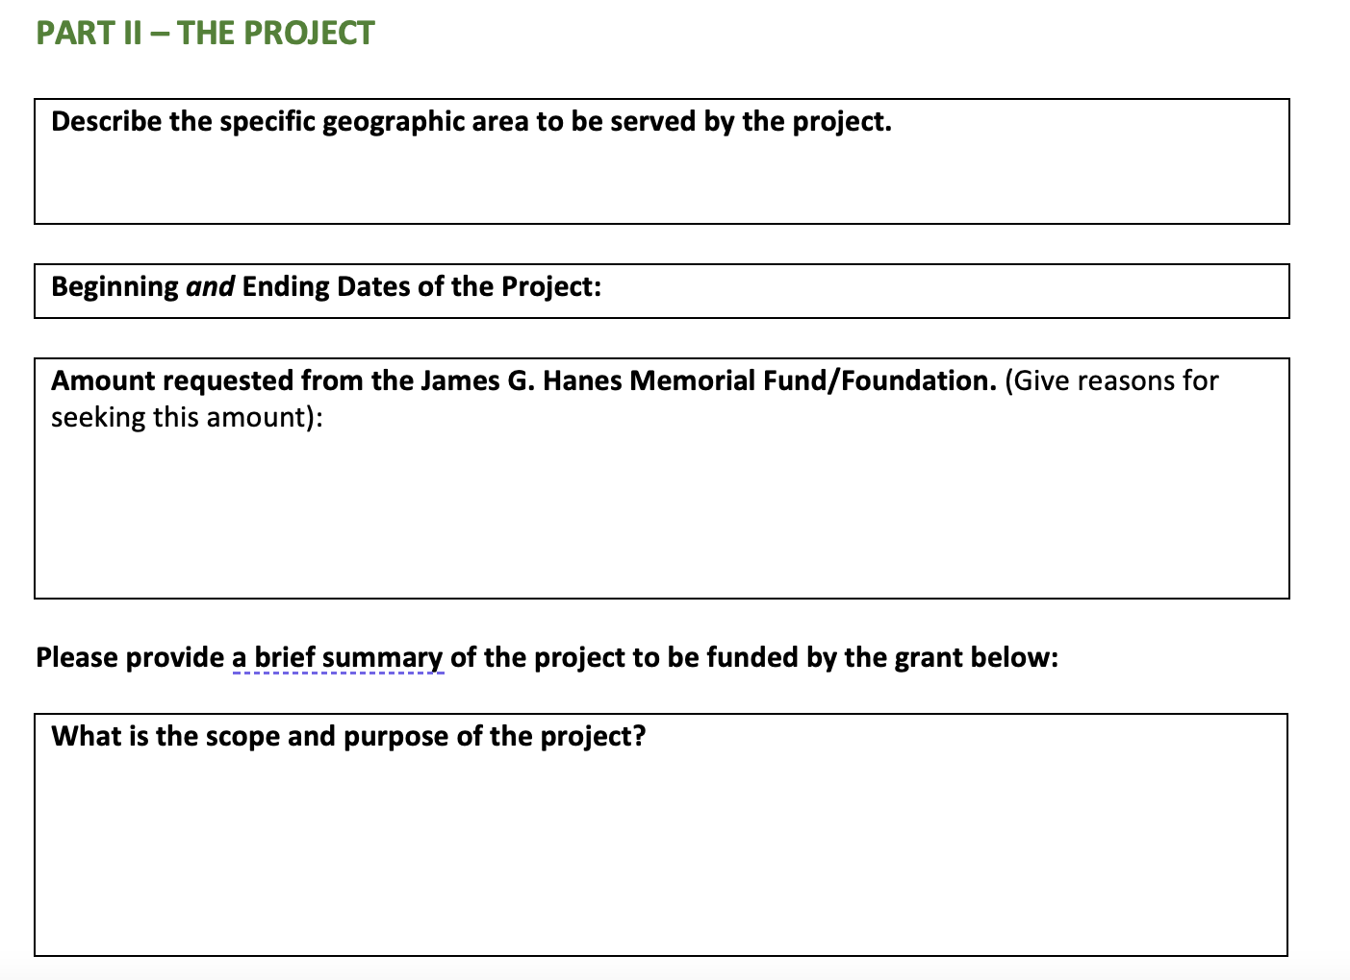
Stylistic Guidance on Foundation vs. Government Grants
In general, foundation grant applications will ask specific questions, but provide significantly less guidance on what your response must include.
From the James G. Hanes Foundation application

Slide 32
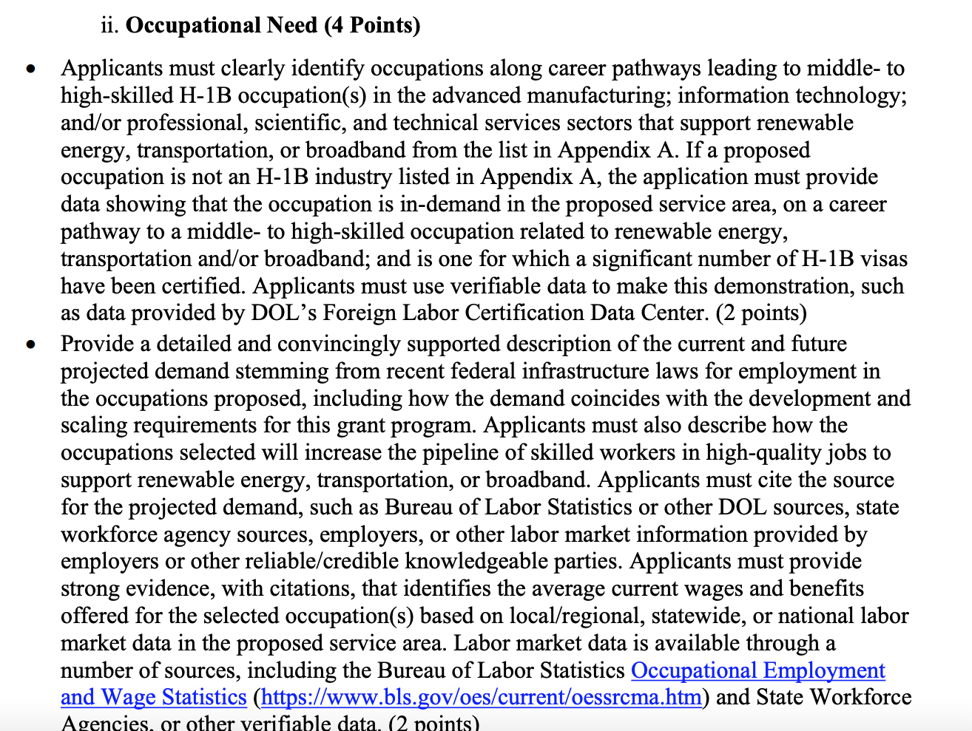
Stylistic Guidance on Foundation vs. Government Grants
Whereas government grant applications will ask a question and give (often lengthy and detailed) instructions on how to answer it.
From a Department of Labor (DOL) Building Pathways to Infrastructure Jobs RFA

Slide 33
Stylistic Guidance on Foundation vs. Government Grants
Q: What should you do with these often lengthy and detailed instructions on how to structure your response?
A: Follow them, exactly.

Slide 34
Stylistic Guidance on Foundation vs. Government Grants
Use the exact phrasing and terminology of the Notice of Funding Opportunity/ Request for Applications to structure each section and response in your proposal. Make it as easy as possible for the reviewer to go down their checklist.
From a USDA Gus Schumacher Nutrition Incentive Program RFA

Slide 35
Content Guidance on Foundation vs. Government Grants
For both, demonstrate that you have fully immersed yourself in understanding the background, vision, and priorities of the funder. How to do this:
FOUNDATION
GOVERNMENT
Read up-to-date mission statements and funding priorities
Review annual reports
Research recently funded projects
Craft proposal content that doesn’t parrot the language of the funder, but clearly reflects their priorities
Read (and re-read) the “Program Purpose” or “Program Description” section of the NOFO/RFA and weave exact language from these sections into your goals and objectives
Review plans/documents the agency references in the NOFO/RFA that currently guide their strategic priorities so that you can reference these in your proposal

Slide 36
Content Guidance on Foundation vs. Government Grants
By familiarizing yourself with these resources and documents, you can explain to a reviewer how your proposed project fits within the larger context of an agency’s goals.

Slide 37
V. Understanding the basics of assessing your organization’s readiness for foundation vs. government grant opportunities
Notes:
Developing a logic model at the beginning of program planning gives you a framework for charting the links between your program’s resources, activities, and outputs and its intended outcomes. It enables you to evaluate your program once it begins. And it helps you communicate to your stakeholders what you want to accomplish, how you intend to reach your goals, and how you will track your progress.
Logic models represent INTENTION; shows connection between the planned work and what you hope to achieve. THIS is informed by the theory of change.
These components illustrate the connection between your planned work and your intended results.
Visual representation, etc. purpose in sharing ,etc.
Start with identifying the impacts and outcomes (relationship to backwards design) then can select the activities

Slide 38
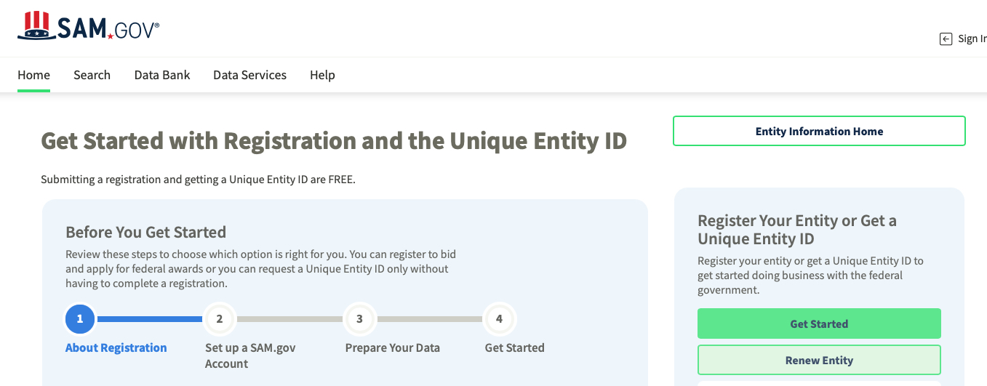
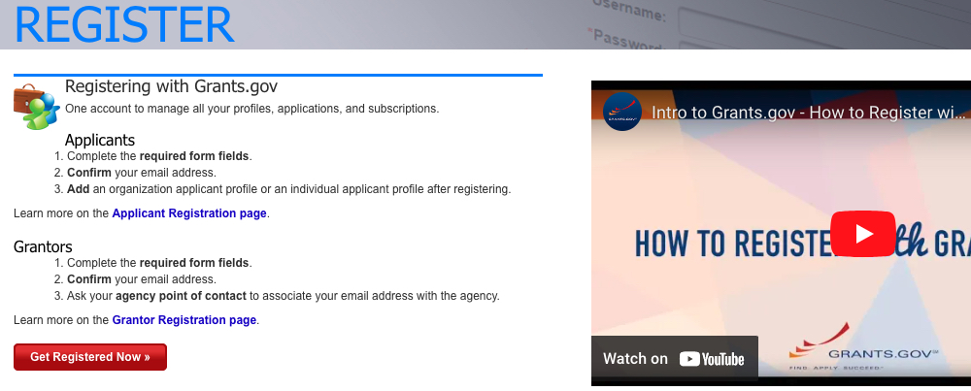
Get registered
Go to Sam.gov to obtain a UEI (allow time)
Check the Entity Registration Checklist to make sure you have all required documents on hand
Designate an EBiz Point of Contact (POC)
Go to Grants.gov
Create a Grants.gov account with the same email address as used in SAM.gov for the EBiz POC
Add a profile with Grants.gov using the UEI obtained from SAM.gov.
Can add multiple users with different roles, e.g. Authorized Organizational Representative (AOR) (who can only submit proposals) or Expanded AOR (has admin privileges)
Notes:
This is what we bring or invest in the program; very influential to the budget.
Resources are the raw materials needed to create the program, implement its activities, and attain the desired outputs and outcomes. Sometimes called inputs, resources include both material items (such as curricula, instruction materials, facilities, and funding) and nonmaterial items (such as time, community support, and specialized knowledge and skills).

Slide 39
Compliance – get ready!
Administrative & Fiscal Capacity
Finance Team: Do they have the bandwidth to manage a federal award? Are there sufficient staff available?
Policies & Procedures, Fiscal Controls: Are your accounting and financial oversight procedures well-established and compliant? Is your team trained in those procedures?
See DHT’s September 2023 training on post-award compliance
Notes:
X Training = IFP’s training that was done at DHT already. Need info.

Slide 40
Aspects of a Grant Readiness Assessment for Federal Opportunities
Conversations with key leaders: Gather their perspectives on all aspects of capacity and institutional readiness. Make sure that everyone is on board with investing in a federal grants program.
SWOT Analysis: An analysis of your organization’s Strengths, Weaknesses, Opportunities, and Threats can prepare you to craft a proposal that builds on strengths, makes the most of available opportunities, and mitigates any risks and challenges.
PEST Analysis: A thorough consideration of external factors and influences: Political, Economic, Social, and Technological. It pays to be attuned to trends in programs that receive funding (check award lists and abstracts), best practices, broader social changes, and the evolving impact of technology on all aspects of functioning.
Gap analysis: What are the gaps between the capacity you have now vs. the capacity you need to develop in order to produce (and implement!) a winning proposal? Investments may be needed in training, infrastructure, and/or temporary external support. Look for Technical Assistance programs offered by federal agencies and apply for capacity-building grants as applicable.
Notes:
This is what we bring or invest in the program; very influential to the budget.
Resources are the raw materials needed to create the program, implement its activities, and attain the desired outputs and outcomes. Sometimes called inputs, resources include both material items (such as curricula, instruction materials, facilities, and funding) and nonmaterial items (such as time, community support, and specialized knowledge and skills).

Slide 41
Ready – set – go!
The right opportunity
At the right time
For the right organization…
With the right relationships
Notes:
This is what we bring or invest in the program; very influential to the budget.
Resources are the raw materials needed to create the program, implement its activities, and attain the desired outputs and outcomes. Sometimes called inputs, resources include both material items (such as curricula, instruction materials, facilities, and funding) and nonmaterial items (such as time, community support, and specialized knowledge and skills).

Slide 42
Questions?
IFP Contact Information:
Louise Mathias, Senior Partner
Louise.mathias@innovativefundingpartners.com
(202) 809-3401

Slide 43
Save the Date
Finding Your Narrative Arc: How to Sustain Reviewers’ Attention from Start to Finish
Wednesday, November 15th, 2023
12-1pm

Slide 44
Appendix: Resources
University of Wisconson-Madison’s guide to writing a competitive grant proposal
SAMHSA’s guide to writing SMART objectives
An introduction to evidence-based practices
Grants.gov Applicant Resources (training videos on registration and much more)
SAM.gov Entity Registration Checklist
Organizational Capacity Assessment Tool from AmeriCorps

Slide 45
dht.org

