Slide 1
Engaging the Target Population:
A Critical Aspect of Grant Development
July 19, 2023

Slide 2
Learning Objectives
I. Developing formal and informal methods of engaging the target population, including needs assessments, SWOT (Strengths, Weaknesses, Opportunities, and Threats) and PEST (Political, Economic, Societal, and Technological) analysis
II. Utilizing existing data, reports, and other documentation of engagement to develop robust sections of a grant application, particularly the Statement of Need section
III. Understanding the importance of utilizing input that is representative of the target population to create strategic/operational plans and mission, vision, and values statements
IV. Understanding the critical role of cultural competency and cultural humility and how to demonstrate this effectively in your grant application.

Slide 3
About Innovative
Funding Partners
IFP is a nationally recognized grants consulting firm highly regarded for an impressive overall grant success rate of 84%. Well known for their expertise in federal and other governmental grant writing, this success is based not only on technical expertise but also on a foundational relationship-building approach. IFP’s team of over 20 highly experienced consultants is passionate about helping organizations meet the unique needs of their local communities and better serve their constituents by seeking and securing high-impact grant funding.

Slide 4
About the
presenters
Brian Kelley, Ph.D., IFP Grants Consultant, is a grant writer with a proven track record of securing federal and foundation grants across multiple sectors, including health care, workforce development, and education. He has worked in academia for over two decades and has served a variety of not-for-profit organizations and medical centers as a consultant to help create innovation and secure foundation, city, state, and federal funds to support biomedical, education, prevention research, and workforce development. He has also served as a grant reviewer for several granting agencies. Dr. Kelley leverages the culmination of these experiences into an authentic and effective approach to grant development for community impact.
.
3.
Brian Kelley, Ph.D.
Senior Partner

Slide 5
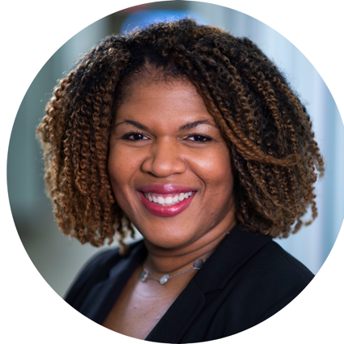
About the
presenters
Sylvette La Touche-Howard, Ph.D., IFP Grants Consultant, is an experienced therapist and public health specialist in the behavioral and community health sector with specializations in mental health, health equity, community engagement, and program evaluation. She brings to the IFP team more than 20 years of experience in the academic, for-profit, and non-profit arenas. She has served on several curriculum development teams that have had state and national impacts. Her passion lies in proactively working with organizations and communities to bridge behavioral health, research, and social impact to create a sustainable and equitable future through policy, systems, and environmental change initiatives. Sylvette holds a Ph.D. in Behavioral and Community Health from the University of Maryland, College Park.
.
3.
Sylvette La Touche-Howard, Ph.D.NCC, CHES
Grants Consultant

Slide 6
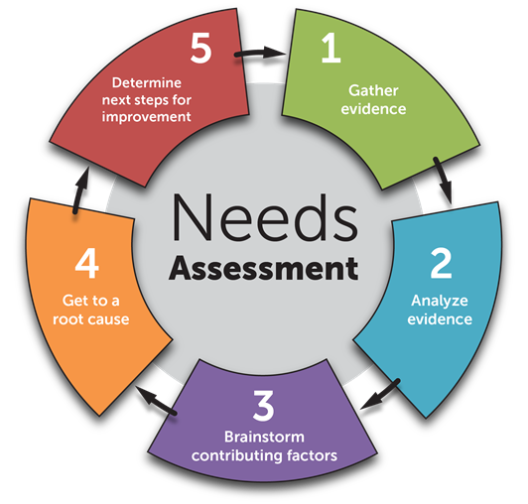
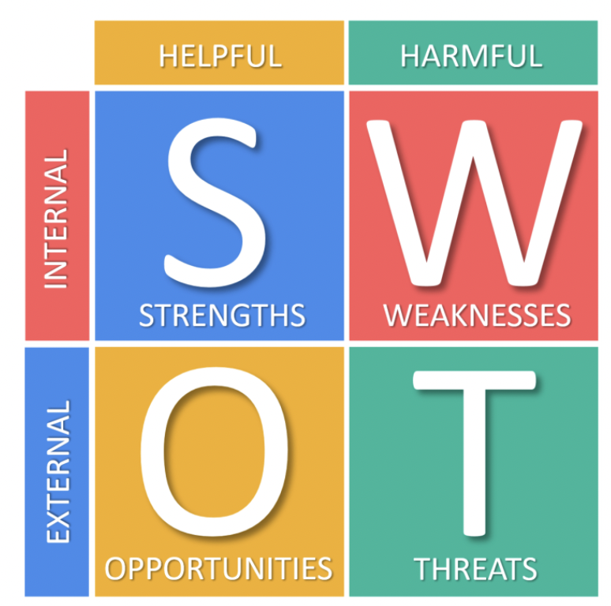
Developing formal and informal methods of engaging the target population, including: i. Needs assessments; ii. SWOT (Strengths, Weaknesses, Opportunities, and Threats); and iii. PEST (Political, Economic, Societal, and Technological) analysis
PEST Analysis
Political Factors
Economic Factors
Social Factors
Technological Factors

Slide 7
Laying the Foundation
Image Source: https://tanveernaseer.com/building-relationships-key-to-leadership-success/
Notes:
By conducting and implementing SWOT analysis firms identify positive and negative aspects and then implement this research. Most companies carry out this analysis every month or once a year depending on the current situation. It not only helps businesses evaluate their current state but also helps in taking countermeasures to overcome barriers and prevent factors from stopping them from achieving their full potential.
Pestleanalysis.com
Strengths – Firms need to focus and improve their strengths in order to achieve their goals, focusing on USP (unique selling point) and increasing the quality of products/services in competition with the competitors. Strengths are an internal factor.
Weaknesses – This implies what the company lacks or is unable to achieve. Lower profits in a specific department or products plus sales and internal structural problems. Weaknesses need to be dealt with since this is also an internal factor.
Opportunity – This is an external factor as it is directly related to the firm’s external environment, through which these companies can gain a lot if they plan their moves wisely. Firms can benefit from lower taxes, good market trends, and a booming economy.
Threats – Companies don’t have control over threats since they are external factors that can create uncertainty. This has a negative impact on the business. Unrest, new competitors, and government policies are some examples.

Slide 8
So how do we do this in a meaningful and effective way?

Slide 9
METHOD 1: Community Strength & Needs Assessment
A community strength and needs assessment…
provides community leaders with a snapshot of local policy, systems, and environmental change strategies currently in place.
helps community leaders identify areas for improvement.
provides communities a way to map out a “course of action” for health improvement by creating strategies for making positive and sustainable changes in their communities.
Source: https://www.cdc.gov/globalhealth/healthprotection/fetp/training_modules/15/community-needs_pw_final_9252013.pdf
Notes:
Before you conduct a community needs assessment you should have a clear understanding of the different cultural groups within a community and how to best work with them to solve the community issues. One cannot truly do good for a community if you do not understand the community that you seek to serve. How best to do that - begin with a community needs assessment

Slide 10
5 Steps of a Community Strength & Needs Assessment
Step 1: Gather the evidence
Step 2: Analyze the evidence
Step 3: Review the data and brainstorm contributing factors
Step 4: Get to a root cause
Step 5: Develop a community action plan

Slide 11
Potential Outcomes of an Effective Community Strength & Needs Assessment
Community Strength & Needs Assessment
Policy Change
Systems Change
Environmental Change
involves change in laws, regulations, rules, protocols, and procedures that are designed to guide or influence behavior.
involves change that affects all community components including social norms of an organization, institution, or system.
involves change that relates to the physical, social, or economic factors designed to influence people’s practices and behaviors
Source: https://www.cdc.gov/globalhealth/healthprotection/fetp/training_modules/15/community-needs_pw_final_9252013.pdf
Notes:
Components of a Needs Assessment: The main outcomes of a community needs assessment are in 3 main categories: Policy Change, Systems Change, and Environmental Change.
Policy Change - This involves laws, regulations, rules, protocols, and procedures that are designed to guide or influence behavior. Policies can be either legislative or organizational. Policies often mandate environmental changes and increase the likelihood that they will become institutionalized or sustainable. Examples of legislative policies include taxes on tobacco products, provision of county or city public land for green spaces or farmers’ markets, regulations governing a national school lunch program, and clean indoor air laws. Examples of organizational policies include COMMUNITY NEEDS ASSESSMENT PARTICIPANT WORKBOOK |7 schools requiring healthy food options for all students, menu labeling in restaurants, and required quality assurance protocols or practices (e.g., clinical care processes).
System Change - This involves change that affects all community components including social norms of an organization, institution or system. It may include a policy or environmental change strategy. Policies are often the driving force behind systems change. Examples are implementing a national school lunch program across a region or provincial school system or ensuring a hospital system becomes tobacco free.
Environmental Change - This type of change relates to the physical, social, or economic factors designed to influence people’s practices and behaviors. Examples of alterations or changes to the environment include: Physical: Structural changes or the presence of programs or services, including the presence of healthy food choices in restaurants or cafeterias, improvements in the built environment to promote walking (e.g., walking paths), the availability of smoking cessation services to patients or workers, and the presence of comprehensive school health education curricula in schools. Social: A positive change in attitudes or behavior about policies that promote health or an increase in supportive attitudes regarding a health practice, including an increase in favorable attitudes of community decision makers about the importance of nonsmoking policies or an increase in nonacceptance of exposure to second-hand smoke from the general public. Economic: The presence of financial disincentives or incentives to encourage a desired behavior including charging higher prices for tobacco products to decrease their use or the provision of nonsmoker health insurance discounts.

Slide 12
METHOD 2: SWOT Analysis
Source: https://www.cdc.gov/globalhealth/healthprotection/fetp/training_modules/15/community-needs_pw_final_9252013.pdf
Notes:
A SWOT ANALYSIS IS A QUICK WAY OF EXAMINING your organization by looking at the internal strengths and weaknesses in relation to the external opportunities and threats. A SWOT helps your team understand the current state, determine where to go next, and inform the strategic actions that can be taken to achieve your organization’s desired future state.

Slide 13
Sample Questions for SWOT Analysis
SWOT
Analysis
Strengths
-What community resources does our organization have that others do not?
-What is our U.S.P (Unique Selling Point) with out community?
-What draws the community to our organization?
Weaknesses
-What is it that our organization doesn’t do so well when it comes to our community?
-What weaknesses are evident to our community?
-What keeps our community from trusting us?
Opportunities
-What potential opportunities for growth exist within our organization?
-Are there any trends our organization can leverage in relation to our community?
-Are they any emerging trends that we can take advantage of?
Threats
-What are our competitors doing that we are not?
-Do any of our weaknesses threaten our organization’s (or our community’s) health?
-Are there any societal changes that present a threat to our organization?
Source: https://www.cdc.gov/globalhealth/healthprotection/fetp/training_modules/15/community-needs_pw_final_9252013.pdf
Notes:
Components of a Needs Assessment The main outcomes of a community needs assessment are in 3 main categories: Policy Change, Systems Change, and Environmental Change. Policy Change This involves laws, regulations, rules, protocols, and procedures that are designed to guide or influence behavior. Policies can be either legislative or organizational. Policies often mandate environmental changes and increase the likelihood that they will become institutionalized or sustainable. Examples of legislative policies include taxes on tobacco products, provision of county or city public land for green spaces or farmers’ markets, regulations governing a national school lunch program, and clean indoor air laws. Examples of organizational policies include COMMUNITY NEEDS ASSESSMENT PARTICIPANT WORKBOOK |7 schools requiring healthy food options for all students, menu labeling in restaurants, and required quality assurance protocols or practices (e.g., clinical care processes). System Change This involves change that affects all community components including social norms of an organization, institution or system. It may include a policy or environmental change strategy. Policies are often the driving force behind systems change. Examples are implementing a national school lunch program across a region or provincial school system or ensuring a hospital system becomes tobacco free. Environmental Change This type of change relates to the physical, social, or economic factors designed to influence people’s practices and behaviors. Examples of alterations or changes to the environment include: Physical: Structural changes or the presence of programs or services, including the presence of healthy food choices in restaurants or cafeterias, improvements in the built environment to promote walking (e.g., walking paths), the availability of smoking cessation services to patients or workers, and the presence of comprehensive school health education curricula in schools. Social: A positive change in attitudes or behavior about policies that promote health or an increase in supportive attitudes regarding a health practice, including an increase in favorable attitudes of community decision makers about the importance of nonsmoking policies or an increase in nonacceptance of exposure to second-hand smoke from the general public. Economic: The presence of financial disincentives or incentives to encourage a desired behavior including charging higher prices for tobacco products to decrease their use or the provision of nonsmoker health insurance discounts.

Slide 14
METHOD 3: PEST Analysis
PEST Analysis
Political Factors
Economic Factors
Social Factors
Technological Factors
PEST analysis helps you…
Understand current external influences on your organization so you can work on facts rather than assumptions.
Identify what factors could change in the future.
Mitigate risks and take advantage of opportunities to remain competitive.
Develop a better long-term strategy.

Slide 15
PEST Examples
Political Factors
Upcoming local, state, or national elections
Economic Factors
Current economic stability
Social Factors
Population growth and demographics
Technological Factors
Main political candidates and their views on different policies
Government regulation of industry or competition
Projected growth and inflation rates
Interest rates
Consumer habits and financial stability
Unemployment rate and competition for jobs
Access to credit (personal and business)
Generational shifts
Consumer habits and values (e.g., focus on product quality or eco-friendliness)
Family size and structure
Consumer lifestyles
Immigration rates
The organization’s access to new technology
Rate of technological change
Evolution of infrastructure
Government or institutional research
Source: https://www.lucidchart.com/blog/pest-analysis
Notes:
Political factors look at how legal and governmental regulations, as well as the political climate, might affect your organization’s freedom to operate and its ultimate profitability.
Economic factors: The economy has a significant impact on any business. Consider the following economic factors that could influence your business operations:
Socio-cultural factors consider the makeup of the population and your target demographics to understand how well your business can compete in the market. These factors might include age distribution, cultural attitudes, and workplace or lifestyle trends.
Technological Factors: This step considers technology’s specific role and development in an organization and the industry, as well as broader technological trends and uses that affect society as a whole.

Slide 16
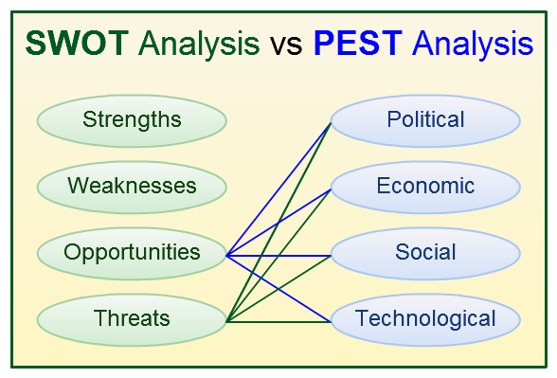
IN SUMMARY
While PEST and SWOT analysis can help organizations make better strategic decisions, they are limited by the knowledge and creativity of the organization during the brainstorming process.
Bringing in managers, workers, and outside experts (i.e. community stakeholders) with diverse viewpoints and knowledge can allow for a more thorough environmental scanning that is less likely to ignore key factors affecting the organization’s ability to achieve their goal.
Source: https://pestleanalysis.com/what-is-pestle-analysis/
Notes:
By conducting and implementing SWOT analysis, firms identify positive and negative aspects and then implement this research. Most companies carry out this analysis every month or once a year depending on the current situation. It not only helps businesses evaluate their current state but also helps in taking countermeasures to overcome barriers and prevent factors from stopping them from achieving their full potential.
Pestleanalysis.com
Strengths – Firms need to focus and improve their strengths in order to achieve their goals, focusing on USP (unique selling point) and increasing quality of products/services in competition of the competitors. Strengths are an internal factor.
Weaknesses – This implies what the company lacks or is unable to achieve. Lower profits in a specific department or products plus sales and internal structural problems. Weaknesses need to be dealt with since this is also an internal factor.
Opportunity – This is an external factor as it is directly related to the firm’s external environment, through which these companies can gain a lot if they plan their moves wisely. Firms can benefit from lower taxes, good market trends and a booming economy.
Threats – Companies don’t have control over threats since they are external factors which can create uncertainty. This has a negative impact on the business. Unrest, new competitors, and government policies are some examples.

Slide 17
II. Utilizing existing data, reports, and other documentation of engagement to develop robust sections of a grant application, particularly the Statement of Need section

Slide 18
Quick Review
What is a Statement of Need?
A Statement of Need…
is usually about 2-4 paragraphs
sets the applicant up for the rest of the grant proposal
demonstrates that the applicant organization is best positioned to do the work proposed
describes the specific public or community needs an organization or project will address
Source: Fundingforgood.org
Notes:
A statement of need communicates key information to donors about your organization and its work. After reading your statement of need, donors should come away feeling certain that their contributions will be supporting critical yet unmet public or community needs. Reading between the lines, donors should also be confident that your organization fully understands these needs and is prepared to meet them.

Slide 19
Quick Review
What is a Statement of Need?
A Statement of Need…
conveys urgency, demonstrates how critical needs are currently unmet or underserved
reveals the real-world impact of unmet needs and points to how these needs can realistically be met with targeted investment
communicates key information to donors about your organization and its work
Source: Fundingforgood.org
Notes:
A statement of need communicates key information to donors about your organization and its work. After reading your statement of need, donors should come away feeling certain that their contributions will be supporting critical yet unmet public or community needs. Reading between the lines, donors should also be confident that your organization fully understands these needs and is prepared to meet them.

Slide 20
Quick Review
What is a Statement of Need?
The Statement of Need should always include a clearly established baseline for the project; that is, it must provide an accurate appraisal of the current situation that you seek to change.
Source: Fundingforgood.org
Notes:
A statement of need communicates key information to donors about your organization and its work. After reading your statement of need, donors should come away feeling certain that their contributions will be supporting critical yet unmet public or community needs. Reading between the lines, donors should also be confident that your organization fully understands these needs and is prepared to meet them.
Documentation of need may come from a variety of qualitative and quantitative sources. You can obtain qualitative and quantitative data by:
(1) Compiling existing data – this involves gathering and comparing national, State, and local information and/or data already collected by individual agencies, State and county public agencies, school systems, health systems, and court systems (e.g., alcohol, tobacco, drug abuse, and mental health data from SAMHSA at SAMHSA data, SAMHSA’s National Survey on Drug Use and Health, and the National Center for Health Statistics/Centers for Disease Control reports at CDC Reports);
(2) Conducting surveys that gather information from a representative sample of your population(s) of focus;
(3) Utilizing the key informant approach – identifying and interviewing community leaders, stakeholders, and decision-makers who are knowledgeable about the community and can accurately identify priority needs and concerns; and
4) Using a community forum approach - conducting public meetings to obtain information from community members about the needs facing the community and to identify the needs that should be prioritized.
Any technique you choose must reflect an understanding and appreciation of the cultural characteristics of your community and population(s) of focus.
10
Reading and reviewing current materials written by leaders in the field can help you determine the most effective strategy for implementing the project in your area. Community assessments focus on local assets, resources, and activities as well as gaps, barriers, or emerging needs. Understanding your community will help you tailor selected strategies and activities for your specific project and population(s) of focus.

Slide 21
Core Building Blocks for a Statement of Need
WHAT
What is the need or problem?
WHO
Who has the need or problem?
WHY
WHAT
Why is this a need or problem?
HOW
What will happen if the need or problem is not addressed?
How do you know this information?
Notes:
The Building Blocks of a Strong Statement of Need
The good news is that, if you’ve undertaken a comprehensive program planning process or organizational strategic planning process, you already have the main elements for your statement of need.
What is the need or problem?
Who has the need or problem?
Why is this a need or problem?
What will happen if the need or problem is not addressed?
How do you know this information?

Slide 22
Where does the data fit?
Notes:
A statement of need communicates key information to donors about your organization and its work. After reading your statement of need, donors should come away feeling certain that their contributions will be supporting critical yet unmet public or community needs. Reading between the lines, donors should also be confident that your organization fully understands these needs and is prepared to meet them.
Data can come in many forms. For example:
Census or other government data
Community meetings
Stakeholder interviews
Surveys
Original analyses of existing datasets
Reports your organization or others have published
Polling
Case studies
Policy details and analysis
Requests for services your organization receives

Slide 23
Give your funders reason to believe
Reading between the lines, funders should also be confident that your organization fully understands the needs and is prepared to meet them.
Data can come in many forms. For example:
Census or other government data
Community meetings
Stakeholder interviews
Surveys
Original analyses of existing datasets
Reports your organization or others have published
Polling
Case studies
Policy details and analysis
Requests for services your organization receives

Slide 24
In Summary…
An impactful and compelling Statement of Need SHOULD ALWAYS be grounded in data!
Notes:
A Statement of Need communicates key information to donors about your organization and its work. After reading your Statement of Need, donors should come away feeling certain that their contributions will be supporting critical yet unmet public or community needs. Reading between the lines, donors should also be confident that your organization fully understands these needs and is prepared to meet them.
Data can come in many forms. For example:
Census or other government data
Community meetings
Stakeholder interviews
Surveys
Original analyses of existing datasets
Reports your organization or others have published
Polling
Case studies
Policy details and analysis
Requests for services your organization receives

Slide 25
III. Understanding the importance of utilizing input that is representative of the target population to create strategic/operational plans and mission, vision, and values statements
Notes:
Your application will have the best chance of success if you can persuade the donor that the need must be addressed as a matter of urgency. So, as you write, be sure to answer the question “What will happen if this project doesn’t go ahead straight away?”
Institutions may have to demonstrate to their trustees, shareholders, etc., that funds have been distributed in the most effective way. If you don’t convince them that prompt action is critical, they are likely to direct their funds elsewhere.
https://www.everettcc.edu/ccec/enewsletters/stakeholder-engagement-strategic-planning
https://ctb.ku.edu/en/table-of-contents/structure/strategic-planning/vision-mission-statements/main

Slide 26
So, how do we engage our community stakeholders?

Slide 27
3 Steps to Engaging Community Stakeholders:
Step 1: Communicate, communicate, communicate!
The first rule of engagement is all about sharing information in a purposeful and consistent way.
Step 2: Actively involve stakeholders in the process.
Ask for input about strategic planning in town hall meetings, through surveys, with targeted suggestion boxes, and in community newsletters. Do your best to include as many different groups as possible.
Step 3: Make sure the community knows what the strategic plan for the organization is and where they fit in.
Engaging community partners in the planning process itself helps build ownership within the organization.
Source: https://www.everettcc.edu/ccec/enewsletters/stakeholder-engagement-strategic-planning
Notes:
How do we engage stakeholders?
To build and support ongoing engagement in the strategic planning and implementation process, there are three important things to remember:
1. Communicate, communicate, communicate!
The first rule of engagement is all about sharing information in a purposeful and consistent way. All key stakeholders need to know the organization’s core purpose. External stakeholders need to understand why the organization exists and what value it provides for its customers, vendors, and the market. Internal stakeholders need to know where the organization is going so they can align their work with those goal(s) and direction. To make sure this happens, use all communication means available – newsletters, electronic messaging, e-mail, meetings, posters, payroll inserts, etc. Be consistent in the messages and use them to show employees how they fit into the plan and how their contributions have helped shape the choices made. Share the results they have achieved and coach them toward strategic performance.
Be visual and make the messages visible everywhere. I often create visual strategic roadmaps that can be posted throughout an organization to remind people of the importance of the company’s mission, vision, and strategies. People who know what is expected and how they contribute are more engaged and committed than those who do not.
2. Actively involve stakeholders in the process.
Ask for input about strategic planning in meetings, through surveys, with targeted suggestion boxes, in employee newsletters. Include representatives of stakeholder groups in discussions for strategic planning to the greatest extent possible, and do not limit planning and review sessions only to the top level of management. Include representatives from as many key stakeholder groups as are appropriate to the discussion at hand. This can be done formally in large group planning activities, or informally by including different key stakeholders in a variety of meetings. Use department meetings as an opportunity to solicit input on the plan and its results. Help employees understand the difference between strategic initiatives (long-term, big picture) and the tactical (day-to-day) work with which they are most familiar. Show them how the two levels are aligned. Greater understanding leads to greater ownership. Keep the messages flowing for constant reinforcement of the shared ideas, and give feedback on how ideas are being incorporated into the process.
3. Make sure people know what the strategic plan is and where they fit in it.
Engaging employees in the planning process itself helps build ownership within the organization. For those not directly involved in the process, however, make sure they know what the plan is, where they fit in it and how they contribute to its goals. Give them time to discuss and internalize it. Employees who do not understand the plan have a difficult time remaining engaged and moving in the desired direction. Meet with work units and departments to show them how they contribute. Develop measures of their work that show them how well they are contributing to desired strategic outcomes, and provide feedback on these measures frequently and consistently. Do everything you can to make sure that the work of the organization is aligned with the plan to keep all employees focused on a common vision, working to achieve a common mission, and engaged in the process of achieving the organization’s strategic goals.
It’s nearly impossible to get where you want to go without a goal, a roadmap, and organizational commitment to get you there. Without a goal, you can’t align the organization to a common desired outcome. Without a roadmap, you have no idea of the options available to get there. And without commitment, you cannot ensure that your stakeholders will move in the direction you need to go. Building commitment through broad stakeholder engagement is an increasingly important element of the strategic planning process.

Slide 28
Creating a Shared Dream: Developing Vision and Mission Statements
VALUES: HOW you will work effectively together
MISSION:
WHAT you will do
effectively together
VISION:
WHY you will work effectively together
Notes:
https://ctb.ku.edu/en/table-of-contents/structure/strategic-planning/vision-mission-statements/main

Slide 29
Meaningful Letters of Support
A letter of support (LOS) is a critical document that is created to lend strong support for the research/grant proposal.
Most letters have three parts:
an opening statement that identifies the project/program for which funds are being sought,
1-2 middle paragraphs that indicate the relationship of the writer to the effort seeking funding,
and a closing statement.
The LOS should also discuss the mission, vision, and values of both the supporter and the organization AND should be able to provide examples of joint work between the two entities BEYOND the current grant application.

Slide 30
IV. Understanding the critical role of cultural competency and cultural humility and how to demonstrate this effectively in your grant application.

Slide 31
Cultural Competency
Assess the level of cultural competence (i.e., ability to respectfully engage those from different cultures or backgrounds) of your organization or community. Consider the current practice or ability to:
Be involved and comfortable with people from different cultures and backgrounds.
Show genuine respect for others who are different.
Work effectively with people from different cultures and backgrounds.
Link to networks of people and groups from different cultures and backgrounds.
Notes:
https://ctb.ku.edu/en/table-of-contents/culture/cultural-competence/culturally-competent-organizations/main
https://healthcity.bmc.org/policy-and-industry/cultural-humility-vs-cultural-competence-providers-need-both#:~:text=At%20its%20base%2C%20cultural%20humility,%2C%20social%20needs%2C%20and%20others.
https://www.opengrants.io/community-engagement-how-to-maximize-grant-outcomes/
https://www.ccsi.org/CCSI/media/pdfs/Family-Community-Engagement.pdf

Slide 32
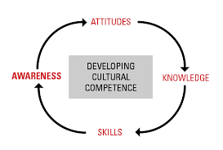
Cultural Competency
A culturally competent organization brings together knowledge about different groups of people – and transforms it into standards, policies, and practices that make everything work.
Source: https://ctb.ku.edu/en/table-of-contents/culture/cultural-competence
Notes:
https://ctb.ku.edu/en/table-of-contents/culture/cultural-competence/culturally-competent-organizations/main
https://healthcity.bmc.org/policy-and-industry/cultural-humility-vs-cultural-competence-providers-need-both#:~:text=At%20its%20base%2C%20cultural%20humility,%2C%20social%20needs%2C%20and%20others.
https://www.opengrants.io/community-engagement-how-to-maximize-grant-outcomes/
https://www.ccsi.org/CCSI/media/pdfs/Family-Community-Engagement.pdf

Slide 33
Cultural Competency and Humility
Cultural Knowledge
Cultural Sensitivity
Cultural Competence
Cultural Awareness
Cultural Humility*
There are four levels to these concepts:
Source: https://www.ccsi.org/CCSI/media/pdfs/Family-Community-Engagement.pdf
Source: https://ctb.ku.edu/en/table-of-contents/culture/cultural-competence
Notes:
There are four levels to these concepts:
"Cultural knowledge" means that you know about some cultural characteristics, history, values, beliefs, and behaviors of another ethnic or cultural group.
"Cultural awareness" is the next stage of understanding other groups -- being open to the idea of changing cultural attitudes.
"Cultural sensitivity" is knowing that differences exist between cultures, but not assigning values to the differences (better or worse, right or wrong). Clashes on this point can easily occur, especially if a custom or belief in question goes against the idea of multiculturalism. Internal conflict (intrapersonal, interpersonal, and organizational) is likely to occur at times over this issue. Conflict won't always be easy to manage, but it can be made easier if everyone is mindful of the organizational goals

Slide 34
Cultural Competency and Humility
Cultural competence is non-threatening because it acknowledges and validates who people are.
By focusing on the organization's culture, it removes the need to place blame and assume guilt.
Since becoming culturally competent focuses on the "how-to" of aligning policies and practices with goals, everyone is involved in the process.
Source: https://www.ccsi.org/CCSI/media/pdfs/Family-Community-Engagement.pdf
Source: https://ctb.ku.edu/en/table-of-contents/culture/cultural-competence/culturally-competent-organizations/main
Notes:
https://ctb.ku.edu/en/table-of-contents/culture/cultural-competence/culturally-competent-organizations/main
https://healthcity.bmc.org/policy-and-industry/cultural-humility-vs-cultural-competence-providers-need-both#:~:text=At%20its%20base%2C%20cultural%20humility,%2C%20social%20needs%2C%20and%20others.
https://www.opengrants.io/community-engagement-how-to-maximize-grant-outcomes/
https://www.ccsi.org/CCSI/media/pdfs/Family-Community-Engagement.pdf

Slide 35
A Cultural Competence Model: 5 Essential Principles
Principle 1: Valuing diversity
Principle 2. Conducting cultural self-assessments
Principle 3. Understanding the dynamics of difference
Principle 4. Institutionalizing cultural knowledge
Principle 5. Adapting to diversity
Source: https://www.ccsi.org/CCSI/media/pdfs/Family-Community-Engagement.pdf

Slide 36
Cultural Competency and Humility
.
A personal lifelong commitment to self-evaluation and self-critique whereby the individual not only learns about another's culture, but one starts with an examination of her/his own beliefs and cultural identities.
Key Components: lifelong learning and self-reflection; mitigating power imbalances; and institutional accountability
Source: https://www.cdc.gov/globalhealth/equity/guide/cultural-humility.html
Notes:
Cultural humility is active engagement in an ongoing process of self-reflection, in which individuals seek to:
Examine their personal history/background and social position related to gender, ethnicity, socio-economic status, profession, education, assumptions, values, beliefs, biases, and culture, and how these factors impact interpersonal interactions.
Reflect on how interpersonal interactions and relationships are impacted by the history, biases, norms, perception, and relative position of power of one’s professional organization.
Gain deeper realization, understanding, and respect of cultural differences through active inquiry, reflection, reflexivity, openness to establishing power-balanced relationships, and appreciation of another person’s/community’s/population’s expertise on the social and cultural context of their own lives (lived experience) and contributions to public health and wellbeing.
Recognize areas in which they do not have all the relevant experience and expertise and demonstrate a nonjudgmental willingness to learn from a person/community/population about their experiences and practices.
https://ctb.ku.edu/en/table-of-contents/culture/cultural-competence/culturally-competent-organizations/main
https://healthcity.bmc.org/policy-and-industry/cultural-humility-vs-cultural-competence-providers-need-both#:~:text=At%20its%20base%2C%20cultural%20humility,%2C%20social%20needs%2C%20and%20others.
https://www.opengrants.io/community-engagement-how-to-maximize-grant-outcomes/
https://www.ccsi.org/CCSI/media/pdfs/Family-Community-Engagement.pdf

Slide 37
Cultural Competency and Humility
.
In summary:
With a foundation of cultural humility and commitment to community engagement, organizations can develop and implement meaningful and ethical grant projects and partnerships to better address health equity, health disparities, and health inequities.
Source: https://www.cdc.gov/globalhealth/equity/guide/cultural-humility.html
Notes:
Cultural humility is active engagement in an ongoing process of self-reflection, in which individuals seek to:
Examine their personal history/background and social position related to gender, ethnicity, socio-economic status, profession, education, assumptions, values, beliefs, biases, and culture, and how these factors impact interpersonal interactions.
Reflect on how interpersonal interactions and relationships are impacted by the history, biases, norms, perception, and relative position of power of one’s professional organization.
Gain deeper realization, understanding, and respect of cultural differences through active inquiry, reflection, reflexivity, openness to establishing power-balanced relationships, and appreciation of another person’s/community’s/population’s expertise on the social and cultural context of their own lives (lived experience) and contributions to public health and wellbeing.
Recognize areas in which they do not have all the relevant experience and expertise and demonstrate a nonjudgmental willingness to learn from a person/community/population about their experiences and practices.
https://ctb.ku.edu/en/table-of-contents/culture/cultural-competence/culturally-competent-organizations/main
https://healthcity.bmc.org/policy-and-industry/cultural-humility-vs-cultural-competence-providers-need-both#:~:text=At%20its%20base%2C%20cultural%20humility,%2C%20social%20needs%2C%20and%20others.
https://www.opengrants.io/community-engagement-how-to-maximize-grant-outcomes/
https://www.ccsi.org/CCSI/media/pdfs/Family-Community-Engagement.pdf

Slide 38
Questions?
IFP Contact Information:
Dr. Brian Kelley
brian.kelley@innovativefundingpartners.com
Dr. Sylvette A. La Touche-Howard
slhoward@innovativefundingpartners.com

Slide 39
Save the Date
Creating a Solid Work Plan
Wednesday, August 16th
12-1pm EST

Slide 40
dht.org

