Slide 1
Government Grant Development for Health and Wellness
An Overview
January 17th, 2024

Slide 2
Learning Objectives
I. Developing familiarity with major funders and their focuses
II. Key and emerging priorities in government grant funding for health and wellness
III. Best practices in project design and proposal development: How to craft a winning health and wellness grant proposal

Slide 3
About
Innovative Funding Partners
IFP is a nationally recognized grants consulting firm highly regarded for an impressive overall grant success rate of 84%. Well known for their expertise in federal and other governmental grant writing, this success is based not only on technical expertise, but also on a foundational relationship-building approach. IFP’s team of over 20 highly experienced consultants are passionate about helping organizations meet the unique needs of their local communities and better serve their constituents by seeking and securing grant funding.

Slide 4
About the
presenters
Carrie Davis, IFP Senior Grants Consultant, is an experienced grant writer and project manager with a consistent track record of success working with organizations across diverse sectors and geographies. She provides project oversight, facilitation, and coordination at all levels of grant development. Carrie has successful experience with foundation, corporate, and government grants including DOL, HRSA, SAMHSA, CDC, DOE, USDA, and more.
.
3.
Carrie Davis
Senior Grants Consultant

Slide 5
About the
presenters
Tracy Zeeger, IFP Grants Consultant, is an experienced public health educator with over 18 years of training in the field of behavioral and community health. Tracy has experience writing foundation and government grants for nonprofit entities, primary, secondary and higher education, and local health departments. Tracy is involved in training new professionals on the many different aspects of grant writing including evidence-based program planning and the utility of theory in plan development. Tracy holds a Ph.D. in Behavioral and Community Health from the University of Maryland, College Park.
.
3.
Tracy Zeeger, Ph.D.
Grants Consultant

Slide 6
I. Developing familiarity with major funders and their focuses

Slide 7
I. Developing familiarity with major funders and their focuses
Department of Health and Human Services (HHS) is the primary department offering grants in health and wellness. HHS has 12 operating divisions, including 9 agencies in the U.S. Public Health Service and 3 Human Services agencies.
Administration for Children and Families (ACF)
Administration for Community Living (ACL)
Administration for Strategic Preparedness and Response (ASPR)
Agency for Healthcare Research and Quality (AHRQ)
Agency for Toxic Substances and Disease Registration (ATSDR)
Centers for Disease Control and Prevention (CDC)
Centers for Medicare and Medicaid Services (CMS)
Food and Drug Administration (FDA)
Health Resources and Services Administration (HRSA)
Indian Health Services (IHS)
National Institutes of Health (NIH)
Substance Abuse and Mental Health Services Administration (SAMHSA)

Slide 8
Primary agencies for health and wellness grants
Health Program Planning and Implementation Grants
Centers for Disease Control and Prevention (CDC)
Health Resources and Services Administration (HRSA)
Substance Abuse and Mental Health Services Administration (SAMHSA)
Indian Health Services (IHS)
Health Research Grants
Agency for Healthcare Research and Quality (AHRQ)
National Institutes of Health (NIH)

Slide 9
Centers for Disease Control and Prevention (CDC)
The CDC protects the public health of the nation by providing leadership and direction in the prevention and control of diseases and other preventable conditions and responding to public health emergencies.
FY24 Funding: $11.581 billion
(increase of $2.4 billion from 2023)

Slide 10
Centers for Disease Control and Prevention
FY24 Focus Areas
Emergency response to health threats
Training, data gathering/analyses, prevention, and laboratory services that Americans depend on for healthy communities
Coping with COVID-19, and poor mental health, suicide, Adverse Childhood Experiences, opioid addiction, and violence
Programs focused on preventable, transmissible diseases such as measles and influenza
Better access to nutrition, physical activity, and protection from environmental hazards

Slide 11
Centers for Disease Control and Prevention
Grantmaking Divisions
National Institute for Occupational Safety and Health
Global Health Center
Office of Health Equity
Office of Public Health Preparedness and Response
Office of Public Health Data, Surveillance and Technology
National Center on Birth Defects and Developmental Disabilities
National Center for Chronic Disease Prevention and Health Promotion
National Center for Emerging and Zoonotic Infectious Diseases
National Center for Environmental Health
National Center for HIV, Viral Hepatitis, STD and TB Prevention
National Center for Immunization and Respiratory Diseases
National Center for Injury Prevention and Control
National Center for State, Tribal, Local and Territorial Public Health Infrastructure and Workforce

Slide 12
Health Resources and Services Administration (HRSA)
The Health Resources and Services Administration provides health care to people who are geographically isolated and economically or medically vulnerable.
FY24 Funding: $15.9 billion
(Increase of $1.5 billion from 2023)

Slide 13
Health Resources and Services Administration (HRSA)
FY 2024 Focus Areas:
Next generation of health workforce
Funding to recruit and retain nurses
Integrate mental health into primary care
Promote well-being of the health workforce
Provide additional investments in rural health
Integrated diagnostics support for Long COVID
Resources for family planning services

Slide 14
Health Resources and Services Administration (HRSA)
Grantmaking Divisions
Bureau of Health Workforce
Bureau of Primary Health Care
Health Systems Bureau
HIV/AIDS Bureau
Maternal and Child Health Bureau
Office of Rural Health Policy
Office of Health Equity
Office for the Advancement of Telehealth
Office of Women’s Health
Office of Special Health Initiatives

Slide 15
Substance Abuse and Mental Health Services Administration (SAMHSA)
The Substance Abuse and Mental Health Services Administration improves access and reduces barriers to high quality, effective programs and services for individuals who suffer from or are at risk for addictive and mental disorders, as well as for their families and communities.
FY24 Funding: $10.8 billion
(Increase of $3.3 billion from 2023)

Slide 16
Substance Abuse and Mental Health Services Administration
FY24 Focus Areas:
Preventing Overdose
Enhancing Access to Suicide Prevention and Crisis Care
Promoting Resilience and Emotional Health for Children, Youth and Families
Integrating Behavioral and Physical Health Care
Strengthening the Behavioral Health Workforce

Slide 17
Substance Abuse and Mental Health Services Administration
Grantmaking Divisions:
Office of Behavioral Health Equity
Center for Behavioral Health Statistics and Quality
Center for Mental Health Services
Center for Substance Abuse Prevention
Center for Substance Abuse Treatment

Slide 18
Indian Health Service (IHS)
The Indian Health Service provides American Indians and Alaska Natives with comprehensive health services by developing and managing programs to meet their health needs.
FY24 Funding: $9.7 billion
(Increase of $2.5 billion from 2023)
FY24 Focus Areas:
Direct health care services, including tribal and federal
pay costs, medical and non-medical inflation, and
population growth
Staffing for newly constructed healthcare facilities
Targeted public health challenges (HIV, Hepatitis C, Maternal health, opioid use)
Indian Health Professions/Workforce Development
Telehealth
Historical Trauma

Slide 19
National Institutes of Health
NIH supports biomedical and behavioral research with the US and abroad, conducts research in its own laboratories and clinics, trains promising young researchers, and promotes collecting and sharing medical knowledge.
FY24 Funding: $48.6 billion
(Increase of $0.9 billion in 2023)
Agency for Healthcare Research and Quality
The Agency for Healthcare Research and Quality’s mission is to produce evidence to make health care safer, higher quality, more accessible, equitable, and affordable, and to work within HHS and with other partners to make sure that the evidence is understood and used.
FY24 Funding: $447.5 million
(Increase of $74 million in 2023)

Slide 20
II. Key and emerging government grant priorities in health and wellness

Slide 21
II. Key and emerging grant priorities in health and wellness
Address the social determinants of health by examining down and upstream impacts on health
The impacts of racism on health outcomes and how to dismantle
Black maternal health
Mental health causes and increasing access/uptake of treatment
Rural health provider burnout, increasing the workforce, and reducing turnover

Slide 22
II. Key and emerging grant priorities in health and wellness
The role of Healthy People 2030 (www.healthypeople.gov)
Climate change and health: Projects mitigating the health impacts of climate change, such as heat-related illnesses and air pollution.
Digital health and telehealth: Expanding access to virtual care, particularly in underserved communities.
Artificial intelligence and personalized medicine: Funding for research and development of AI-powered solutions for disease prevention, diagnosis, and treatment.
Preventative health and wellness: Initiatives promoting healthy lifestyles and chronic disease prevention.
Notes:
Hunger and or diet related

Slide 23
II. Key and emerging grant priorities in health and wellness
Community-based violence interventions & prevention initiatives
Preparing for future public health threats/pandemics
Prevention of infectious disease
Supporting unaccompanied children and refugees
Improving the well-being of children, families, and seniors
Reducing hunger and diet-related chronic diseases (food as medicine) & food-safety
Notes:
Addressing Health Inequities:
Social determinants of health: Projects addressing factors like housing, food insecurity, transportation, and social isolation that impact health outcomes.
Racial and ethnic health disparities: Initiatives focused on reducing disparities in access to care, quality of care, and health outcomes for minority communities.
Rural health access: Grant programs supporting telehealth, mobile clinics, and workforce development in underserved rural areas.
Addressing COVID-19 Long-term Impacts:
Long COVID: Research and interventions for managing post-COVID-19 symptoms.
Mental health and resilience: Programs addressing the mental health burden caused by the pandemic, particularly among vulnerable populations.
Healthcare workforce recovery: Initiatives supporting healthcare worker burnout prevention and mental health.
Emerging Issues and Technological Trends:
Climate change and health: Projects mitigating the health impacts of climate change, such as heat-related illnesses and air pollution.
Digital health and telehealth: Grant programs that expand access to virtual care, particularly in underserved communities.
Artificial intelligence and personalized medicine: Funding for research and development of AI-powered solutions for disease prevention, diagnosis, and treatment.
Preventative health and wellness: Initiatives promoting healthy lifestyles and chronic disease prevention.

Slide 24
III. Best practices in project design and proposal development: How to craft a winning health and wellness grant proposal

Slide 25
Let’s Start with Failing Proposals
Deadline not met
Guidelines not followed
Nothing innovative
Did not meet priorities
Poor literature review
The approach appeared beyond the capabilities of the applicant
Methodology weak and/or too many loose ends
Lacks evidence base (i.e., too innovative)
Unrealistic budget
Cost greater than benefit
Highly biased
Poorly written
Poorly presented

Slide 26
How to Develop a WINNING Proposal: To do BEFORE
Deep dive into the guidelines
Research the funder
Plan and outline
Keep the focus clear
Be descriptive yet concise
Feasibility is important
Notes:
Deep dive into the guidelines: Thoroughly read and understand the specific requirements and priorities of the grant opportunity. Tailor your proposal to closely align with their mission and address their stated needs.
Research the funder: Familiarize yourself with the organization's values, past projects, and preferred language. Use this knowledge to demonstrate a clear understanding of their interests and how your project aligns.
Plan and outline: Develop a concise and detailed project plan outlining your objectives, methodology, timeline, and budget. Ensure it's feasible and impactful.

Slide 27
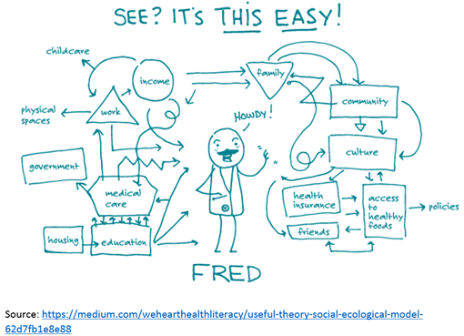
Designing a WINNING Proposal

Slide 28
What Works…
Using a systematic approach to program development, implementation, and evaluation
Considering evidence-based practices, experiences, community/partner input at each step
Using an ecological approach that considers up and downstream impacts on health
Problem Solving
Problem Identification
Notes:
When and how to use theory and evidence? •How to address both environmental and individual change •Assuring ‘active ingredients’ for change
How to address changing the behavior of people in the environment (i.e., people who are not at risk for the health problem, but are important to changing conditions that affect those at risk)? ◻How to address the complexity of multi-causation of problems and multi-level intervention points?
Equitable community participation Ensures that program focus reflects community concerns Brings greater breadth of skills, knowledge, and expertise Improves external validity

Slide 29
6 Steps of Developing Your Program
Needs assessment/problem analysis
What/who needs to be changed
Develop logic model of change
Create programmatic goals and objectives
Short, medium, long
Choose evidence-based intervention methods relating to the short-term objectives
Combine methods into an organized program
Plan for adoption, implementation, and sustainability of the program
Develop an evaluation plan
Notes:
Added #6-Develop an evaluation plan
It maps the path from recognition of a need or problem to the identification of a solution. Although Intervention Mapping is presented as a series of steps, Bartholomew and colleagues (2016) see the planning process as iterative rather than linear. Program planners move back and forth between tasks and steps. The process is also cumulative: Each step is based on previous steps, and inattention to a particular step may lead to mistakes and inadequate decisions.

Slide 30
Extensive Planning Guides You to Answer:
Who will decide to use the program? Who will implement the program? Who will ensure it continues over time?
What needs to be done?
Why would we do this approach (addressing determinants of health)?
How (what methods and strategies) do we influence these adoption, implementation, and maintenance behaviors and conditions?

Slide 31
Step 1: Assess the Problem
The D’s
Death
Disease or injury
Disability
Life Expectancy
Biometric measures
Body fat
Cortisol levels (stress)
Symptoms
Identify the HEALTH problem & who are those in your community at risk of or most impacted by the health problem
How does the particular health problem impact Quality of Life?

Slide 32
Step 1: Assess the Problem
Societal
Organizational
Community
Based on your health problem/factor and your behavioral problem/factor….
Consider the environmental issues contributing to the behavior and health problem:
Availability of services, lack of providers, location of services, political challenges

Slide 33
Step 1: Assess the Problem
Now that you have the other pieces in place, turn to the literature and your community to understand and learn the influences related to the health behavior you wish to change.

Slide 34
Influences on Change
Knowledge
Attitudes
Beliefs
Values
Perceived Needs
Perceived Abilities
Confidence/self-efficacy
Intentions

Slide 35
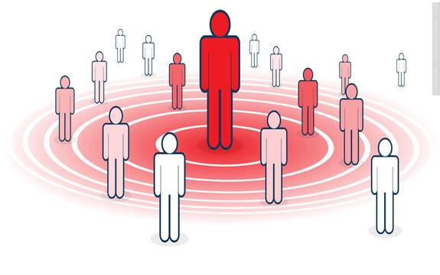
Influences on Change
Cultural beliefs
Family
Peers
Healthcare providers
Mentors
Admired media models
Community Members
Religious Leaders
May offer support, guidance,
approval, disapproval
Improved feelings of self-respect
Receiving a tax incentive
Improved feelings of health
Improved appearance
Physical rewards (pain, comfort, energy)
May be actual or anticipated

Slide 36
All factors must be interrelated….
Influences on Change
Behavior & Environment
Health
Your Intervention
Test it moving down the chain: If I change X then does Y change…
This is your theory of change!
Quality of Life

Slide 37
Step 2: Create Programmatic Goals & Objectives
Remember logic models?
What are the expected outcomes for behavioral change?
Increased rates of mothers breastfeeding through the 6-month mark
SMART-IE Objectives
Specific, measurable, attainable, realistic, timely-inclusive, equitable
What are the performance objectives for behavioral change?
Conduct presentations to at-risk work sites on the value of supporting breastfeeding mothers
Pediatrician teaches mother how to negotiate in the workplace for time to pump
Repeat for shorter-term changes

Slide 38
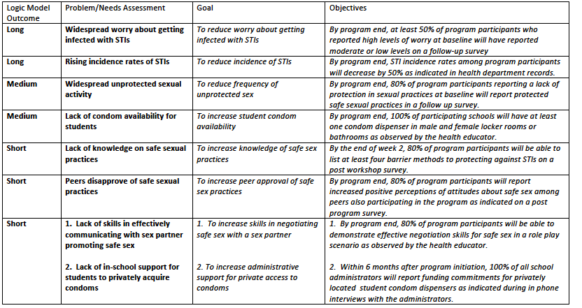

Slide 39
Step 3: Program Design
Review Evidence-Based Practices
Match activities to address each change objective, considering:
Effectiveness evidence for different strategies
Target audience preferences and resources
Feasibility and sustainability of implementation

Slide 40
Steps 4-5: Finalize Activities * Plan for Adoption, Implementation & Sustainability
Design specific program components (e.g., modules, sessions, materials).
Develop an implementation plan including personnel, timeline, budget, and evaluation.
Identify performance objectives
What needs to be done (materials development; partner identification; implementation)
Who needs to do it
When does it need to happen
What resources do you need

Slide 41
Step 6: Plan for Evaluation
Process
Impact
Outcome

Slide 42
Planning the Evaluation
Objective or Performance Outcome | Research Question(s) | Indicators/Measures (by which to answer the research question) | Data collection, timing, and approach
QOL: By program end, at least 50% of program participants who reported high levels of worry at baseline will have reported moderate or low levels on a follow-up survey | To what extent have worry levels changed from pre to post test? | Likert measures of worry about contracting STIs (Rating scale at 1-10 with high 7-10; moderate 6-4; low 3-1) | Baseline and follow-up at program end

Slide 43
Planning the Evaluation: HRSA Rural Health Network Development Program

Slide 44
Summary
Using a systematic approach to program planning can provide a process for identifying and addressing specific needs and developing key messages and materials to address them.
Useful in writing the problem statement
Streamline the narrative
Systematic planning that is participatory, and uses theory/frameworks, evidence, and new data can lead to more successful implementation strategies
Demonstrates community buy-in when they are involved from the start – important to funders

Slide 45
Questions?
IFP Contact Information:
Louise Mathias, Senior Partner
Louise.mathias@innovativefundingpartners.com
(202) 809-3401

Slide 46
Save the Date
Do’s and Don’ts in Grant Development: Successful Proposal Case Studies
Wednesday,
February 21st, 2024
12-1pm

Slide 47
Appendix: Resources
Rural Health Information Hub: Evidence-Based Toolkits: https://www.ruralhealthinfo.org/toolkits
*Provides sample guides on specific topics
Healthy People 2030: www.healthypeople.gov
Fernandez, M.E., Ruiter, R.A.C., Markham, C.M., & Kok, G. (2019). Intervention Mapping: Theory- and Evidence-Based Health Promotion Program Planning: Perspective and Examples. Front Public Health, 7, Article 209. https://doi.org/10.3389/fpubh.2019.00209
Kok, G., Gottlieb, N.H., Peters, G.-J.Y., Mullen, P.D., Parcel, G.S., Ruiter, R.A.C., Fernández, M. E., Markham, C., & Bartholomew, L.K. (2016). A taxonomy of behavior change methods: An Intervention Mapping approach. Health Psychology Review, 10, 297-312. https://doi.org/10.1080/17437199.2015.1077155

Slide 48
dht.org

