Slide 1
Creating a Solid
Work Plan
August 16, 2023

Slide 2
Learning Objectives
I. Understanding the crucial role of the work plan in the overall project design
II. Developing effective goals, objectives and activities, and understanding the differences
III. Ensuring the selected objectives are SMART
IV. Understanding what makes a work plan successful, with examples

Slide 3
About
Innovative Funding Partners
IFP is a nationally recognized grants consulting firm highly regarded for an impressive overall grant success rate of 85%. Well known for their expertise in federal and other governmental grant writing, this success is based not only on technical expertise but also on a foundational relationship-building approach. IFP’s team of over 25 highly experienced consultants is passionate about helping organizations meet the unique needs of their local communities and better serve their constituents by seeking and securing grant funding.

Slide 4
About the
presenters
Susannah Williams, IFP Grants Consultant, is a grant writer with a proven track record of securing federal and foundation grants across multiple sectors, including health care, workforce development, and education. She has extensive experience in supporting clients’ project design and development to meet complex grant requirements. Susannah has written multiple successful proposals for CDC, HRSA, DOE, DOJ, and DOL, among others.
.
3.
Susannah Williams, M.A.
Grants Consultant

Slide 5
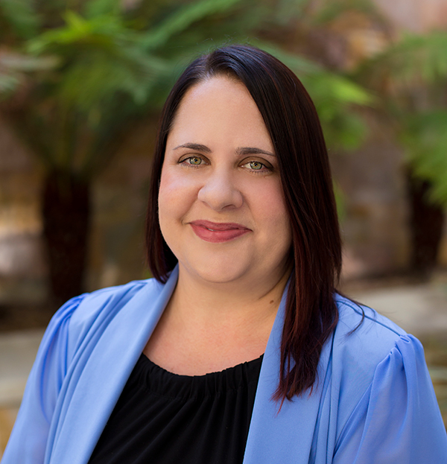
About the
presenters
Sarah Villarreal, IFP Grants Consultant, is an experienced grant writer with over 20 years of experience. Sarah has experience writing foundation, state and federal grants for various industries including education, health care, social services, information, transportation, arts, and public administration. Sarah holds a Ph.D. in Leadership and Change from Antioch University, an M.B.A. from the University of Redlands, and a B.A from the University of California, Los Angeles.
.
3.
Sarah Villarreal, Ph.D.
Grants Consultant

Slide 6
I. Understanding the crucial role of the work plan in the overall project design
Notes:
Developing a logic model at the beginning of program planning gives you a framework for charting the links between your program’s resources, activities, and outputs and its intended outcomes. It enables you to evaluate your program once it begins. And it helps you communicate to your stakeholders what you want to accomplish, how you intend to reach your goals, and how you will track your progress.
Logic models represent INTENTION; shows connection between the planned work and what you hope to achieve. THIS is informed by the theory of change.
These components illustrate the connection between your planned work and your intended results.
Visual representation, etc. purpose in sharing ,etc.
Start with identifying the impacts and outcomes (relationship to backwards design) then can select the activities

Slide 7
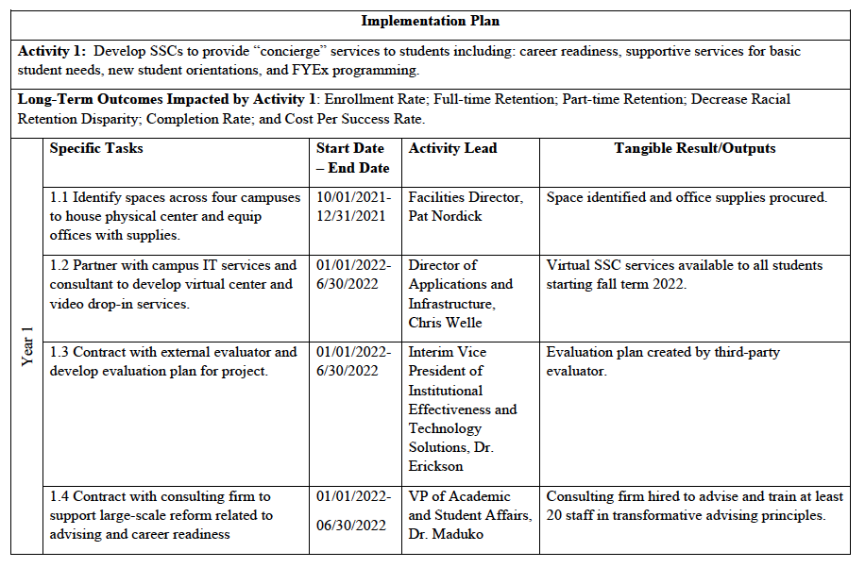
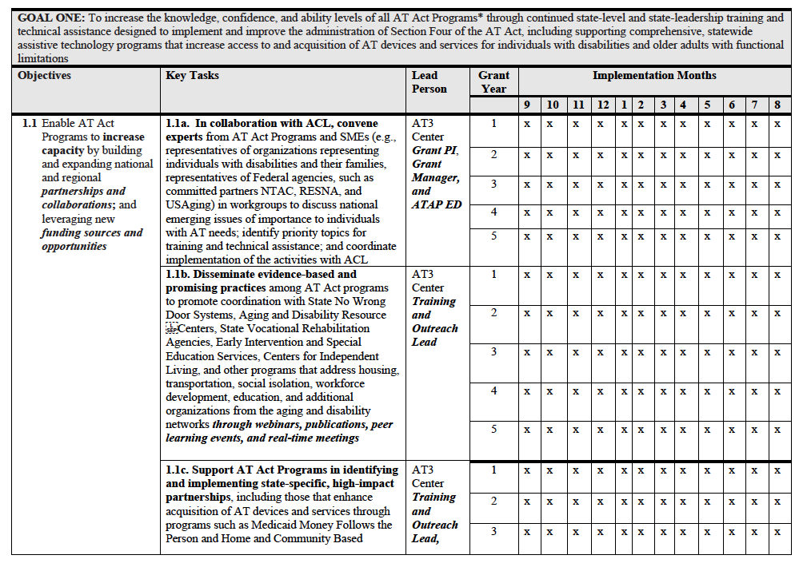
What is the primary purpose of a work plan?
What you are going to do
How you are going to do each task
Who will perform each task
When will the tasks be completed
Notes:
This is what we bring or invest in the program; very influential to the budget.
Resources are the raw materials needed to create the program, implement its activities, and attain the desired outputs and outcomes. Sometimes called inputs, resources include both material items (such as curricula, instruction materials, facilities, and funding) and nonmaterial items (such as time, community support, and specialized knowledge and skills).

Slide 8
Why is a well-structured work plan so important to project design?
Allows reviewers to quickly assess the project’s potential impact, alignment with grant requirements, and your ability to execute effectively
Demonstrates a clear and organized approach to achieving project goals and objectives
Provides a “recipe” for your program
Work plans can also become a strong communication tool for the team throughout the project implementation
Notes:
This is what we bring or invest in the program; very influential to the budget.
Resources are the raw materials needed to create the program, implement its activities, and attain the desired outputs and outcomes. Sometimes called inputs, resources include both material items (such as curricula, instruction materials, facilities, and funding) and nonmaterial items (such as time, community support, and specialized knowledge and skills).

Slide 9
What are the key components of the work plan?
Goals
Objectives
Activities
Timeline
Responsible Personnel
Measures/Outcomes
Notes:
This is what we bring or invest in the program; very influential to the budget.
Resources are the raw materials needed to create the program, implement its activities, and attain the desired outputs and outcomes. Sometimes called inputs, resources include both material items (such as curricula, instruction materials, facilities, and funding) and nonmaterial items (such as time, community support, and specialized knowledge and skills).

Slide 10
II. Developing effective goals, objectives and activities, and understanding the differences
Objectives
Activities
Goals
Notes:
Developing a logic model at the beginning of program planning gives you a framework for charting the links between your program’s resources, activities, and outputs and its intended outcomes. It enables you to evaluate your program once it begins. And it helps you communicate to your stakeholders what you want to accomplish, how you intend to reach your goals, and how you will track your progress.
Logic models represent INTENTION; shows connection between the planned work and what you hope to achieve. THIS is informed by the theory of change.
These components illustrate the connection between your planned work and your intended results.
Visual representation, etc. purpose in sharing ,etc.
Start with identifying the impacts and outcomes (relationship to backwards design) then can select the activities

Slide 11
What’s the first step in developing goals and objectives?
Review the Notice of Funding Opportunity (NOFO) for the specific purpose of the grant and the values of the organization or agency.
Use the language and terminology to construct your plan.
Ensure your work plan flows logically and uses the template or structure required by the proposal.
Notes:
This is what we bring or invest in the program; very influential to the budget.
Resources are the raw materials needed to create the program, implement its activities, and attain the desired outputs and outcomes. Sometimes called inputs, resources include both material items (such as curricula, instruction materials, facilities, and funding) and nonmaterial items (such as time, community support, and specialized knowledge and skills).

Slide 12
GOALS
A goal is a broad statement about ultimate outcomes from program implementation
Goals describe the behavior or condition in the target population that is expected to change
Focus on the big picture
Should align with the grant purpose and your statement of need
Concise – one sentence
Use words such as decrease, deliver, develop, establish, improve, increase, produce, and provide
Notes:
This is what we bring or invest in the program; very influential to the budget.
Resources are the raw materials needed to create the program, implement its activities, and attain the desired outputs and outcomes. Sometimes called inputs, resources include both material items (such as curricula, instruction materials, facilities, and funding) and nonmaterial items (such as time, community support, and specialized knowledge and skills).

Slide 13
What makes a goal compelling?
WEAK GOAL
STRONG GOAL
Increase the capacity of the local employment services agency to support Opportunity Youth
Increase the capacity of the local employment services agency to provide training to Opportunity Youth that will allow them to secure employment through registered apprenticeships

Slide 14
What makes a goal compelling?
WEAK GOAL
STRONG GOAL
Decrease recidivism through a new community partnership between Brown County Substance Use Coalition and the Smith Regional Treatment Center
Decrease the recidivism rate of criminal justice-involved individuals in Brown County through cross-agency, evidence-based behavioral health approaches that address risk factors for recidivism

Slide 15
Aligning goals to NOFO language
NOFO: The purpose of this program is to provide resources to help expand and enhance access to Medications for Opioid Use Disorder (MOUD). It is expected that this program will help to increase access to MOUD for individuals with Opioid Use Disorder (OUD), including individuals from diverse racial, ethnic, sexual and gender minority communities.
GOAL : Increase access to MOUD services for Smith County residents, including those representing historically marginalized populations, and strengthen the local OUD service delivery model by engaging the Smith Substance Awareness Coalition in evidence-based outreach and enrollment efforts

Slide 16
What is the difference between goals and objectives?
Goals describe the long-term expectation of what should happen as a result of your project (the desired result).
Objectives describe the specific results and the specific manner in which they will be achieved. You will usually need multiple objectives to achieve one goal.
Goal: Improve food security among historically marginalized populations in Falls City by increasing access to fresh food and SNAP enrollment services at three food pantry locations.
Objective 1: By 9/1/2024, SNAP agency representatives will have provided a 5-day intensive training to 3 FTE Food Pantry Coordinators, preparing them to provide comprehensive enrollment services to historically marginalized individuals
Objective 2: By 10/30/2024, Food Pantry IT Lead will have implemented a new data management system to track nine key data indicators documenting the provision of food support to target population
Objective 3: By 12/1/2025, the Falls City Food Security Initiative will have provided fresh food to at least 300 individuals, with at least 150 of these individuals completing four encounters over the project period

Slide 17
ACTIVITIES
Further detail on the method
Tasks or strategies
Actions undertaken
Examples:
Hire Project Director.
Develop training materials for case management system.
Write standard operating procedures for program intake.
Notes:
This is what we bring or invest in the program; very influential to the budget.
Resources are the raw materials needed to create the program, implement its activities, and attain the desired outputs and outcomes. Sometimes called inputs, resources include both material items (such as curricula, instruction materials, facilities, and funding) and nonmaterial items (such as time, community support, and specialized knowledge and skills).

Slide 18
Example: objective with activities
Objective 1: By 9/1/2024, SNAP agency representatives will have provided a 5-day intensive training to 3 FTE Food Pantry Coordinators, preparing them to provide comprehensive enrollment services to historically marginalized individuals
Activities:
Hire 3 FTE Food Pantry Coordinators
Develop and finalize training curriculum
Develop and finalize end-of-training assessment
Implement 5-day intensive training

Slide 19
TIMELINE
Partial or entire grant period
Timeline to accomplish each activity
Start and/or end dates
Or by standard fractions of grant period (e.g., quarterly)
Notes:
This is what we bring or invest in the program; very influential to the budget.
Resources are the raw materials needed to create the program, implement its activities, and attain the desired outputs and outcomes. Sometimes called inputs, resources include both material items (such as curricula, instruction materials, facilities, and funding) and nonmaterial items (such as time, community support, and specialized knowledge and skills).

Slide 20
RESPONSIBLE PARTIES
Those responsible for accomplishing each of the designated activities
One or more individuals
A specific person, or group / title (e.g., Program Director, Chief Financial Officer, Steering Committee, Health Navigators, Performance Evaluation Team)
Notes:
This is what we bring or invest in the program; very influential to the budget.
Resources are the raw materials needed to create the program, implement its activities, and attain the desired outputs and outcomes. Sometimes called inputs, resources include both material items (such as curricula, instruction materials, facilities, and funding) and nonmaterial items (such as time, community support, and specialized knowledge and skills).

Slide 21
MEASURES / OUTCOMES
Terms vary across opportunities – e.g., milestones or outputs
Explains how progress is tracked and measured
Process and outcome measures
With objectives to improve measures, baseline data and/or performance targets ideal
Notes:
This is what we bring or invest in the program; very influential to the budget.
Resources are the raw materials needed to create the program, implement its activities, and attain the desired outputs and outcomes. Sometimes called inputs, resources include both material items (such as curricula, instruction materials, facilities, and funding) and nonmaterial items (such as time, community support, and specialized knowledge and skills).

Slide 22
III. Ensuring the selected objectives are SMART
Specific – Target a specific population and area for improvement.
Measurable – Quantify indicators of progress and how much change is expected.
Achievable – Indicate who will complete the action in a specified period of time.
Realistic – State results that can be practically achieved, given available resources.
Time-related – Commit to when the results can be accomplished and when we will know we are done.
Notes:
Developing a logic model at the beginning of program planning gives you a framework for charting the links between your program’s resources, activities, and outputs and its intended outcomes. It enables you to evaluate your program once it begins. And it helps you communicate to your stakeholders what you want to accomplish, how you intend to reach your goals, and how you will track your progress.
Logic models represent INTENTION; shows connection between the planned work and what you hope to achieve. THIS is informed by the theory of change.
These components illustrate the connection between your planned work and your intended results.
Visual representation, etc. purpose in sharing ,etc.
Start with identifying the impacts and outcomes (relationship to backwards design) then can select the activities

Slide 23
SAMPLE SMART OBJECTIVES
Conduct 30 suicide prevention and mental health promotion trainings to program participants based on the Question, Persuade, Refer (QPR) evidence-based practice model, by the end of the project period.
In Year 1, establish five dedicated outreach teams, each consisting of a social worker and housing specialist, to connect housing insecure individuals with available permanent housing resources.
Notes:
This is what we bring or invest in the program; very influential to the budget.
Resources are the raw materials needed to create the program, implement its activities, and attain the desired outputs and outcomes. Sometimes called inputs, resources include both material items (such as curricula, instruction materials, facilities, and funding) and nonmaterial items (such as time, community support, and specialized knowledge and skills).

Slide 24
SAMPLE SMART OBJECTIVES
By the end of Year 3, the Clinical Psychologist will provide behavioral health services, including cognitive behavioral therapy (CBT), to at least 50 incarcerated individuals with substance use disorder (SUD).
Within the first 60 days of grant award, the Consortium will develop and finalize data-sharing agreements with 100% of project partners.
Notes:
This is what we bring or invest in the program; very influential to the budget.
Resources are the raw materials needed to create the program, implement its activities, and attain the desired outputs and outcomes. Sometimes called inputs, resources include both material items (such as curricula, instruction materials, facilities, and funding) and nonmaterial items (such as time, community support, and specialized knowledge and skills).

Slide 25
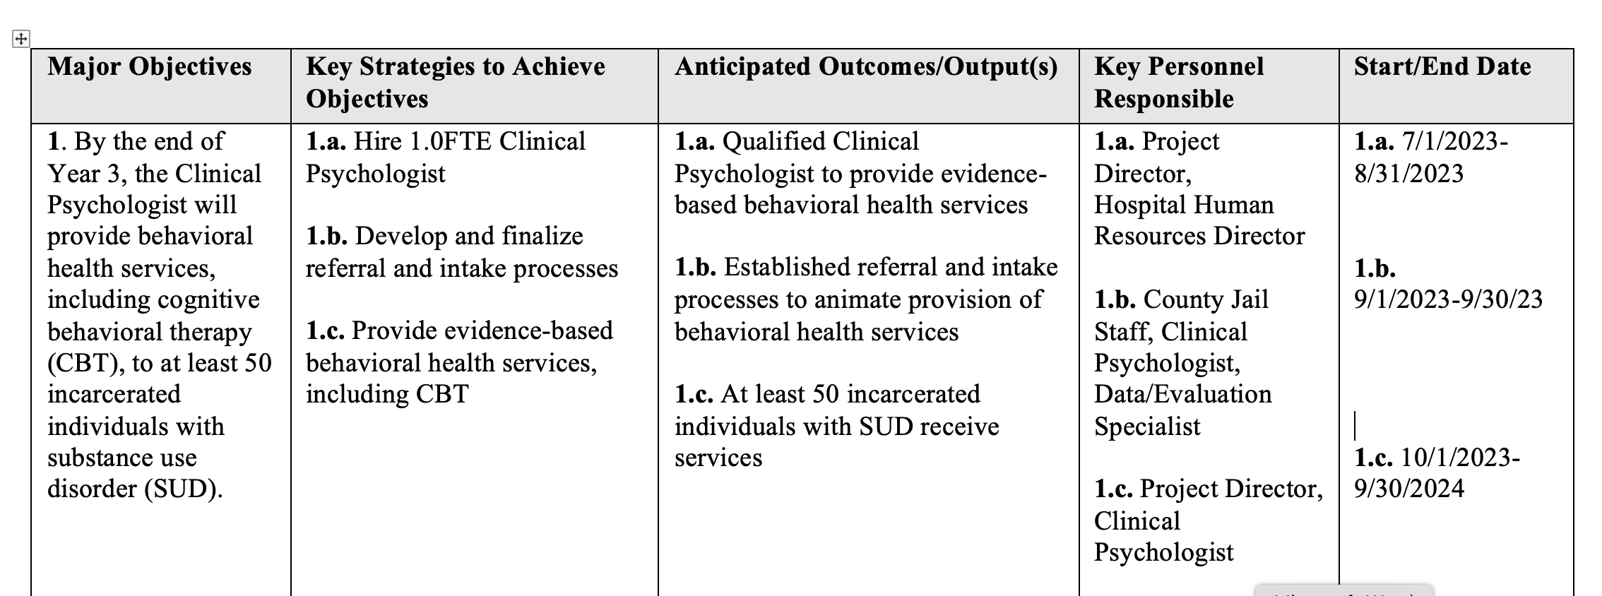
SMART objectives contain some of the “ingredients” for the work plan
WHEN?
WHO?
WHAT?
By the end of Year 3, the Clinical Psychologist will provide behavioral health services, including cognitive behavioral therapy (CBT), to at least 50 incarcerated individuals with substance use disorder (SUD).
WHY DOES IT MATTER?

Slide 26
IV. Understanding what makes a work plan successful, with examples
Other considerations for a strong work plan:
Engage stakeholders in the planning process
Create an adaptive work plan that allows flexibility in addressing unexpected challenges during implementation
Conduct periodic reviews to assess progress against the work plan
Notes:
Developing a logic model at the beginning of program planning gives you a framework for charting the links between your program’s resources, activities, and outputs and its intended outcomes. It enables you to evaluate your program once it begins. And it helps you communicate to your stakeholders what you want to accomplish, how you intend to reach your goals, and how you will track your progress.
Logic models represent INTENTION; shows connection between the planned work and what you hope to achieve. THIS is informed by the theory of change.
These components illustrate the connection between your planned work and your intended results.
Visual representation, etc. purpose in sharing ,etc.
Start with identifying the impacts and outcomes (relationship to backwards design) then can select the activities

Slide 27
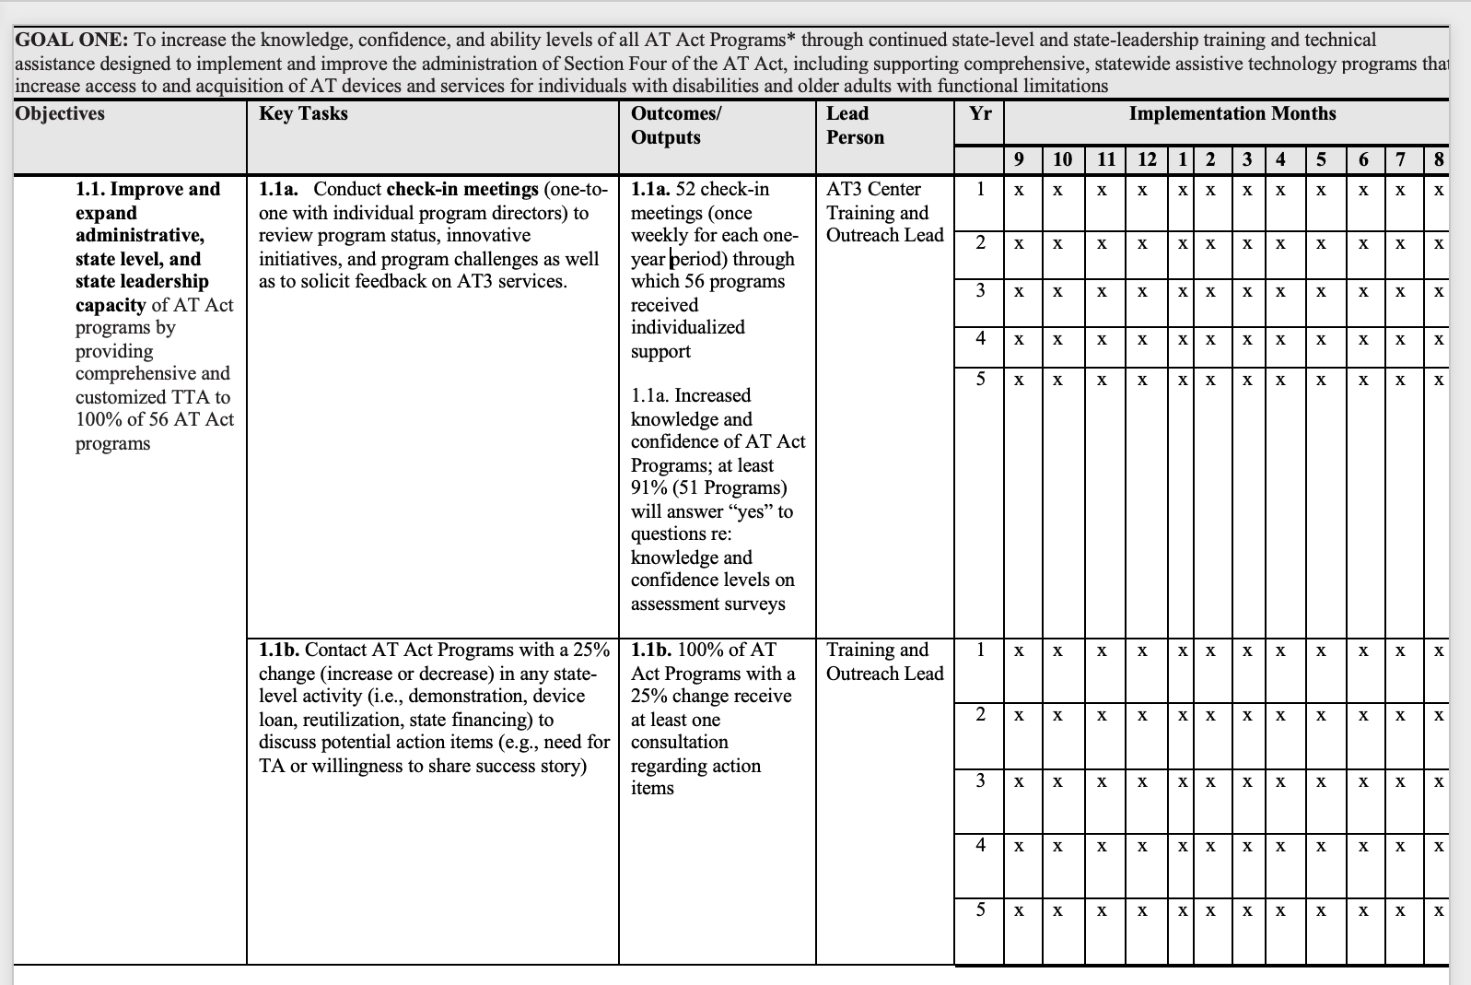
Example 1
Time by grant year / month
Activities as Key Tasks
Notes:
This is what we bring or invest in the program; very influential to the budget.
Resources are the raw materials needed to create the program, implement its activities, and attain the desired outputs and outcomes. Sometimes called inputs, resources include both material items (such as curricula, instruction materials, facilities, and funding) and nonmaterial items (such as time, community support, and specialized knowledge and skills).

Slide 28
Example 2
Year 1 with dates
Notes:
This is what we bring or invest in the program; very influential to the budget.
Resources are the raw materials needed to create the program, implement its activities, and attain the desired outputs and outcomes. Sometimes called inputs, resources include both material items (such as curricula, instruction materials, facilities, and funding) and nonmaterial items (such as time, community support, and specialized knowledge and skills).

Slide 29
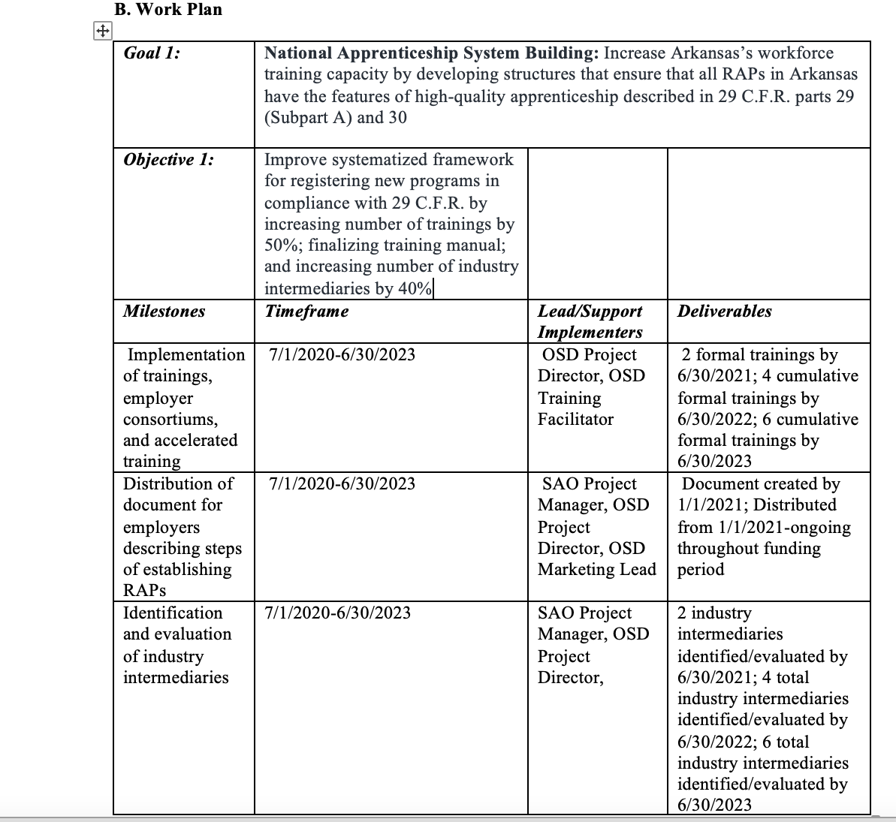
Example 3
Activities as Milestones
Outcomes as deliverables
Notes:
This is what we bring or invest in the program; very influential to the budget.
Resources are the raw materials needed to create the program, implement its activities, and attain the desired outputs and outcomes. Sometimes called inputs, resources include both material items (such as curricula, instruction materials, facilities, and funding) and nonmaterial items (such as time, community support, and specialized knowledge and skills).

Slide 30
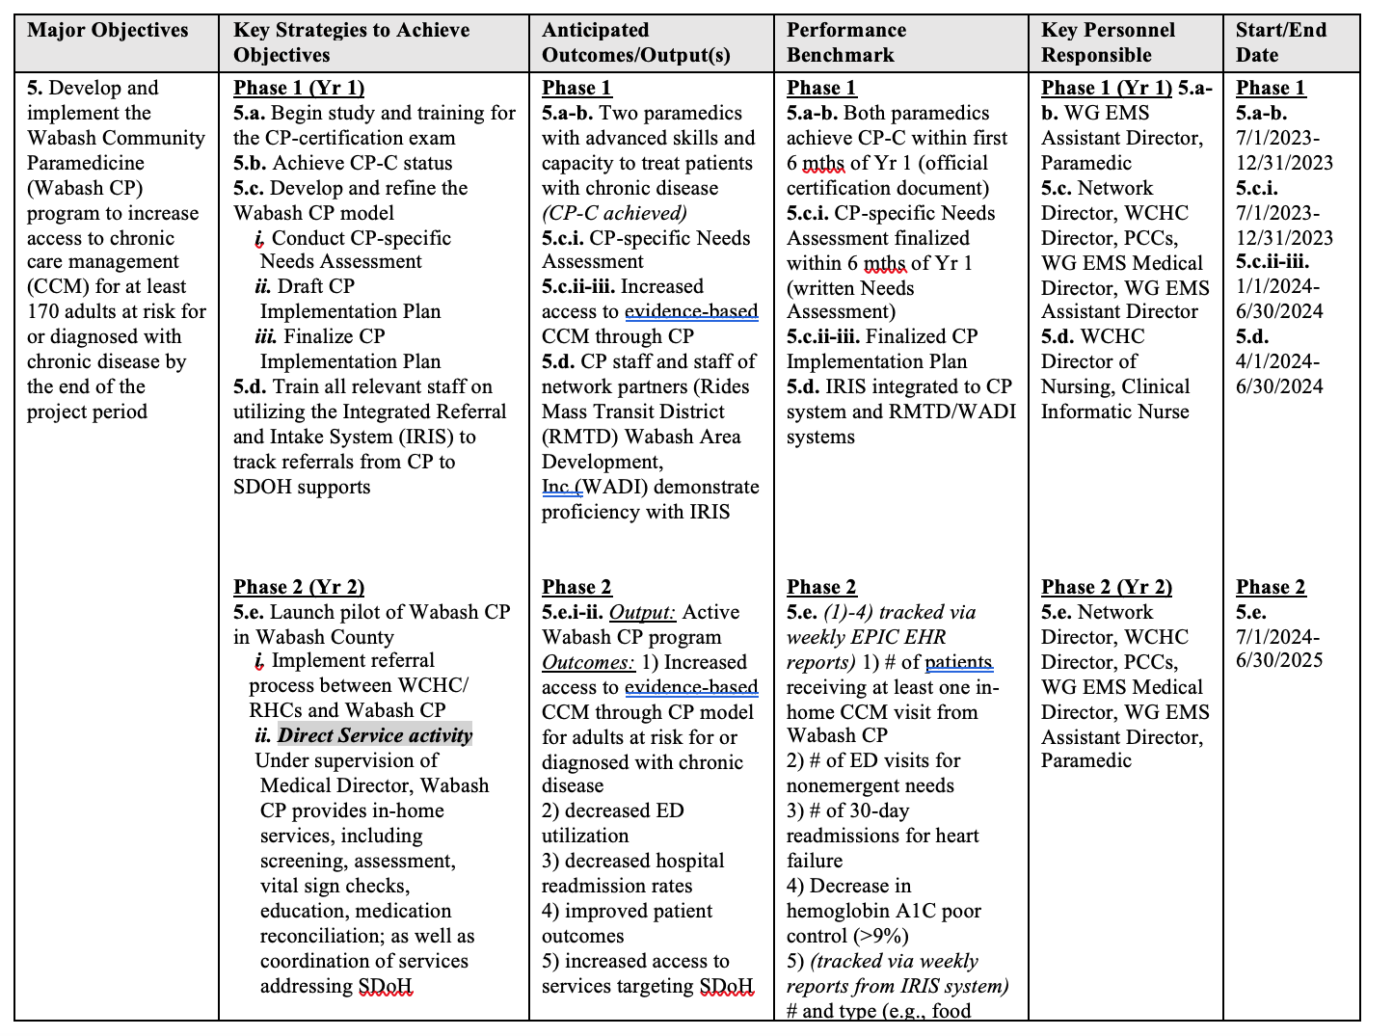
Example 4
Activities as Key Strategies
Numbering to align across columns
This NOFO required Performance Benchmarks in addition to Outcomes/Outputs
Verbs
Notes:
This is what we bring or invest in the program; very influential to the budget.
Resources are the raw materials needed to create the program, implement its activities, and attain the desired outputs and outcomes. Sometimes called inputs, resources include both material items (such as curricula, instruction materials, facilities, and funding) and nonmaterial items (such as time, community support, and specialized knowledge and skills).

Slide 31
Questions?
IFP Contact Information:
Louise Mathias, Senior Partner
Louise.mathias@innovativefundingpartners.com
(202) 809-3401

Slide 32
Save the Date
Fiscal Sponsorship:
A Comprehensive Overview
Wednesday,
September 20th, 2023
12-1pm

Slide 33
Appendix: Resources
https://writing.wisc.edu/handbook/assignments/grants-2/#4
https://www.samhsa.gov/grants/how-to-apply/writing-completing-application/goals-measurable-objectives
https://www.ucop.edu/local-human-resources/_files/performance-appraisal/How%20to%20write%20SMART%20Goals%20v2.pdf
https://bhw.hrsa.gov/sites/default/files/bureau-health-workforce/funding/workplantemplate.pdf

Slide 34
dht.org

