Slide 1
Do’s and Don’ts in Government Grant Development:
Successful Proposal Case Studies
February 21st, 2024

Slide 2
Learning Objectives
I. Understanding how three successful government proposals “work,” including the work plan and budget sections
II. Identifying and avoiding fatal flaws in the government grant application process

Slide 3
About
Innovative Funding Partners
IFP is a nationally recognized grants consulting firm highly regarded for an impressive overall grant success rate of 84%. Well known for their expertise in federal and other governmental grant writing, this success is based not only on technical expertise, but also on a foundational relationship-building approach. IFP’s team of over 20 highly experienced consultants are passionate about helping organizations meet the unique needs of their local communities and better serve their constituents by seeking and securing grant funding.

Slide 4
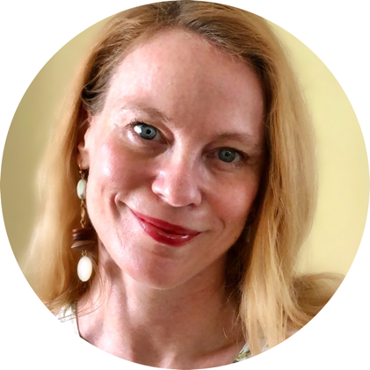
About the
presenters
Louise Mathias, Senior Partner, has over two decades of federal grant development and grant management experience across a wide variety of sectors, including health care, social services, community and economic development, and education. Her experience includes conducting in-depth analysis of organizational resources and readiness to pursue federal grant funding. Louise oversees the federal grants development process and provides ongoing professional development support to IFP’s team of over 20 grant writing consultants. She is particularly passionate about projects that work to address racial equity, enhance rural community infrastructure, and reduce disparities amongst underserved populations of all kinds.
Louise Mathias
Senior Partner

Slide 5
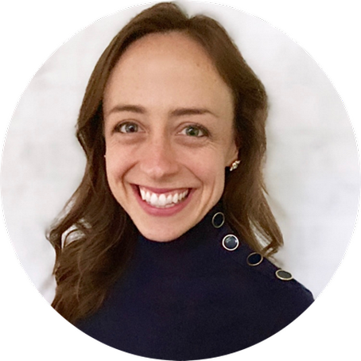
About the
presenters
Susannah Williams, IFP Senior Grants Consultant, is a grant writer with a proven track record of securing federal and foundation grants across multiple sectors, including health care, workforce development, and education. She has extensive experience in supporting clients’ project design and development to meet complex grant requirements. Susannah has written multiple successful proposals for CDC, HRSA, DOE, DOJ, DOL, and USDA.
.
3.
Susannah Williams
Senior Grants Consultant

Slide 6
I. Understanding how three successful government proposals “work,” including the work plan and budget sections

Slide 7
Unifying Factors of Successful Government Grant Proposals
Awardee
The “X Factor”
Unique qualities, compelling story, timely alignment to agency priorities
Work plan/logic model and budget logically connect the dots
Project design is grounded in evidence-based practices
Applicant
Demonstrates capacity to develop, implement, and evaluate the project
Proposal responds thoroughly to every single proposal requirement

Slide 8
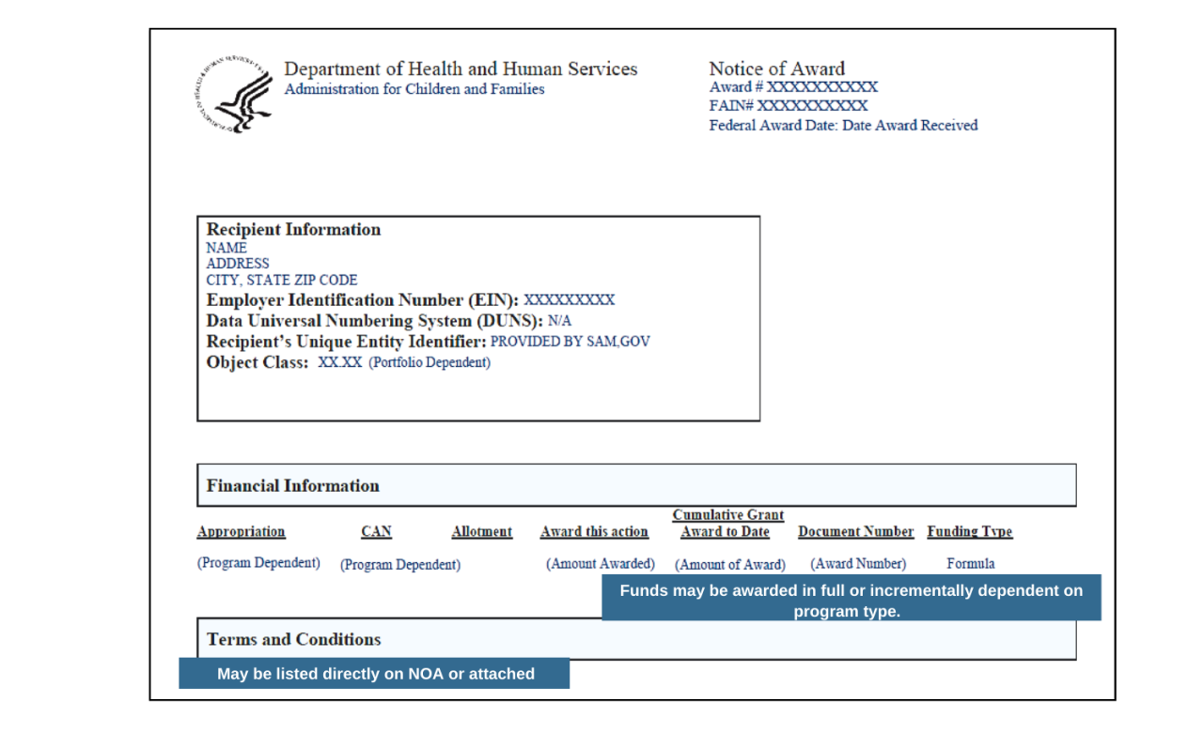
What does this look like across three different proposals?
Getting from here….
…to here.

Slide 9
We will take a closer look at three awarded proposals, each representing a specific sector, federal agency, and grant program:
Sector | Agency | Program
Health care | Health Resources and Services Administration (HRSA) | Rural Communities Opioid Response Program- Behavioral Health Care Support (RCORP BHS)
Economic Opportunity | Department of Labor, Employment and Training Administration (DOL-ETA) | State Apprenticeship Expansion (SAE)
Food and Agricultural Systems | United States Department of Agriculture, National Institute of Food and Agriculture (USDA NIFA) | Gus Schumacher Nutrition Incentive Program (GusNIP)

Slide 10
1. HRSA’s Rural Communities Opioid Response Program- Behavioral Health Care Support (RCORP BHS)
RCORP BHS aims to improve the quality and sustainability of behavioral health care services in rural communities, including evidence-based, trauma-informed treatment for substance use disorder (SUD).
Award recipients receive up to $500,000 per year over the four-year period of performance to implement activities that are aligned with the following program goals:
Address structural- and systems-level barriers to improve rural residents’ access to quality, integrated SUD and other behavioral health care services.
Improve the quality and sustainability of rural behavioral health care services by supporting rural health care providers to offer coordinated, evidence- based, trauma-informed SUD and other behavioral health care services.

Slide 11
1. HRSA’s Rural Communities Opioid Response Program- Behavioral Health Care Support (RCORP BHS)
How does an awarded proposal for this program “work”?

Slide 12
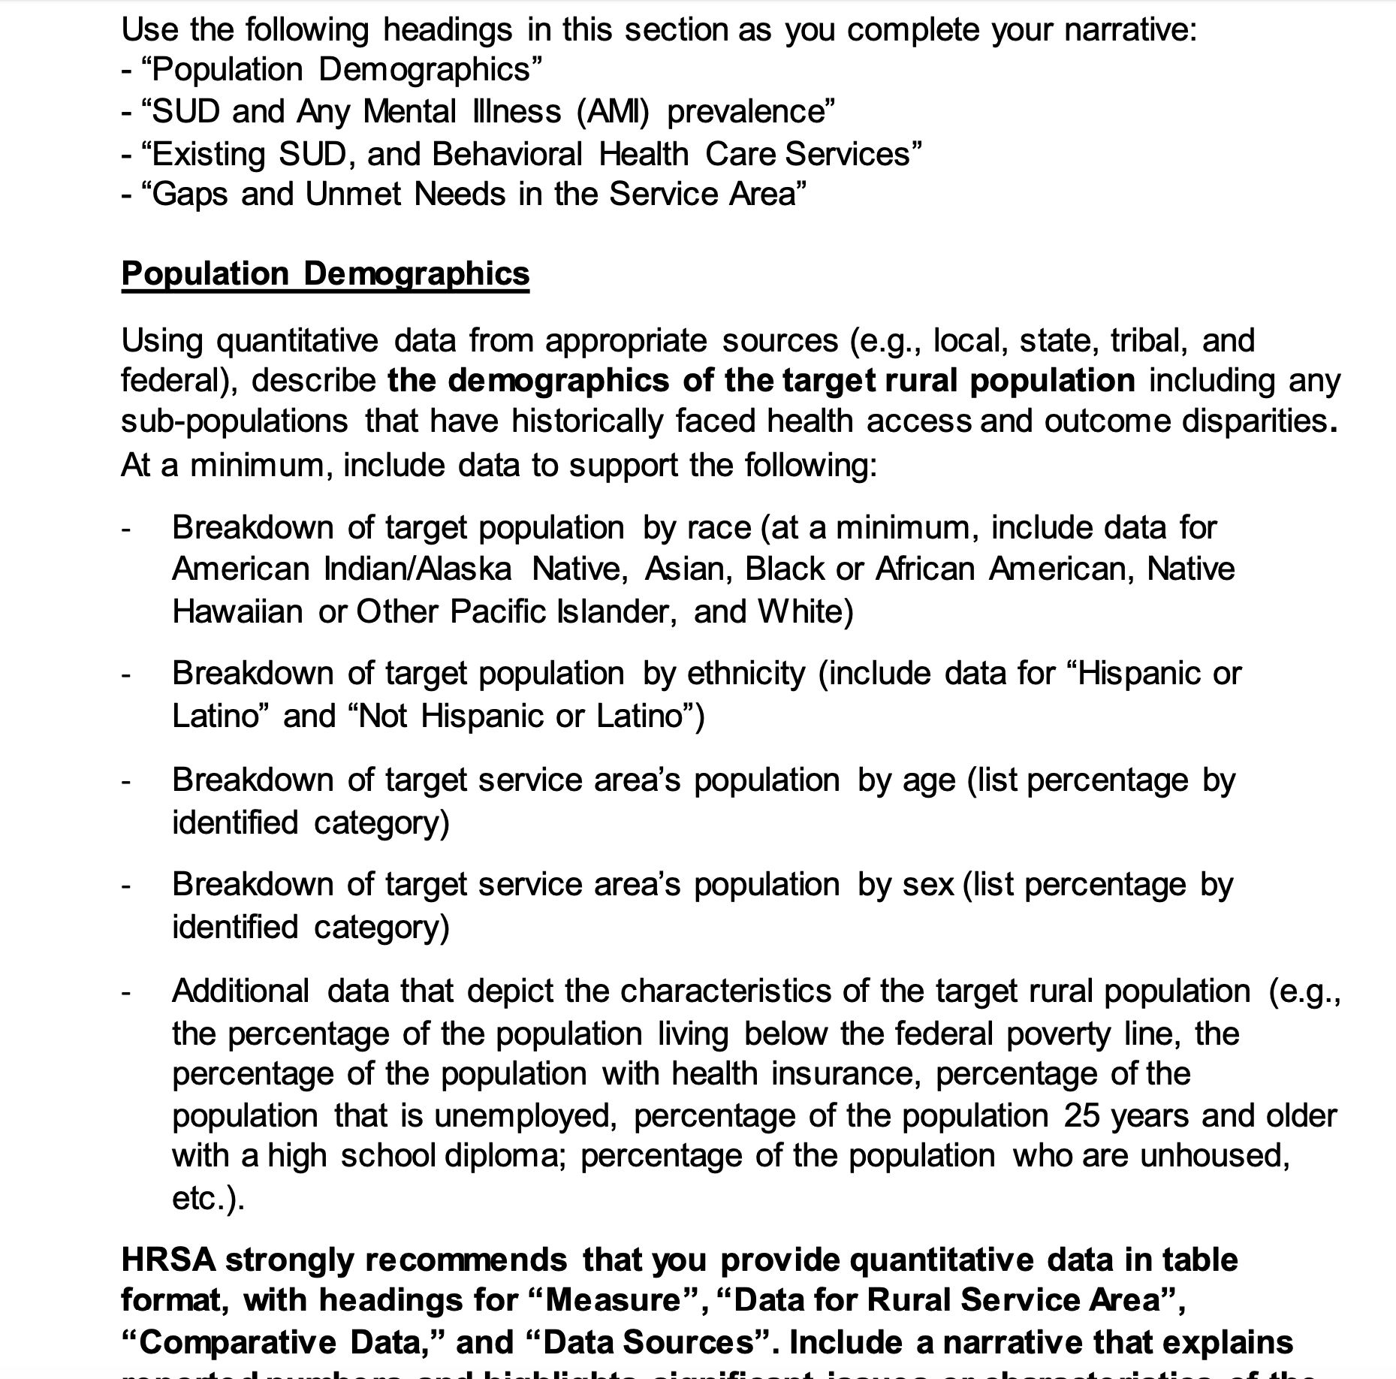
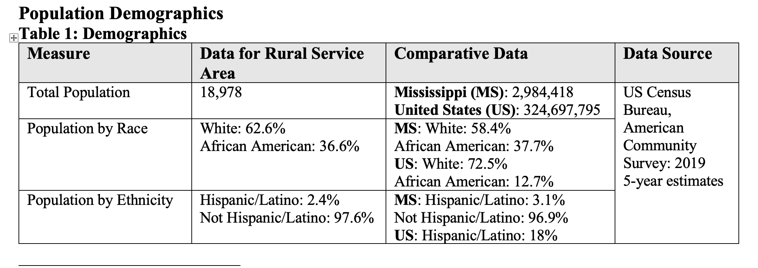
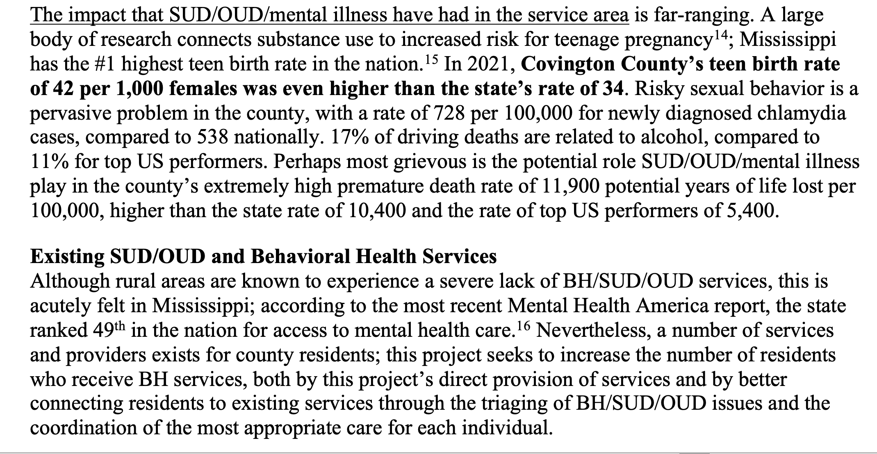
The proposal responds to every requirement in the Notice of Funding Opportunity (NOFO), in order, and embeds the language of the NOFO to make it easy for the reviewer to find.
NOFO
Proposal

Slide 13
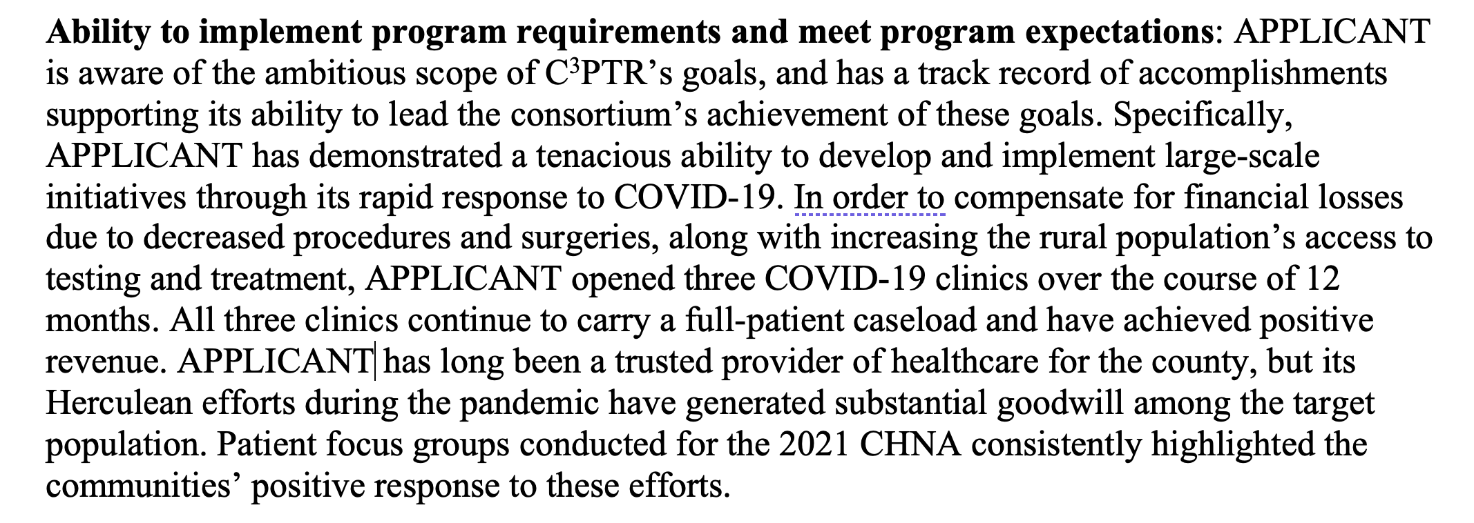
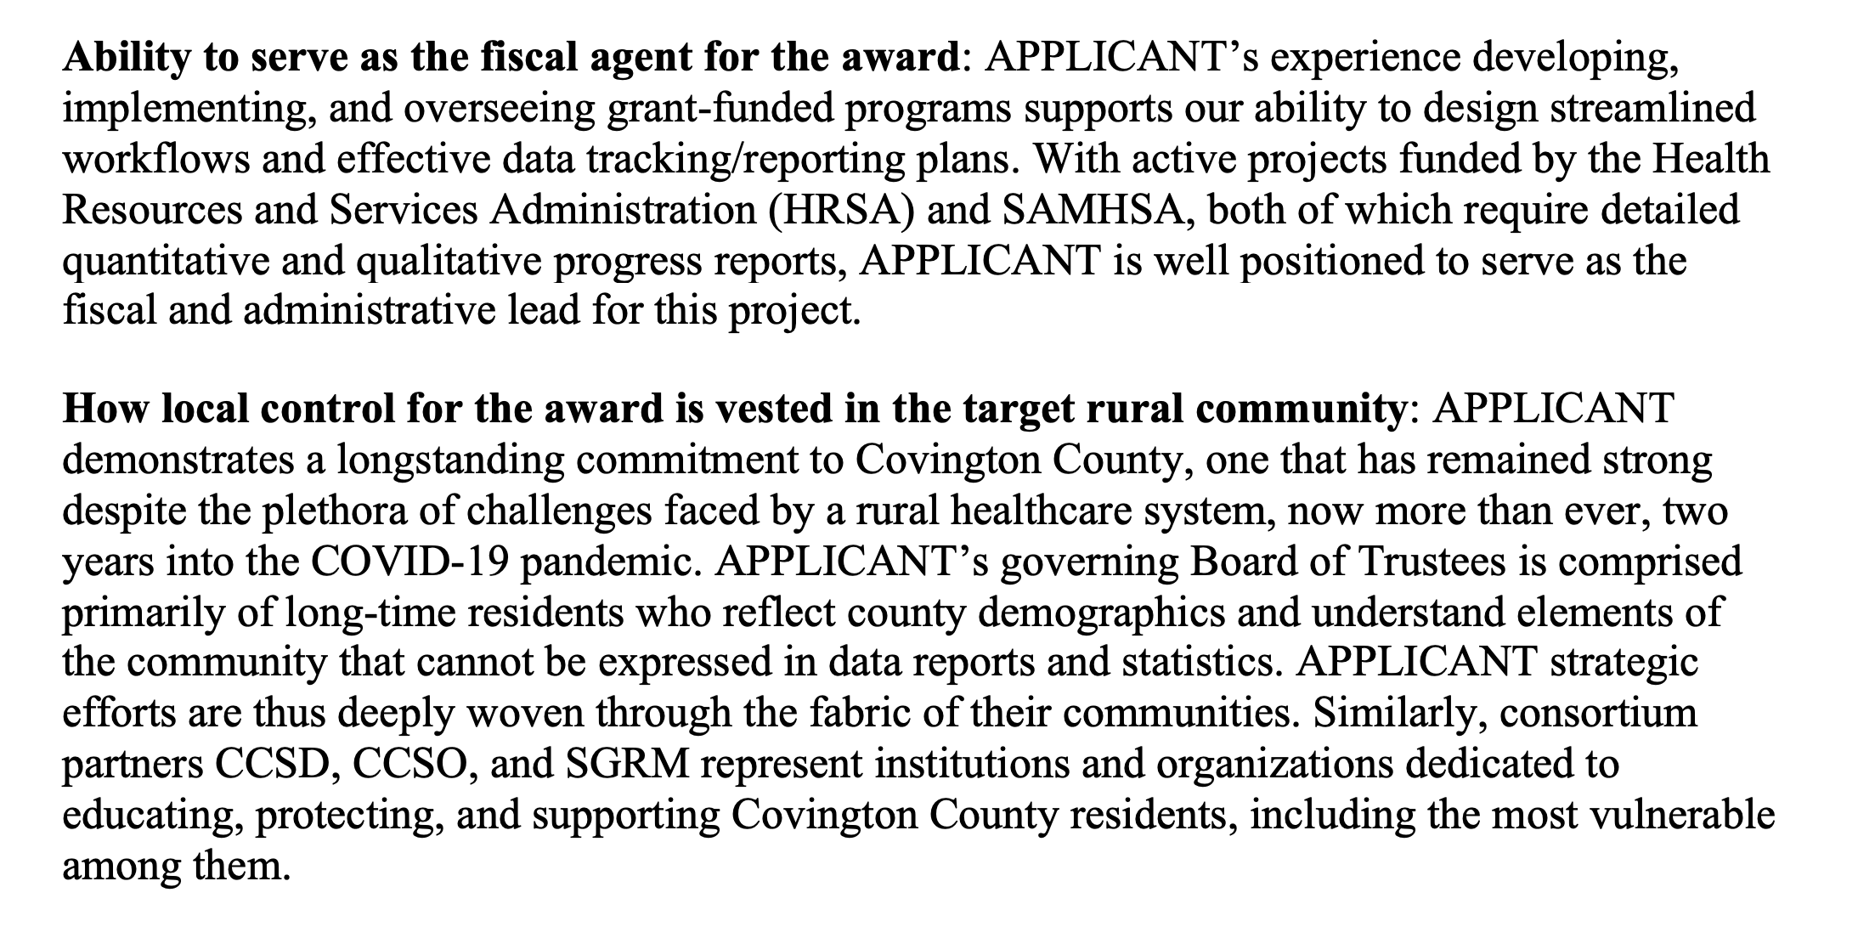
The proposal demonstrates the applicant’s capacity to develop, implement, and evaluate the project.

Slide 14
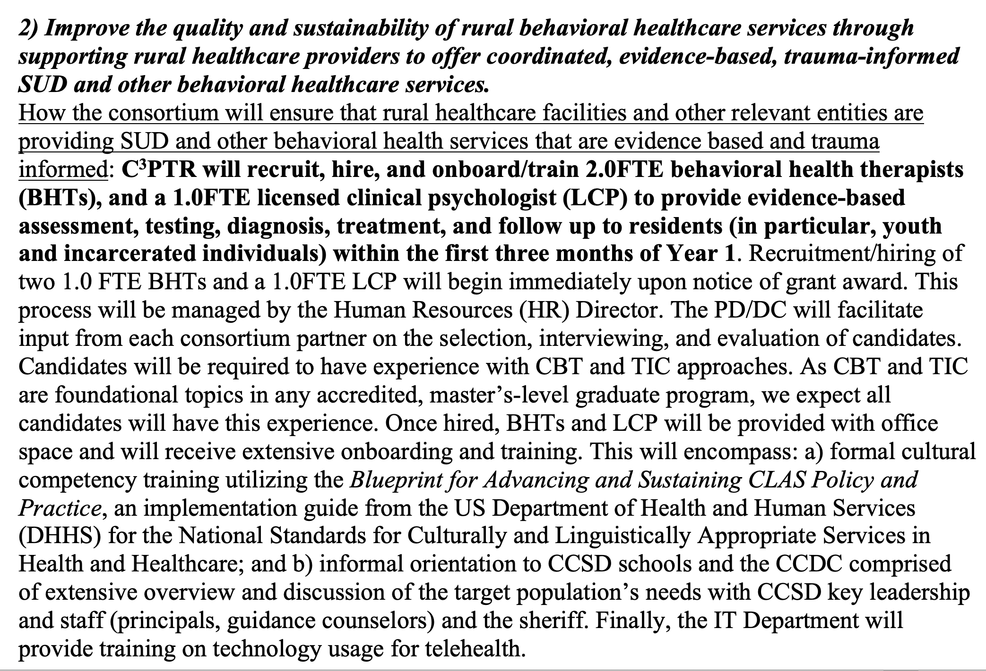
The proposal describes methodology grounded in evidence-based practices and models.

Slide 15
The Work Plan follows NOFO instructions and demonstrates a thorough understanding of what implementation will require. It connects the dots for the reviewer on the who, when, what, how, why.

Slide 16
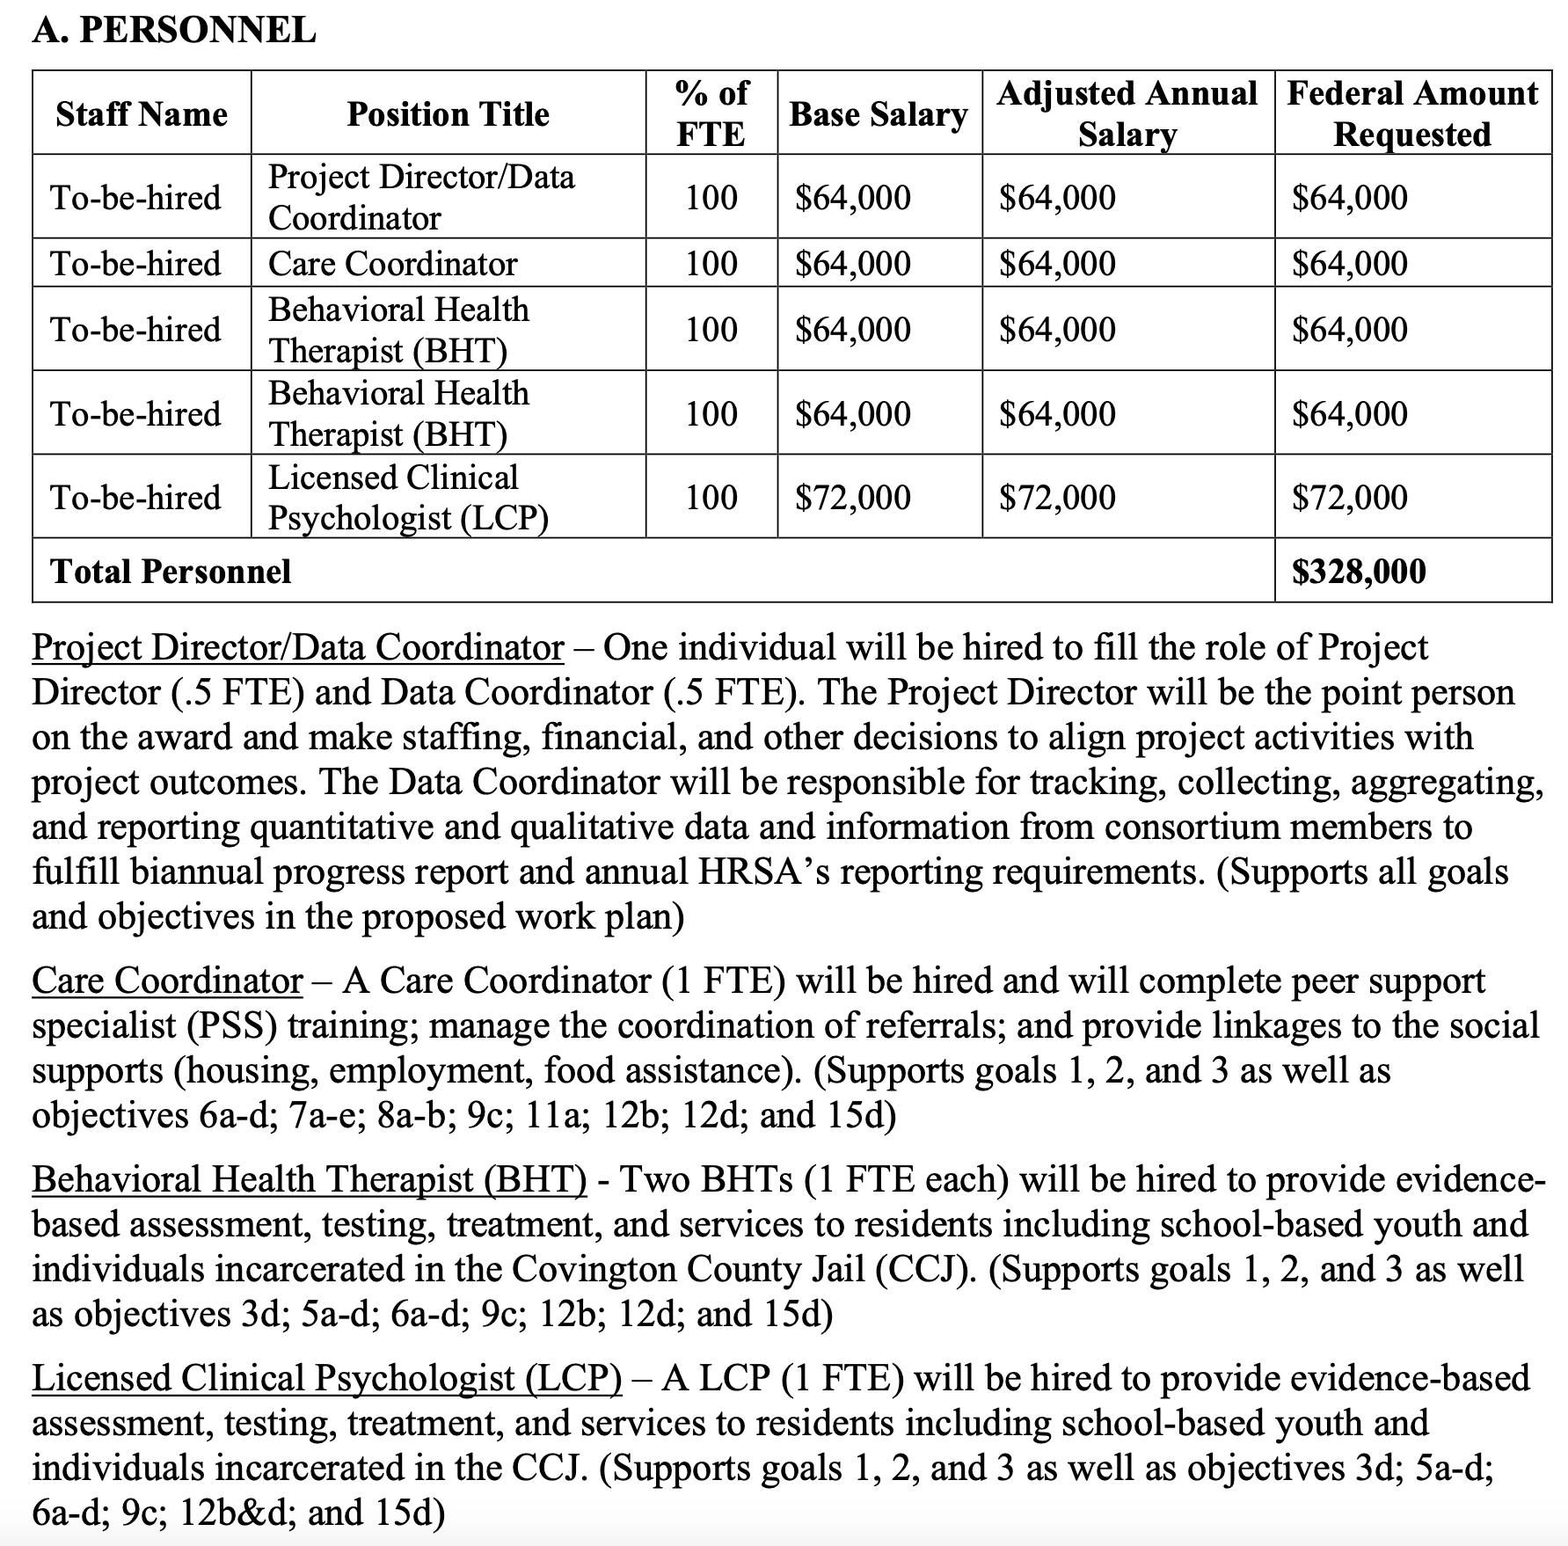
The Budget/Budget Narrative requests funding for to-be-hired staff necessary for implementing the project, as well as necessary training costs. All budget requests are well-aligned to project goals and objectives.

Slide 17
This proposal’s X Factor: a compelling story behind the needs of the target population and the potential to impact a highly diverse target population
This project will offer services that the state neglected to provide-–to the point that it was sued by the Department of Justice

Slide 18
This proposal’s X Factor: a compelling story behind the needs of the target population and the potential to impact a highly diverse target population
This project will serve a rural population with significant representation of African Americans

Slide 19
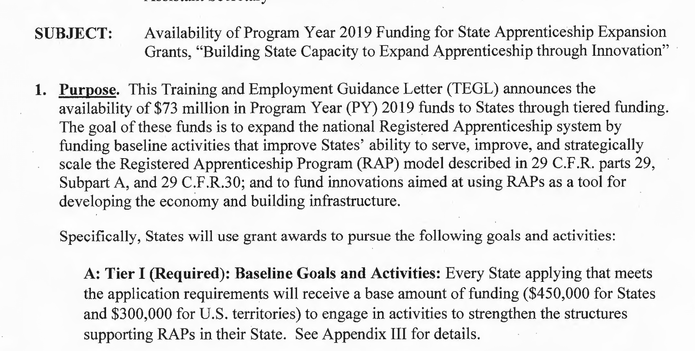
2. DOL-ETA’s State Apprenticeship Expansion (SAE)

Slide 20
2. DOL-ETA’s State Apprenticeship Expansion (SAE)
How does an awarded proposal for this program “work”?

Slide 21
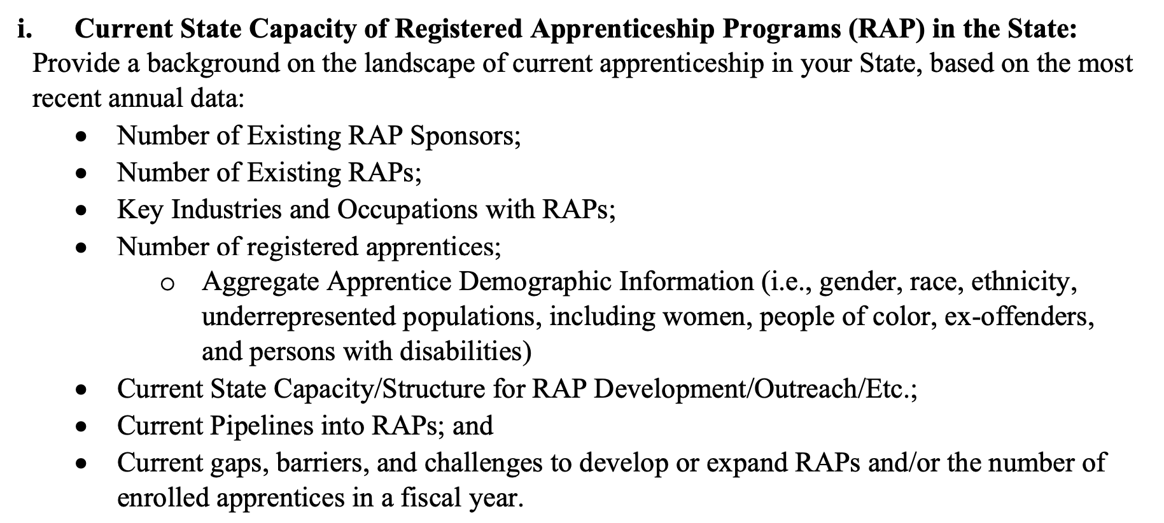
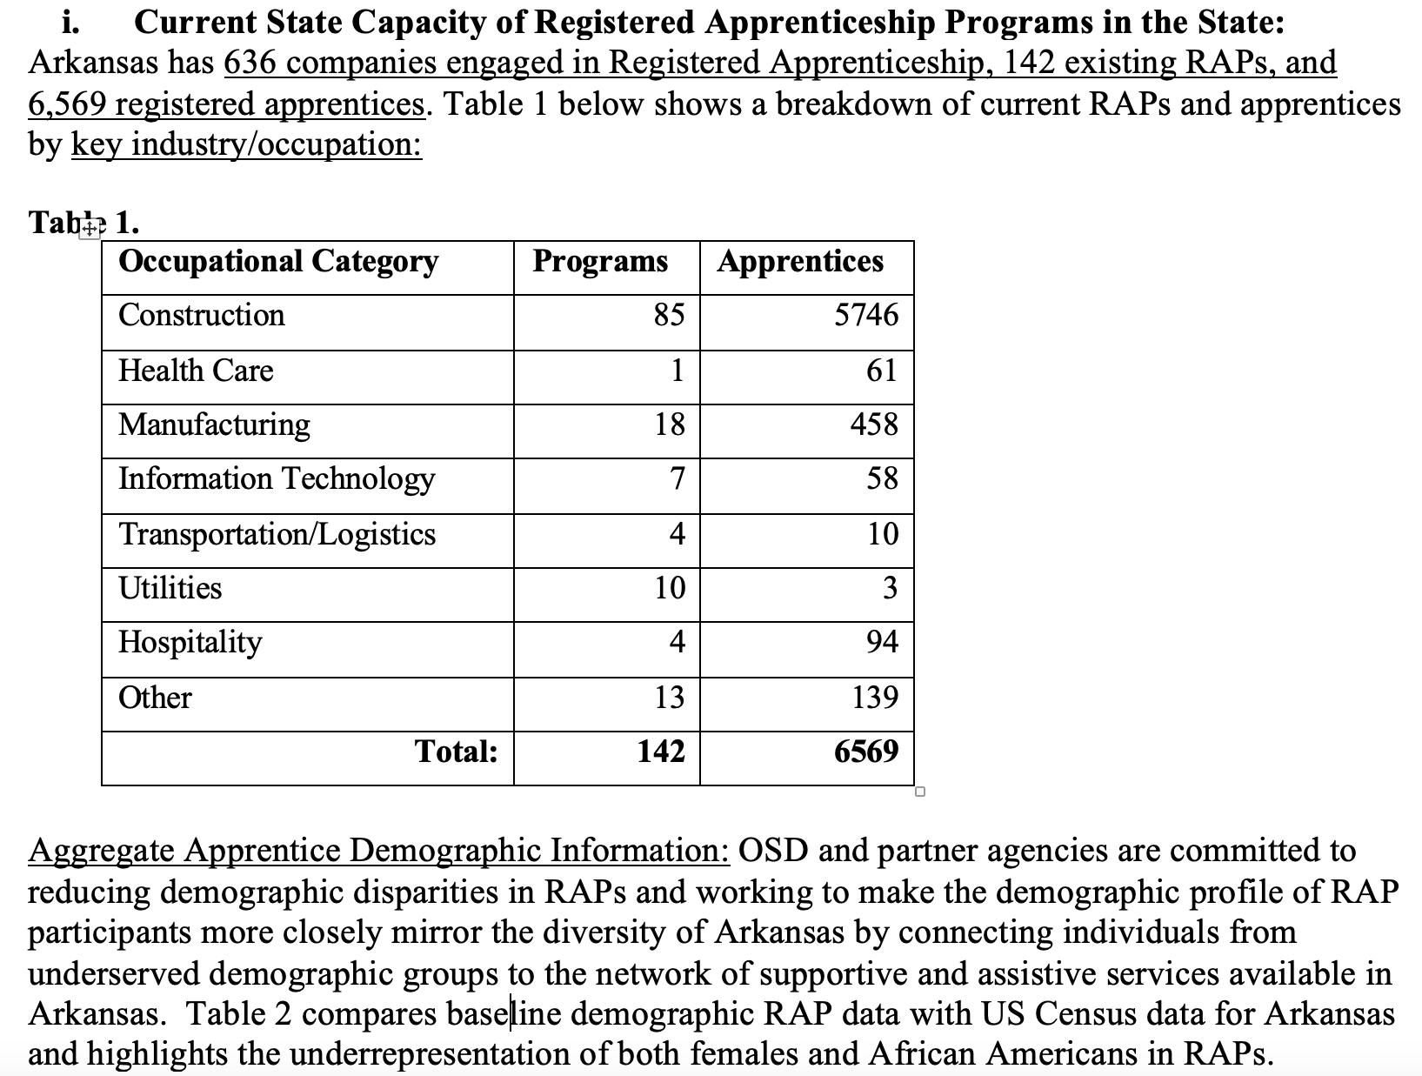
The proposal responds to every requirement in the Training and Employment Guidance Letter (TEGL), in order, and embeds the language of the TEGL to make it easy for the reviewer to find responses.
TEGL
Proposal

Slide 22
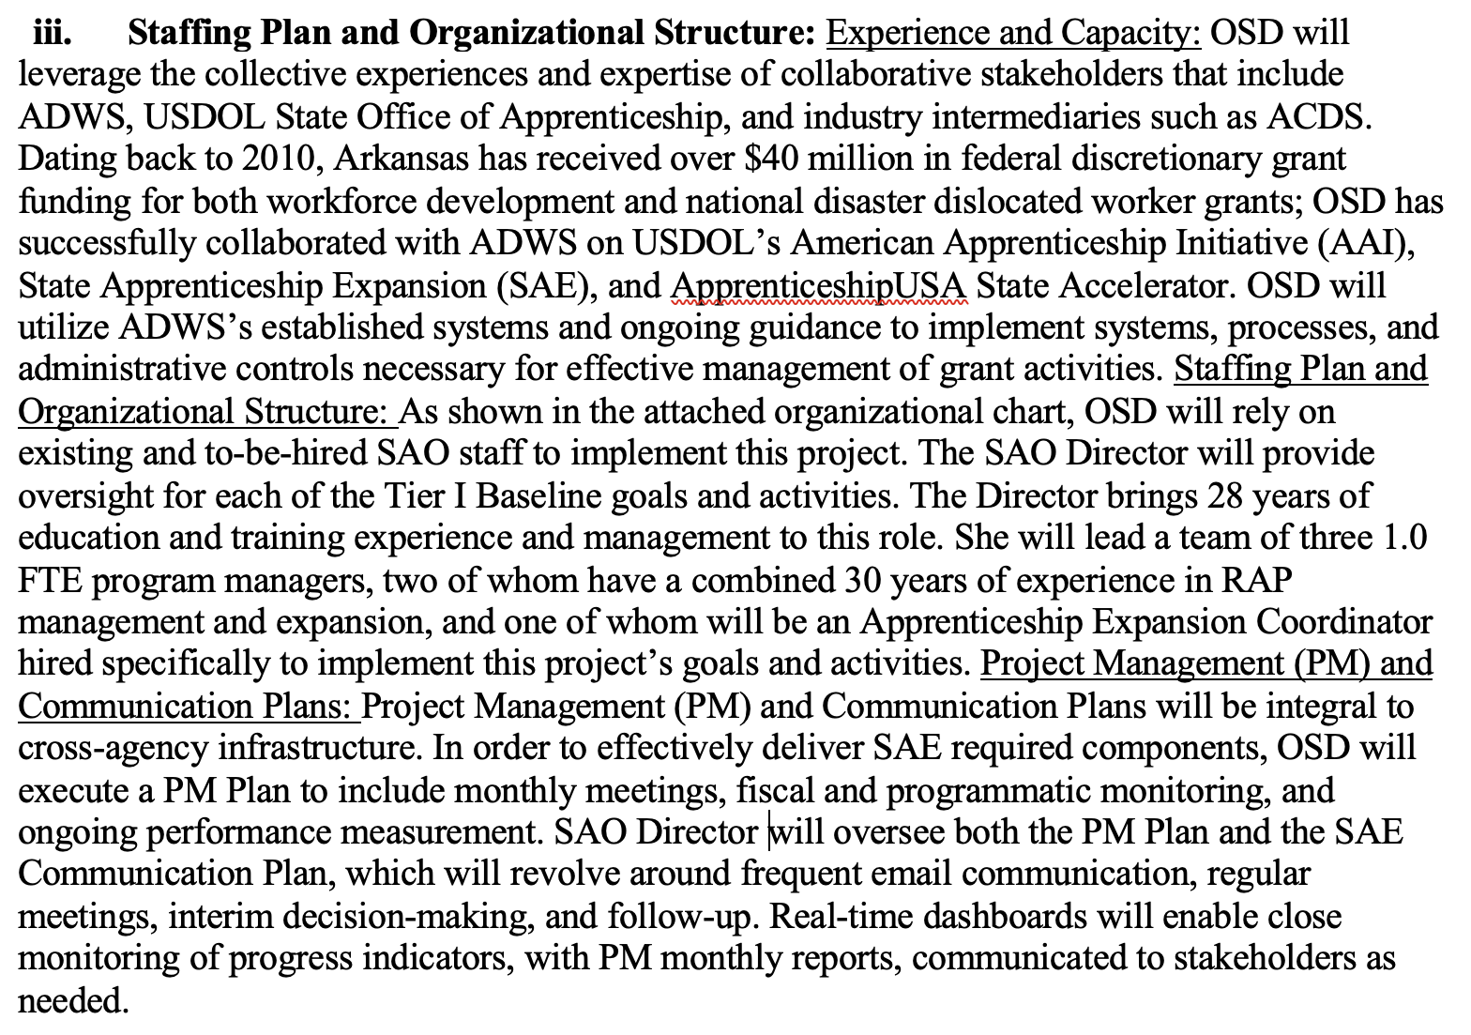
The proposal demonstrates the applicant’s capacity to develop, implement, and evaluate the project. It specifically quantifies the amount of federal funding the applicant has received and highlights the experience of staff on similar grant projects.

Slide 23
The proposal describes methodology grounded in evidence-based practices and models.
This proposal aligns its strategies to State priorities, demonstrating that the applicant has a sense of the bigger picture

Slide 24
The Work Plan follows TEGL instructions and demonstrates a thorough understanding of what implementation will require. It connects the dots for the reviewer on the who, when, what, how, why.
Notice that even when a project has a planning focus, it is still possible to make goals/activities/ objectives measurable

Slide 25
The Budget’s largest expense is funding for a staff position that will be responsible for coordinating the expansion activities outlined in the proposal. As these activities are new and will require significant oversight, this request is in full alignment with the rest of the proposal and the goal of the grant program.

Slide 26
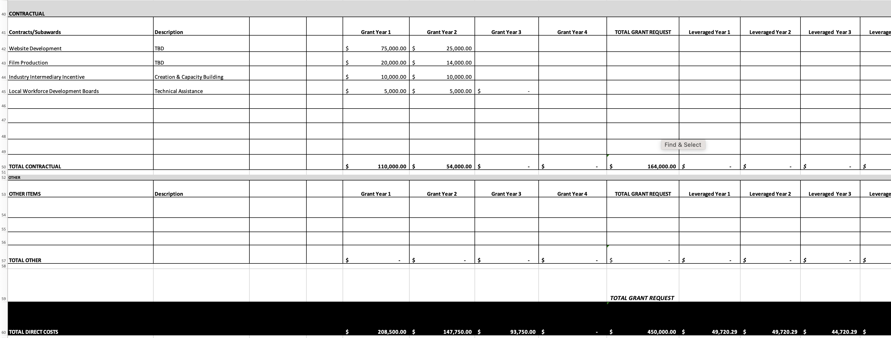
The second major expense category outlined in the Budget is contractual. The project describes specific key activities that will require outside expertise. Again, a reviewer will read this in conjunction with the narrative and see alignment.

Slide 27
This proposal’s X Factor: timely, with the ability to scale outputs
This proposal was submitted in May 2020 and therefore addressed the potential impact of COVID-19 on the economy. Additionally, the proposal described plans for an innovative, centralizing mechanism for tracking RAP data across the state. A project that can create and scale infrastructure is distinctive.

Slide 28
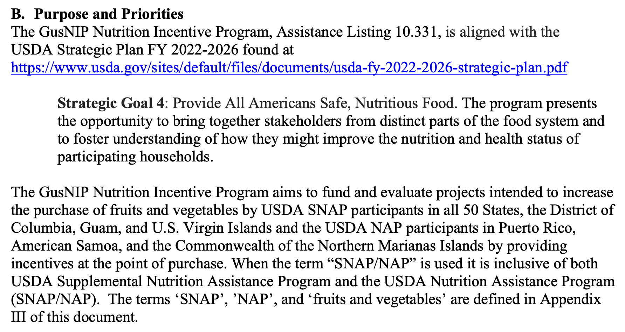
3. USDA-NIFA’s Gus Schumacher Nutrition Incentive Program (GusNIP)

Slide 29
3. USDA-NIFA’s Gus Schumacher Nutrition Incentive Program (GusNIP)
How does an awarded proposal for this program “work”?

Slide 30
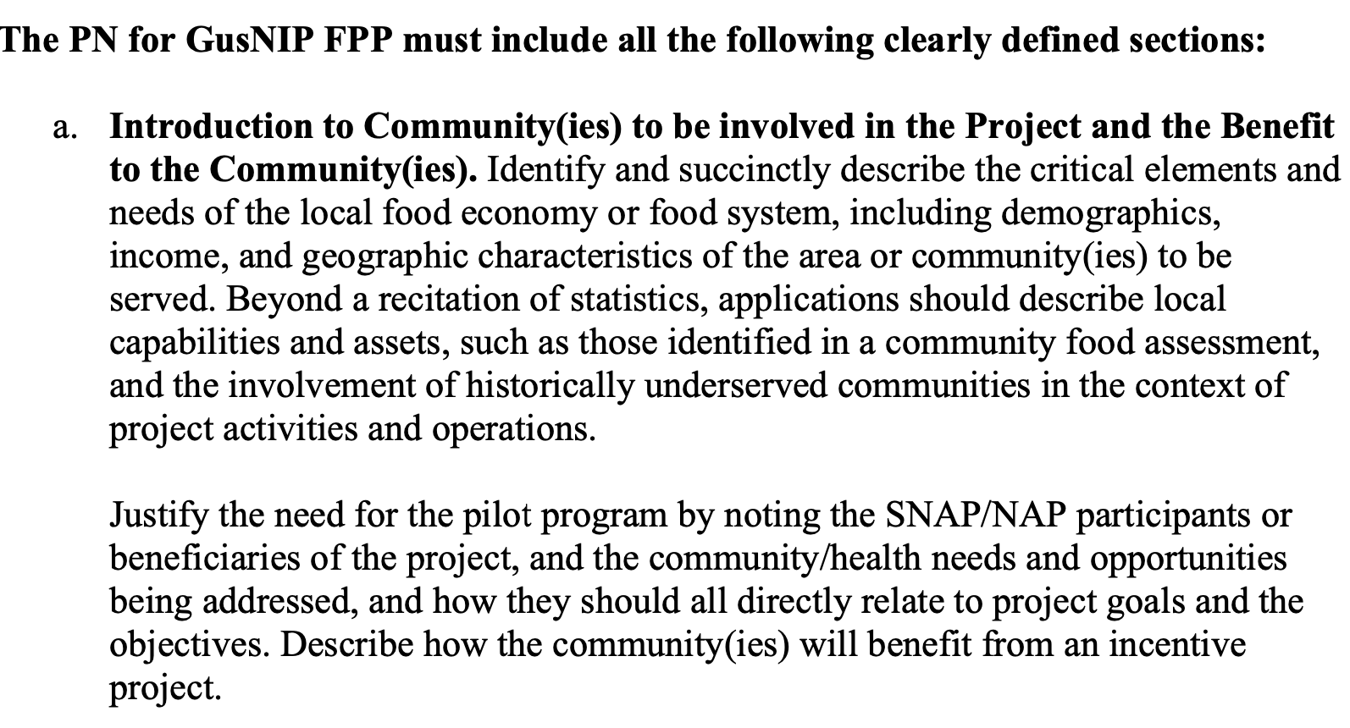
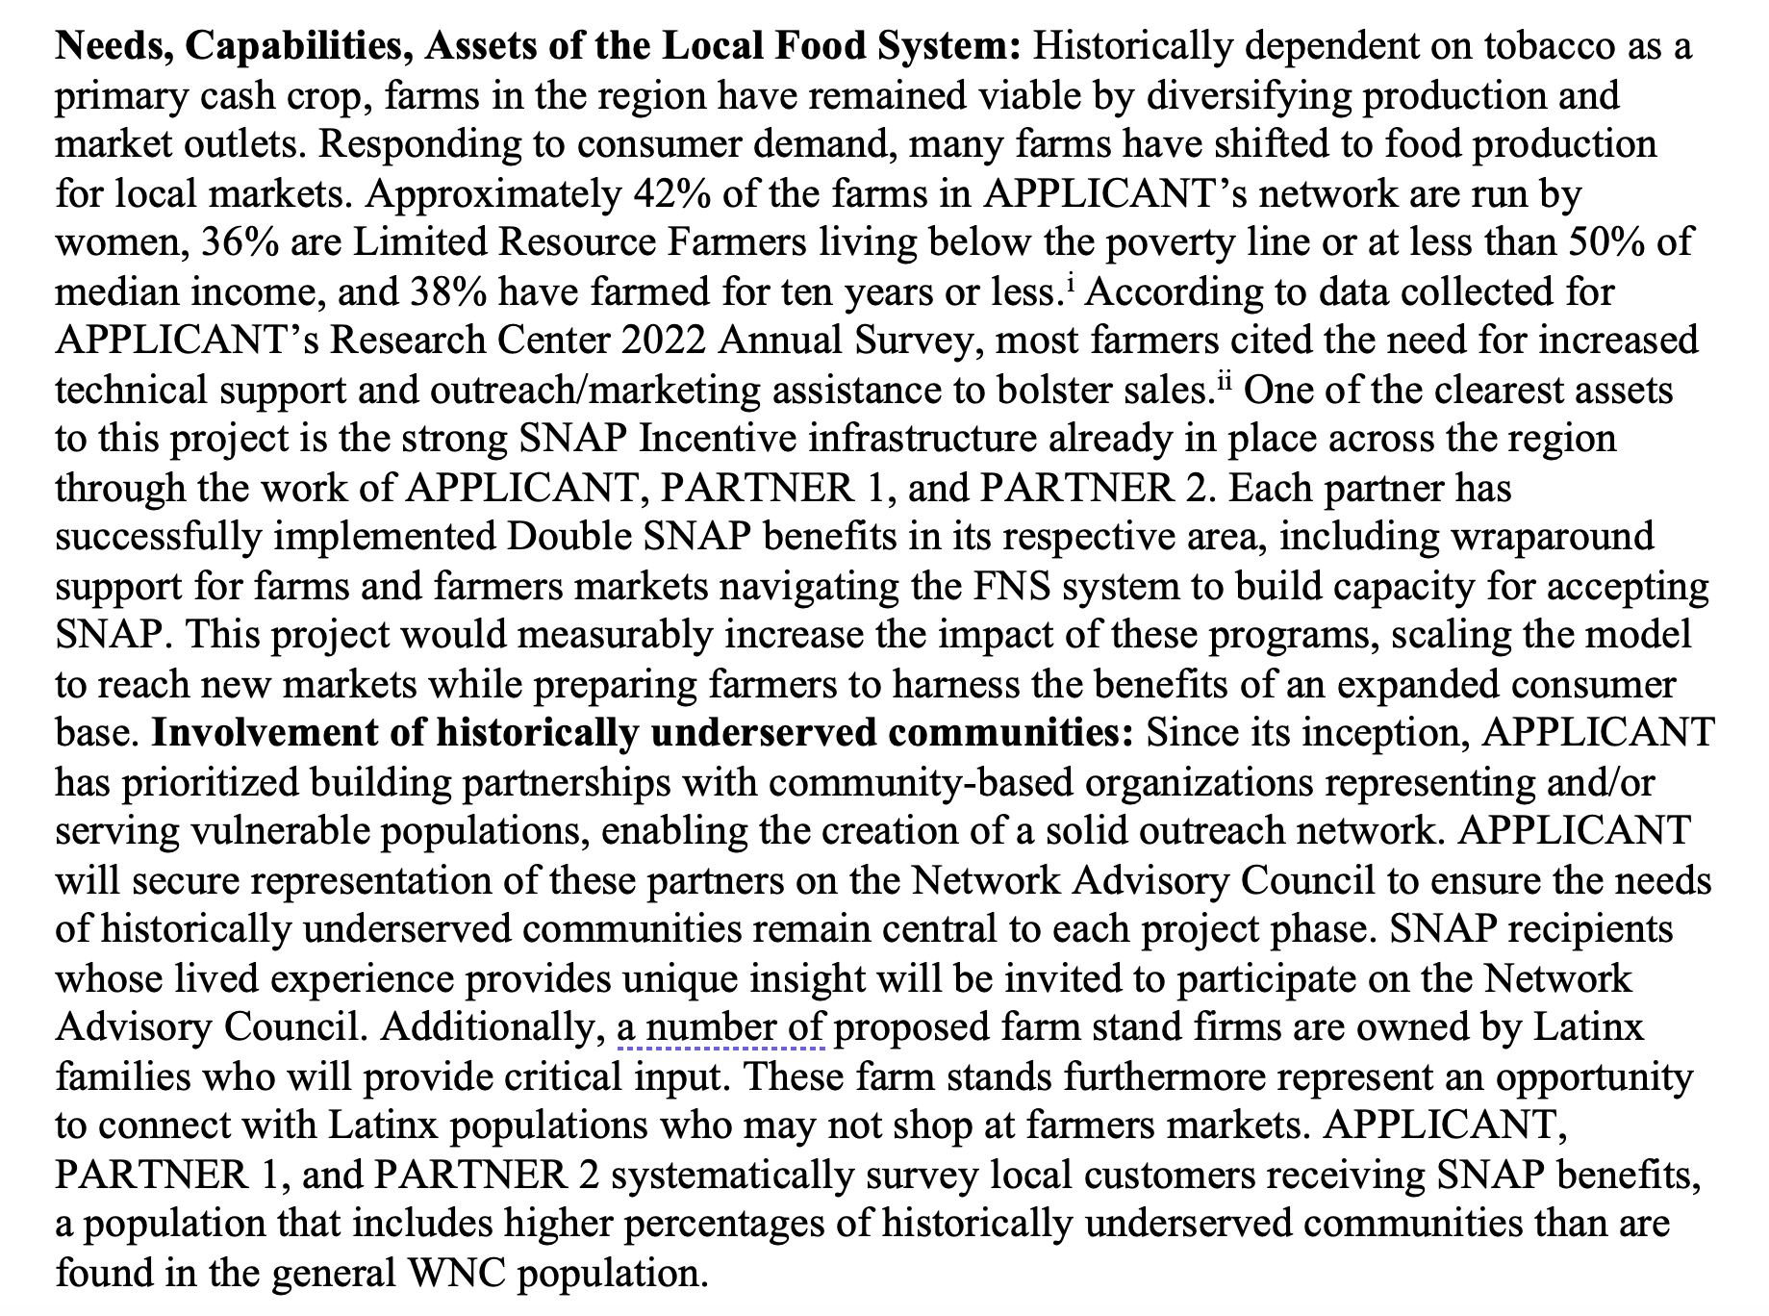
The proposal responds to every requirement in the Request for Applications (RFA) and embeds the language of the RFA to make it easy for the reviewer to find responses.
RFA
Proposal

Slide 31
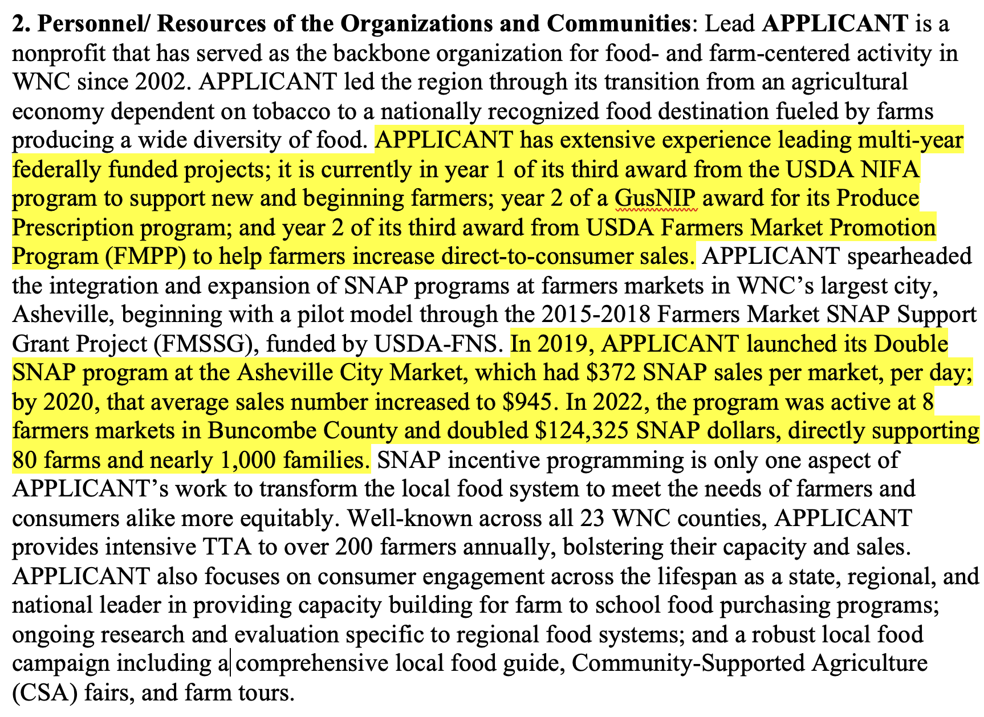
The proposal demonstrates the applicant’s capacity to develop, implement, and evaluate the project. It names each prior federal award. Note that if your organization cannot cite prior federal experience, emphasize and quantify your contributions to your community/the field, as this proposal does here.

Slide 32
The proposal describes methodology grounded in recent research.
The research base supporting the impact of the project’s strategies is cited.

Slide 33
USDA-NIFA RFAs typically request a logic model rather than a work plan. Like a work plan, the logic model allows an applicant to show the reviewer that they understand all of the different elements of operationalizing a project.
This logic model ties each project activity to outputs and specifies outcomes related to changes in knowledge, actions, and conditions.

Slide 34
The Budget requests funding for percentages of staff salaries, costs of promotional and educational materials, and funding to support the cost of incentives for participants. As a priority of this program is to maximize the share of funds used for direct incentives, this cost represents a full 55% of the funding request.

Slide 35
This proposal’s X Factor: an opportunity for three partners representing different geographies to align resources and achieve new outcomes across the region
Federal grant programs typically look favorably on projects that demonstrate strong partnerships leveraging unique strengths.

Slide 36
II. Identifying and avoiding fatal flaws in the government grant application process

Slide 37
What is a “Fatal Flaw”?
In literature, a fatal flaw refers to a character trait possessed by a person that ultimately leads to their downfall. The term fatal flaw generally implies that the character is heroic and admirable in many other ways, and even that the fatal flaw itself would perhaps have been admirable within a different situation
Notes:
This is what we bring or invest in the program; very influential to the budget.
Resources are the raw materials needed to create the program, implement its activities, and attain the desired outputs and outcomes. Sometimes called inputs, resources include both material items (such as curricula, instruction materials, facilities, and funding) and nonmaterial items (such as time, community support, and specialized knowledge and skills).

Slide 38
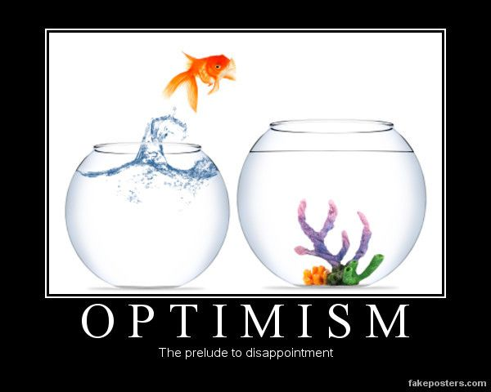
Fatal Flaw # 1 EXTREME Optimism
Do Not:
Underestimate the amount of time this takes, thus not planning ahead accordingly.
Assume that your organization is well qualified for every grant that comes along.
Bite off more than you can chew (if you get funded) by setting unrealistic goals/outcomes or timeframes for activities.
Notes:
This is what we bring or invest in the program; very influential to the budget.
Resources are the raw materials needed to create the program, implement its activities, and attain the desired outputs and outcomes. Sometimes called inputs, resources include both material items (such as curricula, instruction materials, facilities, and funding) and nonmaterial items (such as time, community support, and specialized knowledge and skills).

Slide 39
Things the Extreme Optimist might say
“If we just apply for as many grants as possible, we are bound to get some of them!”
“They might only be making one award, but we are *really* good at what we do!”
”I’m sure we can hire the new grant-funded position within 30 days!”
“$500,000 a year is a TON of money!”
Notes:
This is what we bring or invest in the program; very influential to the budget.
Resources are the raw materials needed to create the program, implement its activities, and attain the desired outputs and outcomes. Sometimes called inputs, resources include both material items (such as curricula, instruction materials, facilities, and funding) and nonmaterial items (such as time, community support, and specialized knowledge and skills).

Slide 40
Fatal Flaw #2 The Lone Wolf
Successful grant writing is almost always a team effort
The average federal grant takes 100-125 hours of staff time to prepare, typically over a 4-6 week period
Can one wolf do that?!?
Notes:
This is what we bring or invest in the program; very influential to the budget.
Resources are the raw materials needed to create the program, implement its activities, and attain the desired outputs and outcomes. Sometimes called inputs, resources include both material items (such as curricula, instruction materials, facilities, and funding) and nonmaterial items (such as time, community support, and specialized knowledge and skills).

Slide 41
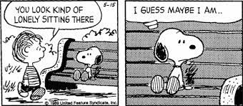
Common Pitfalls of the Lone Wolf
Simply running out of time to do all the things well
No second pair of eyes
Stressed out people make mistakes
BURN OUT!
No one to commiserate with
Notes:
This is what we bring or invest in the program; very influential to the budget.
Resources are the raw materials needed to create the program, implement its activities, and attain the desired outputs and outcomes. Sometimes called inputs, resources include both material items (such as curricula, instruction materials, facilities, and funding) and nonmaterial items (such as time, community support, and specialized knowledge and skills).

Slide 42
A Lone Wolf Cautionary Tale
“The year was 2007. I didn’t have a second pair of eyes on everything before submission, and accidentally uploaded an earlier draft of the narrative instead of the final narrative, and the grant scored a 72/100”
- A Certain Grant Writer Who Wishes to Remain Anonymous
Notes:
This is what we bring or invest in the program; very influential to the budget.
Resources are the raw materials needed to create the program, implement its activities, and attain the desired outputs and outcomes. Sometimes called inputs, resources include both material items (such as curricula, instruction materials, facilities, and funding) and nonmaterial items (such as time, community support, and specialized knowledge and skills).

Slide 43
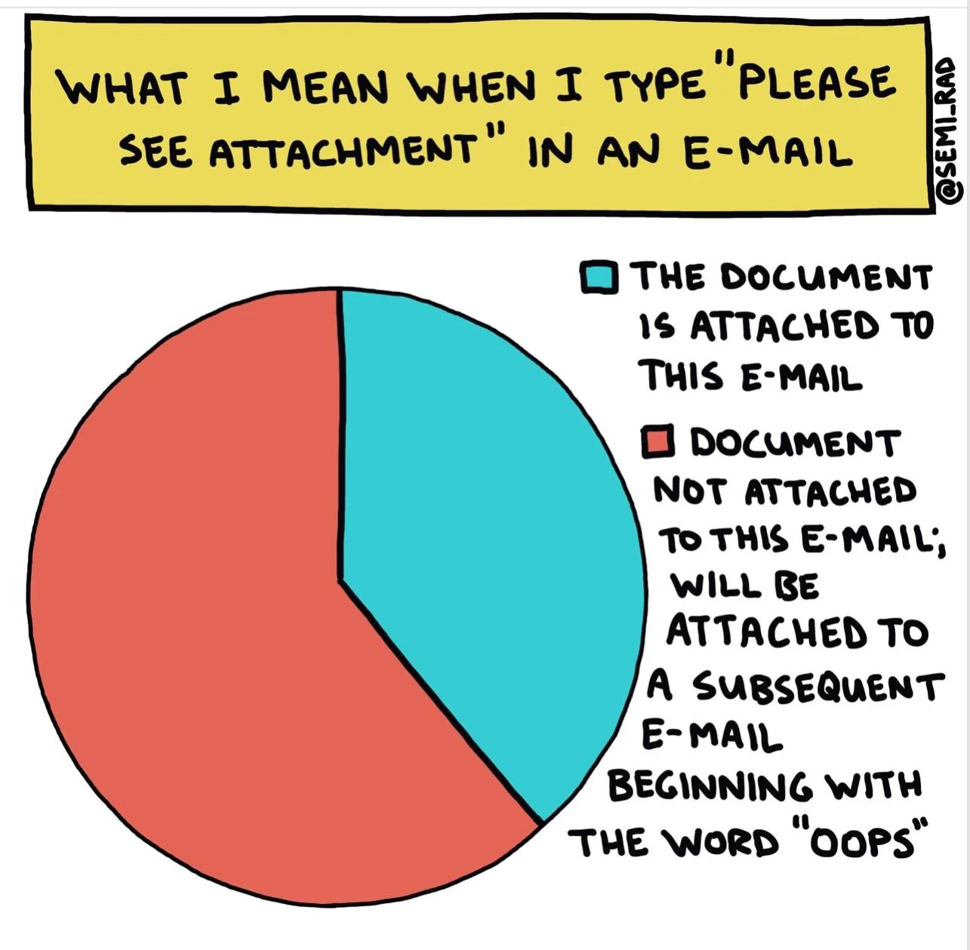
Notes:
This is what we bring or invest in the program; very influential to the budget.
Resources are the raw materials needed to create the program, implement its activities, and attain the desired outputs and outcomes. Sometimes called inputs, resources include both material items (such as curricula, instruction materials, facilities, and funding) and nonmaterial items (such as time, community support, and specialized knowledge and skills).

Slide 44
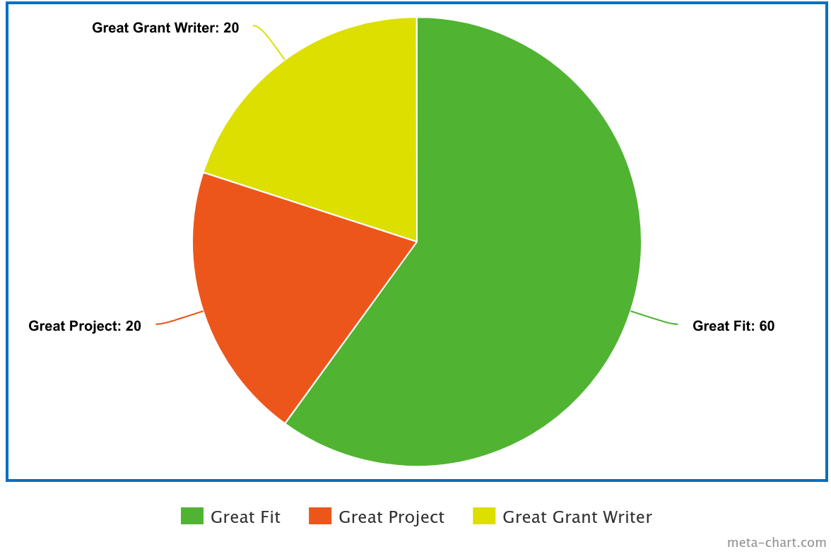
Fatal Flaw #3 More is Better!
Notes:
This is what we bring or invest in the program; very influential to the budget.
Resources are the raw materials needed to create the program, implement its activities, and attain the desired outputs and outcomes. Sometimes called inputs, resources include both material items (such as curricula, instruction materials, facilities, and funding) and nonmaterial items (such as time, community support, and specialized knowledge and skills).

Slide 45
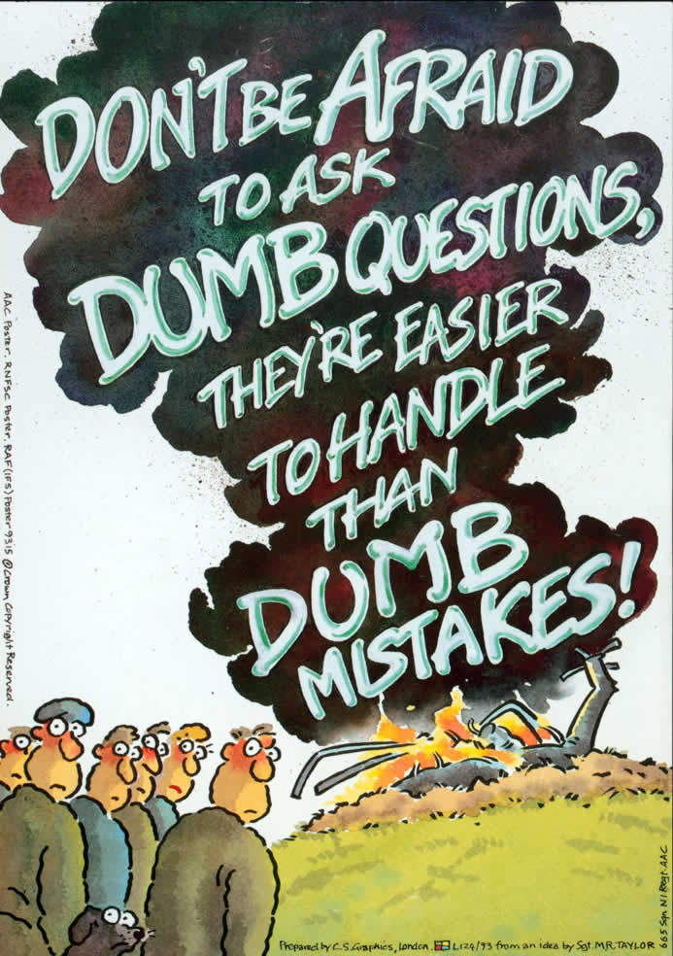
Fatal Flaw #4 Extreme Self-Sufficiency (otherwise know as not asking questions)
Do Not!
- Hesitate to contact program officer with questions
- Hesitate to contact them again when they don’t respond or respond unclearly
- Skip the technical support webinar, if there is one
- Forget to read the FAQ’s
Notes:
This is what we bring or invest in the program; very influential to the budget.
Resources are the raw materials needed to create the program, implement its activities, and attain the desired outputs and outcomes. Sometimes called inputs, resources include both material items (such as curricula, instruction materials, facilities, and funding) and nonmaterial items (such as time, community support, and specialized knowledge and skills).

Slide 46
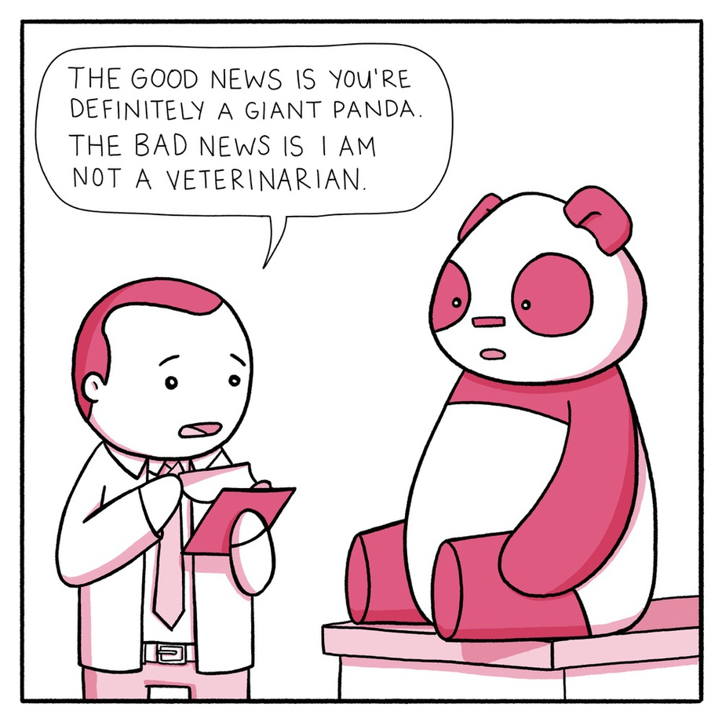
The Bad News:
“Through some questions posed to the program officer at HRSA, we’ve come to realize that we all were misinterpreting the RFP, and that what we were planning to propose
is not eligible for the grant”
The Good News:
“We only wasted 10 hours on this project instead of 125”

Slide 47
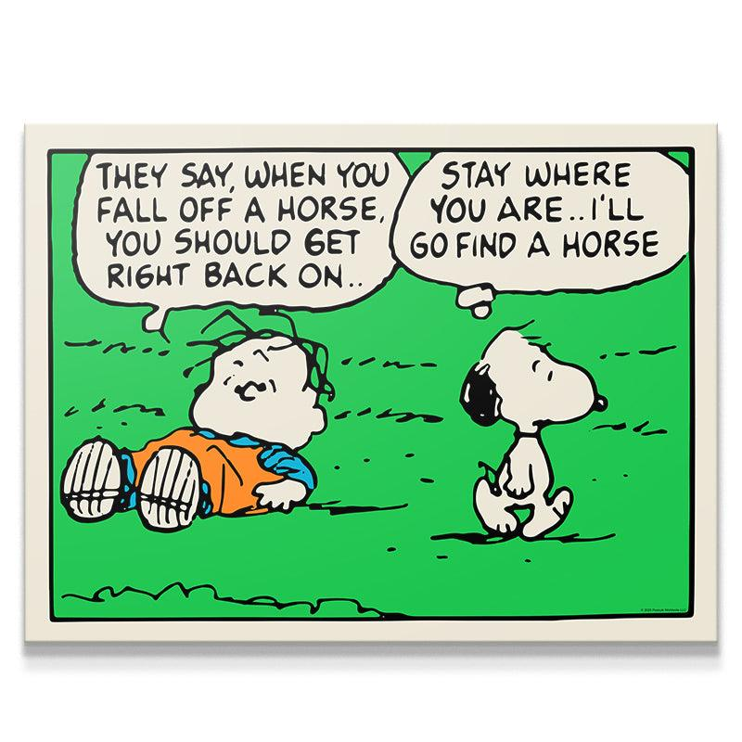
But, most importantly do not give up…
High scoring, but unfunded proposals can be extremely frustrating but should also be extremely encouraging!
Consider reviewer’s feedback, reflect on it and address it, and try again next year
Notes:
This is what we bring or invest in the program; very influential to the budget.
Resources are the raw materials needed to create the program, implement its activities, and attain the desired outputs and outcomes. Sometimes called inputs, resources include both material items (such as curricula, instruction materials, facilities, and funding) and nonmaterial items (such as time, community support, and specialized knowledge and skills).

Slide 48
Questions?
IFP Contact Information:
Louise Mathias, Senior Partner
Louise.mathias@innovativefundingpartners.com
(202) 809-3401

Slide 49
Save the Date
Grant Development for Education: An Overview
Wednesday,
March 20th, 2024
12-1pm

Slide 50
Appendix: Resources
Links to previous relevant Next Level Funding webinars:
Logic Model Basics (February 2023)
Utilizing Evidence-based Best Practices (June 2023)
Creating a Solid Work Plan (August 2023)
Finding your Narrative Arc: How to Sustain Reviewers’ Attention from Start to Finish (November 2023)

Slide 51
dht.org

