Slide 1
Government
Grant Development
for Education
An Overview
March 20, 2024

Slide 2
Learning Objectives
I. Developing familiarity with major government funders and their focuses
II. Key and emerging priorities in government grant funding for education
III. Best practices in project design and proposal development: How to craft a winning education government grant proposal grounded in evidence-based practices

Slide 3
About
Innovative Funding Partners
IFP is a nationally recognized grants consulting firm highly regarded for an impressive overall grant success rate of 84%. Well known for their expertise in federal and other governmental grant writing, this success is based on technical expertise and a foundational relationship-building approach. IFP’s team of over 20 highly experienced consultants is passionate about helping organizations meet the unique needs of their local communities and better serve their constituents by seeking and securing grant funding.

Slide 4
About the
presenters
Susannah Williams, IFP Senior Grants Consultant, is a grant writer with a proven track record of securing federal and foundation grants across multiple sectors, including health care, workforce development, and education. She has extensive experience in supporting clients’ project design and development to meet complex grant requirements. Susannah has written multiple successful proposals for CDC, HRSA, DOE, DOJ, and DOL, among others.
.
3.
Susannah Williams, M.A.
Senior Grants Consultant

Slide 5
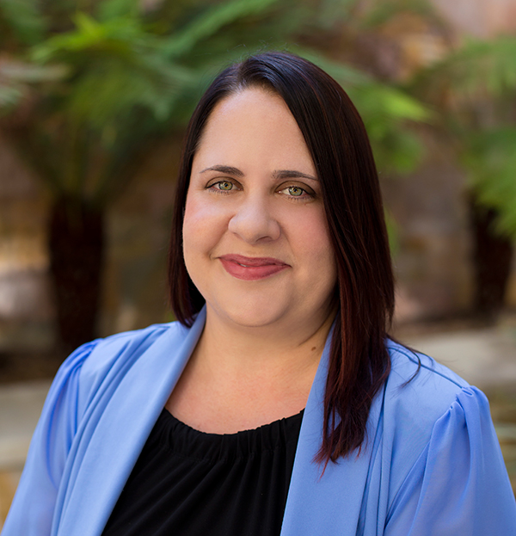
About the
presenters
Sarah Villarreal, IFP Grants Consultant, is an experienced grant writer with nearly 25 years of experience writing foundation, state and federal grants for various industries including education, health care, social services, information, transportation, arts, and public administration. Sarah holds a Ph.D. in Leadership and Change from Antioch University, an M.B.A. from the University of Redlands, and a B.A from the University of California, Los Angeles.
.
3.
Sarah Villarreal, Ph.D.
Grants Consultant

Slide 6
I. Developing familiarity with major government funders and their focuses
Notes:
Developing a logic model at the beginning of program planning gives you a framework for charting the links between your program’s resources, activities, and outputs and its intended outcomes. It enables you to evaluate your program once it begins. And it helps you communicate to your stakeholders what you want to accomplish, how you intend to reach your goals, and how you will track your progress.
Logic models represent INTENTION; shows connection between the planned work and what you hope to achieve. THIS is informed by the theory of change.
These components illustrate the connection between your planned work and your intended results.
Visual representation, etc. purpose in sharing ,etc.
Start with identifying the impacts and outcomes (relationship to backwards design) then can select the activities

Slide 7
I. Developing familiarity with major government funders and their focuses
Department of Education (DOE) is the primary department offering grants in education. The Department of Education administers grant funding programs that fulfill the Department's mission to promote student achievement and preparation for global competitiveness, to foster educational excellence, and to ensure equal access.
Discretionary grant funds are awarded through a competitive process based on program eligibility to:
State Educational Agencies (SEAs)
Local Educational Agencies (LEAs) (e.g., school districts, including public charter schools that operate as a local educational agency),
Tribes and Tribal organizations,
Institutions of Higher Education (including Tribal colleges and universities),
Non-profit organizations,
Other entities (e.g., community-based organizations, public agencies, etc.).

Slide 8
DOE Funding Request for FY2024
$90.0 billion in new discretionary Budget Authority, a 13.6 percent increase from FY2023

Slide 9
DOE Divisions
DOE has 5 operating divisions:
Office of Career, Technical, and Adult Education (OCTAE)
Office of Elementary and Secondary Education (OESE)
Office of English Language Acquisition (OELA)
Office of Postsecondary Education (OPE)
Office of Special Education and Rehabilitative Services (OSERS)

Slide 10
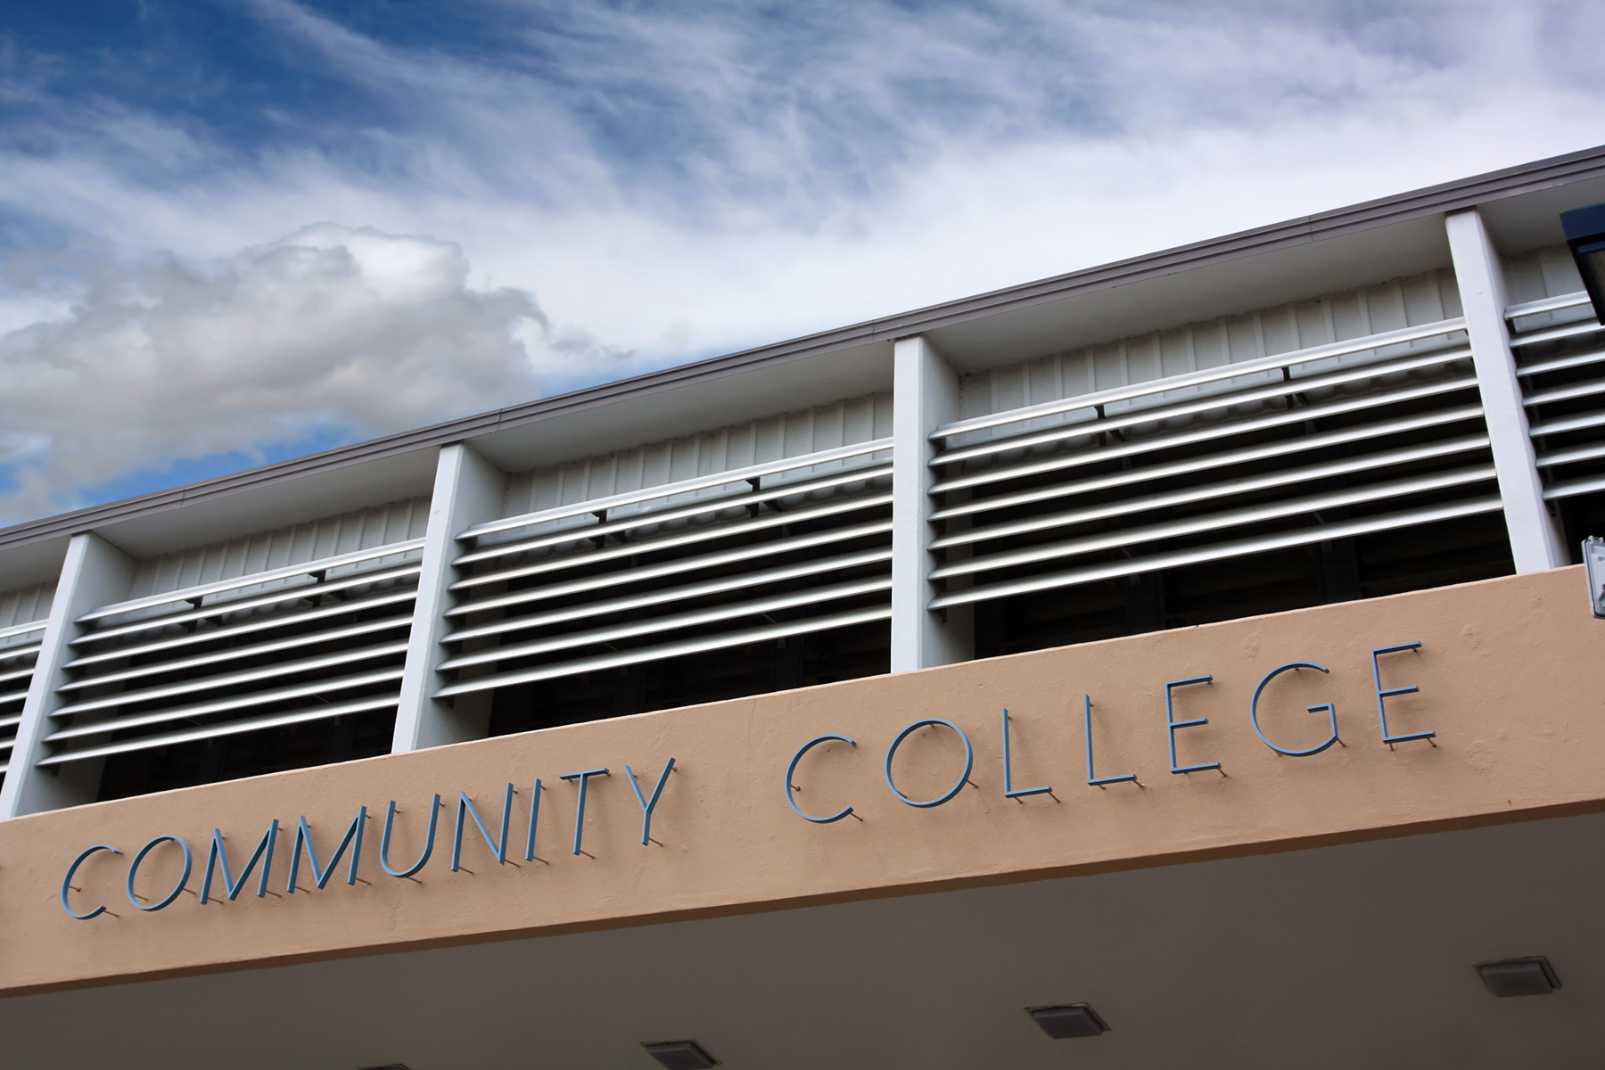
Office of Career, Technical, and Adult Education (OCTAE)
OCTAE administers and coordinates programs that are related to adult education and literacy, career and technical education, and community colleges.
Grants include formula grants to States to administer programs (such as Adult Education) and discretionary grants (such as those administered under the Carl D. Perkins Career and Technical Education Act (Perkins)).

Slide 11
Office of Elementary and Secondary Education (OESE)
The mission of the Office of Elementary and Secondary Education (OESE) is to empower States, districts, and other organizations to meet the diverse needs of every student by providing leadership, technical assistance, and financial support.
A wide range of grants are made to:
improve the achievement of preschool, elementary, and secondary school students; and
support equal access to services to help every child achieve – particularly those who are from low-income families, have disabilities or developmental delays, are educationally disadvantaged, or are English Learners, Native American, migrant, homeless, or in foster care.

Slide 12
Office of Postsecondary Education (OPE)
OPE works to strengthen the capacity of colleges and universities to promote reform, innovation and improvement in postsecondary education, promote and expand access to postsecondary education and increase college completion rates for America’s students, and broaden global competencies that drive the economic success and competitiveness of our nation.
Many grant opportunities come through OPE’s Division of Higher Education Programs (HEP). These include:
Institutional Service: Grant programs to improve academic quality, institutional management, and fiscal stability, and to strengthen physical plants and endowments of institutions of higher education, with an emphasis on institutions that enroll large proportions of minority and financially disadvantaged students.
Student Service: Administers grant programs supporting low-income, first-generation students and individuals with disabilities as they progress through the academic pipeline from middle school to graduate school, in addition to programs focused on college readiness, campus-based childcare, and graduate fellowships.

Slide 13
DOE Funding in 2024
FY2024 focuses:
Mental health supports (particularly in postsecondary schools) and wraparound supports for schools in high-poverty communities
Children with disabilities and English Learners, and educator shortages particularly impacting these students
Educator recruitment, retention, and professional learning
Postsecondary success for all students, particularly with regard to improving affordability, retention, and completion

Slide 14
The Administration for Children and Families (ACF)
ACF promotes the economic and social well-being of families, children, youth, individuals and communities who are resilient, safe, healthy, and economically secure.
FY24 Funding Request: $94.4 billion
(increase of $23.6 billion from FY2023)

Slide 15
The Administration for Children and Families (ACF)
FY2024 Education-related Focus Areas:
Strengthen the early childhood sector to meet the needs of children and families by supporting increased access to affordable, high-quality childcare for families.
Move the field toward a thriving wage for all staff, including a down payment to create pay parity between Head Start educators and elementary school staff with similar qualifications, as well as a cost-of-living adjustment for Head Start.

Slide 16
National Science Foundation (NSF)
NSF was established in 1950 by Congress to:
Promote the progress of science;
Advance the national health, prosperity and welfare; and
Secure the national defense.
NSF grants account for about 25% of federal support to America's colleges and universities for basic research: research driven by curiosity and discovery. NSF also supports solutions-oriented research with the potential to produce advancements for the American people.

Slide 17
National Science Foundation (NSF)
FY 2024 budget request: $11.314 billion
(increase of 18.6% from FY2023)

Slide 18
National Science Foundation (NSF)
FY 2024 focus areas:
Scale up existing pathways into STEM fields and create new tracks to inspire the “missing millions” within science and engineering fields
Research and innovation in Advanced Manufacturing, Advanced Wireless, Artificial Intelligence, and Biotechnology
Research and education in Clean Energy Technology

Slide 19
Department of Labor (DOL)
Employment and Training Administration (DOL-ETA)
The mission of the Employment and Training Administration is to contribute to the more efficient functioning of the U.S. labor market by providing high-quality job training, employment, labor market information, and income maintenance services primarily through state and local workforce development systems.
FY2024 Budget: $22.82 billion

Slide 20
Employment and Training Administration (DOL-ETA)
FY2024 Focuses:
Increasing the availability of good jobs in the care, climate resiliency, and hospitality sectors.
Supporting economic mobility, addressing historic inequities for marginalized communities of color and other underserved and underrepresented communities, and producing high-quality employment outcomes for workers who live or work in the Appalachian, Delta, and Northern Border regions.
Addressing the economic and workforce-related impacts on local communities affected by the opioid and substance misuse epidemic.

Slide 21
Additional agencies with education-related opportunities
Grants related to healthcare
education and training
Education-focused grants such as the Distance Learning and Telemedicine program
Research-focused grants for institutes of higher education

Slide 22
II. Key and emerging priorities in government grant funding for education
Notes:
Developing a logic model at the beginning of program planning gives you a framework for charting the links between your program’s resources, activities, and outputs and its intended outcomes. It enables you to evaluate your program once it begins. And it helps you communicate to your stakeholders what you want to accomplish, how you intend to reach your goals, and how you will track your progress.
Logic models represent INTENTION; shows connection between the planned work and what you hope to achieve. THIS is informed by the theory of change.
These components illustrate the connection between your planned work and your intended results.
Visual representation, etc. purpose in sharing ,etc.
Start with identifying the impacts and outcomes (relationship to backwards design) then can select the activities

Slide 23
Key and Emerging Priorities
Equity and Access:
Ensuring equitable access to quality education for all students regardless of socioeconomic status, race, ethnicity, or geographic location.
Addressing disparities in educational opportunities and outcomes to promote equity and inclusivity in education.
Academic Excellence:
Promoting academic rigor, excellence, and achievement in K-12 education and higher education institutions.
Supporting initiatives to enhance curriculum standards, instructional quality, and student performance.
Notes:
This is what we bring or invest in the program; very influential to the budget.
Resources are the raw materials needed to create the program, implement its activities, and attain the desired outputs and outcomes. Sometimes called inputs, resources include both material items (such as curricula, instruction materials, facilities, and funding) and nonmaterial items (such as time, community support, and specialized knowledge and skills).

Slide 24
Key and Emerging Priorities
STEM Education:
Fostering innovation and competitiveness by promoting Science, Technology, Engineering, and Mathematics (STEM) education.
Investing in STEM programs, resources, and partnerships to prepare students for future careers in STEM fields.
Early Childhood Education:
Recognizing the importance of early childhood education in laying the foundation for lifelong learning and success.
Supporting early childhood development programs, preschool initiatives, and early literacy interventions.
Notes:
This is what we bring or invest in the program; very influential to the budget.
Resources are the raw materials needed to create the program, implement its activities, and attain the desired outputs and outcomes. Sometimes called inputs, resources include both material items (such as curricula, instruction materials, facilities, and funding) and nonmaterial items (such as time, community support, and specialized knowledge and skills).

Slide 25
Key and Emerging Priorities
Career-Connected Learning:
Aligning education with workforce needs and industry demands through career-connected learning opportunities.
Promoting pathways to career readiness, including internships, apprenticeships, and vocational training programs.
Digital Learning and Technology Integration:
Embracing digital learning tools, educational technology, and online resources to enhance teaching and learning experiences.
Investing in technology infrastructure and digital literacy initiatives to bridge the digital divide and promote digital equity.
Notes:
This is what we bring or invest in the program; very influential to the budget.
Resources are the raw materials needed to create the program, implement its activities, and attain the desired outputs and outcomes. Sometimes called inputs, resources include both material items (such as curricula, instruction materials, facilities, and funding) and nonmaterial items (such as time, community support, and specialized knowledge and skills).

Slide 26
Key and Emerging Priorities
Social and Emotional Learning (SEL):
Recognizing the importance of social and emotional well-being in academic success and overall student development.
Integrating SEL initiatives, mindfulness practices, and mental health support services into educational settings.
Culturally Responsive Education:
Promoting culturally responsive teaching practices, inclusive curriculum, and diverse representation in educational materials.
Valuing diversity, equity, and inclusion in education to create inclusive learning environments for all students.
Notes:
This is what we bring or invest in the program; very influential to the budget.
Resources are the raw materials needed to create the program, implement its activities, and attain the desired outputs and outcomes. Sometimes called inputs, resources include both material items (such as curricula, instruction materials, facilities, and funding) and nonmaterial items (such as time, community support, and specialized knowledge and skills).

Slide 27
Key and Emerging Priorities
Community Engagement and Partnerships:
Building strong partnerships between schools, families, communities, and local organizations to support student success.
Engaging stakeholders in decision-making processes and collaborative initiatives to address community needs and priorities.
Evidence-Based Practices and Accountability:
Emphasizing evidence-based interventions, data-driven decision-making, and accountability measures to improve educational outcomes.
Evaluating the effectiveness of programs, interventions, and policies to ensure efficient use of resources and student success.
Notes:
This is what we bring or invest in the program; very influential to the budget.
Resources are the raw materials needed to create the program, implement its activities, and attain the desired outputs and outcomes. Sometimes called inputs, resources include both material items (such as curricula, instruction materials, facilities, and funding) and nonmaterial items (such as time, community support, and specialized knowledge and skills).

Slide 28
III. Best practices in project design and proposal development: How to craft a winning education government grant proposal grounded in evidence-based practices
Notes:
Developing a logic model at the beginning of program planning gives you a framework for charting the links between your program’s resources, activities, and outputs and its intended outcomes. It enables you to evaluate your program once it begins. And it helps you communicate to your stakeholders what you want to accomplish, how you intend to reach your goals, and how you will track your progress.
Logic models represent INTENTION; shows connection between the planned work and what you hope to achieve. THIS is informed by the theory of change.
These components illustrate the connection between your planned work and your intended results.
Visual representation, etc. purpose in sharing ,etc.
Start with identifying the impacts and outcomes (relationship to backwards design) then can select the activities

Slide 29
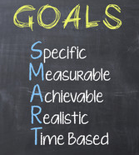
What are the best practices in project design and proposal development?
Understand the Grant Requirements
Thoroughly review the grant guidelines, eligibility criteria, and funding priorities.
Align your proposal with the grant's objectives and requirements to increase your chances of success.
Define Clear Objectives and Outcomes
Clearly articulate the objectives of your project and the intended outcomes you hope to achieve.
Use specific, measurable, achievable, realistic, and time-based (SMART) goals to guide the project implementation and evaluation.
Notes:
This is what we bring or invest in the program; very influential to the budget.
Resources are the raw materials needed to create the program, implement its activities, and attain the desired outputs and outcomes. Sometimes called inputs, resources include both material items (such as curricula, instruction materials, facilities, and funding) and nonmaterial items (such as time, community support, and specialized knowledge and skills).

Slide 30
Best Practices continued…
Utilize Evidence-Based Practices
Base your project design on evidence-based practices and research-supported strategies.
Provide rationale and justification for your approach, citing relevant literature, studies, or best practices in the field.
Engage Stakeholders
Involve key stakeholders in the project design and planning process, including educators, administrators, students, parents, and community members.
Foster collaboration and partnerships to ensure buy-in and support for the proposed project.
Notes:
This is what we bring or invest in the program; very influential to the budget.
Resources are the raw materials needed to create the program, implement its activities, and attain the desired outputs and outcomes. Sometimes called inputs, resources include both material items (such as curricula, instruction materials, facilities, and funding) and nonmaterial items (such as time, community support, and specialized knowledge and skills).

Slide 31
Best Practices continued…
Develop a Comprehensive Project Plan
Create a detailed project plan outlining the activities, timeline, and milestones for implementation.
Define roles and responsibilities for project team members, partners, and stakeholders to ensure accountability and coordination.
Demonstrate Innovation and Creativity
Showcase innovative approaches, strategies, or interventions that set your project apart.
Highlight creative solutions to address educational challenges or leverage emerging technologies to enhance learning experiences.
Tell a compelling story!
Notes:
This is what we bring or invest in the program; very influential to the budget.
Resources are the raw materials needed to create the program, implement its activities, and attain the desired outputs and outcomes. Sometimes called inputs, resources include both material items (such as curricula, instruction materials, facilities, and funding) and nonmaterial items (such as time, community support, and specialized knowledge and skills).

Slide 32
Best Practices continued…
Address Sustainability and Scalability
Consider the long-term sustainability and scalability of your project beyond the grant period.
Identify strategies for securing ongoing funding, sustaining project impact, and scaling successful interventions to reach more students and communities.
Evaluate and Revise
Regularly evaluate the progress and effectiveness of your project against established objectives and outcomes.
Incorporate feedback from stakeholders and make necessary revisions to improve project implementation and outcomes.
Notes:
This is what we bring or invest in the program; very influential to the budget.
Resources are the raw materials needed to create the program, implement its activities, and attain the desired outputs and outcomes. Sometimes called inputs, resources include both material items (such as curricula, instruction materials, facilities, and funding) and nonmaterial items (such as time, community support, and specialized knowledge and skills).

Slide 33
Evidence-Based Practices
Types of Education Evidence-Based Practices
Instructional Strategies – Evidence-based approaches to teaching and learning, including:
Differentiated Instruction
Direct Instruction
Cooperative Learning
Experiential Learning
Problem-Based Learning
Project-Based Learning
Peer Tutoring
Explicit Instruction
Formative Assessment
Scaffolded Instruction
Universal Design for Learning
Understanding By Design
Culturally Responsive Teaching
High-Impact Practices
Notes:
This is what we bring or invest in the program; very influential to the budget.
Resources are the raw materials needed to create the program, implement its activities, and attain the desired outputs and outcomes. Sometimes called inputs, resources include both material items (such as curricula, instruction materials, facilities, and funding) and nonmaterial items (such as time, community support, and specialized knowledge and skills).

Slide 34
High-Impact Practices (HIPs)
What are HIPs?
First-year seminars and experiences, common intellectual experiences, learning communities, writing-intensive courses, collaborative assignments and projects, undergraduate research, diversity/global learning, service learning, internships, e-portfolios, and capstones
Associated with positive undergraduate learning effects, including persistence and retention
Implications for Equity
Provide amplified benefits to historically underserved students (HUS)
May be an effective tool for advancing equity and closing achievement gaps
Five major course elements associated with deep learning and engagement for Latinx undergrads – professor behaviors or traits, real-world and relevant content, preparation for future or career, relationships with peers, and diverse perspectives
Notes:
This is what we bring or invest in the program; very influential to the budget.
Resources are the raw materials needed to create the program, implement its activities, and attain the desired outputs and outcomes. Sometimes called inputs, resources include both material items (such as curricula, instruction materials, facilities, and funding) and nonmaterial items (such as time, community support, and specialized knowledge and skills).

Slide 35
High-Impact Practices (HIPs)
Other Similar EBPs/Theoretical Frameworks
Culturally Responsive Teaching
Culturally Relevant Pedagogy
Academic and Interpersonal Validation
Community Cultural Wealth
Common Elements
Asset-based rather than deficit-based
Recognizes and rewards backgrounds and experiences
Shift the focus from student behaviors (e.g., how engaged or unengaged students were) to how students experience the learning environment
Places the responsibility for action squarely on the educational institution and its agents (vs. students and families)
Notes:
This is what we bring or invest in the program; very influential to the budget.
Resources are the raw materials needed to create the program, implement its activities, and attain the desired outputs and outcomes. Sometimes called inputs, resources include both material items (such as curricula, instruction materials, facilities, and funding) and nonmaterial items (such as time, community support, and specialized knowledge and skills).

Slide 36
Evidence-Based Practices
Types of Education Evidence-Based Practices
Interventions: Research-supported interventions to address specific learning needs, including:
Response to Intervention (RTI)
Multi-Tiered System of Supports (MTSS)
Positive Behavioral Interventions and Supports (PBIS)
Literacy Interventions
Mathematics Interventions
Early Childhood Interventions
Special Education Services
English Language Learner (ELL) Interventions
Mindfulness & Social-Emotional Learning (SEL) Programs
Behavioral Interventions
Technology-Based Interventions
Family and Community Engagement Programs
Restorative Practices
Notes:
This is what we bring or invest in the program; very influential to the budget.
Resources are the raw materials needed to create the program, implement its activities, and attain the desired outputs and outcomes. Sometimes called inputs, resources include both material items (such as curricula, instruction materials, facilities, and funding) and nonmaterial items (such as time, community support, and specialized knowledge and skills).

Slide 37
Where can I learn about EBPs?
Understand the Grant Requirements
Department of Education, The Safer Schools and Campuses Best Practices Clearinghouse - https://bestpracticesclearinghouse.ed.gov
Institute of Education Sciences, What Works Clearinghouse - https://ies.ed.gov/ncee/wwc/#
RAND - https://www.rand.org/topics/educational-program-evaluation.html?page=4
Notes:
This is what we bring or invest in the program; very influential to the budget.
Resources are the raw materials needed to create the program, implement its activities, and attain the desired outputs and outcomes. Sometimes called inputs, resources include both material items (such as curricula, instruction materials, facilities, and funding) and nonmaterial items (such as time, community support, and specialized knowledge and skills).

Slide 38
Questions?
IFP Contact Information:
Louise Mathias, Senior Partner
Louise.mathias@innovativefundingpartners.com
(202) 809-3401

Slide 39
Save the Date
Incorporating Innovation in a Government Grant Proposal
Wednesday,
April 17th, 2024
12-1pm

Slide 40
Appendix: Resources
U.S. Department of Education
Grants – https://www2.ed.gov/fund/grants-apply.html?src=pn
Data & Statistics – https://www2.ed.gov/rschstat/landing.jhtml?src=image
Press Releases – https://www.ed.gov/news/press-releases
Office of Elementary & Secondary Education
Applicant resources including best practices clearinghouse – https://oese.ed.gov
News, Research and Policy Organizations
Institute for Public Higher Education Policy – https://www.ihep.org
Pew Research Center – https://www.pewresearch.org/topic/other-topics/education/
EducationWeek – https://www.edweek.org
The Chronicle of Higher Education – https://www.chronicle.com/?sra=true
EDUCAUSE – https://www.educause.edu

Slide 41
dht.org

