Slide 1
Incorporating Innovation in a
Government Grant Proposal
April 17, 2024

Slide 2
Learning Objectives
I. Gain knowledge in interpreting what funders mean they request “innovative” project designs.
II. Understand considerations for developing innovative projects.
III. Learn how to balance evidence-based models with innovation.
IV. Develop familiarity with how to achieve innovation while setting achievable goals and outcomes.

Slide 3
About
Innovative Funding Partners
IFP is a nationally recognized grants consulting firm highly regarded for an impressive overall grant success rate of 84%. Well known for their expertise in federal and other governmental grant writing, this success is based on technical expertise and a foundational relationship-building approach. IFP’s team of over 20 highly experienced consultants is passionate about helping organizations meet the unique needs of their local communities and better serve their constituents by seeking and securing grant funding.

Slide 4
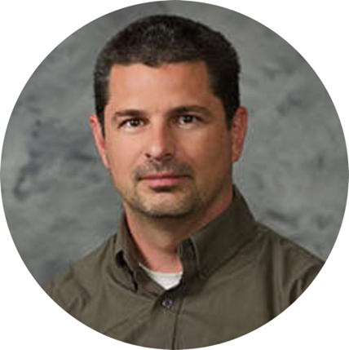
About the
presenters
Brian Kelley, Ph.D., IFP Grants Consultant, is a grant writer with a proven track record of securing federal and foundation grants across multiple sectors, including health care, workforce development, and education. He has worked in academia for over two decades and has served a variety of not-for-profit organizations and medical centers as a consultant to help create innovation and secure foundation, city, state, and federal funds to support biomedical, education, prevention research, and workforce development. He has also served as a grant reviewer for several granting agencies. Dr. Kelley leverages the culmination of these experiences into an authentic and effective approach to grant development for community impact.
.
3.
Brian Kelley, Ph.D.
Senior Partner

Slide 5
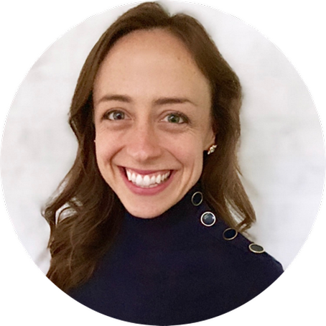
About the
presenters
Susannah Williams, IFP Senior Grants Consultant, is a grant writer with a proven track record of securing federal and foundation grants across multiple sectors, including health care, workforce development, and education. She has extensive experience in supporting clients’ project design and development to meet complex grant requirements. Susannah has written multiple successful proposals for CDC, HRSA, DOE, DOJ, and DOL, among others.
.
3.
Susannah Williams, M.A.
Senior Grants Consultant

Slide 6
I. Gain knowledge in interpreting what funders mean they request “innovative” project designs.
Notes:
Developing a logic model at the beginning of program planning gives you a framework for charting the links between your program’s resources, activities, and outputs and its intended outcomes. It enables you to evaluate your program once it begins. And it helps you communicate to your stakeholders what you want to accomplish, how you intend to reach your goals, and how you will track your progress.
Logic models represent INTENTION; shows connection between the planned work and what you hope to achieve. THIS is informed by the theory of change.
These components illustrate the connection between your planned work and your intended results.
Visual representation, etc. purpose in sharing ,etc.
Start with identifying the impacts and outcomes (relationship to backwards design) then can select the activities

Slide 7
Why Focus on Innovation Development
The culture and practice of managing a not-for-profit community serving organization is always changing. Probably the most pressing issues are revenue generation, financial stability, innovation implementation, and staff recruitment and retention. Trying to engage staff through innovation can be very challenging as is paying for such innovation.
Innovation and proposal writing are effective mechanisms for creating sustainable innovation, collaboration, continuing education, and stakeholder engagement. Why should you encourage your leadership to become more familiar with the grant development process?
Applying for grants provides not-for-profits with the following:
1. An opportunity for a significant return on investment
2. Leadership can direct funding priority areas
3. Increased innovation
4. Long-term sustainability (multiyear funding)
5. Increased brand recognition
6. Better positioned to collaborate with other community-serving organizations
7. Better opportunity for staff recruitment and retention
8. Increased capacity to serve stakeholders
9. Generate programs and outreach efforts that are more outcome-focused
10. It is a continuous quality improvement process

Slide 8
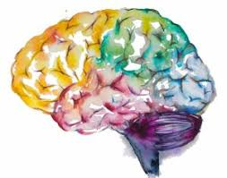
Innovation is (7 I’s of Innovation):
Intellectual
Impactful
Iterative
Inclusive
Improvement
- Focused
Integrative
Informative

Slide 9
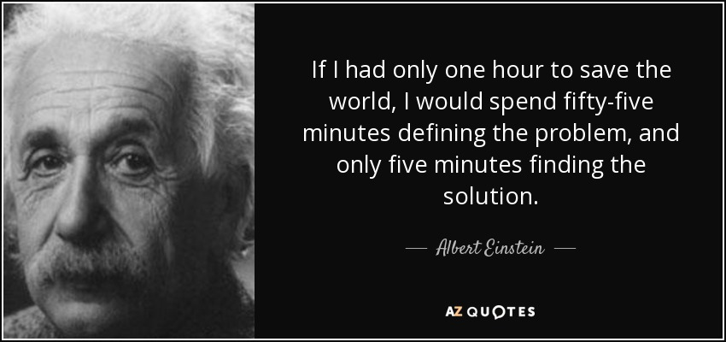
Innovation is Intellectual
Competitive projects are often derived from foundational questions.
What questions are you asking (i.e., what if)?

Slide 10
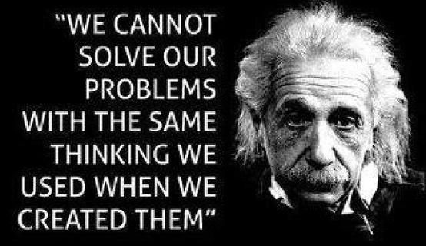
Innovation is Impactful
Competitive grant proposals are often aimed at addressing/solving a real-world problem.
What problem are you trying to solve and how will the funds go to help solve that problem?
How will you know you solved or impacted the problem?
For example, don’t ask at the initial stage of grant development what they want to use the money on, but ask what questions they have and what problems they want to solve.
The money follows the problem not the other way around.

Slide 11
Innovation is Limited in Time and Choices
At some point, given pressing deadlines, a decision will have to be made.

Slide 12
II. Understand considerations for developing innovative projects.
Notes:
Developing a logic model at the beginning of program planning gives you a framework for charting the links between your program’s resources, activities, and outputs and its intended outcomes. It enables you to evaluate your program once it begins. And it helps you communicate to your stakeholders what you want to accomplish, how you intend to reach your goals, and how you will track your progress.
Logic models represent INTENTION; shows connection between the planned work and what you hope to achieve. THIS is informed by the theory of change.
These components illustrate the connection between your planned work and your intended results.
Visual representation, etc. purpose in sharing ,etc.
Start with identifying the impacts and outcomes (relationship to backwards design) then can select the activities

Slide 13
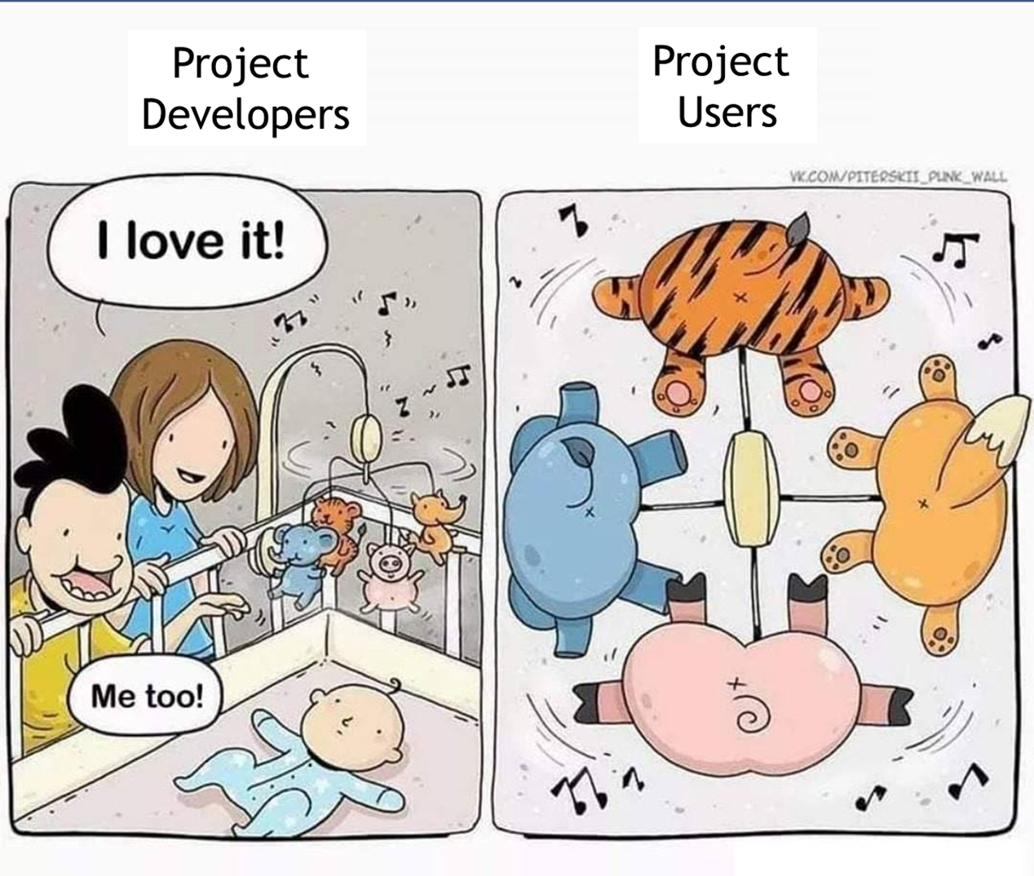
Creativity vs Innovation

Slide 14
Grants Fund Projects that Are Useful and Built on Previous Success
Develop a project that is doable and worth doing?
Of the two, which is more difficult to figure out, and why?

Slide 15
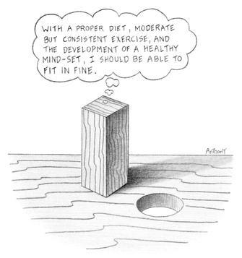
Making a Grant Project Doable is the Greatest Sign of Creativity and Innovation
Trying to align your strategic priorities, community needs, and organizational capacity all within the project requirements, limited budget, and aggressive timeline of the grant is a near impossible task.
This is an iterative process of seemingly trying to fit a square peg into a round hole. Most of the grant effort will be on the later issue not the former.

Slide 16
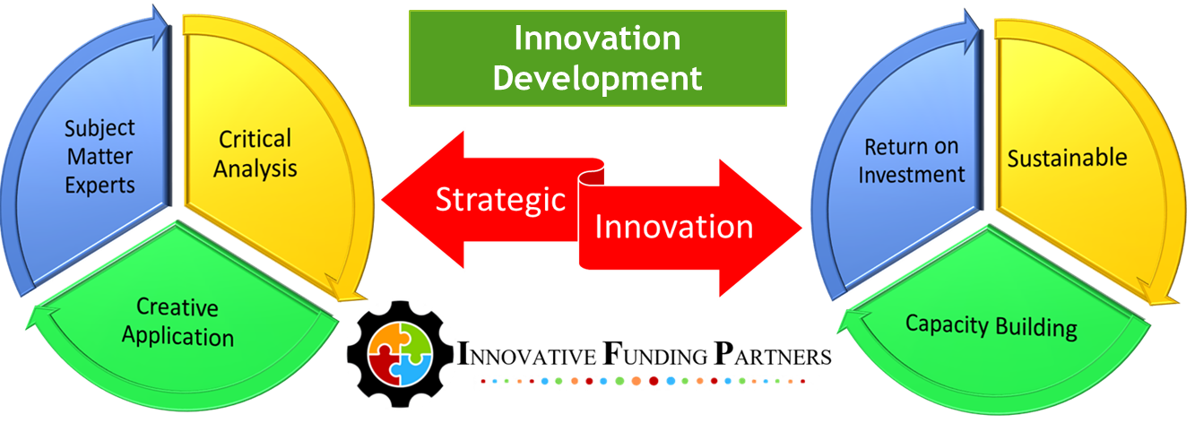
Aligning Innovation with Strategic Planning
Do: Follow the 80/20 rule: 80% of the work done up front, 20% creative application from external partners. Engage subject matter experts to hear from someone who has already learned the information you are looking for.
Don’t: Brainstorm ideas with a large group/coalition. Everyone is busy and everyone is bringing their own expertise to the project. Do your work by reading the grant carefully and have an overarching idea. Have partners add to that existing idea.

Slide 17
The Research Problem and Solution Drives the Entire Project
Why try to systematize the innovation process?
Innovation is difficult and should be approached with the same rigor as any other other process.
Creating steps allows the individual and team to engage in continuous quality improvement of both the idea and the process.

Slide 18
Definition of Innovative from a Federal/ Government Grant Perspective
Comparative Effectiveness, Patient Centered Research
Continuous Quality Improvement

Slide 19
Consensus and Continuous Improvement
Biggest initial challenge is getting everyone to understand the problem and solution and agree on that solution path. Define the problem, define the solution, and define the processes to get there.
Innovation must “close the loop” system, which should go through several iterations; effectively, a continuous quality improvement plan.

Slide 20
Inclusive: Including the Community to Educate, Engage, and Empower
We create success around education, engagement, and empowerment by personalizing the intervention and by meeting the community members where they are in understanding their issues/problems and supporting them on solving their problems—the community is the subject matter expert.
Often the first innovative step is engaging the community around the grant goals and objectives.
Goal:
Making progress
with your community
and not
to your community

Slide 21
Developing Integrative Models: Is This a Realistic Goal?
Increasingly, federal grants are requiring applicants to embrace a more wholistic model of participant engagement and care.

Slide 22
Will Every Project Work Equally Well for Everyone, Everywhere in WNC?
Is this really the best way to conceptualize community groups in WNC? What is a better way?
Rural
Suburban
Urban
Income
Race/Ethnicity
Language

Slide 23
Social Determinants of _______
Which factors and to what degree do such factors influence the development, intensity, diagnosis, and recovery of health problems?

Slide 24
Developing Integrative Models
Health
Reentry
Education
Proposed
Focus
Historical
Focus
How can you consider social determinants within your approach, training, etc.?

Slide 25
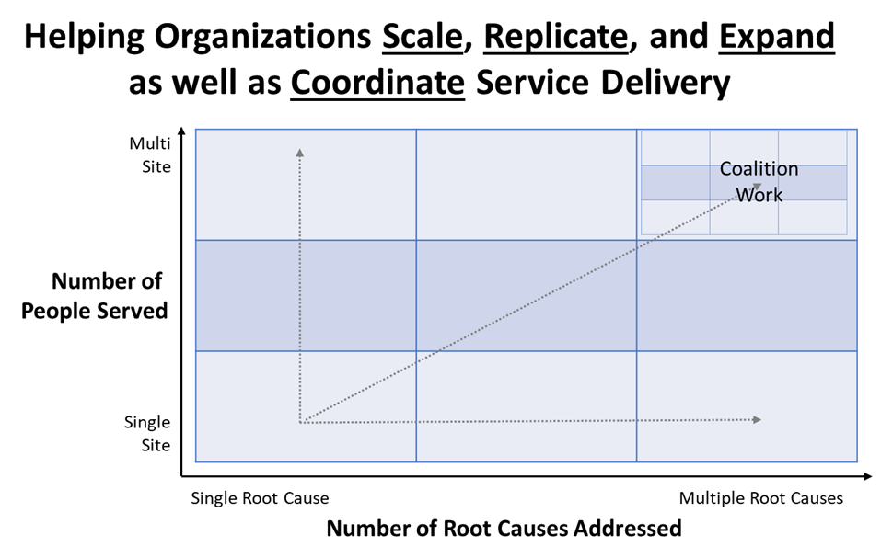
Innovation is Inclusive and Integrative
Are you trying to expand the same services for more people?
Are you trying to expand the number of services for your participants?
Are you trying to expand number of services and numbers of participants?

Slide 26
III. Learn how to balance evidence-based models with innovation.
Notes:
Developing a logic model at the beginning of program planning gives you a framework for charting the links between your program’s resources, activities, and outputs and its intended outcomes. It enables you to evaluate your program once it begins. And it helps you communicate to your stakeholders what you want to accomplish, how you intend to reach your goals, and how you will track your progress.
Logic models represent INTENTION; shows connection between the planned work and what you hope to achieve. THIS is informed by the theory of change.
These components illustrate the connection between your planned work and your intended results.
Visual representation, etc. purpose in sharing ,etc.
Start with identifying the impacts and outcomes (relationship to backwards design) then can select the activities

Slide 27
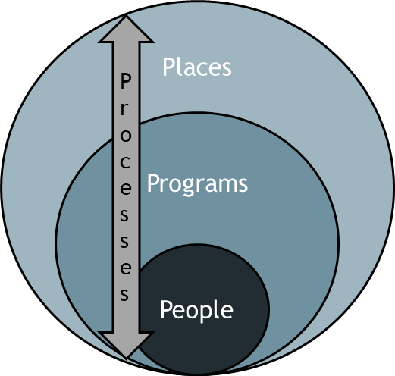
EBBP Innovation in Patients/Participants to Populations
Where is the work being done (population)
How are costs being managed (payments)
What is the EB(B)P (practices)
Plans for access and barriers are present (plans)
Who is doing the work (providers)
Who is being served (patients)
How can quality improvement be shown here?

Slide 28
Be SMART(ER)
Specific – target a specific area for improvement
Measurable – quantify or at least suggest an indicator of progress
Assignable – specify who will do it and a timeline for completing tasks
Realistic – state what results can realistically be achieved, given available resources
Time-related – specify when the result(s) can be achieved
Evaluate – analyze the data; use the data for informed decision making
Re-evaluate – go through iterations of the study to confirm model success

Slide 29
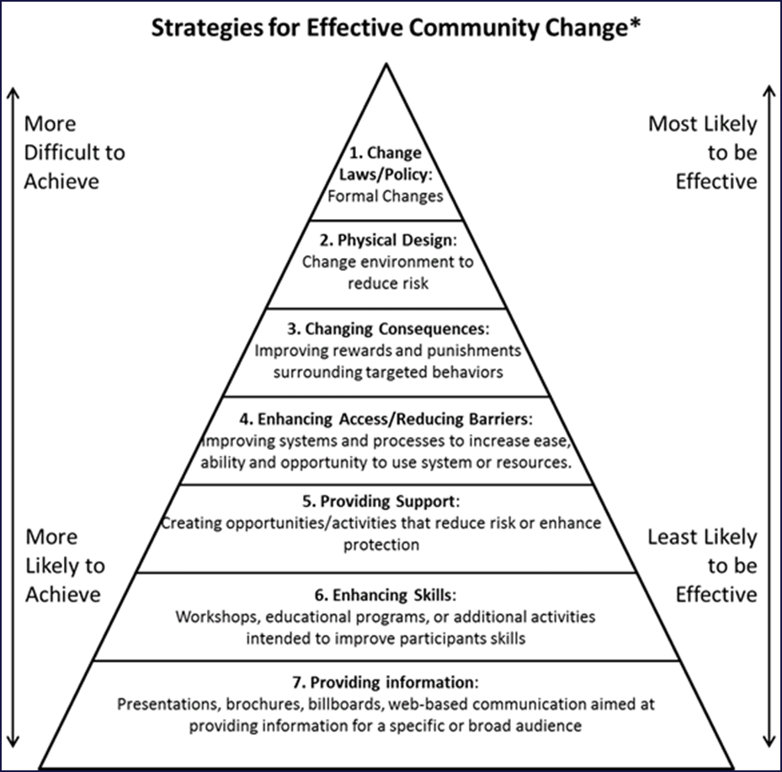
Developing Innovation that is Impactful
What is the likelihood your intervention/program is going to achieve positive, sustainable change?
The goal is to move up as far as possible on the pyramid

Slide 30
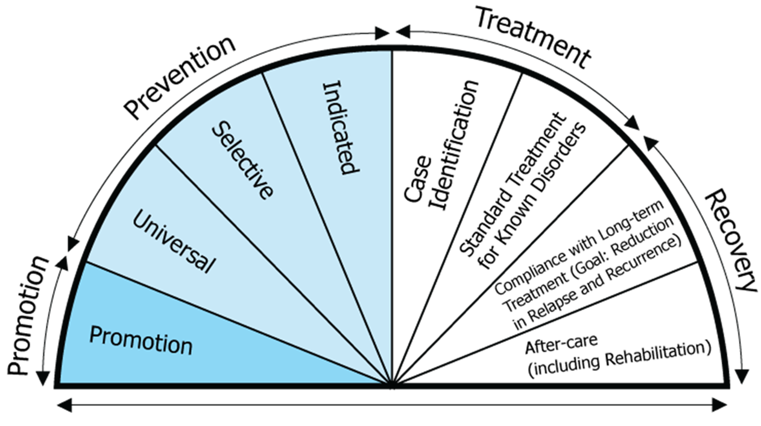
Developing Levels of Interventions
What type of intervention are you proposing across the care continuum?
What would be most impactful for the problem you are attempting to address?

Slide 31
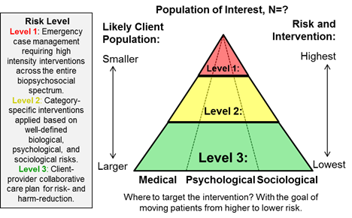
Doing Work that Maximizes Real Change
Selecting the Most Impactful
Patient Populations
Is your intervention targeting the most important part of the population?

Slide 32
Developing a Compelling Project
Characteristics of an Innovative Project
The FINER Model
Feasible
Interesting
Novel
Ethical
Relevant
Must Pass the “So What?” Test!

Slide 33
PICOT Criteria
P = Population (patients/learners)
What specific patient, student population are you interested in building an intervention or program in?
I = Intervention (program/training)
What is your investigational intervention? Is it evidence-based (valid and reliable)
C = Comparison Group (control condition)
What is the main alternative to compare with the intervention?
O = Outcome(s) of Interest (dependent measure)
What do you intend to accomplish, measure, improve, or affect?
T = Time (study length)
What is the appropriate timeline for completing the study and demonstrating impact?
J can chir, Vol. 53, No 4, août 2010

Slide 34
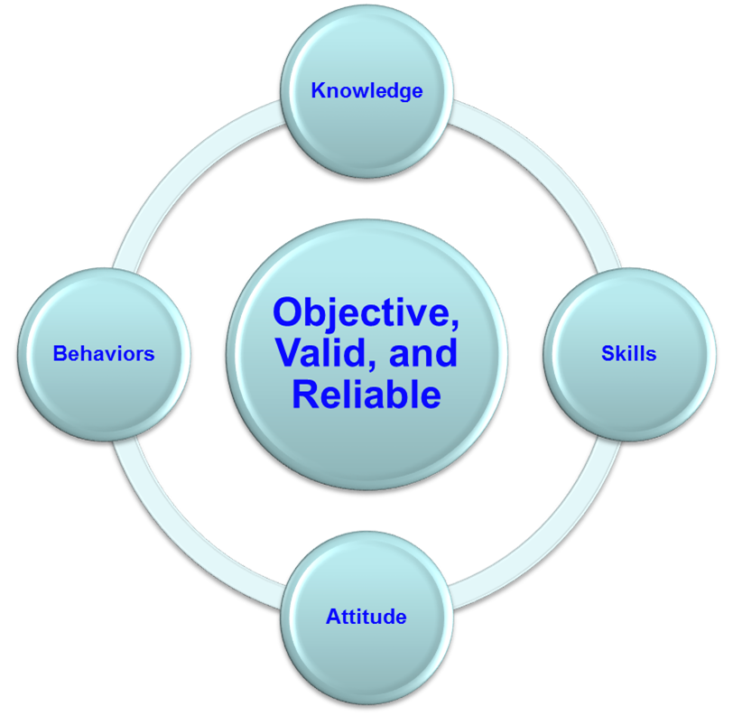
Impact Should be Informative: Focus on Quality Data
Must select outcomes that…
Are important to those providing funds
Are important to the specific research goal
Are important to your organization
Are important to your stakeholders
Are capable of showing the positive impact of your intervention
Are able to be generalized and disseminated to a larger audience
Many projects within an organization already provide a list of predetermined outcome measures—use those.
We suggest the 90/10 rule when it comes to data collection: 90% of your data for a new project should come from existing sources while only 10% should be developed specifically for the grant.

Slide 35
IV. Develop familiarity with how to achieve innovation while setting achievable goals and outcomes.
Notes:
Developing a logic model at the beginning of program planning gives you a framework for charting the links between your program’s resources, activities, and outputs and its intended outcomes. It enables you to evaluate your program once it begins. And it helps you communicate to your stakeholders what you want to accomplish, how you intend to reach your goals, and how you will track your progress.
Logic models represent INTENTION; shows connection between the planned work and what you hope to achieve. THIS is informed by the theory of change.
These components illustrate the connection between your planned work and your intended results.
Visual representation, etc. purpose in sharing ,etc.
Start with identifying the impacts and outcomes (relationship to backwards design) then can select the activities

Slide 36
How Are You Defining Innovation?
First, you must define innovation.
Second, you must conceptualize and define the solution.

Slide 37
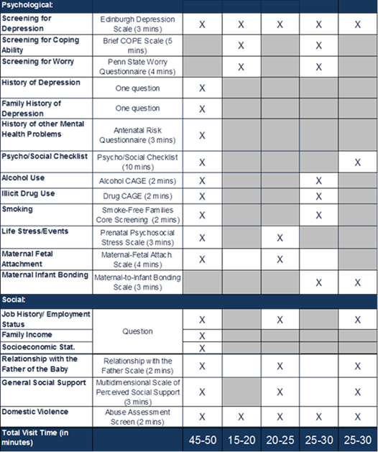
Case Study: Postpartum Depression Project

Slide 38
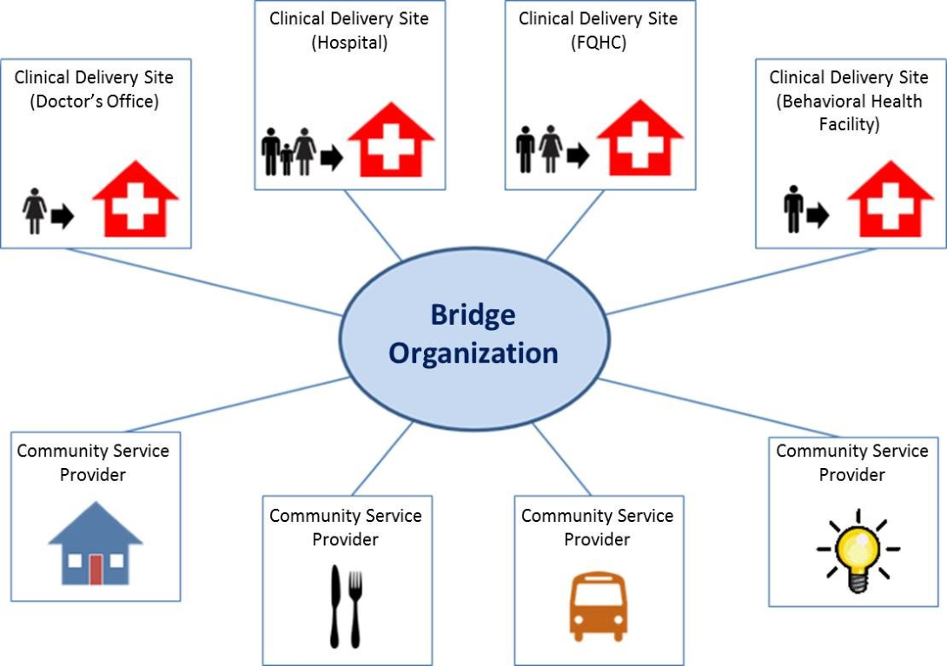
Iterative/Incremental Innovation
Large, complex multifaceted issues focusing on entire spectrum of support
Know what type of problems different federal agencies are interested in solving.
Focused, disease specific solution
Every research project has its own level of focus.
Don’t solve every problem at once.

Slide 39
Innovation is (7 Is of Innovation):
Aims (IV, DV)
Hypotheses
Outcome Measures
Methods
Analysis
Conclusions
Limitations
General Topic
Topic Idea
Gap
Need
Innovation
Goal
Research Quest
Intellectual
Impactful
Iterative
Inclusive
Improvement
-Focused
Integrative
Informative

Slide 40
Questions?
IFP Contact Information:
Louise Mathias, Senior Partner
Louise.mathias@innovativefundingpartners.com
(202) 809-3401

Slide 41
Save the Date
Grant Development for Economic Opportunity: An Overview
Wednesday,
May 15th, 2024
12-1pm

Slide 42
Appendix: Resources on Effective Innovations
AHRQ’S Innovation Exchange
http://www.innovations.ahrq.gov
CDC’s Guide to Community Preventive Services
http://www.thecommunityguide.org
Promising Practices Network
http://www.promisingpractices.net
SAMHSA’s A Guide to Evidence-Based Practices (EBP) on the Web
http://www.samhsa.gov/ebpWebguide
National Registry of Evidence-based Programs & Practices (NREPP) http://www.nrepp.samhsa.gov/;
National Registry of Evidence-based Programs & Practices (NREPP) http://www.nrepp.samhsa.gov/
Office of Juvenile Delinquency Prevention (OJJDP) Model Program Guide http://www.ojjdp.gov/mpg
NACCHO Promising Practice Model Database
http://www.naccho.org/topics/modelpractices/database/index.cfm
Association of State and Territorial Health Officials
http://www.astho.org/Programs/Prevention/
Partnership for Prevention
http://www.prevent.org/
Mental Health First Aid & Youth Mental Health First Aid (MHFA/YMHFA) http://www.mentalhealthfirstaid.org/cs
Best Slide of the Presentation

Slide 43
dht.org

