Slide 1
Government Grant Development for Economic Opportunity
An Overview
May 15th, 2024

Slide 2
Learning Objectives
I. Developing familiarity with major federal funders in economic opportunity and their focus areas
II. Key and emerging priorities in government grant funding for economic opportunity
III. Best practices in project design and proposal development: How to craft a winning economic opportunity government grant proposal

Slide 3
About
Innovative Funding Partners
IFP is a nationally-recognized grants consulting firm highly regarded for an impressive overall grant success rate of 87%. Well known for their expertise in federal and other governmental grant writing, this success is based not only on technical expertise, but also on a foundational relationship-building approach. IFP’s team of over 20 highly-experienced consultants are passionate about helping organizations meet the unique needs of their local communities and better serve their constituents by seeking and securing grant funding.

Slide 4
About the
presenter
Carrie Davis, IFP Senior Grants Consultant, is an experienced grant writer and project manager with a consistent track record of success working with organizations across diverse sectors and geographies. She provides project oversight, facilitation, and coordination at all levels of grant development. Carrie has successful experience with foundation, corporate, and government grants including DOL, HRSA, SAMHSA, CDC, DOE, USDA, and more.
.
3.
Carrie Davis
Senior Grants Consultant

Slide 5
I. Developing familiarity with major federal funders related to economic opportunity and their focus areas
Notes:
Developing a logic model at the beginning of program planning gives you a framework for charting the links between your program’s resources, activities, and outputs and its intended outcomes. It enables you to evaluate your program once it begins. And it helps you communicate to your stakeholders what you want to accomplish, how you intend to reach your goals, and how you will track your progress.
Logic models represent INTENTION; shows connection between the planned work and what you hope to achieve. THIS is informed by the theory of change.
These components illustrate the connection between your planned work and your intended results.
Visual representation, etc. purpose in sharing ,etc.
Start with identifying the impacts and outcomes (relationship to backwards design) then can select the activities

Slide 6
Department of Labor (DOL) is the primary department offering grants for workforce development.
Through labor-focused grants, DOL seeks to fulfill its mission of expanding equitable opportunities for and empowering all workers.
DOL grants connect, protect, train, support and empower workers and job seekers, at home and abroad.

Slide 7
DOL divisions relevant to economic opportunity grants
Employment and Training Administration (ETA)
Occupational Safety and Health Administration (OSHA)
Veterans’ Employment and Training Service (VETS)

Slide 8
DOL- Employment and Training Administration (ETA)
The mission of the Employment and Training Administration (ETA) is to contribute to the more efficient functioning of the U.S. labor market by providing high-quality job training, employment, labor market information, and income maintenance services primarily through state and local workforce development systems.
ETA’s vision is to promote pathways to economic liberty for individuals and families working to achieve the American Dream. On behalf of American taxpayers, the ETA administers effective programs that have at their core the goals of enhanced employment opportunities and business prosperity.
DOL-ETA Funding Request for FY2025: $11 billion

Slide 9
DOL- Employment and Training Administration (ETA)
Critical Legislation Informing the Majority of DOL-ETA Grants: Workforce Innovation and Opportunity Act (WIOA)
WIOA is landmark legislation that is designed to strengthen and improve the nation's public workforce system and help get Americans, including youth and those with significant barriers to employment, into high-quality jobs and careers, as well as help employers hire and retain skilled workers.
WIOA was signed into law on July 22, 2014. WIOA is designed to help job seekers access employment and training and succeed in the labor market as well as to match employers with the skilled workers they need to compete in the global economy. Congress passed the Act with a wide bipartisan majority; it is the first legislative reform of the public workforce system since 1998.

Slide 10
DOL- Employment and Training Administration (ETA)
Grant Focuses:
Apprenticeship programs- combine paid on-the-job training with classroom instruction to prepare workers for highly-skilled careers
Dislocated workers programs- training and other services that are available to assist workers who have been laid off or are about to be laid off
Indian and Native American programs- support employment and training activities for Indian, Alaska Native, and Native Hawaiian individuals.
Job Corps- the nation's largest and most comprehensive residential education and job training program for at-risk youth, ages 16 through 24.
YouthBuild- programs that give at-risk youth ages 16-24 the opportunity to transform their lives by earning their high school diploma or state-recognized equivalency degree, learning to be community leaders, and preparing for college and other post-secondary training opportunities.
People with disabilities- grant programs that offer training and employment assistance to people with disabilities.

Slide 11
DOL- Occupational Safety and Health Administration (OSHA)
With the Occupational Safety and Health Act of 1970, Congress created the Occupational Safety and Health Administration (OSHA) to ensure safe and healthful working conditions for workers by setting and enforcing standards and by providing training, outreach, education and assistance.
The OSH Act covers most private sector employers and their workers, in addition to some public sector employers and workers in the 50 states and certain territories and jurisdictions under federal authority.
DOL-OSHA Funding Request for FY2025: $665 million

Slide 12
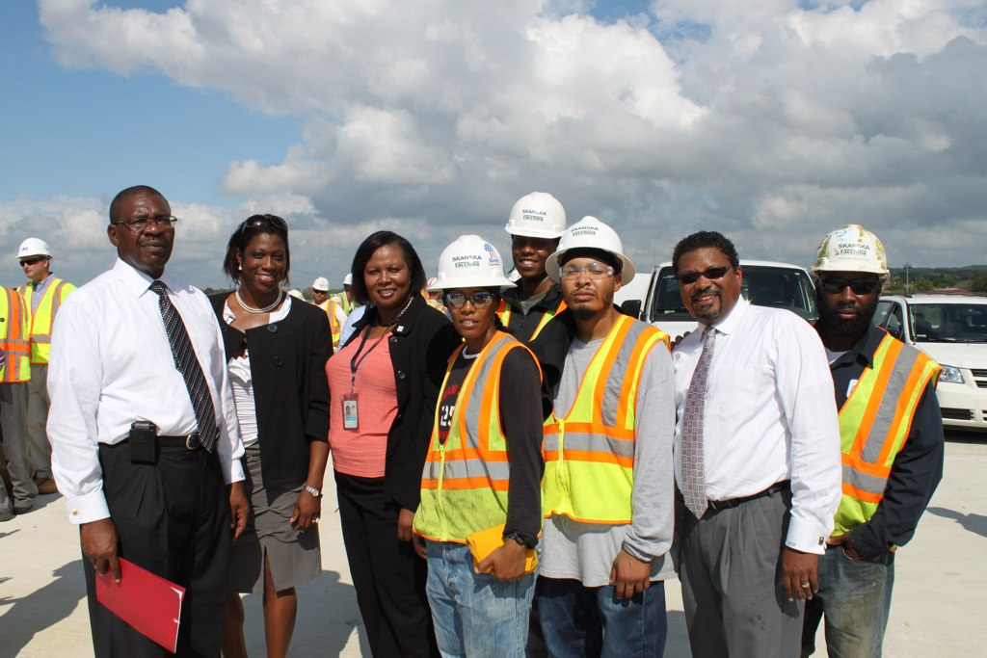
DOL- Occupational Safety and Health Administration (OSHA)
Grants focus on:
Implementing worker health and safety programs
Training workers on occupational safety and health topics
Capacity Building for organizations to deliver quality occupational safety/health training programs

Slide 13
DOL- Veterans’ Employment and Training Service (VETS)
VETS seeks to enable all veterans, service members, and military spouses to reach their full potential in the workplace. Its mission is to prepare America's veterans, service members, and military spouses for meaningful careers, provide them with employment resources and expertise, protect their employment rights, and promote their employment opportunities.
VETS Grant Priorities:
Helping transition the military to civilian employment
Assisting Veterans experiencing homelessness
Leveraging partnerships to maximize employment outcomes
Promoting and advancing equity, inclusion, and accessibility for underserved communities
DOL-VETS Funding Request for FY2025: $337 million

Slide 14
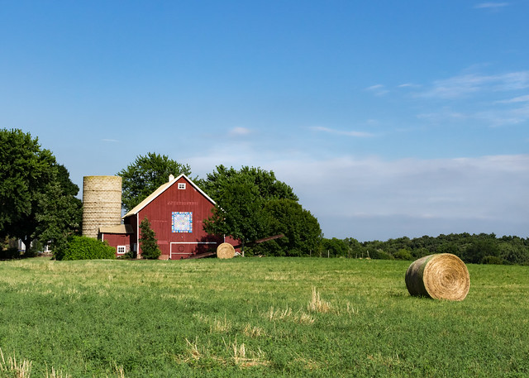
USDA seeks (1) to provide economic opportunity through innovation, helping rural America to thrive; (2) to promote agriculture production that better nourishes Americans while also helping feed others throughout the world; and (3) to preserve our Nation's natural resources through conservation, restored forests, improved watersheds, and healthy private working lands.
FY2025 Funding Request: $29.2 billion

Slide 15
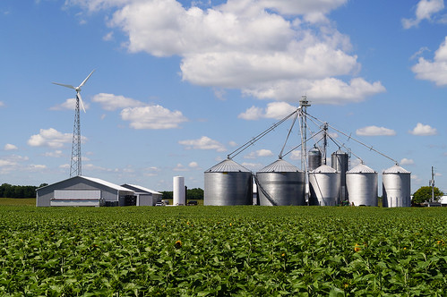
USDA Focus: Rural Development
USDA provides grants to support rural development including:
Rural business development
Rural community facilities (schools, hospitals, public safety services, local food systems, etc.)
Rural infrastructure development (water treatment facilities, electricity, clean energy etc.)
Broadband to rural areas

Slide 16
USDA Focus: Farming
USDA seeks to maintain a strong and appropriate safety net for America's farmers, ranchers, and growers:
assistance to struggling industries
disaster assistance
crop insurance
technical assistance
access to credit
helps producers implement conservation practices.
Grant programs such as Beginning Farmers and Ranchers and The Farmers Market Promotion Program shore up agriculture in rural areas that lack the technical assistance and support necessary to sustain local farms.

Slide 17
USDA Focus: Outdoor Recreation
Over the last two years, USDA has helped support more than 25 state public access programs and opened an estimated 2.4 million acres for hunting, fishing, and other outdoor recreational opportunities on privately-owned lands.
Additionally, almost $30 million in grants, provided through the Voluntary Public Access and Habitat Incentive Program, will help promote an estimated 35 percent increase in the number of participating landowners and increase outdoor recreation in these states by 21 percent.
Outdoor recreation is a major economic driver and can result in job creation and bolstering of the economy.

Slide 18
The Department of Commerce’s mission is to create the conditions for economic growth and opportunity for all communities. The Department has one overarching goal: Improve America’s Economic Competitiveness.
The Department of Commerce has a wide range of focuses, including artificial intelligence, cybersecurity, workforce development, manufacturing, and minority business growth, among others.
FY2025 Funding Request: $11.4 billion

Slide 19
The U.S. Economic Development Administration (EDA) is a major grantmaking arm of the Department of Commerce. The EDA’s investment policy is designed to establish a foundation for sustainable job growth and the building of durable regional economies throughout the United States. This foundation builds upon two key economic drivers - innovation and regional collaboration.
EDA’s grant investments in planning, technical assistance, and infrastructure construction are designed to leverage existing regional assets to support the implementation of economic development strategies that make it easier for businesses to start and grow.

Slide 20
Examples of EDA grant programs:
Distressed Area Recompete Pilot Program- investing in programs that will create good jobs in areas where prime-age (25-54 years) employment significantly trails the national average, with the goal of closing this gap through large, flexible investments
Disaster Preparedness and Recovery- grants to support economic rebuilding and resiliency following natural disasters
Public Works- grants to help distressed communities revitalize, expand, and upgrade their physical infrastructure to attract new industry, encourage business expansion, and create or retain long-term jobs
Economic Adjustment Assistance- provides a wide range of technical, planning, and public works and infrastructure assistance in regions experiencing adverse economic changes that may occur suddenly or over time, such as a steep decline in manufacturing employment following a plant closure, changing trade patterns, a catastrophic natural disaster, a military base closure, or environmental changes and regulations

Slide 21
Additional agencies with economic opportunity-related grantmaking
Grants for post-secondary education
and job training
Grants for small business innovation, veteran-owned small businesses, and micro- entrepreneurship

Slide 22
II. Key and emerging government grant priorities in economic opportunity

Slide 23
II. Key and emerging grant priorities in economic opportunity
Workforce Development
Creating opportunities for affordable, attainable, and accessible post-secondary education
Increase opportunities for non-traditional post-secondary options:
Certificate programs
Stackable credentials
Virtual/hybrid learning
Dual credit learning
School-to-Work opportunities (apprenticeships, on-on-the-job training)

Slide 24
II. Key and emerging grant priorities in economic opportunity
Workforce Development Continued
Push for trades programs (specific training for specialized skills)
Focus on dislocated/displaced workers, unemployed, and underemployed
Collaborations between education/training and business, as well as supportive services and labor/workforce entities

Slide 25
II. Key and emerging grant priorities in economic opportunity
Workforce Development Continued
Focus on reducing barriers (wrap-around services), addressing Social Determinants of Health (transportation, childcare, housing, food, academic support, etc.)
Focus on “Quality Jobs” or “Good Jobs” defined as those that exceed the local prevailing wage for an industry in the region, including basic benefits

Slide 26
II. Key and emerging grant priorities in economic opportunity
Economic Development
Economic development planning and implementation efforts at the local (city or county) and state levels – rural development
COVID relief for businesses in recent years to address loss of revenue tied to the pandemic as well as loss of employees
Focus on creating new, high-quality jobs (incentive funding – amount of funding directly linked to # of new jobs created)

Slide 27
II. Key and emerging grant priorities in economic opportunity
Economic Development
Public infrastructure funding – to improve facilities alongside increasing jobs
Downtown revitalization/Small Business Development/Rural Business Development
Sector-specific opportunities (agriculture, IT, energy, etc.)

Slide 28
II. Key and emerging grant priorities in economic opportunity
Entrepreneurship
Grants for creation of small businesses (women-, minority-, veteran-owned, rural, etc.)
Grants for entrepreneurship training and professional development (Entrepreneurship mentoring programs)

Slide 29
III. Best practices in project design and proposal development: How to craft a winning economic opportunity government grant proposal

Slide 30
III. Best practices in project design and proposal development
Understand grant requirements
Thoroughly review the NOFO/RFP including program purpose, eligibility criteria, required activities, etc.
Ensure your project/program aligns with the grant’s goals and objectives, period of performance, award amount, etc.
Understand requirements around match/cost sharing, indirect costs, reporting, etc.
You will be most competitive if you are not trying to “put a square peg in a round hole”

Slide 31
III. Best practices in project design and proposal development
Define clear goals, objectives and outcomes
Define your overarching goals of the project (align with grant purpose)
Clearly articulate the objectives (what you will do) and outcomes (what you will achieve) of your project
Use SMART objectives:
“Recruit at least 10 employer partners with commitment-to-hire agreements by March 31st, 2022”
Outcomes are changes in behavior/action, attitude, skills or knowledge.
“Increase program completion rates by 20% by January 31, 2024.”

Slide 32
III. Best practices in project design and proposal development
Utilize Evidence-Based Practices
Base your project design and implementation on evidence-based practices and research-supported strategies
Cite relevant research/data to justify your approach
Share information on any innovation you propose through your project (using EBPs with new populations, geographies, or in other ways from which it has been used previously)

Slide 33
III. Best practices in project design and proposal development
Identify and Engage Partners and Stakeholders
Identify and engage partners and stakeholders in the project design and development to ensure buy-in and support
Gather strong letters of commitment from partners that specify financial/in-kind commitment and roles/responsibilities on the project
Emphasize partner experience with similar programming and target populations as well as your history of successful collaboration
Utilize partnerships to support project sustainability

Slide 34
III. Best practices in project design and proposal development
Develop a Strong & Detailed Project Plan
Create a detailed project plan that includes activities, timeline, and milestones aligning with project goals and objectives
Define roles and responsibilities of project staff and partners to ensure accountability and coordination
Details are necessary to show the reviewers you are prepared and have the capacity to successfully implement what you propose

Slide 35
III. Best practices in project design and proposal development
Evaluate Program and Revise as Necessary
Develop a strong evaluation plan to analyze progress and effectiveness of your project
Incorporate feedback from partners, program participants, and other stakeholders to make necessary revisions to project design, activities, or outcomes
Consider using an external evaluator/evaluation team to support program evaluation over the course of the grant period

Slide 36
III. Best practices in project design and proposal development
Address Sustainability and Scalability
Define how you plan to sustain the project after the grant period
Identify strategies for ongoing funding to support sustainability and potentially scalability, if applicable
Show commitments from your organization, project partners, other funders, etc. through letters or other documentation

Slide 37
III. What results in a winning Economic Opportunity proposal?
Workforce Development
Your organization already has successful experience implementing other workforce development programs
You have buy-in and commitments from key stakeholders in the community:
Local businesses in the relevant sector
Workforce development partners (local WIOA programs, chambers of commerce, labor unions, etc.)
Training providers (colleges/universities, certifying institutions, etc.)
Your program incorporates evidence-based training/programs:
On-the-job training
Job shadowing
Career ladders or credential stacking opportunities
Apprenticeships
Mentoring/coaching programs

Slide 38
III. What results in a winning Economic Opportunity proposal?
Workforce Development continued
Your program reduces barriers to workforce training:
Wrap-around services addressing SDOH (transportation, housing, childcare, financial aid, etc.
Student support services (tutoring, mentoring, etc.)
Your program makes workforce training attainable and accessible:
Credit for prior experience/learning
Virtual/online or hybrid, multiple offerings at varying times, etc.
Dual-credit programs for high schoolers
Your program will result in “good jobs” – high quality, high wage jobs to support individuals and families and boost the economy

Slide 39
III. What results in a winning Economic Opportunity proposal?
Economic Development
Your program addresses an identified need in the community and is place-based—locally/regionally driven
You have buy-in and support/commitment from key stakeholders:
Local government
Local associations
Community leaders
Business community
Your project will result in the creation of new jobs, businesses, etc. to build the local economy
Your program/project leverages other resources in the community

Slide 40
III. What results in a winning Economic Opportunity proposal?
Entrepreneurship Programs
Your idea/product is cutting edge and represents the latest thinking in the field
You’ve done your research and can show positive market data to support your idea/product (commercialization, profit margins, etc.)
Training or mentoring programs to support skills development
Underrepresented populations/geographies (women, minorities, veterans, rural)
Identify and engage community stakeholders
Potential consumers/customers
Other local businesses
Venture capital/Angel investors
Community leaders

Slide 41
Questions?
IFP Contact Information:
Louise Mathias, Senior Partner
Louise.mathias@innovativefundingpartners.com
(202) 809-3401
Dr. Brian Kelley, Senior Partner
Brian.Kelley@innovativefundingpartners.com
(202) 809-3399

Slide 42
Save the Date
Aligning Methodology and Evaluation: An Advanced Look
Wednesday,
June 12th, 2024
12-1pm

Slide 43
dht.org

