Slide 1


Aligning Methodology and Evaluation: An Advanced Look
June 12, 2024

Slide 2

Learning Objectives
Developing methodology reflective of the SMARTER (specific, measurable, achievable, realistic, timebound, and evaluation) approach
Determining appropriate data indicators for measuring impact/success
Designing process and outcome evaluation capable of demonstrating the impact of methods
Examining specific case studies of successful methodology and evaluation sections

Slide 3

About
Innovative Funding Partners
IFP is a nationally recognized grants consulting firm highly regarded for an impressive overall grant success rate of 84%. Well known for their expertise in federal and other governmental grant writing, this success is based on technical expertise and a foundational relationship-building approach. IFP’s team of over 20 highly experienced consultants is passionate about helping organizations meet the unique needs of their local communities and better serve their constituents by seeking and securing grant funding.

Slide 4

About the
presenters
Brian Kelley, Ph.D., IFP Grants Consultant, is a grant writer with a proven track record of securing federal and foundation grants across multiple sectors, including health care, workforce development, and education. He has worked in academia for over two decades and has served a variety of not-for-profit organizations and medical centers as a consultant to help create innovation and secure foundation, city, state, and federal funds to support biomedical, education, prevention research, and workforce development. He has also served as a grant reviewer for several granting agencies. Dr. Kelley leverages the culmination of these experiences into an authentic and effective approach to grant development for community impact.
.
3.
Brian Kelley, Ph.D.
Senior Partner

Slide 5

About the
presenters
Tracy Zeeger, IFP Grants Consultant, is an experienced public health educator with over 18 years of training in the field of behavioral and community health. Tracy has experience writing foundation and government grants for nonprofit entities, primary, secondary and higher education, and local health departments. Tracy is involved in training new professionals on the many different aspects of grant writing including evidence-based program planning and the utility of theory in plan development. Tracy holds a Ph.D. in Behavioral and Community Health from the University of Maryland, College Park.
.
3.
Tracy Zeeger, Ph.D.
Grants Consultant

Slide 6
I. Developing methodology reflective of the SMARTER approach
Notes:
Developing a logic model at the beginning of program planning gives you a framework for charting the links between your program’s resources, activities, and outputs and its intended outcomes. It enables you to evaluate your program once it begins. And it helps you communicate to your stakeholders what you want to accomplish, how you intend to reach your goals, and how you will track your progress.
Logic models represent INTENTION; shows connection between the planned work and what you hope to achieve. THIS is informed by the theory of change.
These components illustrate the connection between your planned work and your intended results.
Visual representation, etc. purpose in sharing ,etc.
Start with identifying the impacts and outcomes (relationship to backwards design) then can select the activities

Slide 7

SMARTER
Specific
Measurable
Action-Oriented
Realistic
Timebound
Evaluated
Re-Evaluated
B

Slide 8
Writing Methods Using the SMART(er) Approach
Specific | Define what you expect to happen Determine who will do it Detail accountability Use action verbs, expressing physical or mental action as much as possible Provide enough detail to be exceptionally clear
Measurable | Identify how you will know the objective was accomplished (usually means quantity but sometimes is quality)
Achievable | Ensure you have the person-power, time, resources and authority to accomplish the objective Consider if there are factors beyond your control OR milestones to be accomplished first
Relevant | The objective helps you meet the purpose of the grant & is aligned with the problem statement in the narrative
Time bound | Specify when the objective should be completed Include time-lined benchmarks

Slide 9
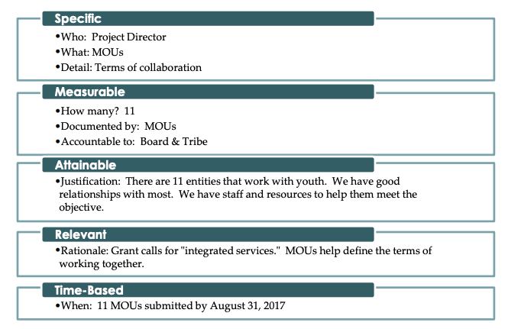
What Does This Look Like in
Planning

Slide 10
The project director will obtain MOUs that spell out the terms of agency collaboration for 11 tribal entities working with youth. The MOUs will state how many times a year the entities will meet as well as other details about how the entities will work together. The advisory committee will review all MOUs before signing; the director will submit all signed MOUs to the advisory committee and Tribal Council by August 31st.

Slide 11
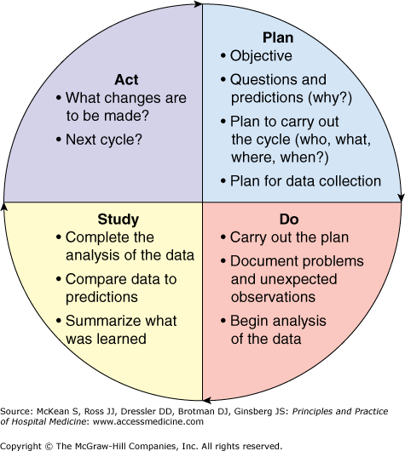
What about the ER?
Builds into the process evaluation and continuous quality improvement plan
Builds in milestones & checkpoints to assess progress towards the workplan
May phase in “testing” or “pilot” cycles
Reviewed to identify how to improve and make changes in the next cycle/iteration
Involves collaborators and partners in the process

Slide 12
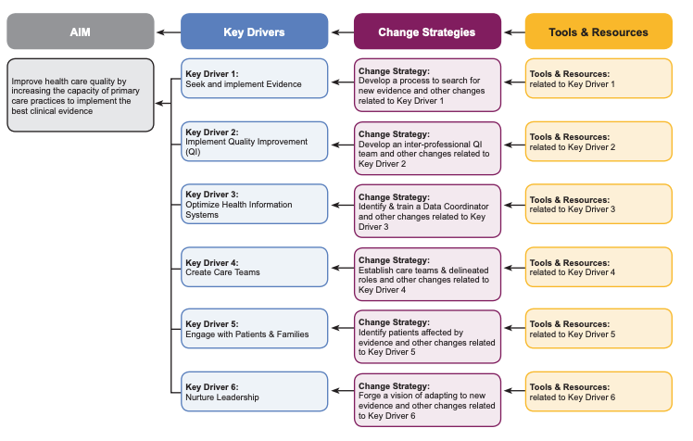
Key Driver Diagram for Planning
Notes:
https://www.ahrq.gov/sites/default/files/wysiwyg/evidencenow/tools-and-materials/KeyDriver_onepager.pdf

Slide 13
II. Determining appropriate data indicators for measuring impact/success
Notes:
Developing a logic model at the beginning of program planning gives you a framework for charting the links between your program’s resources, activities, and outputs and its intended outcomes. It enables you to evaluate your program once it begins. And it helps you communicate to your stakeholders what you want to accomplish, how you intend to reach your goals, and how you will track your progress.
Logic models represent INTENTION; shows connection between the planned work and what you hope to achieve. THIS is informed by the theory of change.
These components illustrate the connection between your planned work and your intended results.
Visual representation, etc. purpose in sharing ,etc.
Start with identifying the impacts and outcomes (relationship to backwards design) then can select the activities

Slide 14
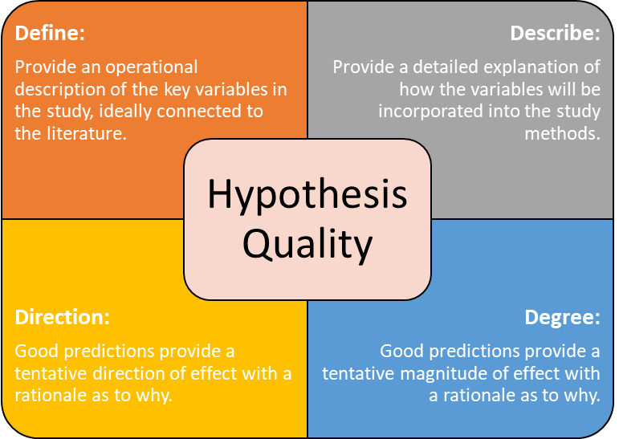
A hypothesis is just a directly testable statement.
It is framed as a prediction about the relationship between the independent and dependent variables.
Example: “If X is increased, then Y should decrease.”
B
THE MESSY SCIENTIFIC PROCESS OF MAKING FACTS
Developing Hypotheses

Slide 15
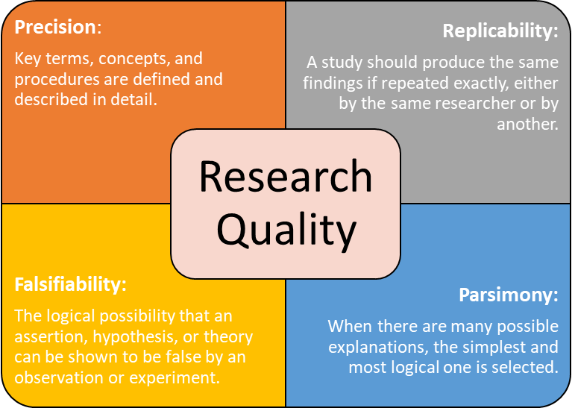
Developing an informed and effective hypothesis is just the necessary prerequisite work required for quality ideas.
Good research develops from good ideas.
An important paradoxical note:
In cognitive psychology, we rarely measure what we say we are measuring.
Instead, we measure performance and make assumptions about the relationship between performance changes and their relationship to some proposed underlying cognitive process.
B
THE MESSY SCIENTIFIC PROCESS OF MAKING FACTS
Validity

Slide 16
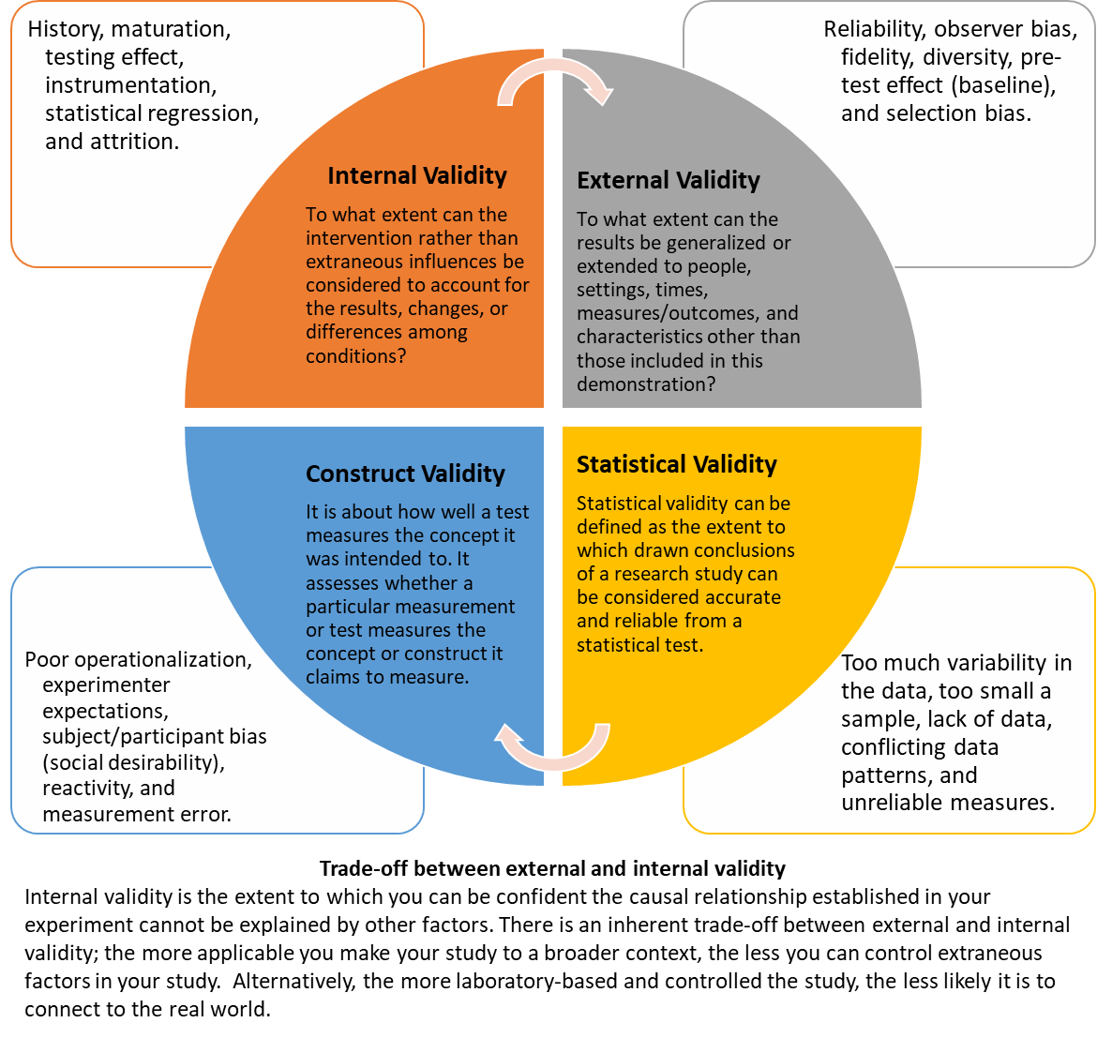
B
THE MESSY SCIENTIFIC PROCESS OF MAKING FACTS
Developing Hypotheses

Slide 17
Make an Observation
The scientific method is a set of orderly steps used to analyze and solve problems universally applied across scientific disciplines—the framework for the systematic study of behavior and mental processes.
The scientific method allows psychological data to be replicated and confirmed in many instances, under different circumstances, and by a variety of researchers.
Ask a Question
Form a Hypothesis
Try Again
Make a Prediction
Replicate
Conduct an Experiment
Analyze the Data
Hypothesis Correct
Hypothesis Incorrect
Report Results
THE SCIENTIFIC METHOD

Slide 18
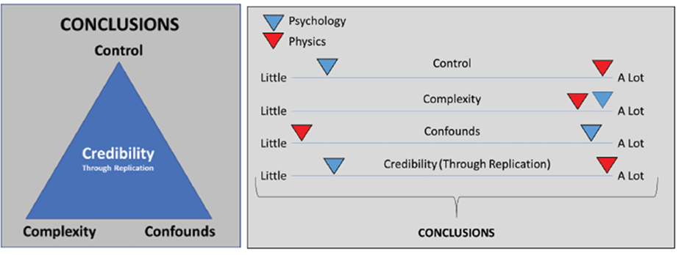
Psychology is influenced by these factors:
How well the study variables can be controlled
How complex the study variables are on that behavior
How many potential confounds are influencing the outcomes.
There is less ability to control all the needed variables in a psychological study.
Less control, greater complexity, and increased confounds result in less potential credibility of the empirical findings, thus impacting how factual conclusions are reached.
DRAWING CONCLUSIONS AND EVALUATING STUDIES

Slide 19
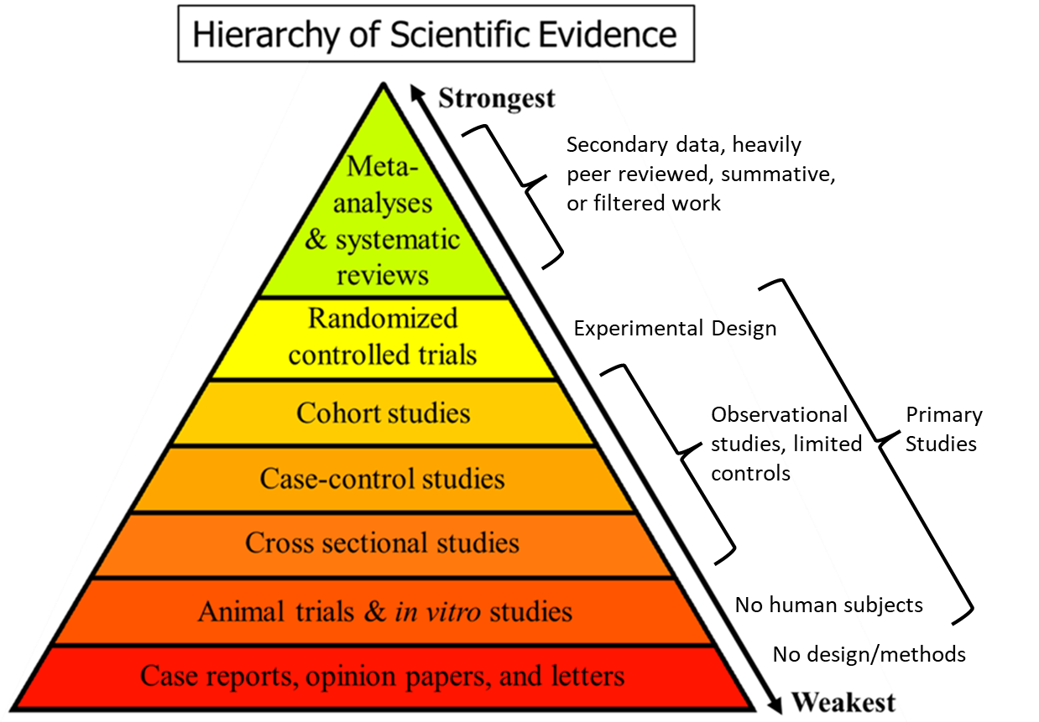
In many ways, the more participants and the more data points a study has, the better it is.
The more controls there are, the better the study is, at least in terms of drawing conclusions.
DRAWING CONCLUSIONS AND EVALUATING STUDIES

Slide 20
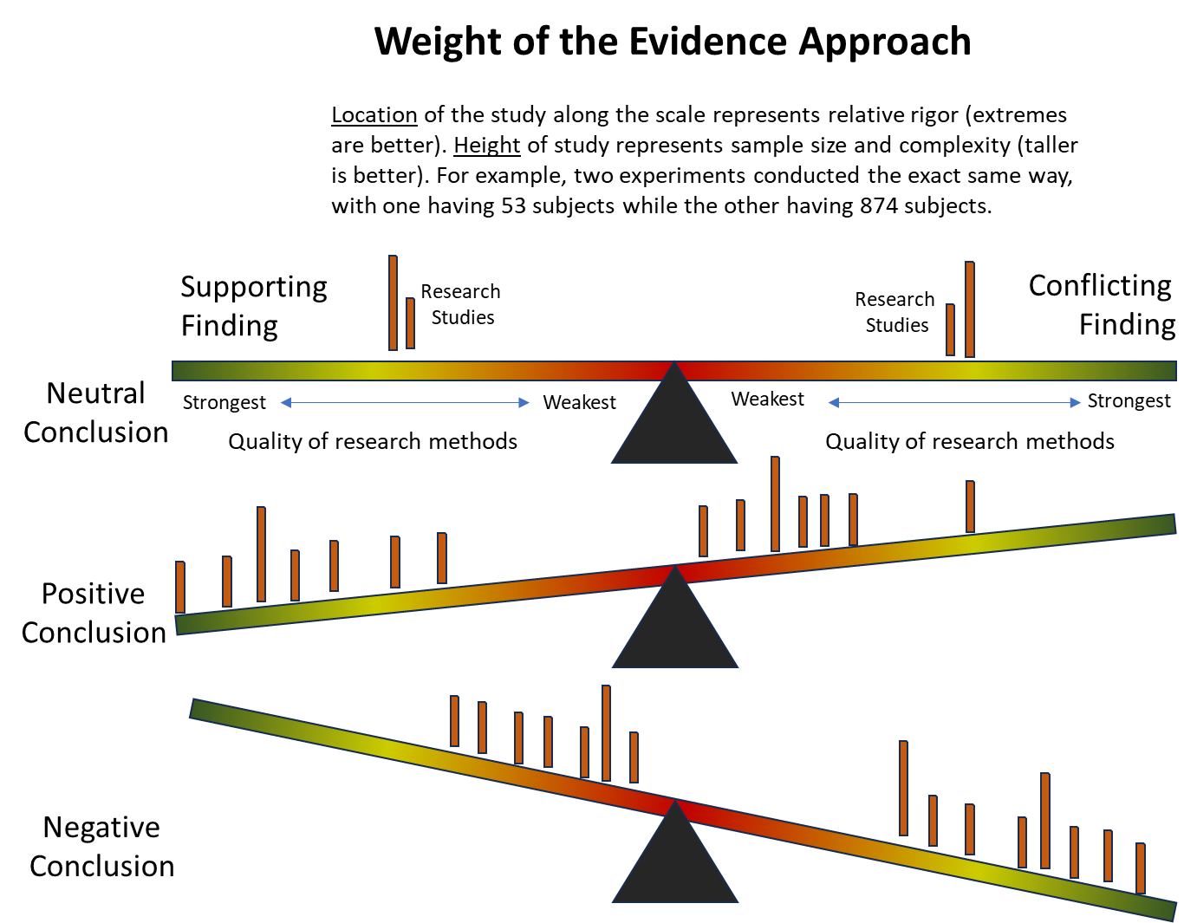
Weight of the Evidence Approach:
A methodological and analytical approach used to evaluate and draw conclusions from multiple sources of evidence or studies on a particular scientific question or hypothesis.
Researchers consider the collective body of evidence available from various studies, experiments, observations, and data sources related to a specific topic.
The goal of the weight of the evidence approach is to assess the overall strength and consistency of the evidence supporting or refuting a hypothesis or research question.
DRAWING CONCLUSIONS AND EVALUATING STUDIES

Slide 21
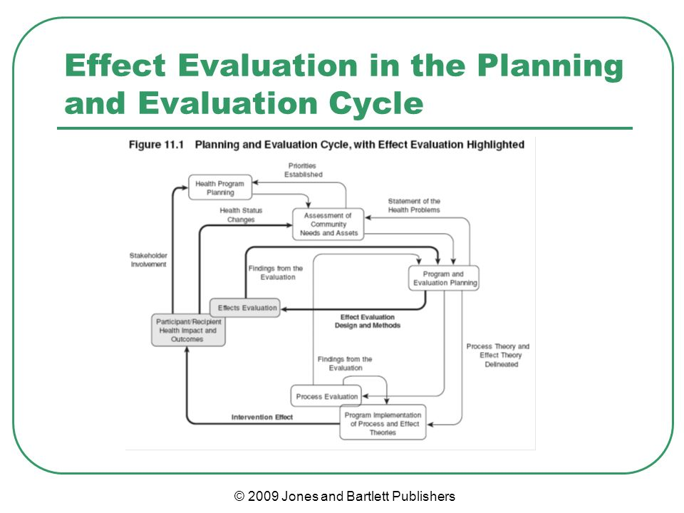

Slide 22
What are the considerations that go into making decisions regarding the focus and purpose of an evaluation?
Effect Theory
Logic Model
Outcome Objectives
Who the evaluation is for:
e.g., funders, stakeholders, research

Slide 23
Three Components of Program Effect Theory
Causal component
  Existing and causal factors, mediators and moderators, and health outcomes
Intervention Component
  How the interventions affect the causal, moderating, and mediating factors
Impact Component
  How immediate outcomes become long-term impact

Slide 24
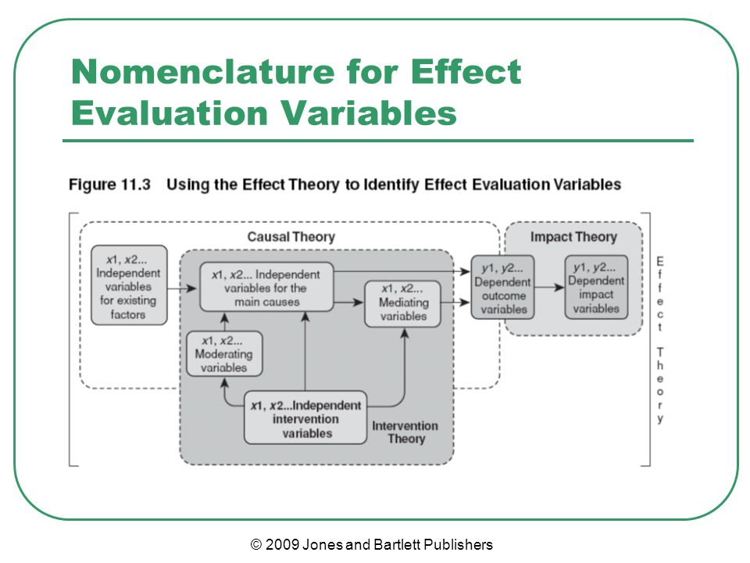

Slide 25
Steps for Selecting Evaluation Data Sources and Methods
Step 1: Identify Constructs or Indicators | - Define evaluation questions clearly and precisely. - Determine what specific aspects will be measured (indicators) to answer each question. - Consider using multiple indicators for a single question for comprehensive evaluation.
Step 2: Identify Entities with Data | - Identify the individuals, organizations, or materials that possess the needed information. - Common sources include program stakeholders, program events, and program materials. - For example, for an evaluation of a college program, sources might include enrollment records, student interviews, and program documentation.
Step 3: Determine Data Collection Methods | - Choose between different methods such as surveys, interviews, observations, or a combination. - Consider the cost, time, and resources required for each method. - Decide based on the level of detail and insight needed from participants.
Step 4: Identify Data Collection Procedures | - Determine the specific procedures for collecting data using the chosen methods. - Decide on the mode of survey administration or interview settings. - Identify who will be responsible for collecting and storing the data.
Step 5: Plan for Training and Data Recording | - Develop a training plan for those involved in data collection to ensure consistency. - Determine how data will be recorded (e.g., notes, recordings) and stored. - Consider if non-evaluators will be involved in data collection and plan for their training.

Slide 26
Best Practices for Choosing Indicators
Accepted practice & history of use
Acceptability in different settings
Availability of data
Burden of data collection on participants
Clarity of focus and meaning
Cultural appropriateness and relevance
Data quality
Investment of resources
Nondirectional language
Opportunity to detect unexpected or unintended findings
Pathway for use of data
Strength of evidence or substantive merit
Value within a set of indicators
Requirements by the funder
Notes:
https://wmich.edu/sites/default/files/attachments/u350/2014/Indicator_checklist.pdf
https://www.cdc.gov/evaluation/materials/FinalCDCEvaluationRecommendations_Formatted_120412.pdf

Slide 27
Outcomes & Example Indicators
Criterion-Referenced Tests | - Measure performance against an absolute criterion. - Used to evaluate a particular program or curriculum. - Provide information for judging a program’s success. - Consider using sub scores or individual items to measure relevant constructs. - Remember the goal is to improve student learning.
Objectives-Referenced Tests | - Use items keyed to specific instructional objectives. - Provide formative feedback for improvement. - Useful for summative decisions about program success.
Domain-Referenced Tests | - Estimate knowledge of a specific content area or domain. - Linked to the content domain being measured. - Costly to develop but can be used to assess program graduates' knowledge.
Norm-Referenced Tests | - Compare the performance of students taking the same test. - Mainly used for comparing students' performance. - Permit comparison with established norm groups. - Useful for assessing progress but may not always be valid for the program or curriculum being evaluated.
Performance-Based Assessment | - Involves executing a task in a structured situation while being observed and rated. - Useful for skills-based content areas. - Can include speaking skills, language proficiency, scientific experiments, etc. - More costly due to the need for trained assessors.
Psychometric Tests | - Rigorously designed and validated to measure complex (psychological or educational) constructs. - Published in resources like the Mental Measurements Yearbook. - Useful for evaluating programs in various fields such as intelligence, abilities, skills, attitudes, personality, and aptitude (ex: the Auditory Phoneme Sequencing Test, Employability Skills Inventory, etc.)

Slide 28
Commonly Used Indicators
Outcome Domain | Examples of Indicators to Measure Objectives
Physical Health | General Measures: cardiovascular fitness, weight, medical diagnosis of acute/chronic illness Standardized Measures: normal range on laboratory tests
Mental Health | General Measures: motivation, values, attitudes, emotional bonding, diagnosis of mental illness, diagnosis of substance use disorder, stress Standardized Measures: Edinburgh Post Depression Scale; Daily Hassles Scale
Cognitive Processes | General Measures: decision making, judgements, problem solving ability Standardized Measures: IQ tests, Bayley Scales of Infant Development
Behavior | General Measures: smoking, exercise, seat belt use, food purchasing behavior, risk taking Standardized Measures: Self-care inventory, Adolescent Sexual Activity Index, items from the BRFSS
Knowledge | General Measures: skill, ability, performance, recall, synthesis of facts Standardized Measures: Smith Alcohol Knowledge Test, Self-Rated Abilities for Health Practices
Social Health | General Measures: marital status, social network, volunteerism Standardized Measures: Norbeck Social Support Questionnaire, Life Events Scale
Resources | General Measures: income, insurance source, housing situation, employment status Standardized Measures: Hollingshead Index, dissimilarity index

Slide 29
Considerations for Setting Targets for Objectives
How much change or improvement is realistic to expect given time and resources
Is there baseline data to build from
Examine the literature for similar programs and the change that has been made
Review pilot program data for rates of change

Slide 30
III. Designing process and outcome evaluation capable of demonstrating the impact of methods
Notes:
Developing a logic model at the beginning of program planning gives you a framework for charting the links between your program’s resources, activities, and outputs and its intended outcomes. It enables you to evaluate your program once it begins. And it helps you communicate to your stakeholders what you want to accomplish, how you intend to reach your goals, and how you will track your progress.
Logic models represent INTENTION; shows connection between the planned work and what you hope to achieve. THIS is informed by the theory of change.
These components illustrate the connection between your planned work and your intended results.
Visual representation, etc. purpose in sharing ,etc.
Start with identifying the impacts and outcomes (relationship to backwards design) then can select the activities

Slide 31
Quick Review of the Purpose of Program Evaluation
Ongoing, requires real-time data collection
Purpose is to identify issues and possible ways to modify implementation to improve reach, satisfaction, coverage, desired components or service units
Varies depending on the program features
Feasibility is key
Efficiency, effectiveness, efficacy

Slide 32
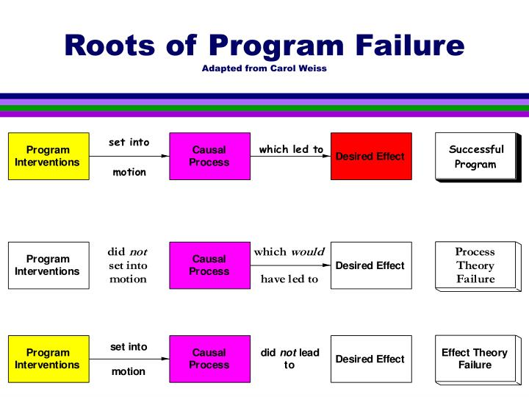

Slide 33
Key Process Evaluation Measures
Reach: the extent to which the program reached its intended audience.
Satisfaction: the degree to which participants receive what they expect to receive and the extent to which their expectations are met regarding how they are treated.
Service completion: the degree to which program participants completed the health program.
Dose: the level of intensity of the intervention received by participants.
Fidelity: the degree to which the intervention was implemented the way it was intended.

Slide 34
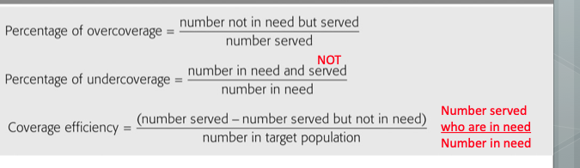
Formulas for Measurement of Coverage

Slide 35
Indicators Included in a Process Evaluation
Organizational Plans & Inputs
Services Utilization Plan Inputs
Immediate Outcomes
Human Resources
Outputs
Outputs
Participants
Informational Resources
Information System
Queuing
Coverage
Monetary Resources
Budget
Units of Service
Physical Resources
Social Marketing
Timeline
Service Completion
Transportation
Intervention Delivery
Operation Manual
Managerial Resources
Materials Produced
Time Resources
Organizational Chart
Workflow

Slide 36
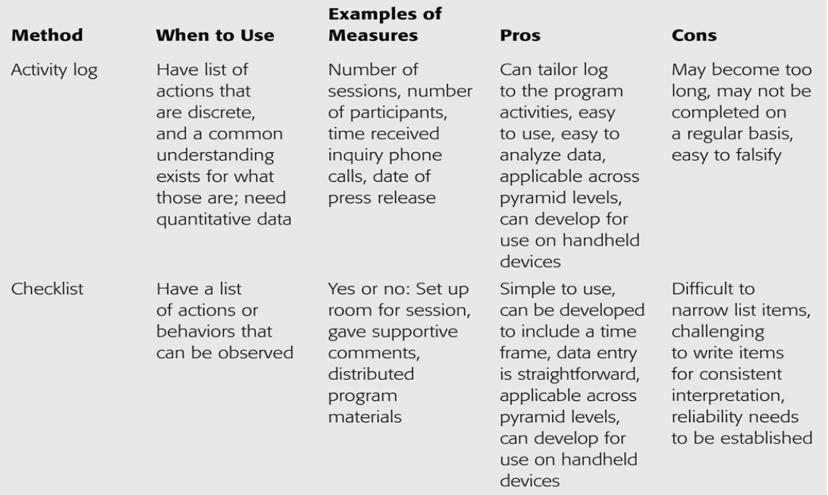
Methods of Collecting Process Evaluation Data

Slide 37
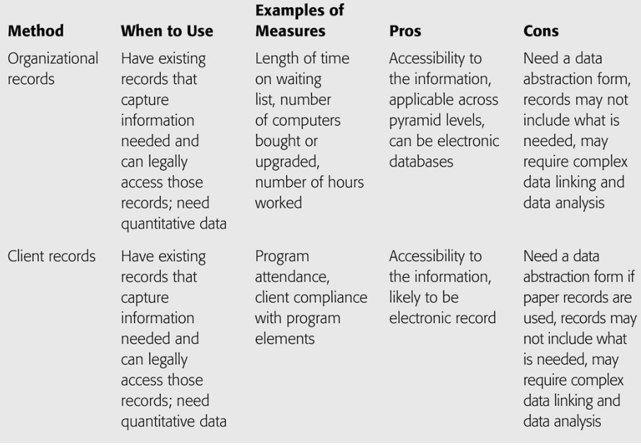
Methods of Collecting Process Evaluation Data

Slide 38
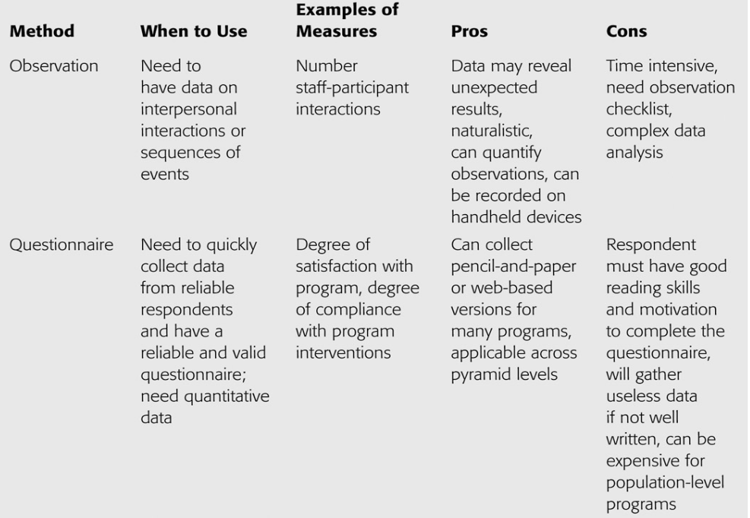
Methods of Collecting Process Evaluation Data

Slide 39
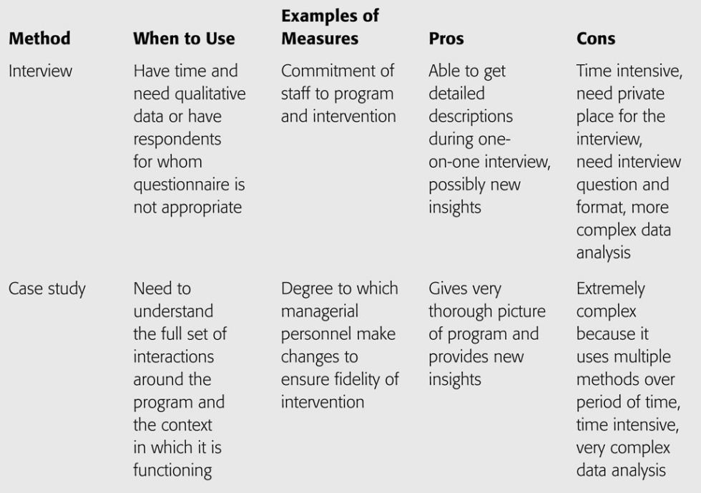
Methods of Collecting Process Evaluation Data

Slide 40
Organizational Plan
Accountability Type | Definition: The extent to which... | Examples of Indicators
Efficiency | Resources are utilized without waste or redundancy | Dollars spent on the program, cost per client served, cost per unit of outcome
Fiscal | Resources are managed according to the budget | Existence of receipts and bills paid, # of errors found during annual audit, % budget variance
Legal | Legal, regulatory, and ethical standards are met | # of malpractice suits, investigations, or personnel with licensure

Slide 41
Service Utilization Plan
Accountability Type | Definition: The extent to which... | Examples of Indicators
Coverage | Target population is reached | Coverage efficiency, efficiency index, % coverage efficiency target achieved
Service delivery | Intervention is provided as planned | # of units of service provided, breaches of protocol, or intervention modifications

Slide 43
Interpreting Implementation Data
Compare your process monitoring data with the targets stated in your process objectives/work plan
Attention to coverage is critical
Get staff insight into congruence between objectives and achievements
Consider the extent to which program components are provided

Slide 44
Outcome Evaluation Designs

Slide 45
IV. Examining specific case studies of successful methodology and evaluation sections
Notes:
Developing a logic model at the beginning of program planning gives you a framework for charting the links between your program’s resources, activities, and outputs and its intended outcomes. It enables you to evaluate your program once it begins. And it helps you communicate to your stakeholders what you want to accomplish, how you intend to reach your goals, and how you will track your progress.
Logic models represent INTENTION; shows connection between the planned work and what you hope to achieve. THIS is informed by the theory of change.
These components illustrate the connection between your planned work and your intended results.
Visual representation, etc. purpose in sharing ,etc.
Start with identifying the impacts and outcomes (relationship to backwards design) then can select the activities

Slide 46
Address structural- and systems- level barriers to improve rural residents’ access to quality, integrated SUD and other behavioral health care services. | 1.Serve as an internship site for students at all levels (associates to doctoral) from local colleges/universities for completion of clinical hours towards their degree | Project Director | 1a. MOU is established with at least 2 colleges/universities to offer internship hours 1b. Each FQHC has at least one intern from a local university 1c. Training program for recruits is established and implemented 1d. Interns are running at least 3 groups per week across the lifespan in each service area 1e. At least 1 new BHS provider is hired from the intern program within each FQHC 1f. Average wait time to obtain an appointment has reduced by one month | 1a. Y1 Q1-3 1b. Y2 Q1-4 1c. Y1 Q2-4 1d. Y2 Q1-Y4 Q4 1e. Y2 Q3 1f. Y3 Q1
 | 2. Expand synchronous, video telehealth services for behavioral health and SUD treatment | Project Director & Program Managers | 2a. All BHS providers have equipment to perform telehealth services 2b. Protocol for billing and use is developed with staff trainings completed 2c. Patient education and advertisements are disseminated on social media 2d. At least 2 community trainings to increase understanding and utility of telehealth have been held in each county 2e. Adherence to scheduled appointments by patients has increased by 20% | 2a. Y1 Q2 2b. Y1 Q2 2c. Y1 Q3 2d. Y1 Q3 2f. Y3 Q1
 | 3. Implement media campaign to decrease stigma associated with utilizing behavioral health and substance use services | Project Director | 3a. At least 5 theory-based slogans/messages are developed for placement online and in local community spaces 3b. Messages are transformed into at least one poster per message and at least one social media post 3c. Campaign is implemented on FQHC and community partner social media platforms and in physical spaces | 3a. Y2 Q3 3b. Y2 Q4 3c. Y3 Q1-Y4 Q4

Slide 47
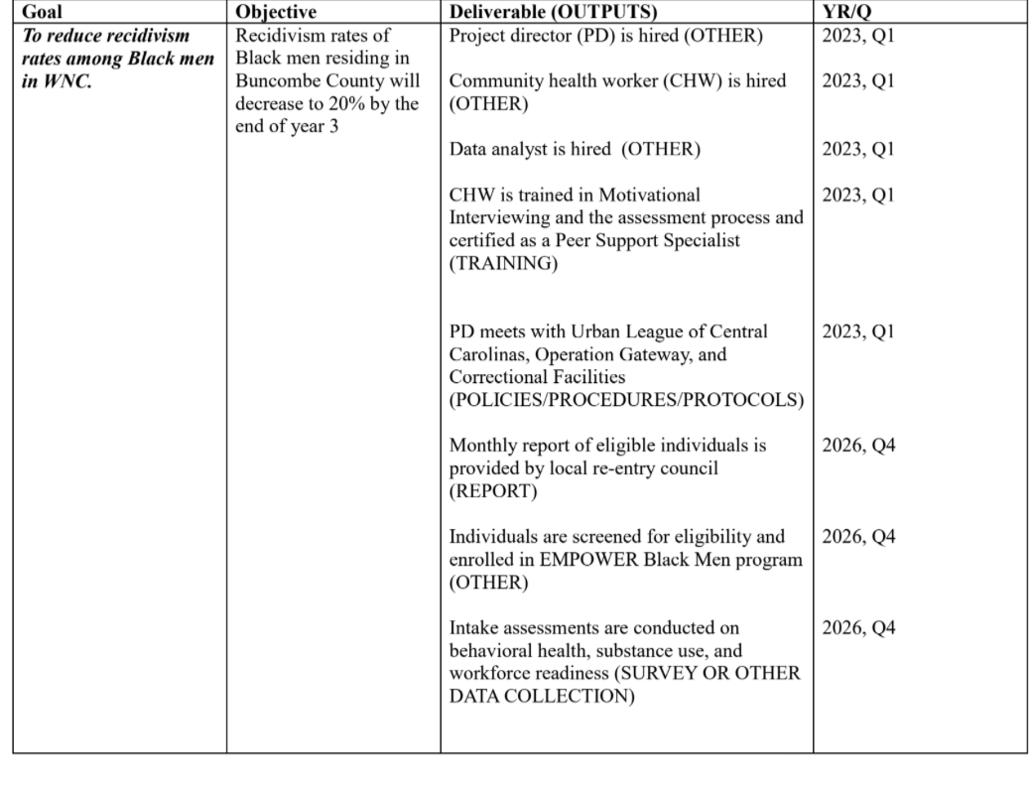

Slide 48
Narrative of Evaluation Sample
Participant data will be collected by the CHWs and reported to the data analyst (DA) (to be hired), who will compile and conduct needed analyses. Participant data will be collected upon entry to the program and every six months while imprisoned up until the release date. Post-release participants will be followed up for data collection at the 90-day and one-year marks. Data to be collected include work readiness skills (using a tool developed by the data analyst), feelings of hope and self-worth (Likert measures), scores on emotional intelligence (Mayer-Salovey-Caruso Emotional Intelligence Test), employment outcomes (self-reports of employment length, location), rates of displacement (self-report), recidivism (self-report and state data), and desistance to crime. Desistance to crime will be measured using a series of measures related to attitudes toward crime, pro-social behaviors, social support and relationships, and overall well-being. The aim of the evaluation will be to determine which programmatic components are most impactful on overall desistance and recidivism.

Slide 49
Outcome | Measures/Indicators | Data Source(s)
Increased Knowledge of MAT | Multiple choice questions on MAT statistics and use | Education Session Pre/Post Test
Increased positive beliefs on use of MAT among jail administrators and community members | Likert measures of agreement on list of beliefs and stigma | Education Session Pre/Post Test
Increased confidence to use naloxone among jail administrators and community members | Likert measures of confidence | Naloxone Training Pre/Post Test
Increased readiness to implement MAT among jail administrators | Score on Readiness Assessment | Readiness Assessment
Increased perceived control/confidence over ability to maintain abstinence post release among incarcerated/recently released | Likert measures of control; Likert measures of confidence | Meeting 1 with PSS & 1 week pre-release across all systems
Increased MAT uptake among high risk incarcerated/recently released individuals | # and % of incarcerated prescribed MAT # and % of released prescribed MAT | FQHC Medical Director Reports
Increased access to naloxone among jails and community members | 100% of jails have adopted the use of naloxone by the end of year 2 50% of recently released individuals have been provided naloxone by the end of year 2; 100% by the end of year 3 | Readiness Assessment conducted every 6 months FQHC Medical Director Reports
Reduced recidivism rates in the four service counties (5% reduction by end of year 2 and 10% post program engagement | Readmission rates | County jail booking data
Reduced opioid overdose rates in the four service counties (10% by end of year 2; 20% by end of year 3) | Mortality data by cause | NC Department of Health county level data

Slide 50
Questions?
IFP Contact Information:
Louise Mathias, Senior Partner
Louise.mathias@innovativefundingpartners.com
(202) 809-3401

Slide 51

Save the Date
Government Grant Development for Housing: An Overview
Wednesday, July 17
12-1pm EST

Slide 52
Appendix: Resources on Methodology & Evaluation
AHRQ’S Innovation Exchange
http://www.innovations.ahrq.gov
CDC’s Guide to Community Preventive Services
http://www.thecommunityguide.org
Promising Practices Network
http://www.promisingpractices.net
SAMHSA’s A Guide to Evidence-Based Practices (EBP) on the Web
http://www.samhsa.gov/ebpWebguide
National Registry of Evidence-based Programs & Practices (NREPP) http://www.nrepp.samhsa.gov/;
National Registry of Evidence-based Programs & Practices (NREPP) http://www.nrepp.samhsa.gov/
Office of Juvenile Delinquency Prevention (OJJDP) Model Program Guide http://www.ojjdp.gov/mpg
NACCHO Promising Practice Model Database
http://www.naccho.org/topics/modelpractices/database/index.cfm
Association of State and Territorial Health Officials
http://www.astho.org/Programs/Prevention/
Partnership for Prevention
http://www.prevent.org/
Mental Health First Aid & Youth Mental Health First Aid (MHFA/YMHFA) http://www.mentalhealthfirstaid.org/cs
Best Slide of the Presentation

Slide 53
dht.org

