Slide 1


Government Grant Development for
Substance Use Disorder/ Opioid Use Disorder Projects
April 16, 2025

Slide 2

Learning Objectives
Identifying major funders addressing substance use disorder (SUD) and opioid use disorder (OUD)
Developing familiarity with an overview of data sources, evidence-based practices, and guidance to support SUD/OUD project designs
Understanding key considerations for developing a winning SUD/OUD-focused proposal
Identifying ways to be most competitive in the current federal funding situation for SUD/OUD projects

Slide 3

About
Innovative Funding Partners
Innovative Funding Partners is a nationally recognized consulting firm that offers a range of services that improve our clients’ ability to achieve sustainable impact in their communities. Highly regarded for an impressive overall grant success rate of 85%, we offer turnkey grant writing and grants management, organizational planning (strategic, operational, sustainability), data-driven decision making and evaluation services, and training and technical support to a diverse client base of nonprofits, city and county governments, and small businesses/start-ups. Our team of over 30 highly experienced consultants has a wide range of subject matter expertise and is exceptionally passionate about helping organizations meet the unique needs of their local communities.

Slide 4

About the
presenters
Brian Kelley, Ph.D., Senior Partner, is a grant writer with a proven track record of securing federal and foundation grants across multiple sectors, including health care, workforce development, and education. He has worked in academia for over two decades and has served a variety of not-for-profit organizations and medical centers as a consultant to help create innovation and secure foundation, city, state, and federal funds to support biomedical, education, prevention research, and workforce development. He has also served as a grant reviewer for several granting agencies. Dr. Kelley leverages the culmination of these experiences into an authentic and effective approach to grant development for community impact.
.
3.
Brian Kelley, Ph.D.
Senior Partner

Slide 5

About the
presenters
Susannah Williams, IFP Senior Grants Consultant, is a grant writer with a proven track record of securing federal and foundation grants across multiple sectors, including health care, workforce development, and education. She has extensive experience in supporting clients’ project designs and development to meet complex grant requirements. Susannah has written multiple successful proposals for CDC, HRSA, DOE, DOJ, and DOL, among others.
.
3.
Susannah Williams
Senior Grants Consultant

Slide 6
I. Identifying Major Funders Addressing Substance Use Disorder (SUD) and Opioid Use Disorder (OUD)
Notes:
Developing a logic model at the beginning of program planning gives you a framework for charting the links between your program’s resources, activities, and outputs and its intended outcomes. It enables you to evaluate your program once it begins. And it helps you communicate to your stakeholders what you want to accomplish, how you intend to reach your goals, and how you will track your progress.
Logic models represent INTENTION; shows connection between the planned work and what you hope to achieve. THIS is informed by the theory of change.
These components illustrate the connection between your planned work and your intended results.
Visual representation, etc. purpose in sharing ,etc.
Start with identifying the impacts and outcomes (relationship to backwards design) then can select the activities

Slide 7
A Note on Impending Federal Restructuring
On March 27, 2025, the U.S. Department of Health and Human Services announced plans for restructuring several federal agencies in accordance with President Trump's Executive Order, “Implementing the President’s ‘Department of Government Efficiency’ Workforce Optimization Initiative.”
Creation of the Administration for a Healthy America (AHA) will combine multiple agencies — the Office of the Assistant Secretary for Health (OASH), Health Resources and Services Administration (HRSA), Substance Abuse and Mental Health Services Administration (SAMHSA), Agency for Toxic Substances and Disease Registry (ATSDR), and National Institute for Occupational Safety and Health (NIOSH) — into a new, unified entity.
Although we cannot predict how this will affect grant programs, we believe it is nevertheless helpful to understand the agencies and opportunities that have historically managed SUD/OUD grant opportunities.

Slide 8

Substance Abuse and Mental Health Services Administration (SAMHSA)
SAMHSA’s mission is to lead public health and service delivery efforts that promote mental health, prevent substance misuse, and provide treatments and support to foster recovery while ensuring access and better outcomes for all.

Slide 9
Substance Abuse and Mental Health Services Administration (SAMHSA) Grant Programs
SAMHSA manages a large portfolio of discretionary grants focused on the prevention and treatment of mental health and substance use issues. These include:
First Responders – Comprehensive Addiction and Recovery Act: support first responders and members of other key community sectors to administer a drug or device for emergency reversal of known or suspected opioid overdose.
Sober Truth on Preventing Underage Drinking Act (STOP Act): prevent and reduce alcohol use among youth and young adults ages 12 to 20 in communities throughout the United States.
Building Communities of Recovery: mobilize and connect a broad array of community-based resources to increase the availability and quality of long-term recovery support for persons with SUD and co-occurring substance use and mental disorders (COD).
Mental Health Awareness Training: train individuals across sectors to recognize the signs and symptoms of mental disorders and how to safely de-escalate crisis situations involving individuals with a mental illness

Slide 10

Health Resources and Services Administration (HRSA)
HRSA’s mission is to improve health outcomes through access to quality services, a skilled health workforce, and innovative, high-value programs.
HRSA programs provide health care to people who are geographically isolated and economically or medically vulnerable. This includes programs that deliver health services to people with HIV, pregnant women, mothers and their families, those with low incomes, residents of rural areas, American Indians and Alaska Natives, and those otherwise unable to access high-quality health care.

Slide 11

Health Resources and Services Administration (HRSA) Grant Programs
One of HRSA’s largest grant divisions is the Rural Communities Opioid Response Program (RCORP) which has funded a total of 14 separate grant programs over the years. Each of these programs has a specific focus; all aim to prevent or treat opioid use disorder (OUD) for people in rural areas. They include:
RCORP Overdose Response
RCORP Behavioral Health Support
RCORP Psychostimulant
RCORP Medication Assisted Treatment Access
RCORP Child and Adolescent Behavioral Health

Slide 12
Health Resources and Services Administration (HRSA) Grant Programs
HRSA has multiple other major grant programs through which applicants may address SUD/OUD in their program design. These include:
Rural Health Network Development (planning and implementation)
Rural Health Care Coordination
Rural Health Outreach

Slide 13

The Centers for Disease Control and Prevention (CDC)
CDC is the nation's leading science-based, data-driven, service organization that protects the public's health.
CDC puts science into action to help children stay healthy so they can grow and learn; to help families, businesses, and communities fight disease and stay strong; and to protect the public's health.

Slide 14
The Centers for Disease Control and Prevention (CDC) Grant Programs
The Drug-Free Communities (DFC) Support Program is the nation's leading effort to mobilize communities to prevent youth substance use. The program provides grant awards to over 750 community-based coalitions addressing youth substance use per year.
In coordination with the DFC Support Program, Comprehensive Addiction and Recovery Act (CARA) Local Drug Crisis grants provide funds to 65 communities to enhance DFC efforts by creating sustainable community-level change to prevent and reduce the use of illicit opioids or methamphetamine and the misuse of prescription drugs.

Slide 15

Department of Justice—Bureau of Justice Assistance (BJA)
The Bureau of Justice Assistance (BJA) was created in 1984 to reduce violent crime, create safer communities, and reform our nation’s criminal justice system.
BJA’s mission is to provide leadership and services in grant administration and criminal justice policy development to support state, local, and tribal justice strategies to achieve safer communities. BJA works with communities, governments, and nonprofit organizations to reduce crime, recidivism, and unnecessary confinement, and promote a safe and fair criminal justice system.

Slide 16
Department of Justice—Bureau of Justice Assistance (BJA) Grant Programs
Comprehensive Opioid, Stimulant, and Substance Use Program: aims to reduce the impact of opioids, stimulants, and other substances on individuals and communities by supporting comprehensive, collaborative initiatives.
Adult Treatment Court Program: supports state, local, and tribal efforts to plan, implement, and enhance the operations of adult treatment courts, including tribal healing to wellness courts.
Collaborative Crisis Response and Intervention Training Program: supports law enforcement partnerships with mental health, substance use disorder, and community service agencies to improve responses to individuals in crisis who have behavioral health conditions or intellectual, developmental, or physical disabilities.
Improving Adult and Youth Crisis Stabilization and Community Reentry Program: supports efforts to establish or expand cross-system approaches to reduce the risk of crisis and improve reentry and recovery outcomes for people reentering the community from correctional facilities (e.g., jails, prisons, juvenile detention) with serious mental illness, substance use disorders, and co-occurring disorders.

Slide 17
II. Developing familiarity with an overview of data sources, evidence-based practices, and guidance to support SUD/OUD project designs

Slide 18
Data in Government Grant Proposals: How You Tell the Story
All government grant requests for proposals (RFPs) will request you help reviewers understand the community or population served by your proposed project. This is usually the backbone of the Need section, and is often described along the following lines:
“You must use appropriate data sources (e.g., local, state, federal) in your analysis of the environment in which the project will be implemented.”

Slide 19
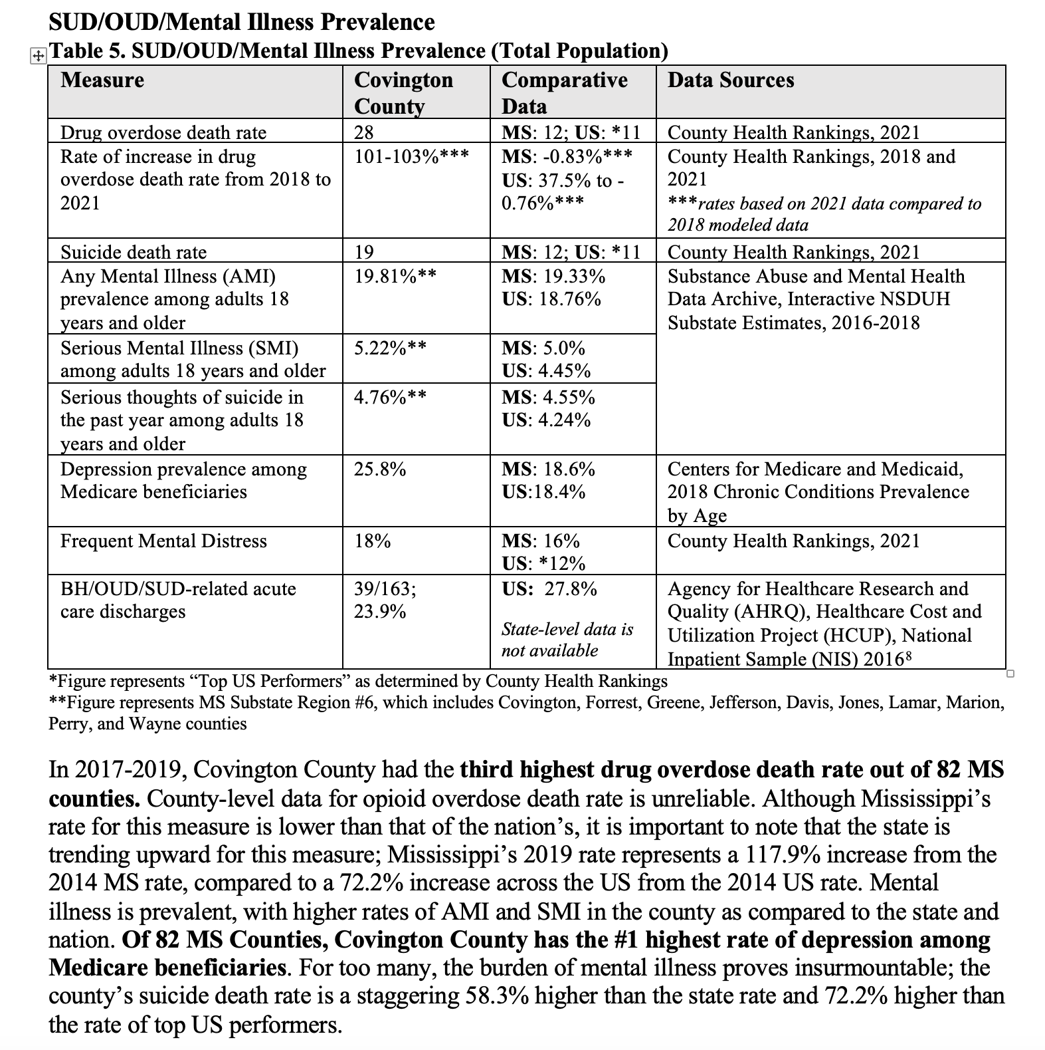
Example of a Data Table and Accompanying Narrative in a SUD/OUD Government Grant Proposal
How does this example work? It covers:
A comparison of the target service area to the state and nation
Data from reputable state and national sources
Emphasis on particularly severe disparities (highlighted narratively)

Slide 20

Key Data Source: WNC Health Network
WNC Health Network collects and curates high-quality regional data to achieve its mission of supporting people and organizations to improve community health and well-being across WNC.
Since 2011, WNC Health Network has collected and provided foundational data for local and regional community health efforts, including:
Primary Data: WNC Healthy Impact Community Health Survey and WNC Healthy Impact Key Informant Survey
Secondary Data: Demographic, economic, and social characteristics of the region and morbidity and mortality data
Maps
2-1-1 Resource Lists

Slide 21
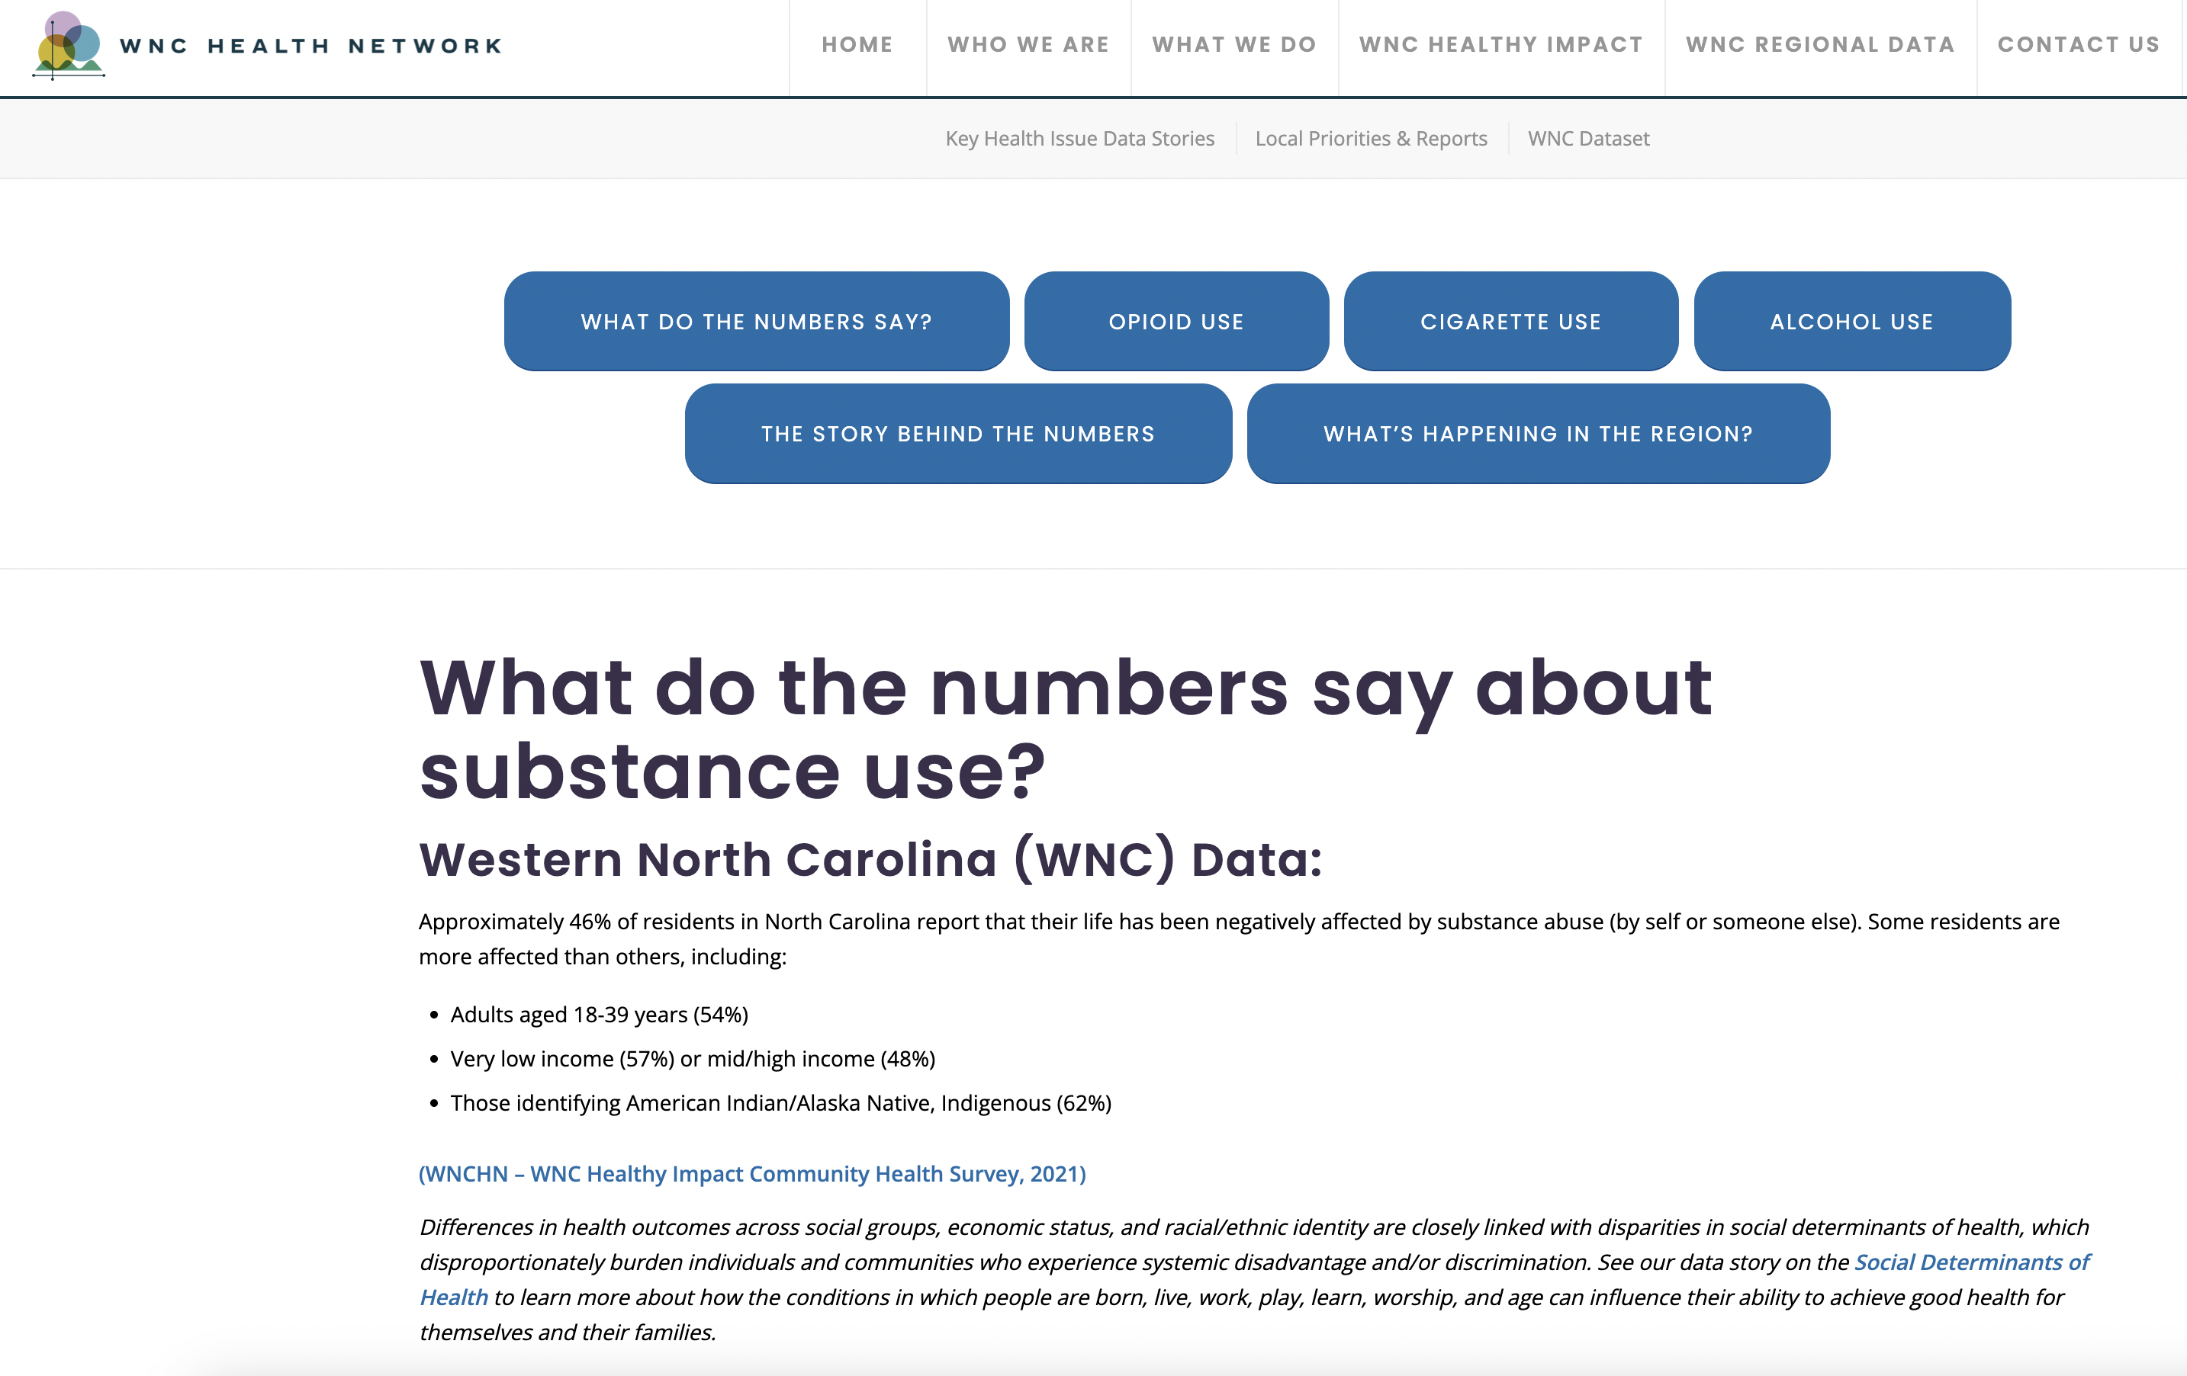
Key Data Source: WNC Health Network
The WNC Health Network site provides a wealth of information on the unique challenges facing WNC, including:
Data stories on key health issues
Access to the publicly available WNC Dataset (in Excel workbook format), for researching 279 indicators across the 18-county region

Slide 22
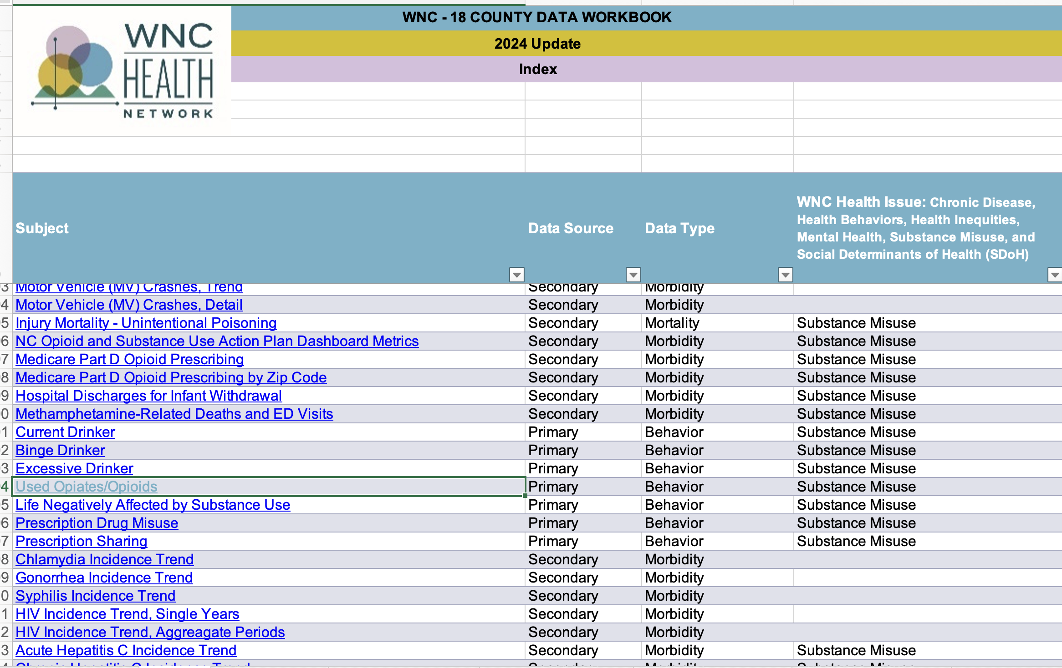
Key Data Source: WNC Health Network

Slide 23
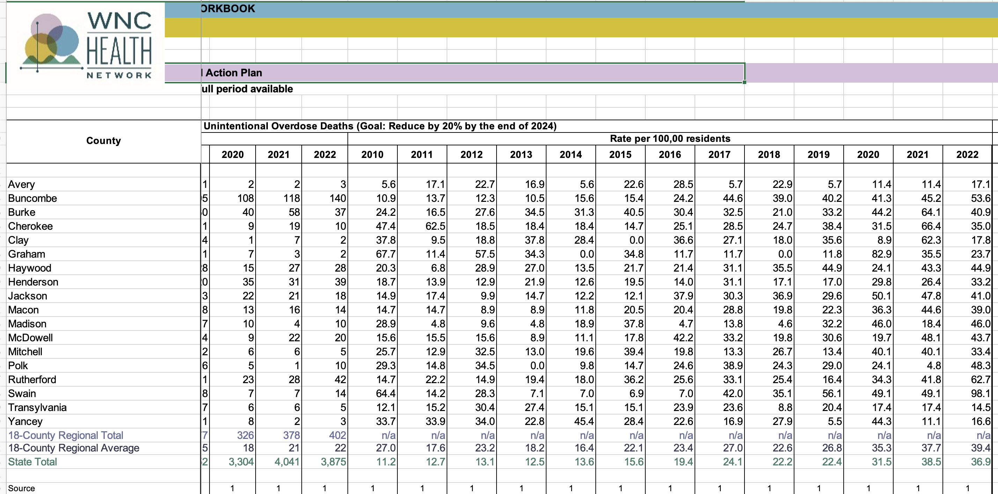
Key Data Source: WNC Health Network
Many key indicators offer data over a ten-year period, allowing users to calculate increases/decreases.

Slide 24
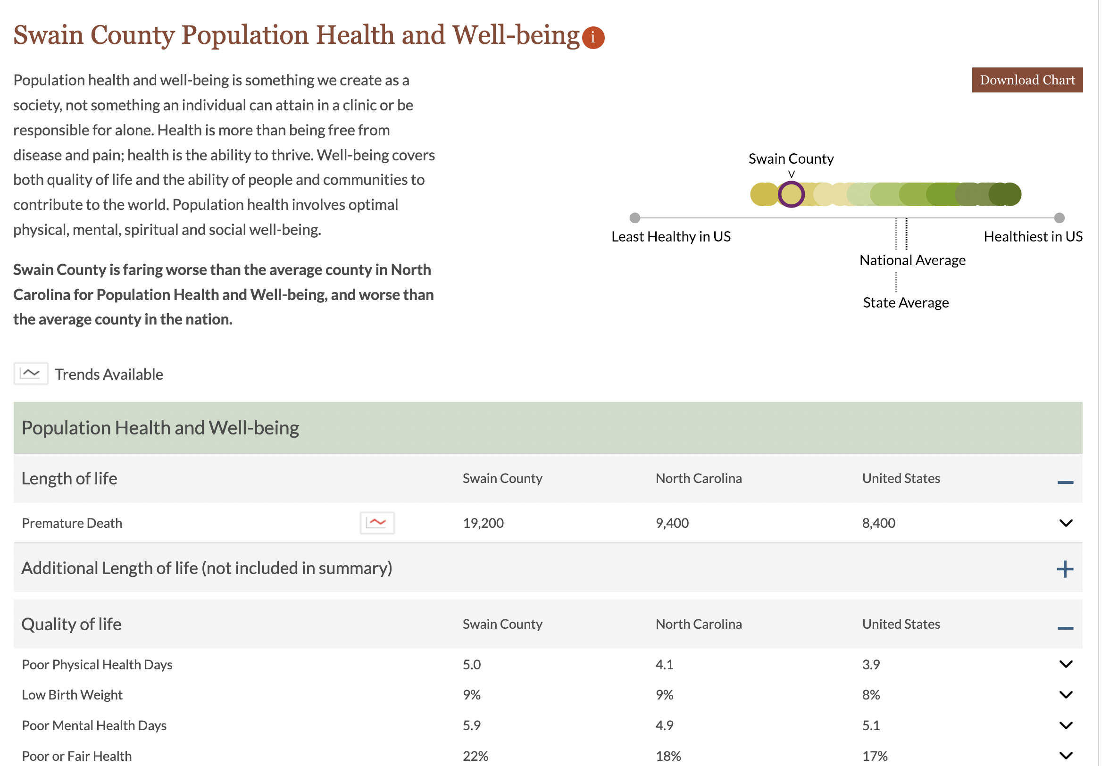
Key Data Source: County Health Rankings & Roadmaps
This is an excellent resource for understanding a full portrait of a county, from health outcomes to key social determinants of health.

Slide 25
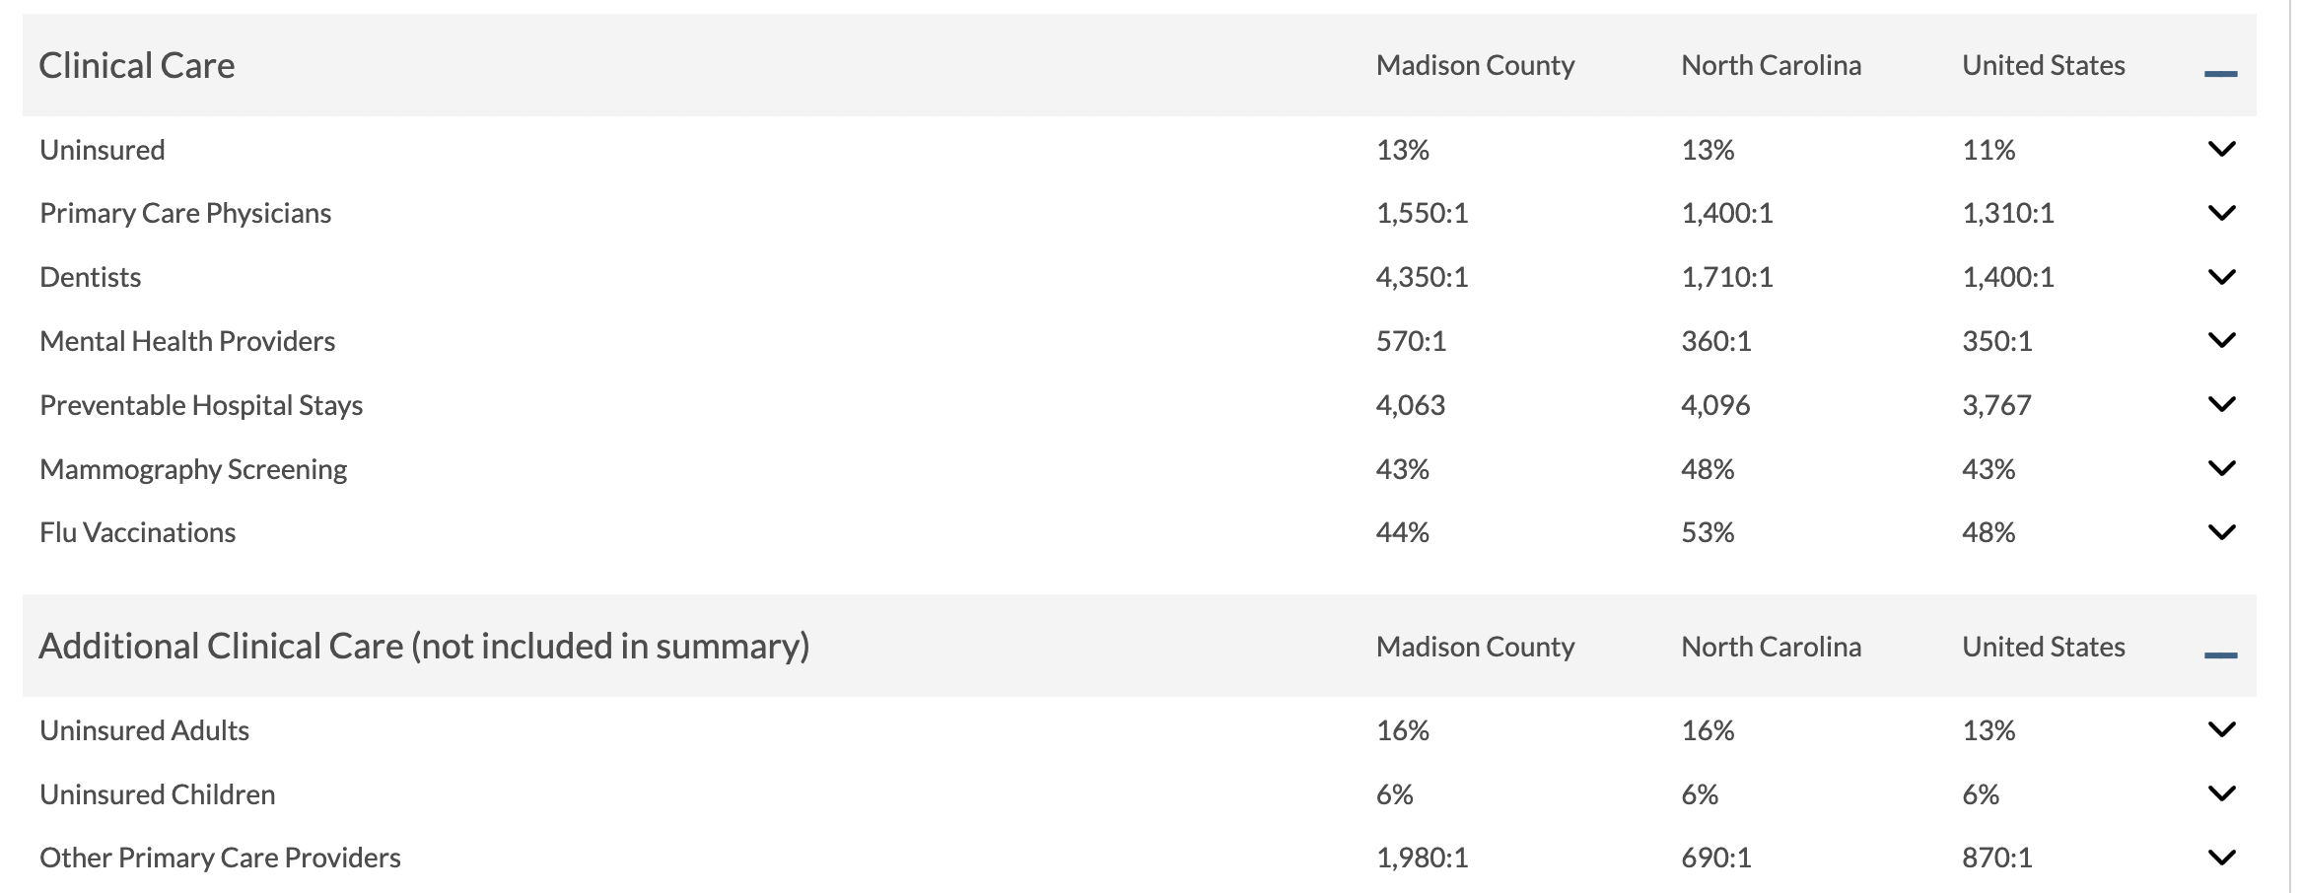
Key Data Source: County Health Rankings & Roadmaps
Data under “Clinical Care” can help describe barriers to accessing care among the target population.

Slide 26
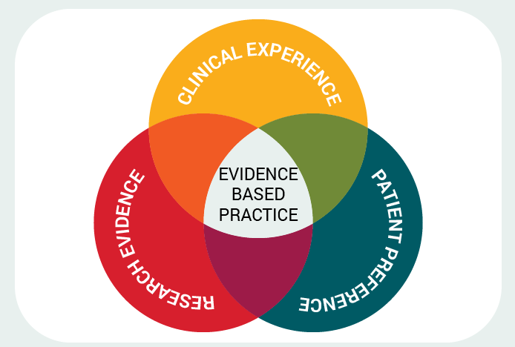
What is Evidence-Based Practice?
Using research to provide evidence your programmatic (policy or intervention) approach will work
Systematic use of data and information systems
Appropriate use of behavioral science theory
Application of planning models
Integrates science-based interventions with community preferences
Different populations need different approaches
Consider cultural factors, community characteristics
Simply stated: an intervention/approach that has shown to have evidence of effectiveness in a particular setting and is likely to be replicable in other situations
The effects are clearly linked to the activities, not outside-related events
From Evidence-Based Practice for Clinical and Diagnostic Professionals by Carla M. Allen

Slide 27
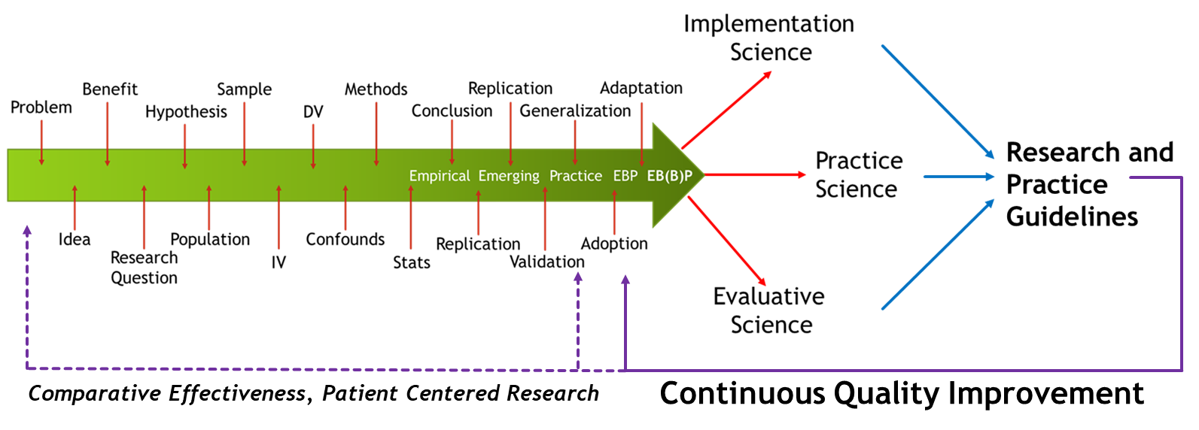
What is Evidence-Based Practice?
Notes:
Converting academic practice into something that benefits the community. Converting that potential benefit into a research question—converting the research question into a hypothesis. If then statement. Then we identify a population. WNC. So we get 1% of that pop for the sample. Independent variable. Something you are changing. Dependent variable—what you are measuring—your outcome. What is hard to come up with is confounding variable—everything that can interfere. Maybe it is too rural or too urban or too male etc. What methodology are you going to use? Pre and post surveys, etc. Stats collecting data. Then you draw conclusions from your study. When someone says this is empirically based that means someone has dpne a study on it. You repeat it. And go from empirical to emerging which means we have more confidence. Do it in a different location to test and validate it. We are about to generalize
With an evidence based practice, you see a lot of studies. Such as CBT---you will find numerous studies showing its impact.

Slide 28
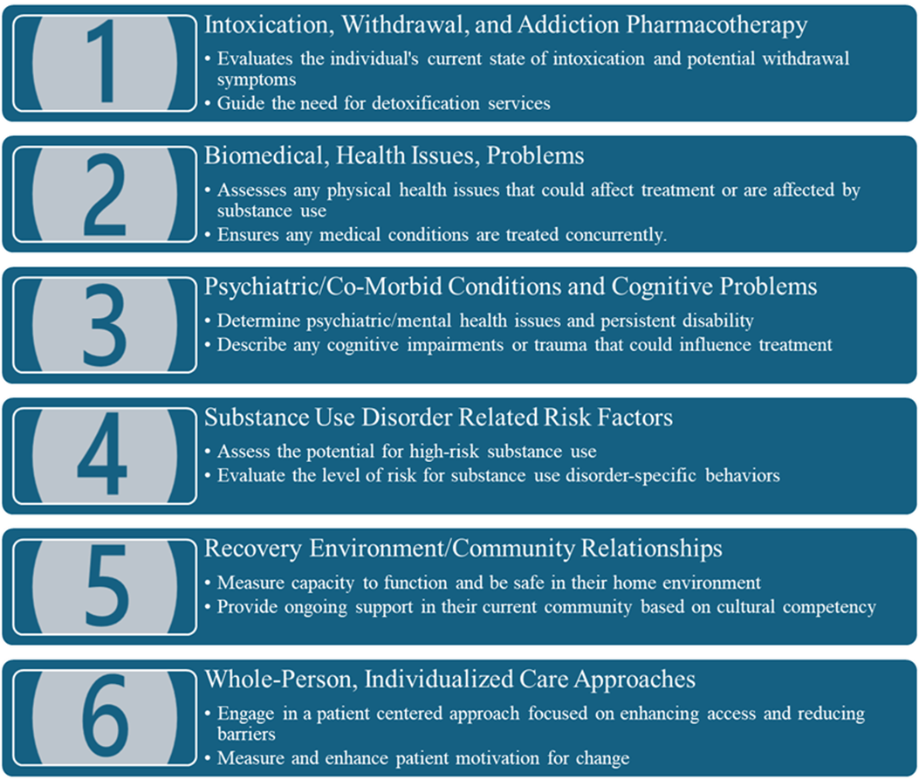
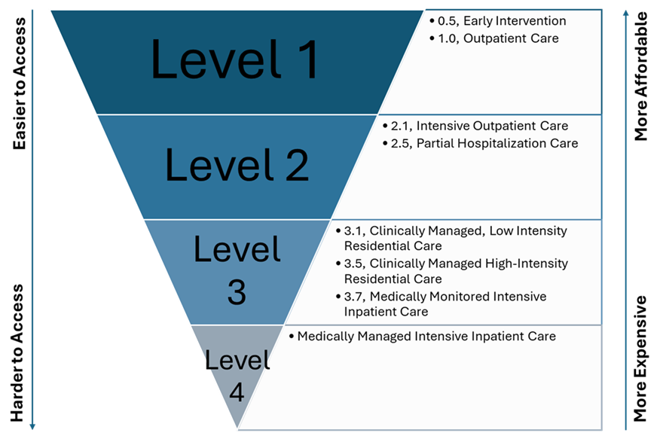
American Society of Addiction Medicine (ASAM)
The ASAM Criteria is the most widely used and comprehensive set of standards for placement, continued service, and transfer of patients with addiction and co-occurring conditions. The ASAM criteria define a continuum of care, offering a tiered approach to treatment, ranging from outpatient services to intensive inpatient care.

Slide 29
How does using EBPs in your project design help create a competitive proposal?
Communicates to the funder that you are well-versed in the issue/problem and have explored others’ successful approaches to the issue/problem.
Means you do not have to reinvent the wheel!
By studying programs that have successfully implemented EBPs, you can find the basis for your project’s performance measures, projected outcomes, and evaluation plan.

Slide 30
Example of Utilizing EBP in a Proposal
Grant opportunity focused on addressing SUD/OUD treatment needs requests a description of the evidence-based approach
Applicant organization’s idea is to provide an alternative to incarceration for drug-abusing defendants through a drug treatment court program model
Applicant organization goes to EBP database (National Institute of Justice Crime Solutions) and reviews relevant EBPs rated “effective”

Slide 31
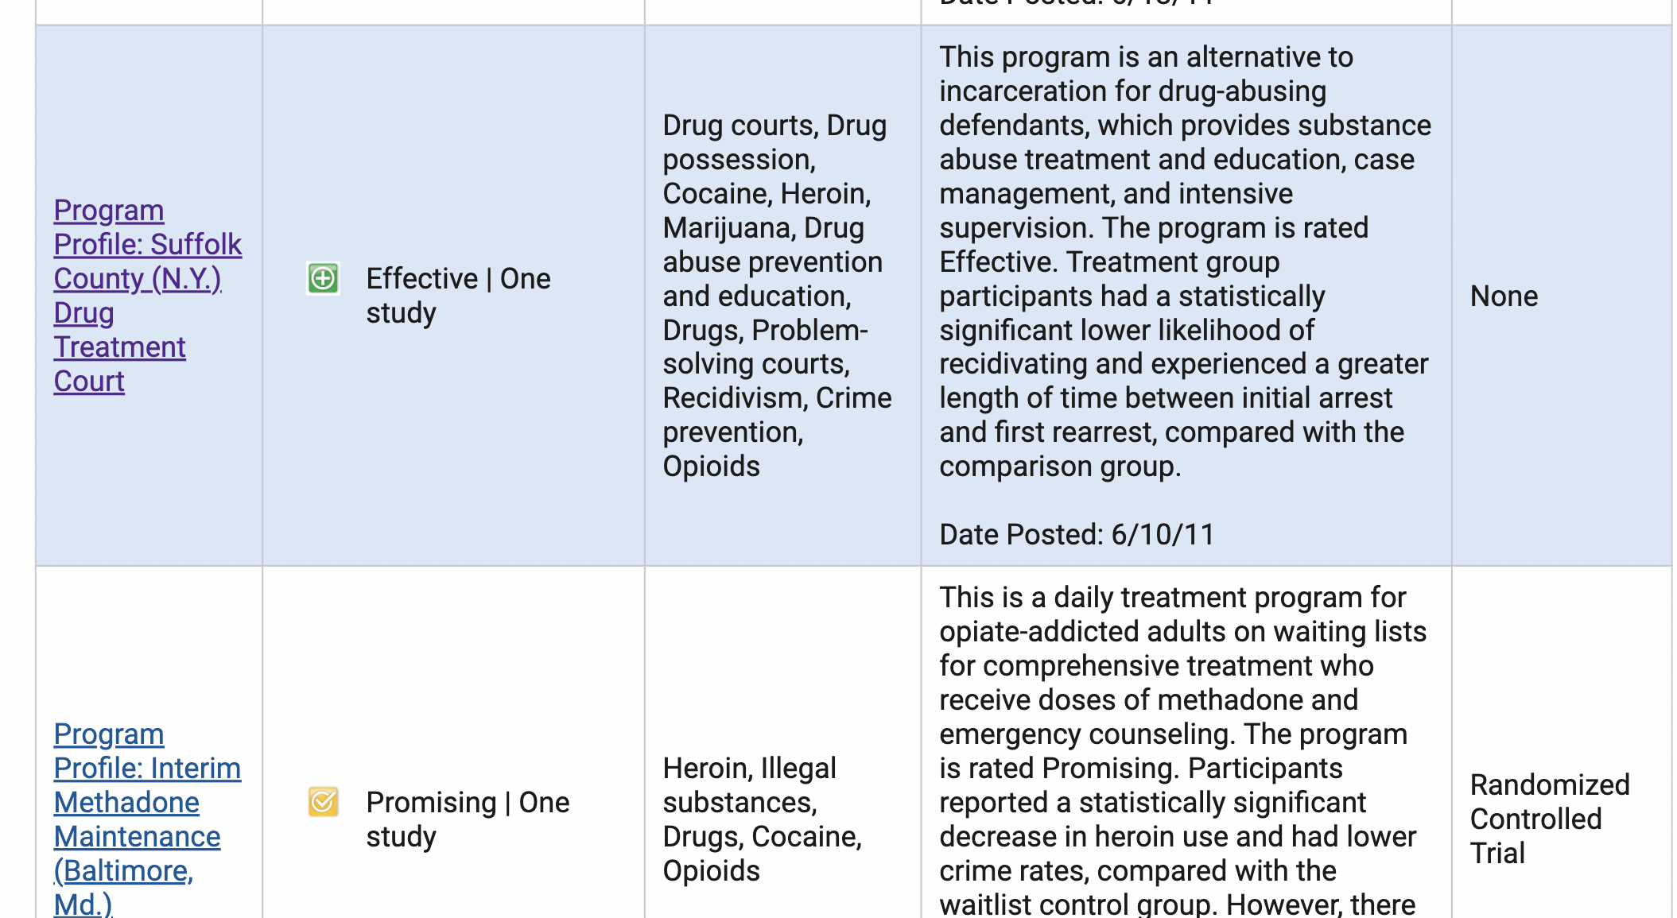
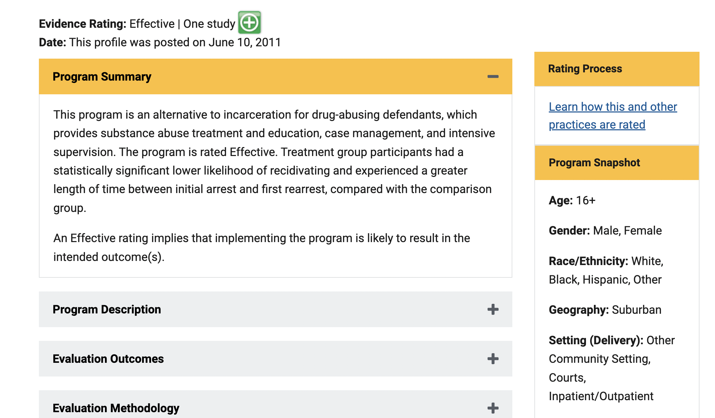
Example of Utilizing EBP in a Proposal
Applicant can review multiple interventions and select the most relevant EBP(s).
Additionally, applicant can review multiple Crime Solutions-rated programs related to the EBP. This review can provide helpful guidance in developing the applicant’s project design AND a corresponding evaluation plan.

Slide 32
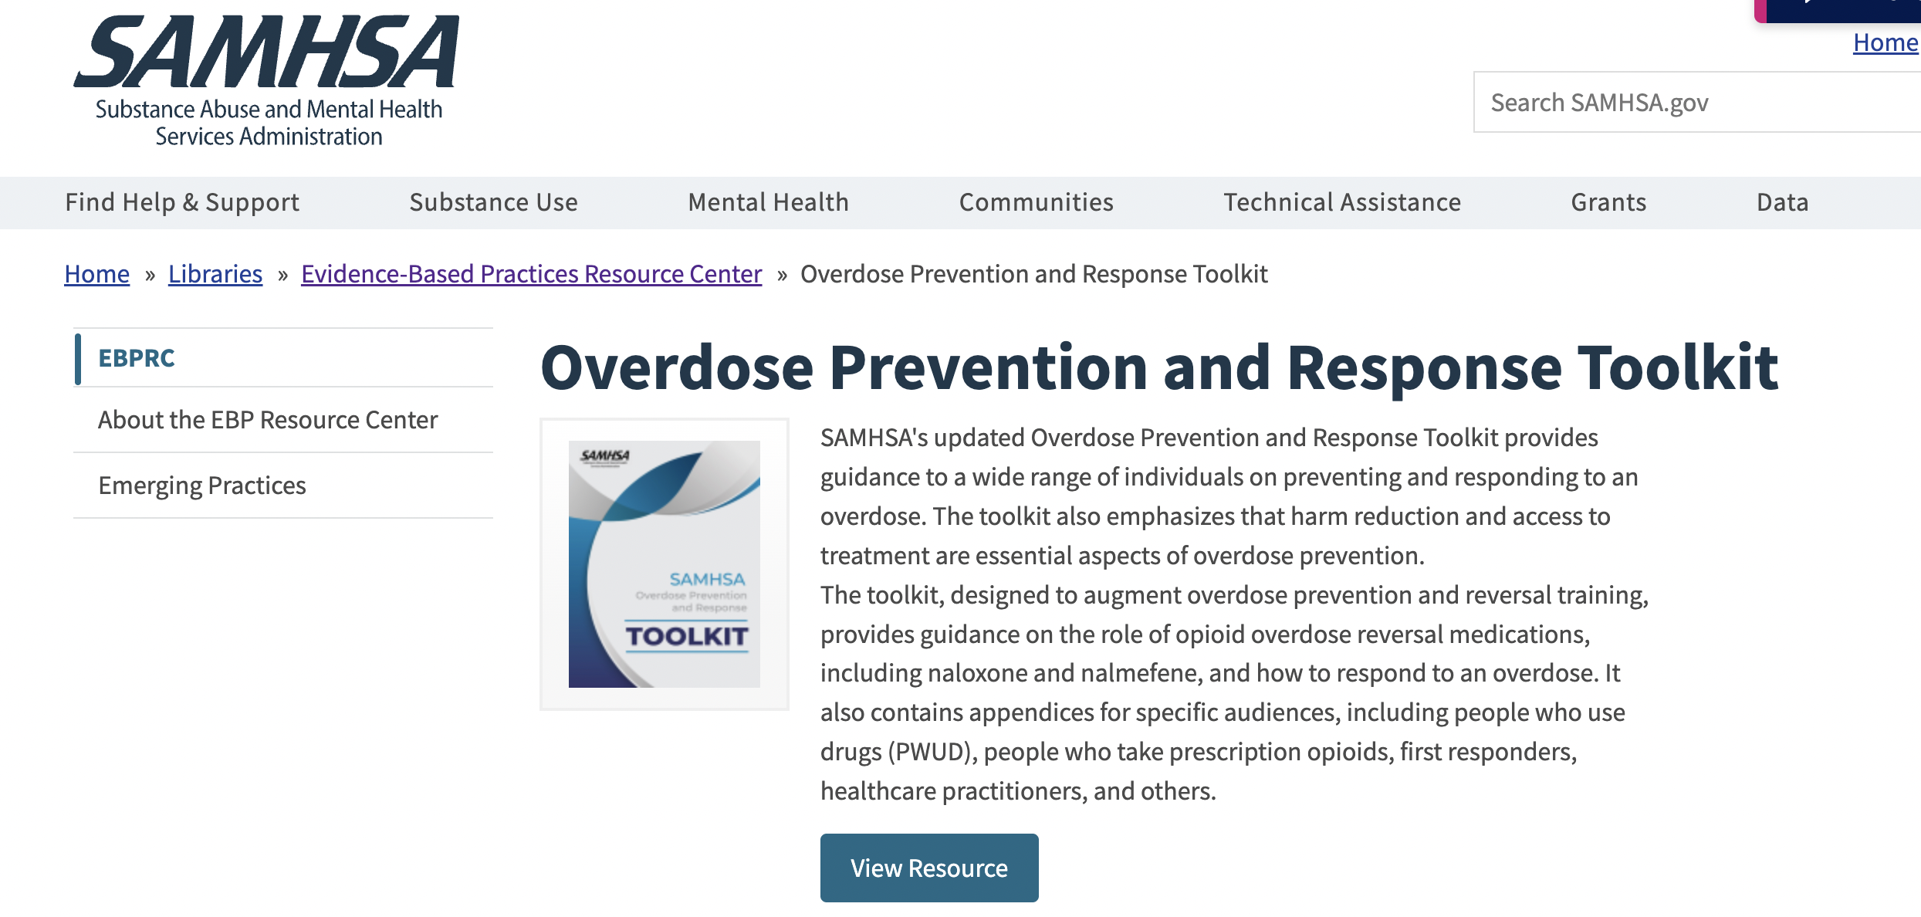
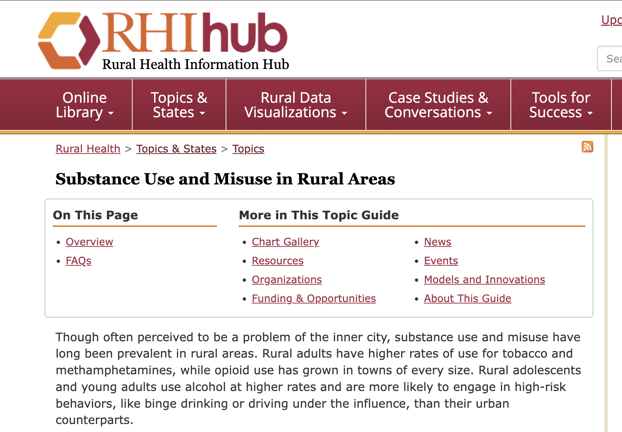
Toolkits: SAMHSA, Rural Health
Reviewing toolkits, which offer a comprehensive look at multiple EBPs in one document, can help guide applicants in considering the details of their program designs.

Slide 33
III. Key Considerations for Developing a Winning SUD/OUD-focused proposal

Slide 34
1. Ensure Your Goals and Objectives are Airtight
Although all government agencies expect well-written goals and measurable objectives, SAMHSA in particular is known for its high standards with regard to the quality of goals and measurable objectives.
Review SAMHSA’s tips on developing goals and measurable objectives; the agency offers multiple examples in this guide
Ensure all your objectives are SMART (specific, measurable, achievable, realistic, and timebound)

Slide 35
2. Emphasize the Unique Aspects of Your Proposal
Discussing the unique aspects of your project, your work, and/or your target population is a way to grab reviewers’ attention and distinguish your application from the rest. If nothing is immediately coming to you, consider the following questions:
Is there anything beyond the relevant data that shares something important for understanding the needs of the target population?
E.g., a paper mill that was once one of the county’s top employers shut down five years ago, which has had a rippling effect on income, health, and substance use rates
What do you consider your organization’s greatest strength in terms of implementing this project?
E.g., you have established strong relationships with key partners in the community also serving the target population, such as harm reduction agencies or behavioral health providers
Has your region experienced any major changes or developments in recent years/decades that are fueling the need for this project?
E.g., you are located in a county declared a disaster area following Hurricane Helene

Slide 36
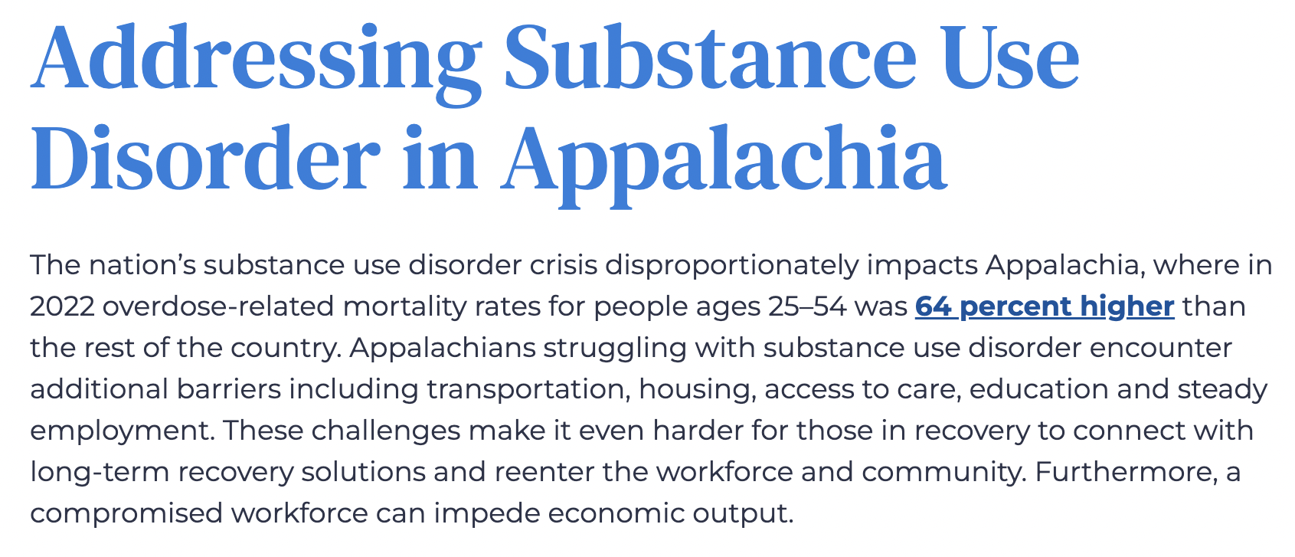
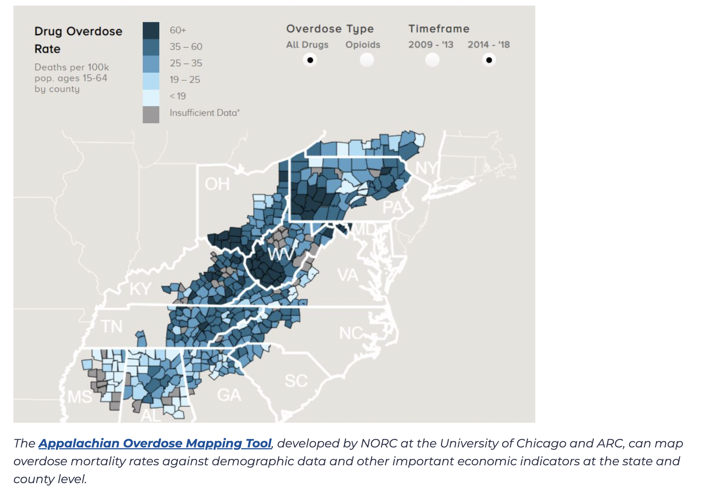
3. Discuss the Severity of the Opioid Crisis in Southern Appalachia
From the Appalachian Regional Commission, 2024
In 2022, North Carolina began receiving opioid settlement funds that will total roughly $1.4 billion by the end of 2038. This funding is the result of two nationwide settlement agreements that have been reached to resolve all opioid litigation by state and local governments against three of the largest drug distributors, one manufacturer, and its parent company, Johnson & Johnson.

Slide 37
3. Discuss the Severity of the Opioid Crisis in Southern Appalachia Why is this important?
A federal reviewer may be unfamiliar with this region of the country; you want to help orient them to the historical and cultural factors that have influenced the severity of the opioid crisis (see Appendix for resources)
As Appalachian cultural norms prioritize relationships with known community members/trusted arbiters (as opposed to “outsiders” or “experts”), this is an opportunity to discuss your organization’s long history of work in a community, staff members’ experience living/working in the region, and/or your established relationship of trust with the target population

Slide 38
4. Discuss Potential Positive Economic Impacts
“Substance abuse is a preventable and treatable condition that imposes tremendous financial and social costs. Societal costs of tobacco, alcohol, and illicit drug use are nearly 6 percent of the nation’s income — over $532 billion a year.”
--Health Policy Institute, Georgetown University McCourt School of Public Health
As the current administration is likely to emphasize economic growth and workforce development in grant funding, you’ll want to consider how your project may influence the economic status of the target population.
Discuss issues affecting your community, such as unemployment, the prevalence of Opportunity Youth, high school graduation/dropout rates, and educational attainment rates; and consider their connection to SUD/OUD prevalence
Identify whether there is a way to integrate job readiness and/or employment services into your project design
If your project serves incarcerated individuals, emphasize any connections to reentry services that include workforce training or employment assistance

Slide 39
IV. Being Competitive in the Current Federal Funding Situation for SUD/OUD projects

Slide 40
Current Federal Funding Situation
Summary:
There is still much unknown about how the Executive Orders will impact federal funding programs
The subsumption of major agencies such as SAMHSA and HRSA into the Administration for a Healthy America (AHA) may cause changes to the longstanding grant programs offered by these agencies
Continue monitoring the situation and be sure to access the numerous resources being developed by trusted sources
Expect ongoing changes to existing grant programs to align with Executive Orders
Expect limited release of federal grant NOFOs until agency reviews are completed

Slide 41

Current Federal Funding Situation: HHS Announcement
On March 18th, the new Secretary of the U.S. Department of Health and Human Services, Robert F. Kennedy, Jr., announced a renewed focus on the opioid crisis:
“Although overdose deaths are starting to decline, opioid-involved overdoses remain the leading cause of drug-related fatalities,” HHS Secretary Kennedy said. “This Administration is going to treat this urgent crisis in American health as the national security emergency that it is. Renewing the Opioid Public Health Emergency Declaration affirms the Administration’s commitment to addressing the opioid overdose crisis.”

Slide 42
What Can You Do?
Strengthen Broad Community Engagement: Build stronger relationships with the entire community being served to ensure programs are responsive to their needs. Be careful not to focus on just some demographics.
Data-Driven Decision Making: Rely on data and evidence to assess program effectiveness and make informed adjustments.
Focus on Economic Impact: If your program will connect participants to workforce development or a job-training program, emphasize this throughout your proposal.

Slide 43
Preparing Your Proposal for Alignment with New Federal Priorities
Frame the Purpose: Focus on universal access and participation, not equity for specific groups.
Emphasize Merit: Highlight qualifications and project alignment over diversity as a goal.
Broaden Target: Use inclusive language targeting all interested, not specific demographics.
Focus on Goals: Center on measurable objectives (access, outcomes) over social impact.

Slide 44
Preparing Your Proposal for Alignment with New Federal Priorities
Tips for Success
Align your language with the funding agency’s priorities; avoid terminology that is not in the NOFO and that might not be compatible with recent Executive Orders
Use the terminology and phrasing preferred by the agency to demonstrate alignment
Thoroughly investigate the agency’s updated mission, current values, and past grant awards
Highlight Universal Benefits: Frame the project as benefiting all participants or society at large, rather than specific groups
Stay Mission-Driven: Keep the focus on the project’s core objectives—for example: scientific advancement, education, and/or innovation

Slide 45
Questions?
IFP Contact Information:
Louise Mathias, Senior Partner
Louise.mathias@innovativefundingpartners.com
(202) 809-3401
Dr. Brian Kelley, Senior Partner
Brian.Kelley@innovativefundingpartners.com
(202) 809-3399

Slide 46
Appendix: Resources for SUD/OUD-focused projects
WNC Health Network Dataset
County Health Rankings & Roadmaps
SAMHSA Evidence-based Practices Resource Center
Rural Health Information Hub
National Institute of Justice Crime Solutions Evidence-based Practices Database
SAMHSA: How to Develop Goals and Measurable Objectives
American Psychiatric Association: Best Practice Highlights, Appalachian Patients
Ohio University: Introduction to Appalachian Health

Slide 47
dht.org

