Slide 1


Sustainability for Nonprofit Organizations: Considerations for Long-term Success
August 20, 2025

Slide 2

Learning Objectives
Understand the importance of analyzing your organization’s strategic and operational strengths and challenges using tools such as SOAR and PEST
Gain confidence in assessing your organization’s funding mix for sustainability in the current funding climate
Understand how to develop an effective grant seeking strategy that reflects the current funding environment

Slide 3

About
Innovative Funding Partners
Innovative Funding Partners is a nationally recognized consulting firm that offers a range of services that improve our clients’ ability to achieve sustainable impact in their communities. Highly regarded for an impressive overall grant success rate of 85%, we offer turnkey grant writing and grants management, organizational planning (strategic, operational, sustainability), data-driven decision making and evaluation services, and training and technical support to a diverse client base of nonprofits, city and county governments, and small businesses/start-ups. Our team of over 30 highly experienced consultants has a wide range of subject matter expertise and is exceptionally passionate about helping organizations meet the unique needs of their local communities.

Slide 4
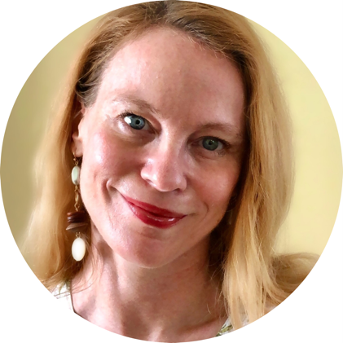
About the
presenters
Louise Mathias, Senior Partner, has over two decades of leadership experience in nonprofit and public entity fund development and organizational planning across multiple sectors, including healthcare, workforce development, education, community development, environmental conservation, housing, and more. Louise has extensive experience in all aspects of fund development, including federal grant writing and management. She has secured and managed funding from agencies such as SAMHSA, HRSA, DOL, USDA, CDC, and ACF, as well as numerous state agencies and private foundations. Her skill set spans the full grants lifecycle, from mission alignment and proposal development to post-award compliance and implementation.
.
3.
Louise Mathias
Senior Partner

Slide 5
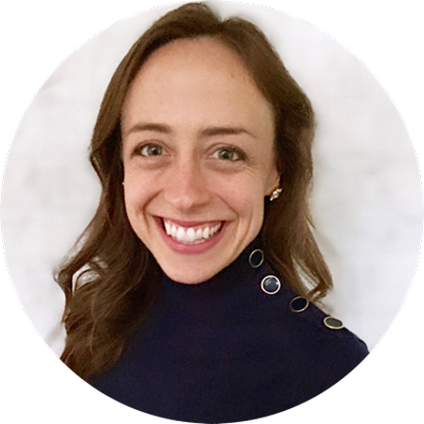
About the
presenters
Susannah Williams, IFP Senior Grants Consultant, is a grant writer with a proven track record of securing federal and foundation grants across multiple sectors, including health care, workforce development, and education. She has extensive experience in supporting clients’ project designs and development to meet complex grant requirements. Susannah has written multiple successful proposals for CDC, HRSA, DOE, DOJ, and DOL, among others.
.
3.
Susannah Williams
Senior Grants Consultant

Slide 6
What is the Grants Help Desk?
The Grants Help Desk provides technical support to eligible organizations that have questions about a funding opportunity to which they are considering applying, or questions that may arise during the grant development process. The goal is to help make grant applications more competitive and to improve the chances of securing funding outside of Dogwood. Support is provided by IFP.

Slide 7
Nonprofit or municipal government organizations that:
Received grant funding from Dogwood in 2023 and/or 2024 and are in and serving within the Qualla Boundary and/or the 18 counties of Western North Carolina (Avery, Buncombe, Burke, Cherokee, Clay, Graham, Haywood, Henderson, Jackson, Macon, Madison, McDowell, Mitchell, Polk, Rutherford, Swain, Transylvania and Yancey)
OR
Have not received grant funding from Dogwood Health Trust but are located in one of the 12 counties most impacted by Hurricane Helene (Buncombe, Yancey, Mitchell, Avery, Henderson, McDowell, Rutherford, Madison, Polk, Burke, Haywood, and Transylvania) and are seeking funding for hurricane relief and recovery efforts.
Have not received support from the Grants Help Desk within the last 30 days
Who is Eligible to Receive Support from the Grants Help Desk?

Slide 8
Eligible:
-Assessing the eligibility/competitiveness of a particular project for a specific grant opportunity
-Answering questions that arise during the grant development process (such as those related to the narrative, budget, forms, attachments, and submission to the funding agency/organization)
-Navigating the complexities of state, federal, and private foundation grant applications
-Guidance on grant management and post-award compliance
Not Eligible:
-Drafting a full narrative
-Creating the project budget, work plan, or logic model
-Performing a comprehensive search of funders that might support a project
What are examples of eligible requests for Grants Help Desk support?

Slide 9
Request a consultation by following this link.
Read more about the Grants Help Desk here.
How do we request Grants Help Desk support?

Slide 10
I. Understanding the importance of analyzing your organization’s strategic and operational strengths and challenges using tools such as SOAR and PEST
Notes:
Developing a logic model at the beginning of program planning gives you a framework for charting the links between your program’s resources, activities, and outputs and its intended outcomes. It enables you to evaluate your program once it begins. And it helps you communicate to your stakeholders what you want to accomplish, how you intend to reach your goals, and how you will track your progress.
Logic models represent INTENTION; shows connection between the planned work and what you hope to achieve. THIS is informed by the theory of change.
These components illustrate the connection between your planned work and your intended results.
Visual representation, etc. purpose in sharing ,etc.
Start with identifying the impacts and outcomes (relationship to backwards design) then can select the activities

Slide 11

What supports and challenges your sustainability?
This challenging time is also an opportunity to get clear on your organization’s strengths and challenges and make a pragmatic assessment of factors that are supporting or detracting from its sustainability. We will review two tools that can support this effort. Using these tools can help inform your funding and sustainability strategy moving forward.

Slide 12
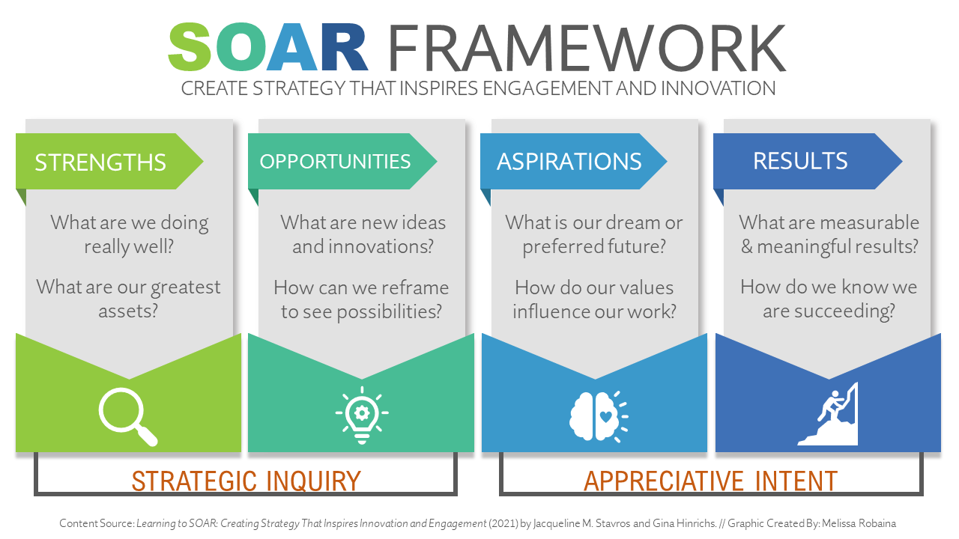
1. Strengths, Opportunities, Aspirations, Results (SOAR) Analysis

Slide 13
SOAR Examples
Strengths | Opportunities | Aspirations | Results
We are the only organization in our county offering subsidized early childhood education Demonstrated experience implementing state and/or federal funding and meeting all financial and programmatic reporting requirements Established cross-sector partnerships that multiply our impact Leadership has lived experience of the challenges faced by our target population Achieved a major capital campaign goal, demonstrating community support and trust | Demand for our programs exceeds our current capacity, indicating a strong opportunity to expand We have partners who receive federal and/or state grant funding through which we could potentially serve as a sub awardee Our development strategies could use expansion and improvement Our target population is likely going to face new challenges due to changes in federal priorities and policies, creating the opportunity for us to offer new services | Gaps in federal grant funding are filled by expanded development work Robust data collection and evaluation capacity is fine-tuned to assess core measures for each program and push results out to stakeholders in addition to funders Funding scenarios for our major programs have been developed and assist us in long-term decision-making around the future of these programs We expand efforts in non-grant fundraising/ development that elevate the potential of donors and major gifts | Active programs continue to meet and often exceed projected goals related to measures of success We have a streamlined grants portfolio, with fewer grants overall due to prioritization of large grants with high probability of success Development income trends toward 25% of total annual revenue (up from 5-year average of 17%) over the next three years to reflect a healthier revenue mix Through exploration of new partnerships and expansion of existing ones, we are actively pursuing new potential sources for grant and contract work

Slide 14
How SOAR Can Inform Grant Proposals
Strengths
Your organization’s background, history, and accomplishments
Opportunities
Your proposed project designs and potential partnerships
Aspirations
Your intended/projected long-term impact
Results
The measurable outputs and outcomes your work can achieve

Slide 15
2. Political, Economic, Social, Technological (PEST) Analysis
P
Political
E
Economic
T
S
Social
Technological
PEST is a method of analysis that assists in understanding and predicting changes across important variables impacting an organization’s success. PEST includes influences across Politics, Economics, Society, and Technology. The benefit of a PEST analysis is that it guides effective strategies and, thus, the allocation of resources in response to factors working for or against an organization’s mission, vision, values, and actions.

Slide 16
PEST Examples
Political | Economic | Social | Technological
Executive Orders prohibiting service provision to undocumented immigrants and eliminating diversity, equity, and inclusion initiatives Large scale restructuring and/or elimination of federal agencies Changes in Medicaid coverage affecting access to health care Changes in SNAP eligibility resulting in increases in food insecurity | Impact of long-term disaster recovery efforts on Western NC’s economy Tariffs, a volatile stock market, and rising consumer prices causing economic pressures, which in turn may affect donor psychology and related potential for contributions Potential for overburdened emergency departments if the lack of health insurance coverage means more individuals wait until their condition is severe before seeking care Rising costs of seed, fuel, and fertilizer and potential loss of labor puts pressure on small farms, common in WNC | Disrupted communities across WNC post-Helene face displacement of people, loss of social cohesion, increased mental health issues, and heightened social inequalities Disinclination among immigrants to engage in social assistance for fear of legal action/deportation WNC has a relatively large number of nonprofits, which can dilute available revenue sources and make connecting to potential donors/funders more challenging | Robust data collection systems and evaluative capacity are of critical importance in a highly competitive funding environment Increasing number of digital tools available to support engagement of target population (text messaging, online surveys, etc.) Need to ensure email/newsletter subscription to local funders to remain aware of quick turnaround grant opportunities

Slide 17

How Conducting a PEST Analysis Can Support Sustainability
Help your organization determine which programs are best positioned for different types of grant funding (federal, state, foundation) and which are a better fit for donors, corporate sponsorships, and major gifts
Help you prioritize your staff time and resources for the next several years
Help you identify organizational gaps and weaknesses (e.g., your data tracking needs an overhaul; you need to consider a different way of engaging your target population)
Help you consider how you will respond strategically and programmatically to changes in federal policies and priorities

Slide 18
II. Gaining confidence in assessing your organization’s funding mix for sustainability in the current funding climate

Slide 19
Assessing Your Current Funding Portfolio
What is the breakdown of funding for your organization across:
public/private
grants vs. development (individual donors, corporate sponsorships, capital campaigns)
general operating vs. program specific funds (unrestricted vs restricted)

Slide 20
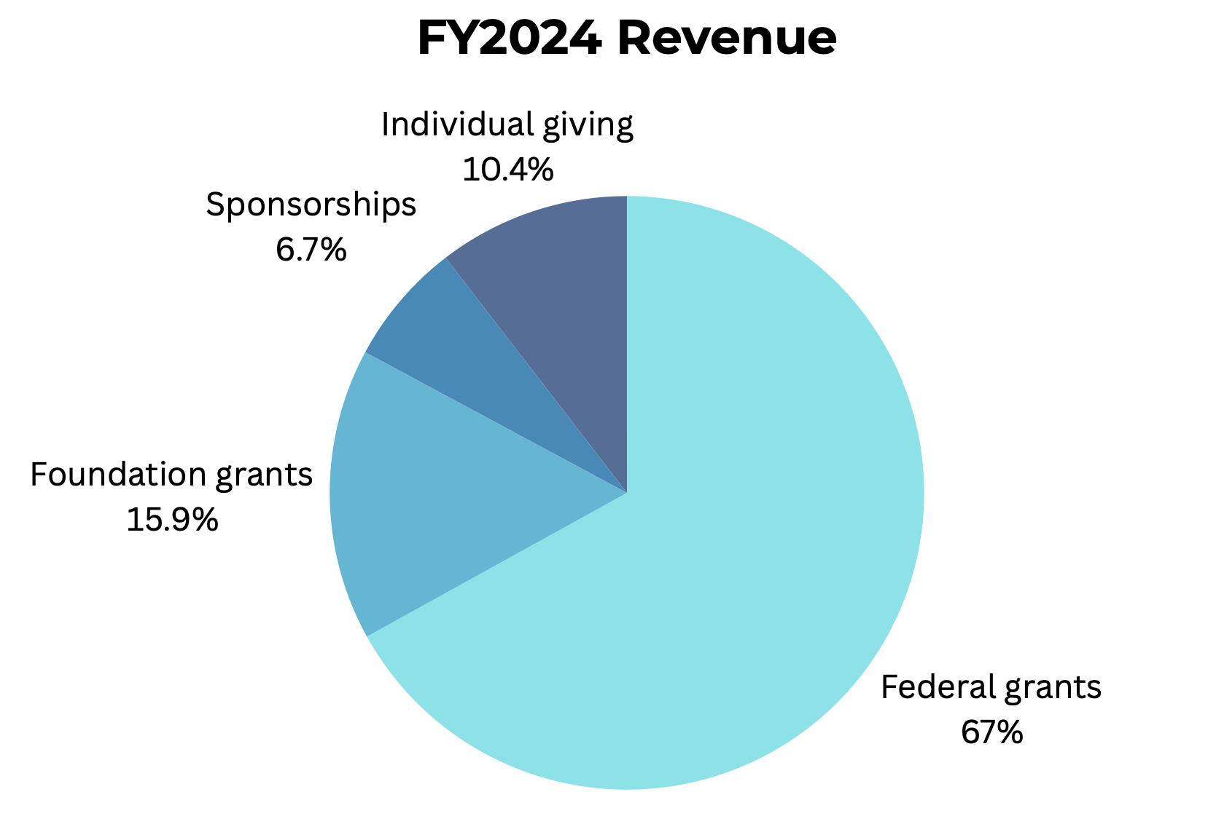
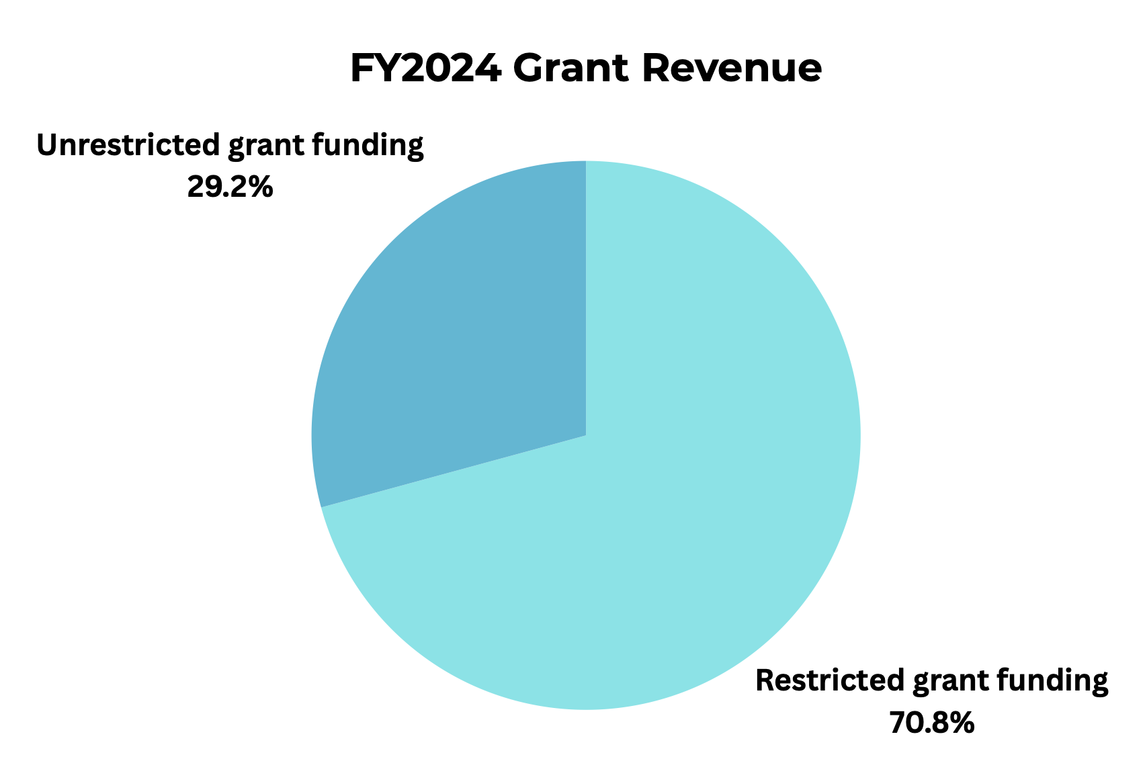
Assessing Your Current Funding Portfolio

Slide 21



How Are Current Circumstances Impacting the Future of Your Portfolio?
Loss of federal funding
Renewed commitment to your work by foundations
Opportunity to lean on established relationships with corporations or major donors

Slide 22

Developing a More Sustainable Funding Mix
If your organization is reliant on federal funding or state pass-through funding, consider the following for developing a strategy to increase other revenue sources:

Slide 23
Developing a More Sustainable Funding Mix
1. Increase attention to individual donors and/or major gifts
Now is the time to do a deep dive on your current individual giving strategies.
If you have an annual giving framework, would it be helpful to shift to monthly giving?
Who are your high-capacity donors, and can you build a deeper relationship with them?
What systems do you have in place for identifying, vetting, and engaging potential donors?
Do you need to shift some staff members’ responsibilities to take on more development work?

Slide 24

Developing a More Sustainable Funding Mix
2. Develop an updated case for support
Updating your case for support–the answer to “why should we fund you?”—is a priority in the current environment. Draft a brief version and a longer version that compellingly describes how recent events and changes impact your programming and the individuals you serve.
Use these drafts to inform talking points for conversations with funders, emails to annual donors, and grant proposals.

Slide 25
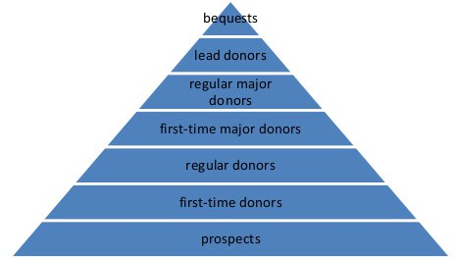
Developing a More Sustainable Funding Mix
3. Consider moving donors “up the pyramid” of giving
With federal funding uncertain and foundations fielding a vast increase in applications, now is the time to consider your donor base. Who has the capacity to potentially become a major donor? Who has the capacity to move from an occasional donor to a regular one?
Consider prioritizing prospecting and vetting and increasing donor communications to support this effort.

Slide 26
Developing a More Sustainable Funding Mix
4. Increase attention to corporate giving
Use your updated case for support to approach existing corporate partners or newly identified corporate prospects.
Research the largest companies in your local and regional area
Prioritize identifying any possible connections during Board meetings—leverage your Board as much as possible
Develop pitches for support (brief slide deck or marketing document) tailored to each company’s values and interests; embed opportunities for name recognition and brand promotion through events or communications

Slide 27
Developing a More Sustainable Funding Mix
5. Consider exploring donor-advised funds (DAFs)
A donor-advised fund (DAF) is a philanthropic financial vehicle in which donors contribute money to an investment fund managed by a sponsoring organization such as a community foundation or national foundation (commonly, charitable arms of financial services providers, like Fidelity or Schwab).
Donors can contribute cash and a wide range of non-cash assets, including stocks, shares of mutual funds, publicly traded securities, and private assets.
After the sponsoring organization invests the funds to grow them, donors can recommend grants be made to charities of their choice using money from the fund.

Slide 28
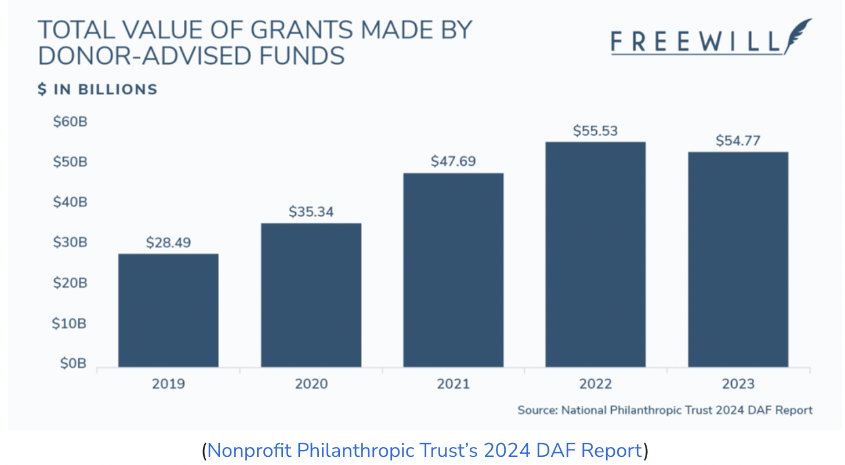
Developing a More Sustainable Funding Mix
More on DAFs
DAFs are growing:
Payout rates have been relatively steady despite economic disruptions, holding at around 24%, but the total value of those payouts has increased to a record high of $54.77 billion.
DAF donors are loyal to their favorite organizations. Fidelity Charitable found that nearly 80% of grants they facilitated in 2024 went to a nonprofit that the donor had supported in the past, and 31% of those were pre-scheduled or recurring donations.

Slide 29
Developing a More Sustainable Funding Mix
More on DAFs
To get connected to a DAF, you need to have a relationship with a donor who has opened one. Typically, to open a DAF, a donor has to contribute between $5,000 and $25,000, meaning they are used most often by wealthy donors. The incentive for the donor is that the sponsoring organization actively manages and invests the funds, providing tax-free growth. The donor also receives an immediate tax deduction.
Establishing relationships with high-capacity donors is the clearest way to increase your chance of receiving donor-advised funding.

Slide 30
Developing a More Sustainable Funding Mix
6. Increase attention to foundation grant funding
If you have current foundation support, leverage these relationships to request additional funding, or ask them for recommendations of similar funders in their network.
Prioritize foundations that align with your specific needs (funding award amounts, restricted/unrestricted funding).

Slide 31
III. Understanding how to develop an effective grant seeking strategy that reflects the current funding environment

Slide 32

Evaluating your grant seeking strategy in light of the current funding environment
Potential trends in federal funding for the current administration:
Recently released Notices of Funding Opportunity (NOFOs) across several agencies have relatively short turnarounds (some 2-3 weeks)
Grant forecasting and planning is more important than ever
Opportunities emphasize economic growth, safety, and services open to all groups

Slide 33
Evaluating your grant seeking strategy in light of the current funding environment
2. How to align your programming to these trends:
Create and maintain a grants calendar that tracks forecasted and posted opportunities; assign responsibility for monitoring grant releases to staff
Consider the economic impact of your programming and craft (data-driven if possible) a narrative describing this
Identify which of your programs will be most competitive for federal vs. foundation grant funding given current priorities, and plan accordingly

Slide 34
Evaluating your grant seeking strategy in light of the current funding environment
3. Devote time to staying aware of state and local government (county, town) opportunities while federal funding is reduced
Reach out to existing contacts at the state and local levels, or seek to establish contacts
Consider creating a one- or two- pager to send these contacts highlighting your programs and achievements
Lean on your Board members or local champions to advocate for your organization to state or local government representatives—now is the time to highlight your achievements and unique contributions

Slide 35

Best Practices for Maximizing Grant Seeking Success

Slide 36
1. Be aware of the potential trickle-down effect of federal changes to foundations
With Executive Orders seeking to eliminate diversity, equity, and inclusion initiatives and making provision of services to immigrants illegal, some foundations may be wary of federal scrutiny that could put their 501(c)(3) status at risk.
Remain closely attuned to shifts in the language used by foundations you are prospecting or with whom you have an established relationship.

Slide 37
2. Focus your grant seeking on behalf of programs that have the strongest, most compelling case for support
Apply for funding on behalf of your “A Team” programs–those with stand-out statements of need, measurable outcomes, and/or innovative project designs. Grant funding, which is usually restricted, can support these programs while you use unrestricted revenue (e.g., individual contributions) for programs that are harder to “sell” in a highly prescriptive grant proposal.
Competition for grant funding is fierce

Slide 38
3. Every proposal must be tailored to the opportunity
More than ever, you must carefully tailor your proposal to each foundation/federal agency. No “form” proposals submitted to every opportunity on your radar—this is a poor use of your time and resources.
Use the funder’s exact terminology; pay close attention to how they are addressing vulnerable populations.
Be cautious about using AI to generate proposal content. Some foundations are using AI detectors, potentially to perform a first round of reviews.

Slide 39

4. Strengthen your data tracking and evaluation systems
Assessing your ability to collect, analyze, and disseminate data is time well spent in the current environment. Consider:
What are the key measures that demonstrate the impact of your work?
How easy is it for you to collect and report on these measures? What needs to happen to improve this process?
Do you have a system for reporting/communicating results to different stakeholders (donors, funders, community members)?

Slide 40

5. Build or expand partnerships
With limited funding available, partnering with other organizations in your field to apply for larger grant opportunities could be a win-win.
Engage potential partners in conversations around your organizations’ current priorities and programs at risk of discontinued or decreased funding
Identify potential grant opportunities for which you could apply as lead applicant/subawardee or as a network
Don’t forget state or national foundations; many large foundations are interested in partnerships that allow for systemic change

Slide 41
Questions?
IFP Contact Information:
Louise Mathias, Senior Partner
Louise.mathias@innovativefundingpartners.com
(202) 809-3401
Dr. Brian Kelley, Senior Partner
Brian.Kelley@innovativefundingpartners.com
(202) 809-3399

Slide 42
Appendix: Resources for Sustainability
How the SOAR framework can help your nonprofit elevate to new heights
PEST analysis guidelines
National Philanthropic Trust’s 2024 Donor Advised Fund Report
Candid: How Can Organizations Craft Compelling Stories
Candid: Case for Support Template
Guidestar (resource for looking up foundations and researching their 990s to determine their giving history)

Slide 43
dht.org

