Slide 1


Advancing Development for Nonprofits: Best Practices in Donor Cultivation and Major Gift Strategies
October 15, 2025

Slide 2

Learning Objectives
1. Understand the current individual giving landscape & donor motivations.
2. Develop familiarity with individual giving plans and goal-setting methods.
3. Identify how to create, optimize, or begin to develop a prospect list.
4. Learn methods to facilitate initial prospect outreach for major and grassroots giving.
5. Recognize stewardship and donor engagement as a critical part of the giving cycle.

Slide 3
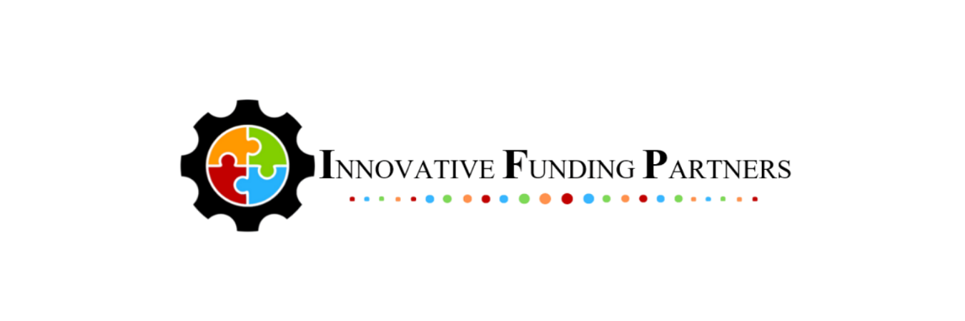
About
Innovative Funding Partners
IFP is a nationally-recognized grants consulting firm highly regarded for an impressive overall grant success rate of 85%. Well-known for their expertise in federal and other governmental grant writing, this success is based not only on technical expertise, but also on a foundational relationship-building approach. IFP’s team of over 25 highly-experienced consultants are passionate about helping organizations meet the unique needs of their local communities and better serve their constituents by seeking and securing grant funding.

Slide 4
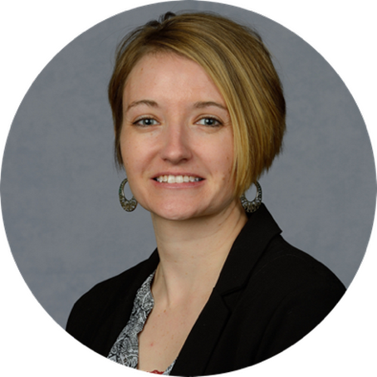
About the
presenters
Carrie Davis, GPC, IFP Director of Client Services, has over two decades of experience in multiple areas of fund development for nonprofits including individual/major giving, grant writing, marketing/communications, and organizational planning. Carrie has extensive successful fund development experience in numerous areas including healthcare, behavioral health, education, workforce and economic development, housing, human services, food insecurity, and more. In her role at IFP, Carrie typically leads our teams as a project manager, supporting and coordinating services for organizations across diverse sectors and geographies. Carrie holds a B.S. in Community Psychology from St. Cloud State University, a Certificate in Editing from the Poynter Institute, and a Grant Professional Certification (GPCI).
.
3.
Carrie Davis
Director of Client Services

Slide 5
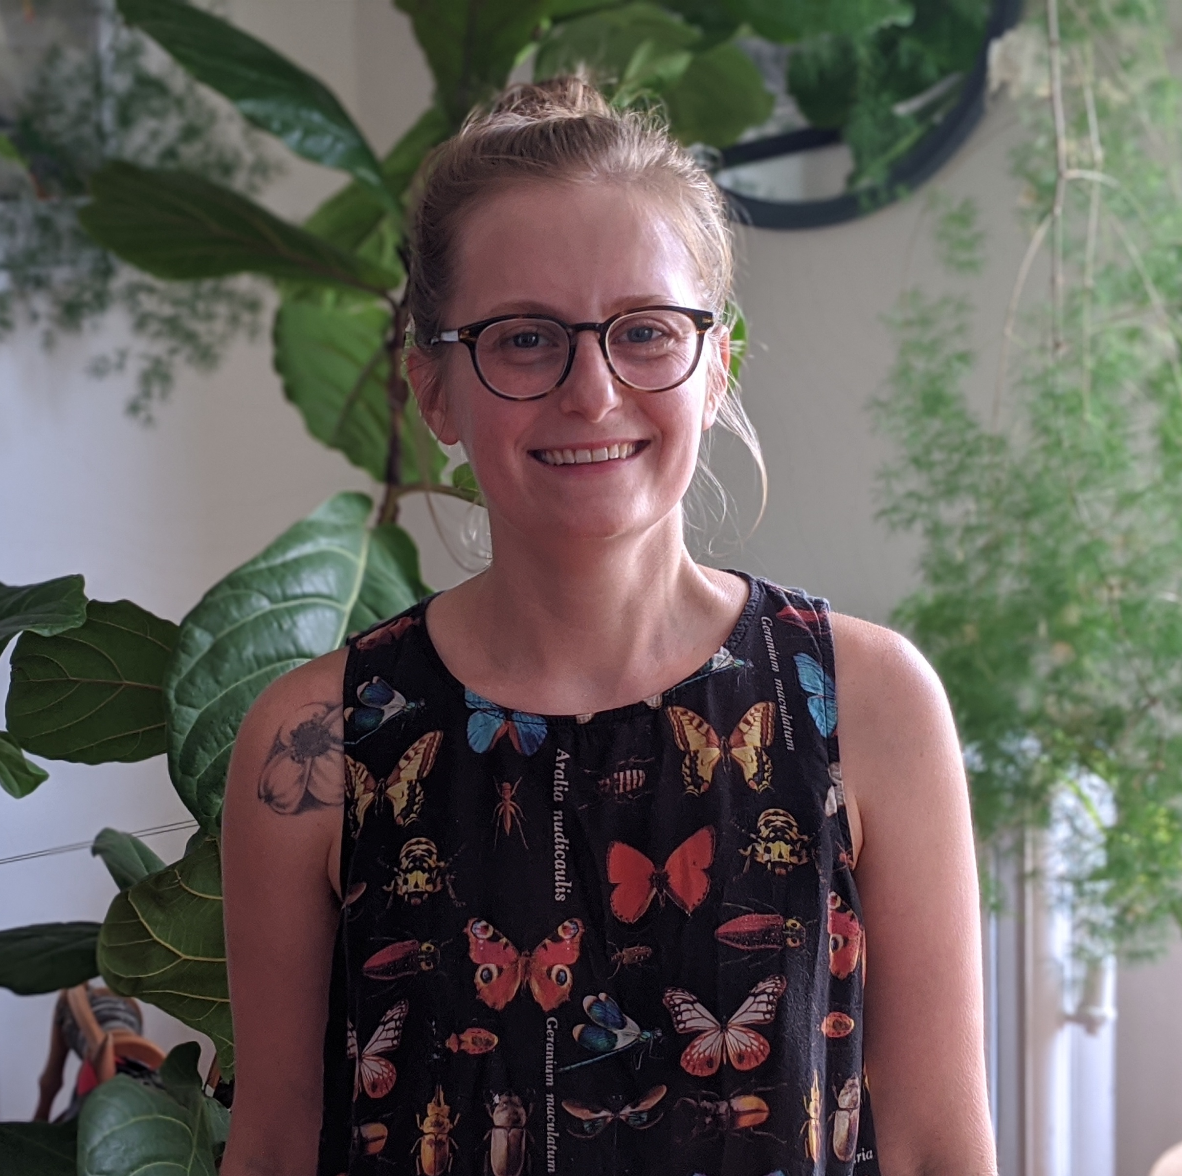
About the
presenters
Morgan Holland, Grant Consultant, is a development professional with over ten years of experience in the nonprofit, higher education, and government sectors. Her work has included executive leadership, program management, and fundraising through grant writing and individual giving.
She has been engaged with major and grassroots giving campaigns from $10,000 to $25M and has raised over $15M in grant funding the past five years from both foundation and federal sources, including HUD and SAMHSA.
.
3.
Morgan Holland
Grants Consultant

Slide 6
What is the Grants Help Desk?
The Grants Help Desk provides technical support to eligible organizations that have questions about a funding opportunity to which they are considering applying, or questions that may arise during the grant development process. The goal is to help make grant applications more competitive and to improve the chances of securing funding outside of Dogwood. Support is provided by IFP.

Slide 7
Nonprofit or municipal government organizations that:
Received grant funding from Dogwood in 2023 and/or 2024 and are in and serving within the Qualla Boundary and/or the 18 counties of Western North Carolina (Avery, Buncombe, Burke, Cherokee, Clay, Graham, Haywood, Henderson, Jackson, Macon, Madison, McDowell, Mitchell, Polk, Rutherford, Swain, Transylvania, and Yancey)
OR
Have not received grant funding from Dogwood Health Trust but are located in one of the 12 counties most impacted by Hurricane Helene (Buncombe, Yancey, Mitchell, Avery, Henderson, McDowell, Rutherford, Madison, Polk, Burke, Haywood, and Transylvania) and are seeking funding for hurricane relief and recovery efforts.
Have not received support from the Grants Help Desk within the last 30 days
Who is Eligible to Receive Support from the Grants Help Desk?

Slide 8
Eligible:
-Assessing the eligibility/competitiveness of a particular project for a specific grant opportunity
-Answering questions that arise during the grant development process (such as those related to the narrative, budget, forms, attachments, and submission to the funding agency/organization)
-Navigating the complexities of state, federal, and private foundation grant applications
-Guidance on grant management and post-award compliance
Not Eligible:
-Drafting a full narrative
-Creating the project budget, work plan, or logic model
-Performing a comprehensive search of funders that might support a project
What are examples of eligible requests for Grants Help Desk support?

Slide 9
Request a consultation by following this link.
Read more about the Grants Help Desk here.
How do we request Grants Help Desk support?

Slide 10
I. Understanding the current individual giving landscape and donor motivations
Notes:
Developing a logic model at the beginning of program planning gives you a framework for charting the links between your program’s resources, activities, and outputs and its intended outcomes. It enables you to evaluate your program once it begins. And it helps you communicate to your stakeholders what you want to accomplish, how you intend to reach your goals, and how you will track your progress.
Logic models represent INTENTION; shows connection between the planned work and what you hope to achieve. THIS is informed by the theory of change.
These components illustrate the connection between your planned work and your intended results.
Visual representation, etc. purpose in sharing ,etc.
Start with identifying the impacts and outcomes (relationship to backwards design) then can select the activities

Slide 11
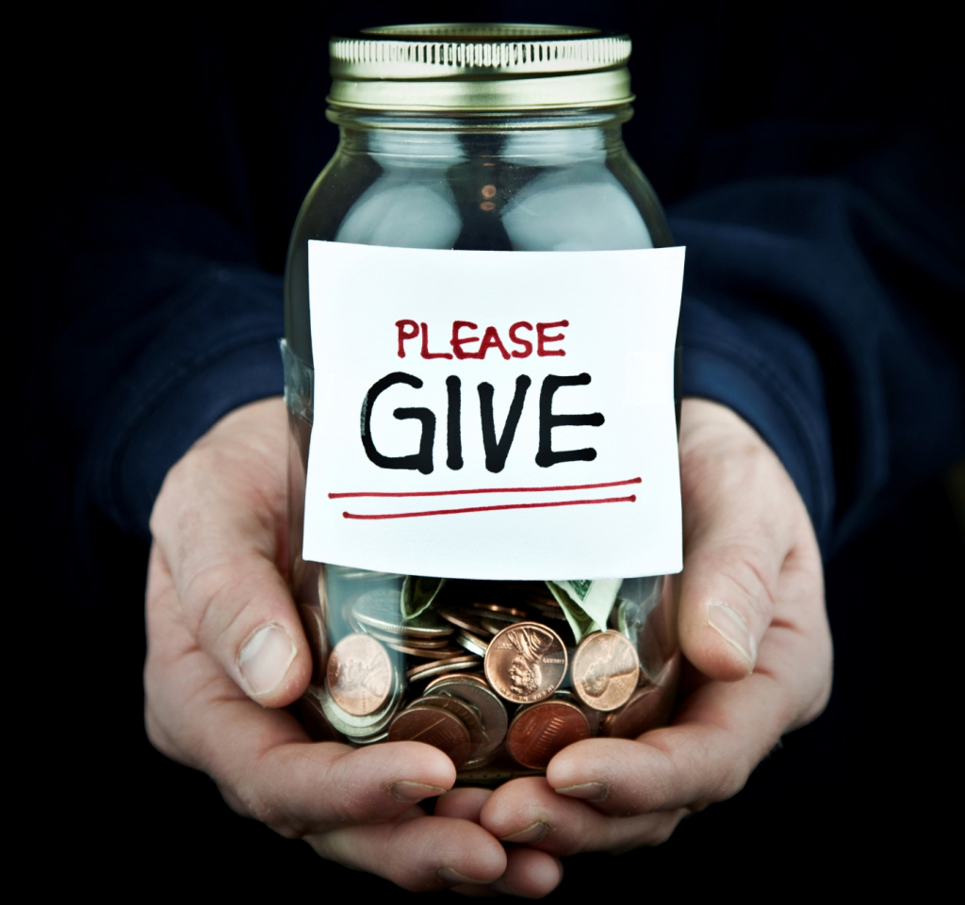
The current individual giving landscape
National giving trends in traditional philanthropic fields are changing rapidly (i.e., grant funding)
Current cuts, delays, and shutdowns at the federal level are creating a greater need for private donations to fill the gaps and support ongoing nonprofit operations
Individual donors can provide a base of consistent support, but may not be able to fill all the gaps left by federal funding
Individual giving is more reliant on personal ethics so less likely to ebb and flow like other giving areas

Slide 12
The current individual giving landscape
Individuals gave an estimated $592.5 billion to U.S. charities in 2024.
Total giving grew 6.3% in 2024
All sectors saw donations increase in current dollars while giving to foundations remained flat
57% of donors are enrolled in a recurring giving program (94% of recurring donors give monthly)
In 2025 thus far, individual giving has remained steady but not much data available yet on impact of federal funding cuts on individual giving
Donors may too be impacted by financial uncertainties, due to federal funding cuts, which could impact their decision to give
It’s important that we see individual donors as partners. Update messaging to inform donors of financial changes at your nonprofit, especially gaps left by federal funding cuts.

Slide 13

Donor Motivations
“Think of giving not only as a duty
but as a privilege.”
John D. Rockefeller

Slide 14
Donor Motivations
Individuals choose to donate to an organization for many reasons…
Desire to help others and improve the world
Value alignment – donors are more likely to support causes that align with their personal beliefs, values, and identity
Sense of purpose – donors seek to live in a purpose-driven life and want to feel they are contributing
Social influence – donors are motivated to give because their peers are giving
Want a sense of community and belonging
Legacy and tradition – some donors desire to leave a lasting legacy, honor a loved one’s memory, or pass down a culture of generosity
External Factors such as simply being asked; urgent/tangible needs; convenience

Slide 15
Impact of Technology of Giving
Technology has greatly shaped philanthropic giving in recent years.
Technology has made giving more accessible, transparent, and engaging.
Accessibility: Technology puts giving at a donors’ fingertips. Mobile apps simplify and expand access to charitable giving.
Transparency: Digital platforms offer dashboards that show exactly where funds go and how they are spent; advanced technology creates tamper-proof records of financial transactions to ensure funds are being used as intended.
Engaging: Crowdfunding allows individuals to raise money for causes that are important to them (GoFundMe, Kickstarter, etc.). Nonprofits can also embrace crowdfunding to directly connect with individual donors. Social media is another great tool to engage donors and amplify reach.

Slide 16
2026 Tax Changes for Individual donors
Current Administration’s “Big Beautiful Bill” made tax changes that could impact year-end charitable giving.
For non-itemizers (90% of filers):
New tax break worth up to $1,000 for single filers and $2,000 for married couples filing jointly for taxpayers who take the standard deduction (excluded Donor Advised Funds)
This change will likely provide tax benefits to a large number of taxpayers who previously donated but did not itemize
Could make sense to delay smaller year-end gifts to January if you don’t itemize

Slide 17
2026 Tax Changes for Individual donors
For itemizers:
There is an itemized charitable deduction “floor” which only permits the tax break once your total donations exceeds 0.5% of your AGI. Smaller donations may no longer reduce your tax bill unless they clear this threshold. (If your AGI is over $200,000, only gifts above $1,000 would be deductible.)
Taxpayers in the 37% income tax bracket will see the value of their charitable deduction benefits capped at 35%. (A $10,000 gift that currently generates a $3,700 tax savings would be limited to $3,500.) – GIVE EARLY!
Permanent AGI limit – taxpayers have the ability to deduct cash gifts to public charities up to 60% of your AGI (historically 50% cap)
If your gifts exceed the annual cap, taxpayers can carry forward the unused deduction for up to five tax years

Slide 18
II. Develop familiarity with individual giving plans and goal-setting methods.
Notes:
Developing a logic model at the beginning of program planning gives you a framework for charting the links between your program’s resources, activities, and outputs and its intended outcomes. It enables you to evaluate your program once it begins. And it helps you communicate to your stakeholders what you want to accomplish, how you intend to reach your goals, and how you will track your progress.
Logic models represent INTENTION; shows connection between the planned work and what you hope to achieve. THIS is informed by the theory of change.
These components illustrate the connection between your planned work and your intended results.
Visual representation, etc. purpose in sharing ,etc.
Start with identifying the impacts and outcomes (relationship to backwards design) then can select the activities

Slide 19
II. The Giving Cycle
Planning
Setting up the organization to create and scaffold goals—not just dollars raised, but people engaged, and how you’ll market.
Stewardship
Caring for the donor year-round to retain their attention and future giving potential.
Donor Identification Looking at who you know, who has ‘raised their hand,’ and who else you can engage.
Engagement
Finally making the ask!
How much is connection vs. strategy?
Cultivation
Educate donors on how their dollars will make change; build value and trust in the connection and investment.

Slide 20

II. Planning – Set Giving Goals & Timeline
What are your goals?
  What are you fund-raising for? Program, event, capital needs, operations, starting an individual giving program or monthly giving program.
  How much do you need to raise? Want to raise? Consider *stretch* goals.
  Is the fund-raising time-limited, and formatted as a “campaign,” or ongoing?

Slide 21

II. Planning – Determine Audience
Who should be engaged?
  Are you aiming to raise just funds or awareness too? Social media followership?
  How high is your target, and how much access do you have to wealth, generally? Might you have greater reach than your immediate landscape through digital access? More on developing prospects in the next step!
  What kind of person would be interested, considering purpose, timeline, and target? This helps shape messaging and strategy.

Slide 22
II. Planning – Set Strategies
Create messaging & the case for support
  How are you positioning yourself in the greater landscape, considering the audience and purpose you’ve identified? If online – the landscape can be both massive and hyper-specific (i.e., interest groups).
  Highlight the value you provide to the community, and the impact individual dollars can have. Consider providing several arguments, similar to appealing to a grant-maker.
  The most important piece of the puzzle – what do they care about?
  For individuals – leverage personal ethics
  For grass-roots – leverage community need
  Individual giving often requires more integration with marketing & communications than grant proposals – repeating messaging and presenting it in an appealing way.

Slide 23
III. Identify how to create, optimize, or begin to develop a prospect list.
Notes:
Developing a logic model at the beginning of program planning gives you a framework for charting the links between your program’s resources, activities, and outputs and its intended outcomes. It enables you to evaluate your program once it begins. And it helps you communicate to your stakeholders what you want to accomplish, how you intend to reach your goals, and how you will track your progress.
Logic models represent INTENTION; shows connection between the planned work and what you hope to achieve. THIS is informed by the theory of change.
These components illustrate the connection between your planned work and your intended results.
Visual representation, etc. purpose in sharing ,etc.
Start with identifying the impacts and outcomes (relationship to backwards design) then can select the activities

Slide 24
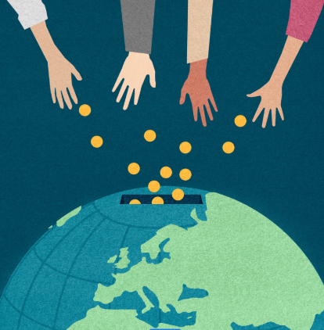
III. Donor Identification
Who has “raised their hand” that you already know?
  Capacity – wealth
  Affinity – ethics
  Propensity – engagement
  Traditional metrics include the number of donations made or increased giving year over year. Grassroots metrics may include social media engagement, events attended, or volunteer hours.
How do you find more people?
  Leverage relationships to find more relationships – who does your board, volunteers, or staff know? Inter-generational house party example
  Grassroots methods may be slow to build philanthropic partners but can build numbers motivating to larger donors. Tabling, social media, crowdfunding.

Slide 25
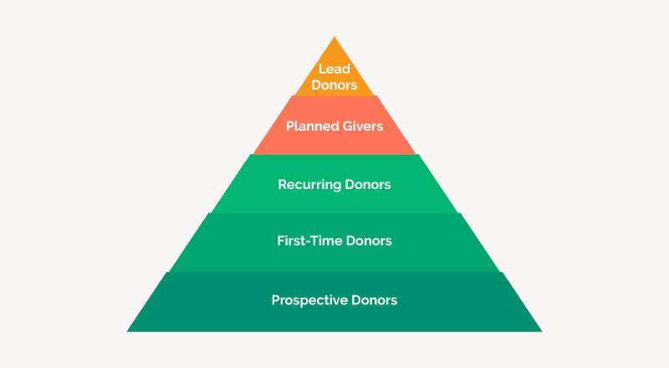
III. Donor Identification
Assign a prospect list
  Referring back to your planning steps, assign donors or donor segments to responsible staff, leaning on relationships as the primary driver of individual philanthropy.
  Consider interest, affinity, and identity when assigning staff to donors or segments.
  Lean on a CRM, shared drive, or other database to help with tracking shared goals.
https://doublethedonation.com/donor-pyramid/

Slide 26
IV. Learn methods to facilitate initial prospect outreach for major and grassroots giving.
Notes:
Developing a logic model at the beginning of program planning gives you a framework for charting the links between your program’s resources, activities, and outputs and its intended outcomes. It enables you to evaluate your program once it begins. And it helps you communicate to your stakeholders what you want to accomplish, how you intend to reach your goals, and how you will track your progress.
Logic models represent INTENTION; shows connection between the planned work and what you hope to achieve. THIS is informed by the theory of change.
These components illustrate the connection between your planned work and your intended results.
Visual representation, etc. purpose in sharing ,etc.
Start with identifying the impacts and outcomes (relationship to backwards design) then can select the activities

Slide 27

IV. Cultivation
Prepare the donor for the ask with education, far before asking
  Reflect on your donor pyramid and assess if you’re ready to connect with an appeal.
  Do they understand your programs and how they connect to their own life? Email messaging, social media, annual reports, direct contact.
  Do they understand the value proposition? How their dollars will make a difference, as well as how the program impacts the community? Consider a private meeting or educational session before making an appeal.

Slide 28

V. Engagement / Appeal
Personalized outreach to donors to appeal
  Major gifts (challenge gifts, large gifts)
  - Facilitated introductions with board, staff, and tailored messaging, face-to-face meeting, or call.
  - Consider a formal appeal, with a bold ask.
  Mid-level giving (monthly givers, pledges)
  - Tailored messaging, perhaps through program reports or targeted/segmented outreach.
  Grassroots giving (new donors, monthly givers)
  - Social media campaign, email campaign, mail campaign. Annual appeal or event-related appeal.
  - Giving Days (i.e.: Giving Tuesday) and crowdfunding platforms democratize giving priorities and mobile/online giving creates ease of making a gift.

Slide 29
V. Recognize stewardship and donor engagement as a critical part of the giving cycle
Notes:
Developing a logic model at the beginning of program planning gives you a framework for charting the links between your program’s resources, activities, and outputs and its intended outcomes. It enables you to evaluate your program once it begins. And it helps you communicate to your stakeholders what you want to accomplish, how you intend to reach your goals, and how you will track your progress.
Logic models represent INTENTION; shows connection between the planned work and what you hope to achieve. THIS is informed by the theory of change.
These components illustrate the connection between your planned work and your intended results.
Visual representation, etc. purpose in sharing ,etc.
Start with identifying the impacts and outcomes (relationship to backwards design) then can select the activities

Slide 30

Why is Donor Stewardship Important?
Retention is cheaper than acquisition!
The ROI is higher for retaining donors than identifying and cultivating new donors.
Retaining donors is the basis of any successful giving program.
Good stewardship leads not only to repeat giving but new connections as well.

Slide 31
Why is Donor Stewardship Important?
Most donors lapse for preventable reasons including:
Poor communication
Never getting thanked
Thinking other nonprofits are more deserving
Forgetting that they donated
“To keep a lamp burning, we have to keep putting oil in it.”
Mother Theresa

Slide 32
Donor Stewardship Best Practices
Donor Stewardship includes:
Recognizing your donors (how you do this may vary based on giving level)
Staying connected with your donors through multiple means of communication (email, social media, conversation, reports)
Sharing news and updates on both the organization and programs that are close to a donor’s heart
Special check-ins when special things happen at the organization or for the donor (birthday, holiday, giving anniversary, etc.)

Slide 33
Donor Stewardship Best Practices
Schedule it! Work regular stewardship into your giving calendar as if it were a grant report (using a database or CRM can help)
Consider segmenting your donors by gift size, frequency, and type to support communication plan
Ensure some of the connections and communication are personal to make the donor feel special and valued!
Consider using visual tools to share progress and success (“giving thermometer,” pictures, email news blasts with graphics and colors)

Slide 34
Questions?
IFP Contact Information:
Louise Mathias, Senior Partner
Louise.mathias@innovativefundingpartners.com
(202) 809-3401
Dr. Brian Kelley, Senior Partner
Brian.Kelley@innovativefundingpartners.com
(202) 809-3399

Slide 35
dht.org

