Slide 1


Grant Writing in the ChatGPT Era:
How AI can Help and Hinder Successful Proposal Development
April 15, 2026

Slide 2

Learning Objectives
1. Understand an overview of the impact of AI on the grant funding landscape.
2. Identify key benefits and potential pitfalls of using AI in grant development, including its negative effect on “the long game.”
3. Understand where typical pivotal “moments” are in proposal structure and how to leverage them by weaving in “X factors” that cannot be generated by AI.

Slide 3

About
Innovative Funding Partners
IFP is a nationally recognized grants consulting firm highly regarded for an impressive overall grant success rate of 85%. Well known for their expertise in federal and other governmental grant writing, this success is based not only on technical expertise, but also on a foundational relationship-building approach. IFP’s team of over 25 highly experienced consultants are passionate about helping organizations meet the unique needs of their local communities and better serve their constituents by seeking and securing grant funding.

Slide 4
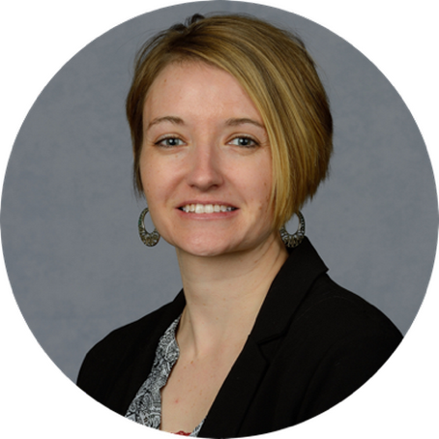
About the
presenters
Carrie Davis, Director of Client Services, has over two decades of experience in multiple areas of nonprofit fund development, including grant writing, grants management, strategic planning, sustainability planning, individual/major giving, and more. Carrie has successfully written foundation, corporate, and government grants to numerous federal agencies. Additionally, Carrie has experience supporting organizations with post-award grants management, including grant reporting (program and financial), submitting post-award amendments, and developing internal policies and controls for managing federal funding. Carrie holds a B.S. in Community Psychology from St. Cloud State University, a Certificate in Editing from the Poynter Institute, a Certificate in Post Award Grants Management from the Grant Professionals Association, and the Grant Professional Certification (GPC).
.
3.
Carrie Davis
Director of Client Services

Slide 5

About the
presenters
Susannah Williams, IFP Senior Grants Consultant, is a grant writer with a proven track record of securing federal and foundation grants across multiple sectors, including health care, workforce development, and education. She has extensive experience in supporting clients’ project design and development to meet complex grant requirements. Susannah has written multiple successful proposals for CDC, HRSA, DOE, DOJ, DOL, and USDA. Susannah holds a B.A. in Political Science from Loyola University Maryland and an M.A. in Political Science from The University of Chicago.
.
3.
Susannah Williams
Senior Grants Consultant

Slide 6
What is the Grants Help Desk? The Grants Help Desk provides technical support to eligible organizations that have questions about a funding opportunity to which they are considering applying, or questions that may arise during the grant development process. The goal is to help make grant applications more competitive and to improve the chances of securing funding outside of Dogwood. Support is provided by IFP.

Slide 7
Nonprofit or municipal government organizations that: Received grant funding from Dogwood in 2023 – present and are in and serving within the Qualla Boundary and/or the 18 counties of Western North Carolina (Avery, Buncombe, Burke, Cherokee, Clay, Graham, Haywood, Henderson, Jackson, Macon, Madison, McDowell, Mitchell, Polk, Rutherford, Swain, Transylvania, and Yancey) OR Have not received grant funding from Dogwood Health Trust but are located in one of the 12 counties most impacted by Hurricane Helene (Buncombe, Yancey, Mitchell, Avery, Henderson, McDowell, Rutherford, Madison, Polk, Burke, Haywood, and Transylvania) and are seeking funding for hurricane relief and recovery efforts. Have not received support from the Grants Help Desk within the last 30 days
Who is Eligible to Receive Support from the Grants Help Desk?

Slide 8
Eligible: -Assessing the eligibility/competitiveness of a particular project for a specific grant opportunity -Answering questions that arise during the grant development process (such as those related to the narrative, budget, forms, attachments, and submission to the funding agency/organization) -Navigating the complexities of state, federal, and private foundation grant applications -Guidance on grant management and post-award compliance Not Eligible: -Drafting a full narrative -Creating the project budget, work plan, or logic model -Performing a comprehensive search of funders that might support a project
What are examples of eligible requests for Grants Help Desk support?

Slide 9
Request a consultation by following this link. Read more about the Grants Help Desk here.
How do we request Grants Help Desk support?

Slide 10
I. An overview of the impact of AI on the grant funding landscape
Notes:
.
These components illustrate the connection between your planned work and your intended results.
Visual representation, etc. purpose in sharing ,etc.
Start with identifying the impacts and outcomes (relationship to backwards design) then can select the activities

Slide 11

Impact of AI on grant funding landscape
AI has had a significant impact on the grant funding landscape over the last few years, with new tools and technology taking over many nonprofits’ fundraising departments.
Using AI has raised many ethical questions around how it is being used and accepted within the nonprofit space.
Most foundations and nonprofits use AI in their work but share a common set of concerns about the technology (Center for Effective Philanthropy, AI With a Purpose: How Foundations and Nonprofits are Thinking About Using AI).
2/3 of Nonprofits report using AI – mostly for communications (70%); productivity (78%) and fundraising (61%).

Slide 12

Impact of AI on grant funding landscape
When asked what problems they would most like AI to solve, nonprofit leaders indicated to automate routine tasks:
Data entry
Drafting emails
Generating social media posts
Taking notes
Another area of interest is in improving fundraising capabilities.
As AI use increases in nonprofit and foundation sectors, many leaders are concerned about the potential effects of AI on their organizations and the communities they serve.

Slide 13

Impact of AI on grant funding landscape
Top concerns of nonprofits and foundations related to the effects of AI:
Misinformation or inaccurate results –
77% foundations; 73% nonprofits
Data security and privacy –
83% foundation; 67% nonprofits
Lack of staff expertise & capacity to learn –
52% foundations; 58% nonprofits
Uncertainty about how best to use AI –
62% foundation; 56% nonprofits
Bias or discrimination in AI algorithms –
53% foundations; 50% nonprofits

Slide 14
Impact of AI on grant funding landscape
How AI is being used for the Grant Development Process
In grant writing, AI often is used to streamline processes in areas such as research, reviewing NOFOs, outlining or developing funder talking points, etc.
AI is seen as improving efficiency and automating time-consuming prep work.
AI is being used in fundraising/grant writing teams to automate workflows, track and manage grants, etc.
Many nonprofits are using AI to generate proposals to save time and get more grants submitted.
Using AI platforms to generate grant content results in generic writing and lacks compelling, personalized information that only human insight can provide.
AI could be used to spark ideas or recommend language, but someone should always review and tweak content to give it an authentic voice
Because some see AI as making it easier to submit more applications, the overall volume of proposals is expected to rise, increasing competition.

Slide 15
Impact of AI on grant funding landscape
How AI is being used for the Grant Development Process
AI may help to summarize documents and identify funding sources, which can enhance efficiency, but it is not without its issues and can miss critical requirements so it should not replace direct human review (e.g., summarizing a NOFO)
Can be used to research data to support need statements
Critical to understand and confirm the origin of the data to ensure accuracy and that it is from a reputable source
AI can “hallucinate” data, so be sure to double check all sources
AI can do an internal peer review of grant drafts – asking AI to compare the draft or sections to the scoring criteria in a NOFO.
AI can actually score a draft, but ask it to be “brutally honest”, critical, and rigorous in its evaluation to ensure a strong result.
If being written by multiple people, AI can call out inconsistencies in language, tense, style, etc. to help create a more cohesive voice.

Slide 16

Impact of AI on grant funding landscape
How AI is being used for the Grant Review Process
Grant funders may be using AI to help develop grant guidelines and evaluate proposals.
Some foundation are using AI detectors when reviewing grant proposals and automatically rejecting those with a high percentage of AI-generated content.
Funders are using AI to quickly parse through applications, identify errors in applications and reports, and analyze data.
More foundations are starting to publish AI policies or expectations around AI use in their grant guidelines.

Slide 17

Impact of AI on grant funding landscape
How AI is being used for the Grant Research Process
13% of nonprofits are using AI to help identify potential funders (TechSoup)
AI can generate potential funding opportunities by putting in key terms and parameters into chatbots, but it is still critical that someone takes a close look at each funder’s guidelines and requirements to ensure alignment. (This often does not generate a lot of quality results.)
The best options are still paid platforms/databases like GrantStation, Foundation Directory, etc., where opportunities have been vetted and offer multiple parameters by which to identify grants (though still requires thorough vetting to ensure eligibility and alignment)

Slide 18
Impact of AI on grant funding landscape
How AI is being used for the Grant Reporting Process
Many grant management software has built-in AI tools to help track when reports are due, data collection for reporting, etc., and can offer helpful efficiencies.
AI may be used to review reports to confirm alignment with the original proposal requirements and maintain consistent tone
AI may help draft progress reports – feed key metrics, accomplishments, challenges, etc. into AI to generate an initial draft of a report. Critically important to thoroughly review the content generated and tweak to ensure authentic voice and to put content into the required format of the funder.
AI can “hallucinate” statistics or inaccurately describe achievements, so you cannot just take the content generated “as is”.
AI tools generally reflect and reinforce existing biases in datasets. Could lead to AI-generated reports that misrepresent a program’s effectiveness or unfairly grade, select or assess participants based on flawed data, algorithmic design, or historical inequities.

Slide 19
II. Identify key benefits and potential pitfalls of using AI in grant development, including its negative effect on “the long game”
Notes:
Developing a logic model at the beginning of program planning gives you a framework for charting the links between your program’s resources, activities, and outputs and its intended outcomes. It enables you to evaluate your program once it begins. And it helps you communicate to your stakeholders what you want to accomplish, how you intend to reach your goals, and how you will track your progress.
Logic models represent INTENTION; shows connection between the planned work and what you hope to achieve. THIS is informed by the theory of change.
These components illustrate the connection between your planned work and your intended results.
Visual representation, etc. purpose in sharing ,etc.
Start with identifying the impacts and outcomes (relationship to backwards design) then can select the activities

Slide 20

Potential Benefits of Using AI in Grant Development

Slide 21


1. Funding Searches
Although utilizing a grant database like GrantStation is best practice, AI can help perform general searches on top regional and national foundations making grants in your sector.
This will still require deeper research on your part, but AI can provide an initial list.
Note that AI will likely have less accurate and comprehensive information on local community foundations.

Slide 22
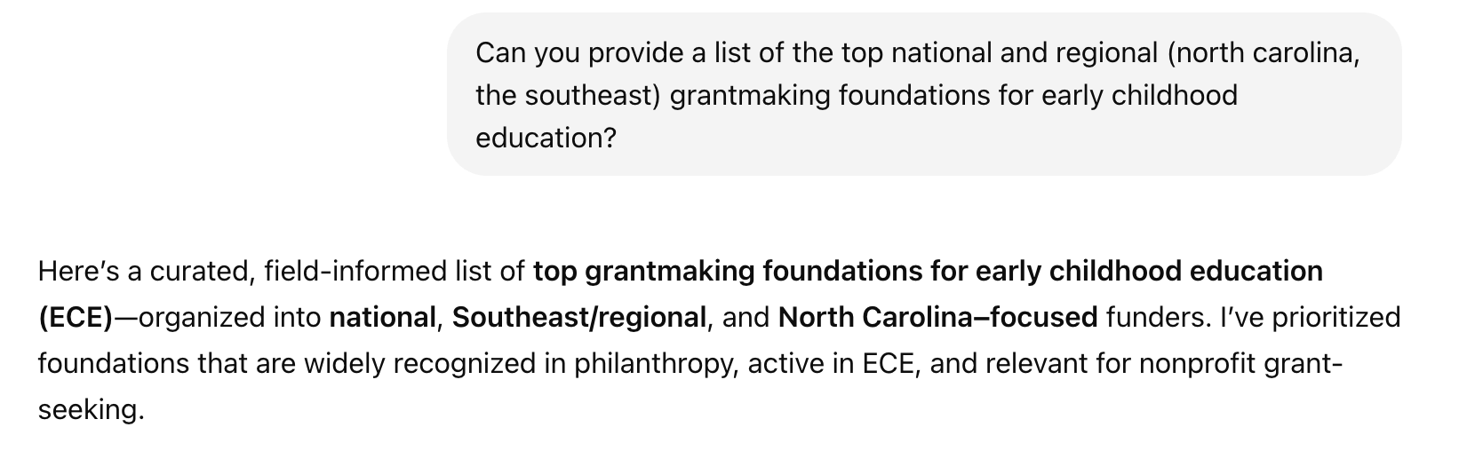
Example 1: National and Regional Funders for Early Childhood Education
.

Slide 23
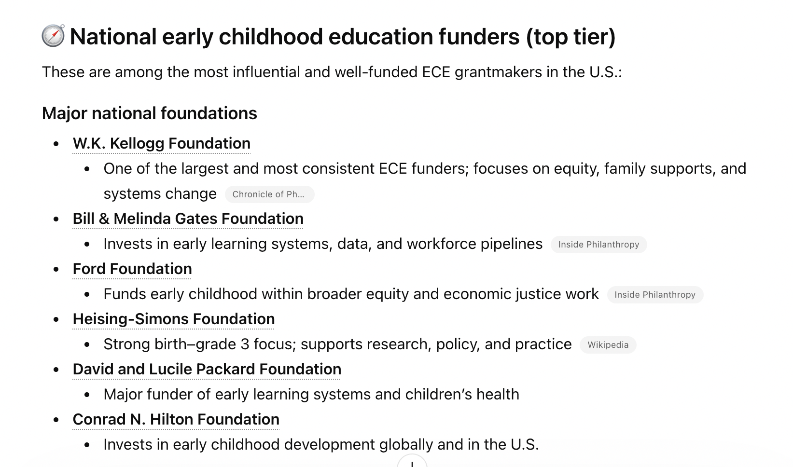
Example 1: National and Regional Funders for Early Childhood Education
.

Slide 24
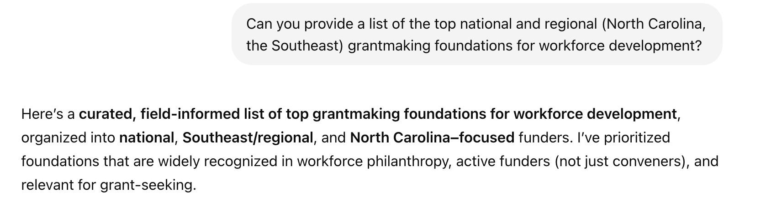
Example 2: National and Regional Funders for Workforce Development
.

Slide 25
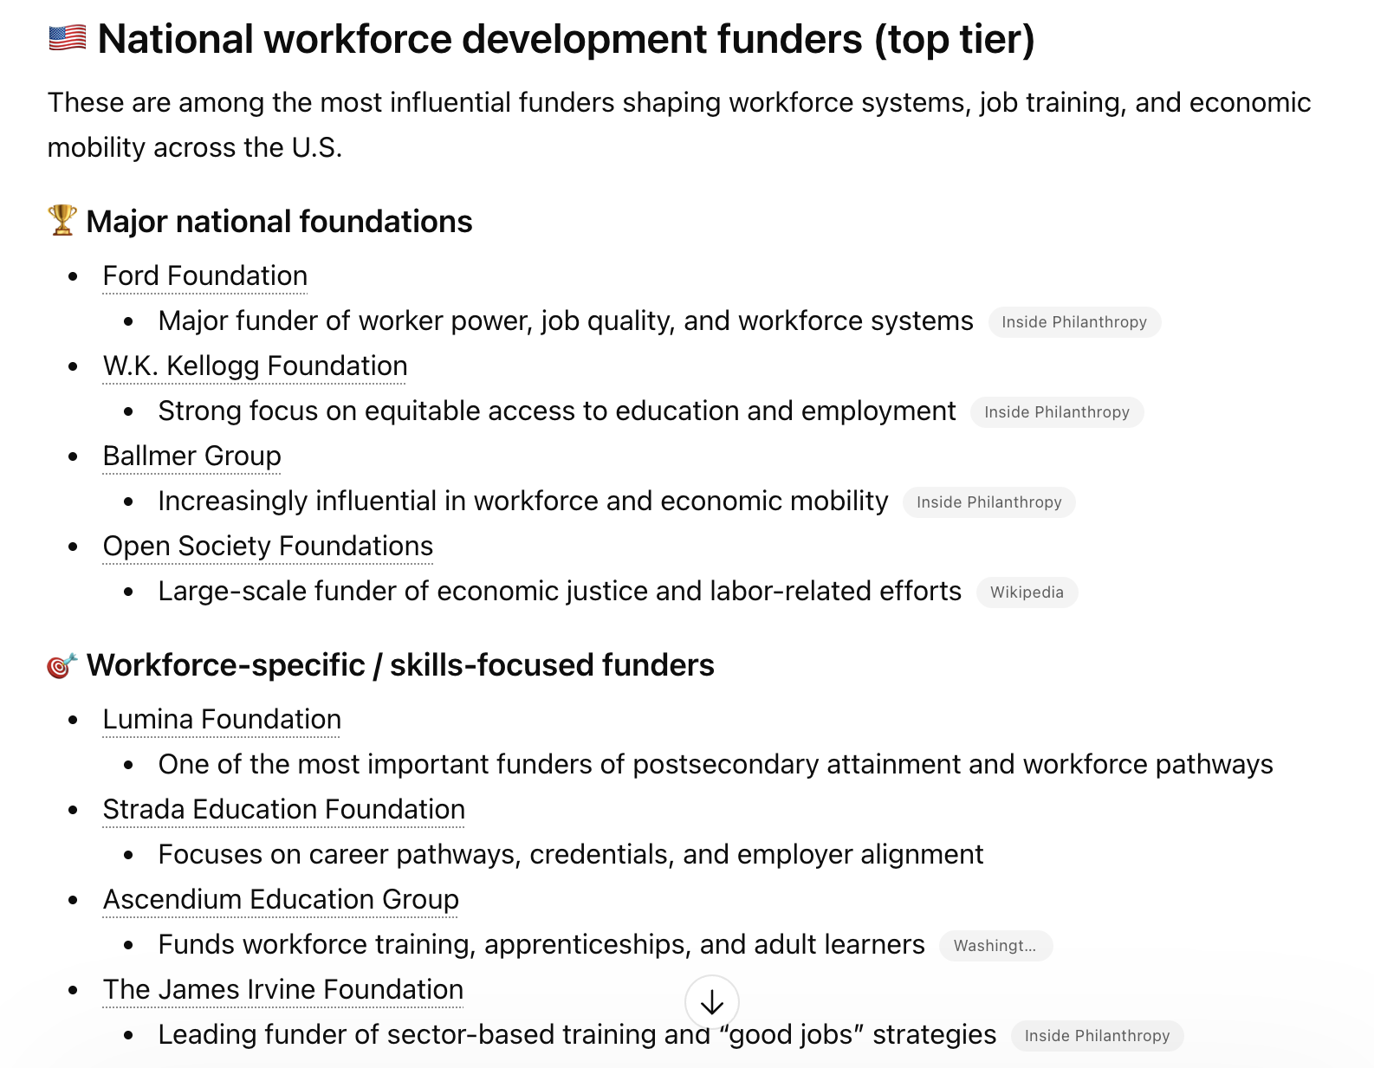
Example 2: National and Regional Funders for Workforce Development
.

Slide 26
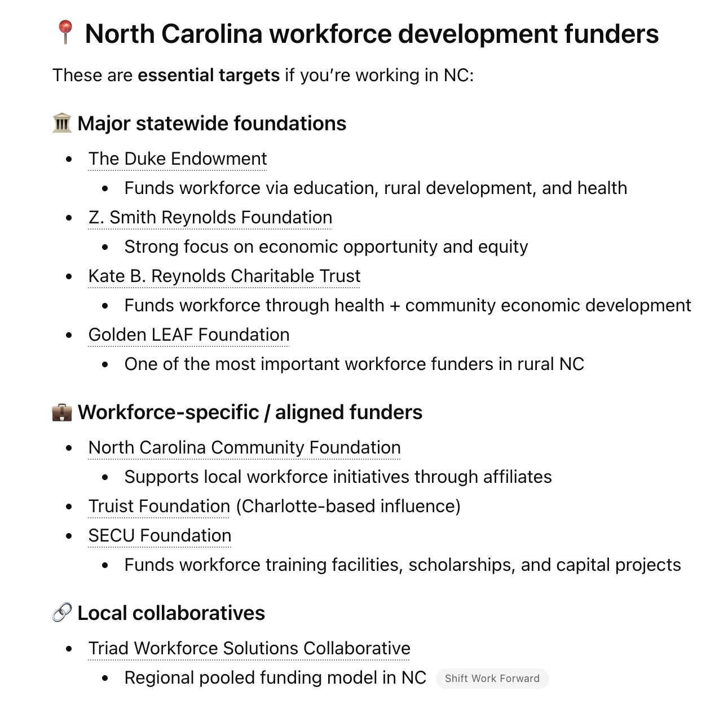
Example 2: National and Regional Funders for Workforce Development
.

Slide 27
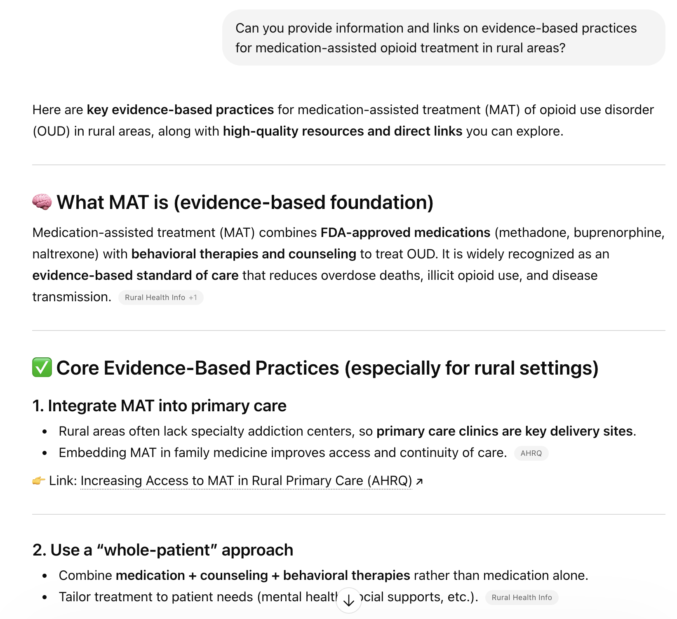
2. Researching the Evidence Base For Your Project
AI can help you begin to research the evidence base around your topic area and to find evidence-based best practices.
Be cautious to vet all links/sources.

Slide 28
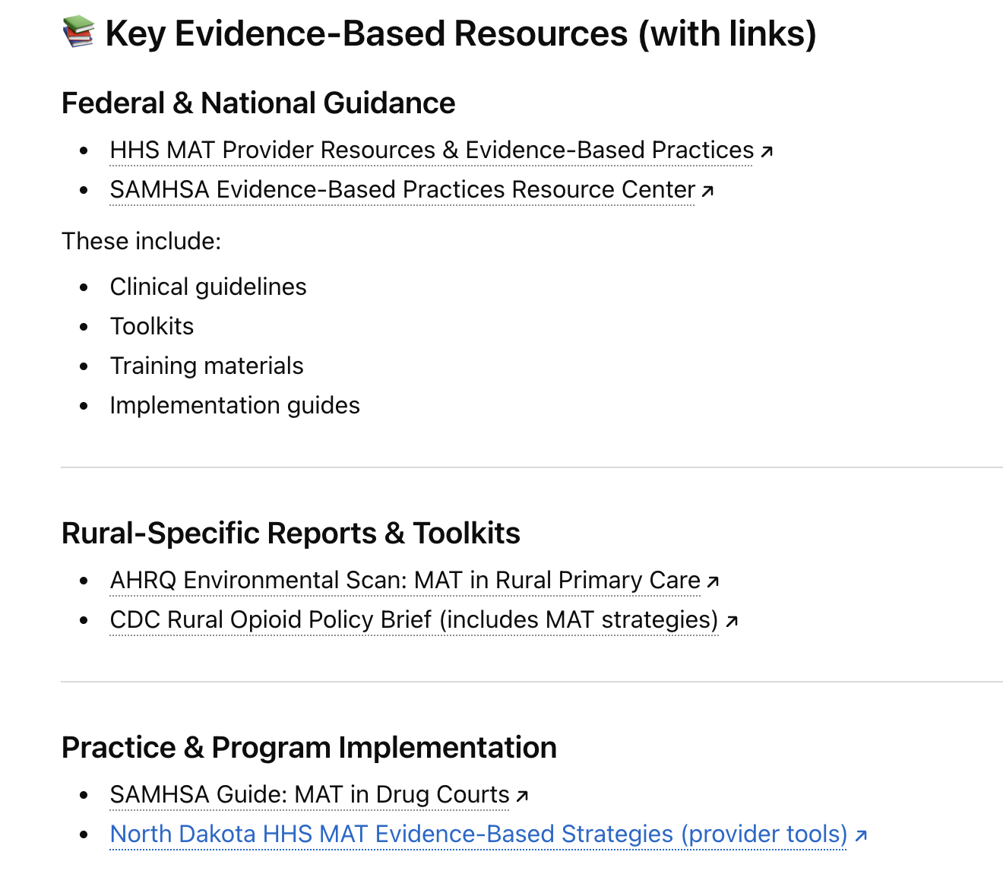
2. Researching the Evidence Base For Your Project

Slide 29
2. Researching the Evidence Base For Your Project
Tips for writing Prompts that have the most helpful results:
Ask AI to provide a literature review summary with specific peer-reviewed sources and annotated references
If you want a summary to understand the topic better (rather than specific sources to cite in your proposal), ask for a policy brief
Ask AI to link to peer-reviewed sources that explore specific program models

Slide 30
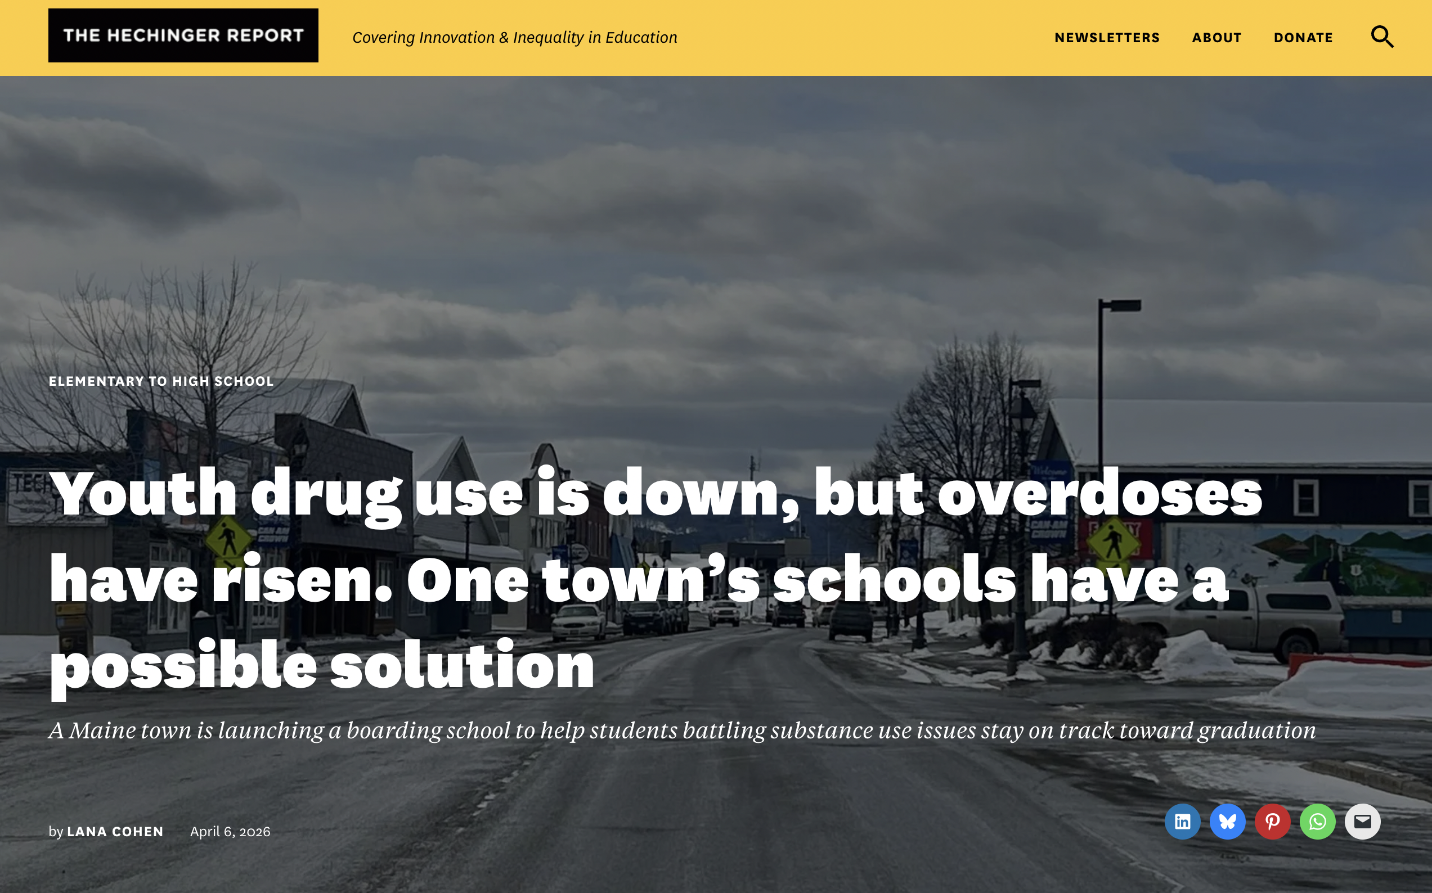
2. Researching the Evidence Base For Your Project
Generating correct citations: an AI Perk
ChatGPT and other chatbots can correctly format sources in APA or other styles, saving you time.

Slide 31
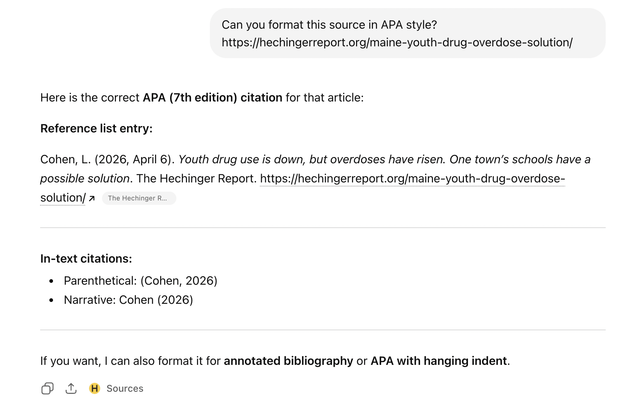
2. Researching the Evidence Base For Your Project

Slide 32
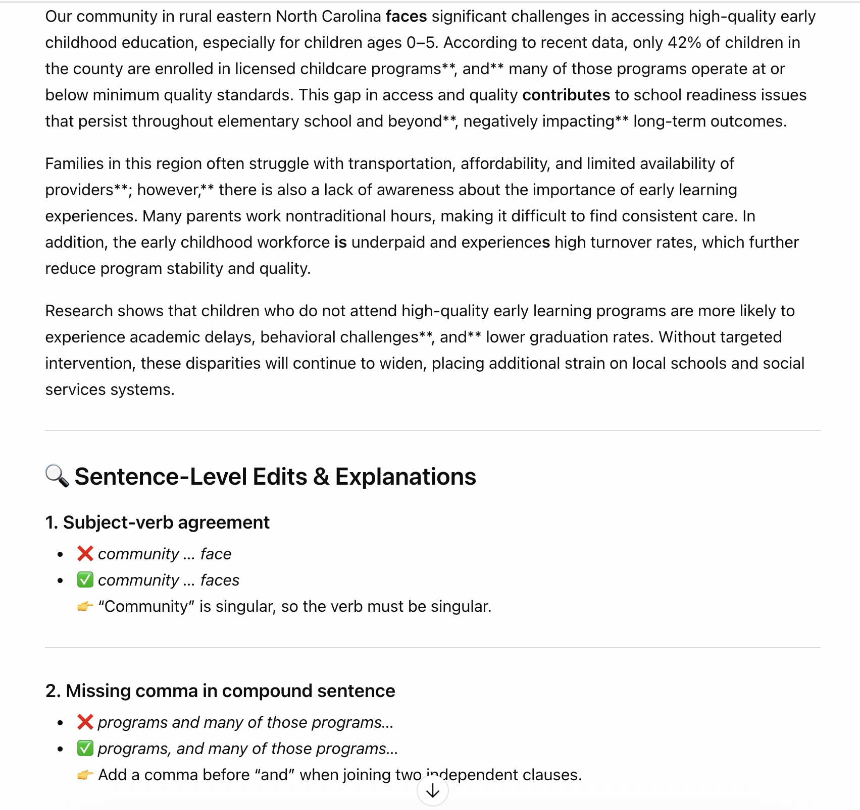
3. AI as Editor
Chatbots such as ChatGPT can serve as an advanced spell-checker/ editor, making sentence-level edits.

Slide 33
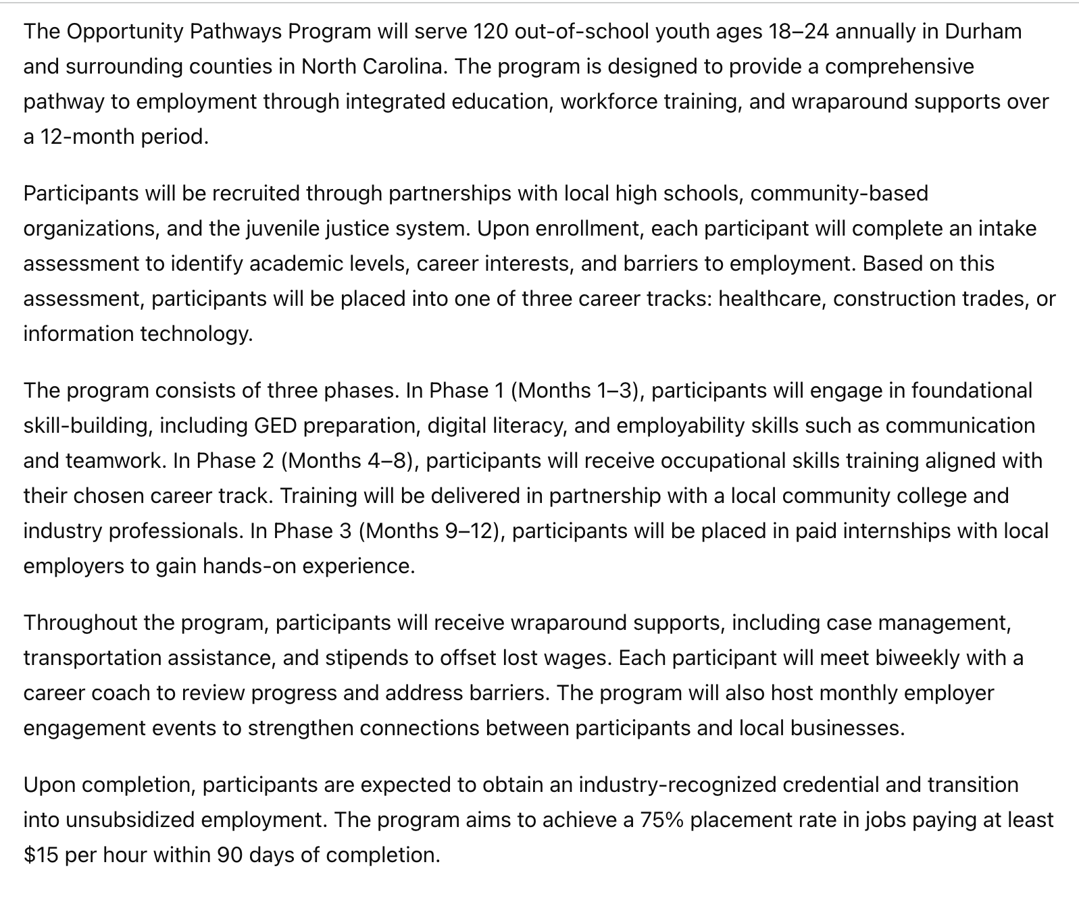
3. AI as Editor
Chatbots can also identify logical weaknesses in your need section or project design.

Slide 34
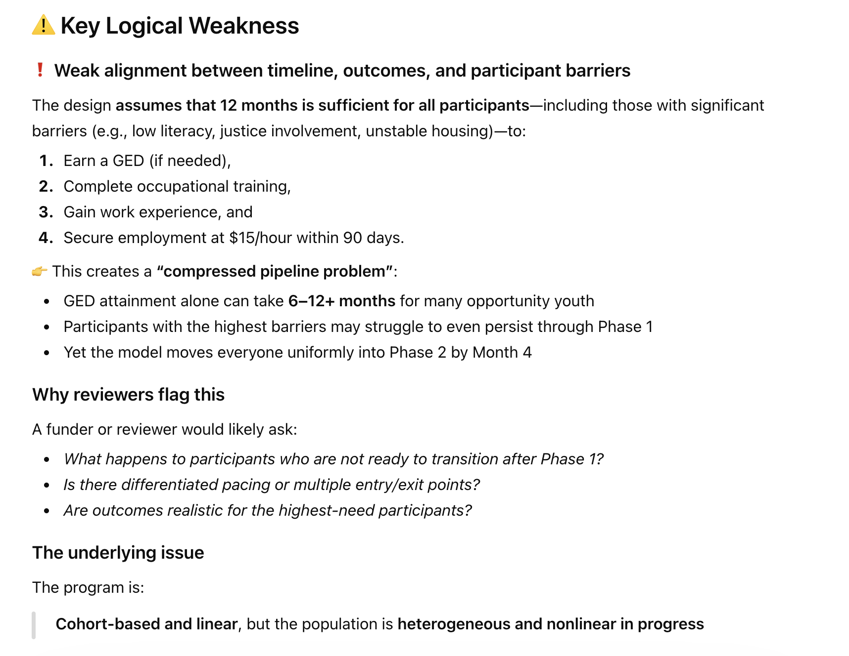
3. AI as Editor
Chatbots can also identify logical weaknesses in your need section or project design.

Slide 35
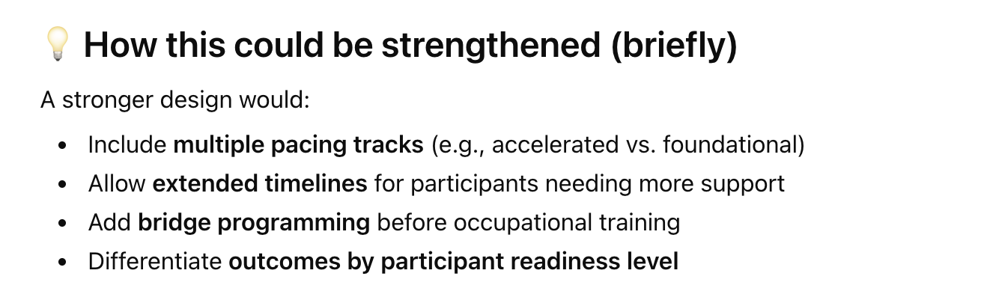
3. AI as Editor
Chatbots can also identify logical weaknesses in your need section or project design.

Slide 36
4. AI for Work Plans and Logic Models
Chatbots can help you begin to develop content for work plans and logic models, especially if you are new to working on these tools.
Asking a chatbot to generate an entire work plan or logic model is NOT recommended.
However, these are examples of how AI can be helpful as you develop a work plan or logic model:
You can input your key project activities and ask AI what some logical outputs or outcomes for these activities might be
You can input your key project activities and ask AI what inputs/resources you would need to execute them
You can upload a draft logic model and ask AI to identify any logical weaknesses

Slide 37
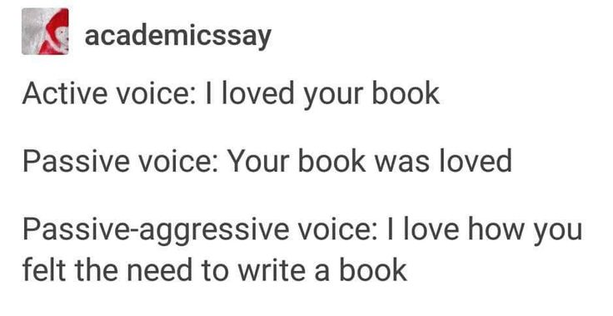
5. AI for Assessing Tone and Style
AI can:
assess whether your tone is too casual for a federal/state proposal
assess the general reading level of your narrative and tell you if you are using a great deal of jargon
identify places where you are using passive rather than active voice

Slide 38
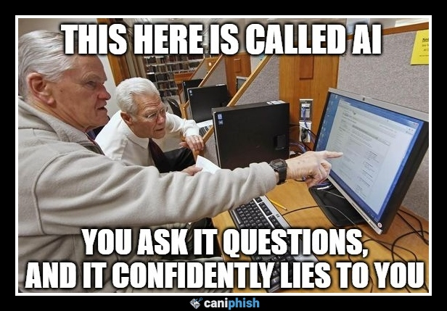
Potential Pitfalls of Using AI in Grant Development

Slide 39
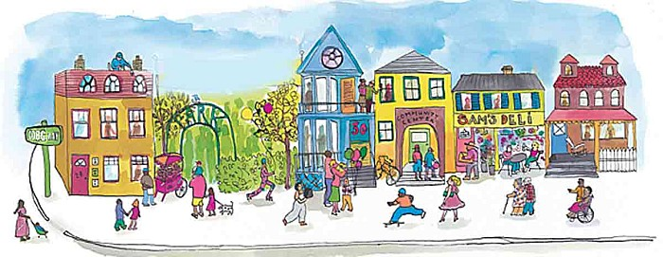
1. AI Does Not Share Your Earned Knowledge of Your Community or Work
A key strength in a proposal is deep knowledge of the community or target population to be served.
These are considerations such as historical, cultural, and/or economic influences that AI is not nuanced enough to grasp.
This earned knowledge is often the same content that distinguishes your proposal from others and takes a proposal from “good” to “awarded.”

Slide 40

In each of the following examples, the most unique and distinctive features of the proposal could not have been ascertained by using AI.

Slide 41
Example 1: Bureau of Justice Assistance Comprehensive Opioid, Stimulant, and Substance Use Program
The applicant proposed a project to provide behavioral health services and care-coordinated reentry support services to detainees of a county jail. The proposed project was distinct for many aspects, including:
The applicant had previously completed a comprehensive gap analysis and needs assessment of OUD/SUD prevalence and existing supports in the county that included qualitative/quantitative data collection from the county jail’s staff and detainees. The final document identified the need for therapeutic, reentry, and recovery support services as a priority for the county.
“This project is therefore a direct product of systematically convening key county stakeholders (including culturally-competent engagement of this project’s target population), utilizing data-driven approaches to identify priority needs, and moving toward strategic action.”
The applicant planned to work with an evaluator with years of experience in the target service area and with the target population.
“This project has the potential to produce research on the effects of peer-supported recovery and reentry services and behavioral health services on detainees in rural Appalachian service areas.”

Slide 42
Example 2: USDA Wood Innovations
The applicant, a sawmill, proposed a project to expand operations through the purchase of new equipment. The sawmill was unique for the following reasons:
The applicant had managed to weather economic shifts over decades that had forced several other mills to close:
“This equipment will ensure the viability of (applicant) in an area where several mills have closed in the last decade due to steep equipment prices and overseas competition. This project therefore promotes (applicant’s) continued ability to support commercial timber harvesting that treats hazardous fuels and reduces the risk of wildfire in a densely forested area.”
The applicant did not export logs for processing:
“In comparison to the region’s other sawmills, (applicant) is unique for its commitment to processing the logs it purchases in-house, rather than exporting logs for cheaper processing abroad. This keeps the entirety of revenue within a 100-mile radius of the mill.”

Slide 43

2. AI Has a Tone
The persuasive quality of narrative writing depends on authentic “voice” and tone.
AI tools, such as ChatGPT, have a distinctive tone that can read very generically to reviewers and prevent your proposal from standing out—key to winning in this highly competitive funding environment.
Remember that reviewers may be reading 100 applications. You want your voice to stand out.

Slide 44
3. AI Impacts Your Long Game
AI may seem like a quick and easy solution to help tackle challenging deadlines, but asking it to design your project means that if you are awarded, you may be tied to implementing a project that is not feasible or desirable for the problem you seek to address.
You know your target population better than AI.
Your subject matter experts know what is possible, and when it is possible to achieve, when it comes to “boots on the ground” implementation.

Slide 45
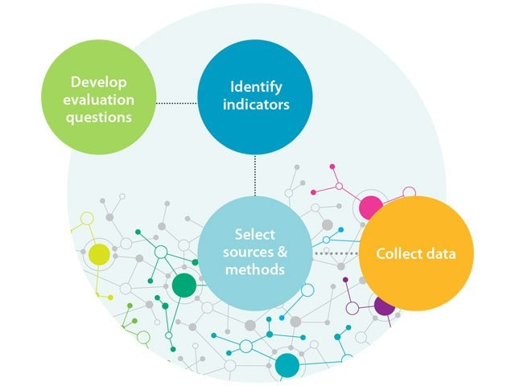
3. AI Impacts Your Long Game
An AI-generated evaluation plan may not reflect your project goals or organizational capacity and commit you to the impossible.
Thinking through your evaluation approach can often help clarify and troubleshoot your project design. Having AI tackle this step means you lose this opportunity to deeply understand the how and why of your project.

Slide 46
3. AI Impacts Your Long Game
Submitting an AI-generated project and/or evaluation plan may lead to panicked realization upon award that you cannot do what you said you could.
Requesting changes to an awarded project should be a last resort, as it can have a long-term impact on your relationship with a funder (government or foundation).

Slide 47
III. Examples of “X Factors” in winning proposals that cannot be generated by AI
Notes:
.
These components illustrate the connection between your planned work and your intended results.
Visual representation, etc. purpose in sharing ,etc.
Start with identifying the impacts and outcomes (relationship to backwards design) then can select the activities

Slide 48



Unifying Factors of Successful Government Grant Proposals
Awardee
The “X Factor”
Unique qualities, compelling story, timely alignment to agency priorities
Work plan/logic model and budget logically connect the dots
Project design is grounded in evidence-based practices
Applicant
Demonstrates capacity to develop, implement, and evaluate the project
Proposal responds thoroughly to every single proposal requirement

Slide 49

X Factors emerge at pivotal moments in a grant proposal
Pivotal moments are opportunities, at specific points over the course of a proposal, that connect the dots clearly for the reviewer. They create a story and build a unified argument.
They communicate to the reviewer: “Remember the issue I explained in the Need section? This is why we are the ones to address it, this is why this project will work, and this is why it matters.”
Notes:
Context:
Why are you proposing to do what you are proposing to do? What do the data say about community needs?
For example:
• Nonprofit hospitals are required to conduct a Community Health Needs Assessment (CHNA) once every three years. A CHNA describes a community’s population characteristics, demographics, health needs, health disparities, access to care, and more. References to a CHNA in a proposal for a healthcare program can build the case that your proposed activities are needed and provide a foundation for describing the program objectives and activities that you will use to meet those needs.
• Use credible data sources that are verifiable (Centers for Disease Control, US Census, Bureau of Labor Statistics, Climate and Economic Justice Screening Tool, etc.). If a government RFP provides suggested data sources, use them!
Building on successes:
As an organization our track record is one of your most important assets. You will need to make a solid connection between your accomplishments and your proposed project to show that you are well-positioned to meet your goals.

Slide 50

Pivotal Moments allow you to answer the major “WHY?” questions for the reviewer
WHY is this project able to address the need or problem?
(What is unique about your organization or your approach that makes you the best choice for addressing the need?)
WHY will this approach work?
(What evidence is there that suggests its potential?)
WHY does it matter?
(What is the projected impact?)
Notes:
Leadership:
To what extent do your leaders represent your clients or constituents (demographics, socioeconomics, lived experience). For example, if you are designing a mentorship program for justice-impacted youth, do you have leaders on the Staff or Board who have lived experience with justice system involvement?
It is helpful to have up-to-date resumes and bios of key staff (Directors, Managers) on hand to weave their qualifications into the narrative.
If a position, such as a Project Director, is “to be hired,” have a job description that describes that person’s required minimum qualifications.
Broader community input:
Both foundation and government funders will want to see that your solutions are designed to meet community needs as defined by the community members themselves. Questions to ask yourself: What are the mechanisms for community input? How will it be collected, and how often, and how will it be used (example: quarterly survey, focus groups)? How will community members be involved in the planning, implementation, evaluation, and ongoing quality improvement of your programs?
Partnerships:
Foundation funders want to see collaboration across organizations. LOSs may suffice.
Government funders often want to see or even require collaboration between nonprofits, public entities (ex: Workforce Development System), and industry. More formal: LOCs or MOUs may be needed as opposed to letters of support.
In general, foundation grants are more interested in Board and Staff, while government funders are more interested in structures, systems, and processes (Governance, Advisory Committee and who’s on it, how often they meet etc.

Slide 51
Where in a proposal do these moments usually occur?
WHY is the project able to address the need or problem? | At the end of the NEED section, often with a prompt such as “how will your project address the identified needs?” In the Introduction section or introductory paragraph to the proposal
WHY will this approach work? | Methodology section (even if the NOFO/RFP does not specifically request discussion of evidence-based practices, include it)
WHY does it matter? | Impact/Expected Results section If no specific Impact section, you can include it in Methodology or tie it into your discussion of outcomes
Notes:
Staffing:
Does your staff have the relevant qualifications?
Are there sufficient FTE allotments in the budget?
Do you need to hire anyone?
Scope: on slide
Timeline: on slide
Budget:
Are other funding sources secure? Can you meet the match requirement (if applicable)? Does your budget include adequate FTEs to carry out your scope of work?
Are your goals achievable given the amount of funding available via this opportunity and the larger project budget
No one wants to be the sole source of funding. What are your other sources? match, in-kind, other funders, etc.)?
External Factors:
“Risks and Challenges” question (HRSA). For example, many supply chain and logistics challenges arose during COVID. Challenges to procurement of equipment and materials. They will want to know that you have a plan for mitigating risks and external factors that could delay or threaten the project.

Slide 52
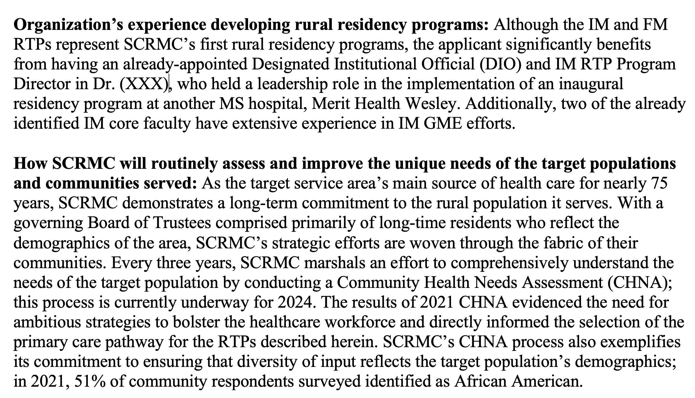
Example 1: HRSA Rural Residency Planning and Development proposal from Mississippi applicant
Nuanced weaving of local, state, and national data to demonstrate the need for this project

Slide 53
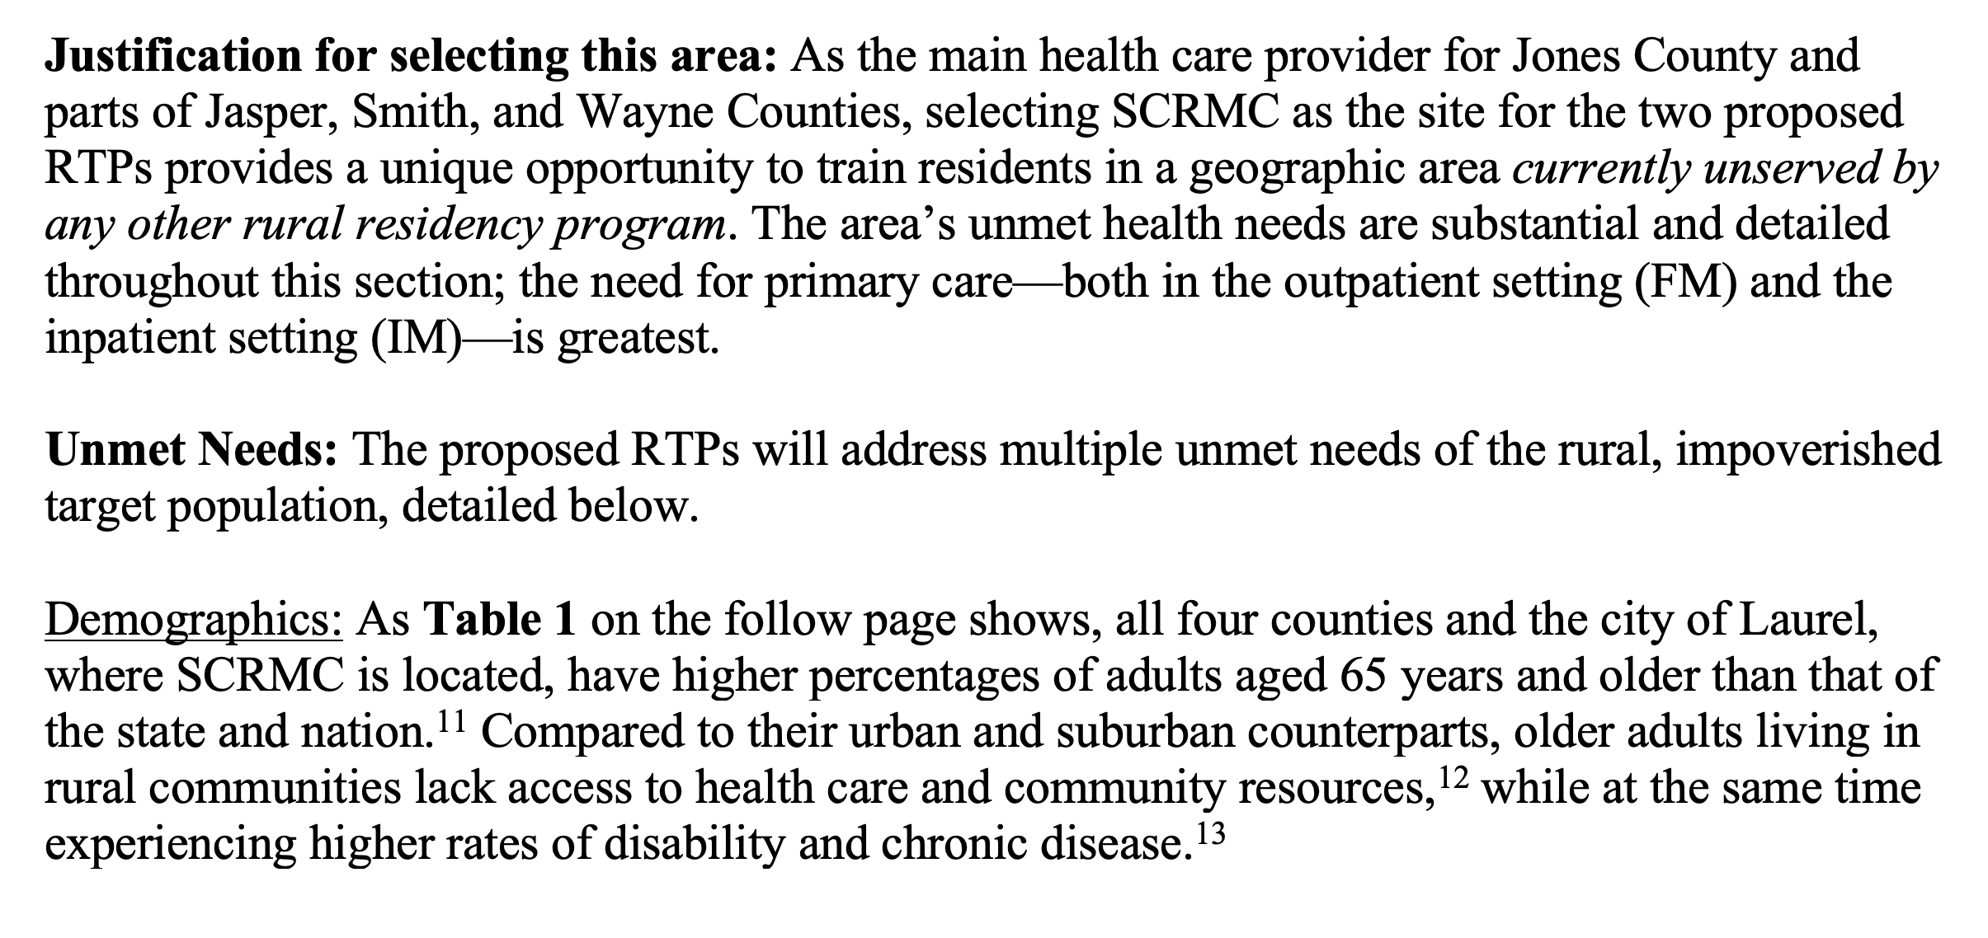
Example 1: HRSA Rural Residency Planning and Development proposal from Mississippi applicant
Nuanced weaving of local, state, and national data to demonstrate the need for this project

Slide 54
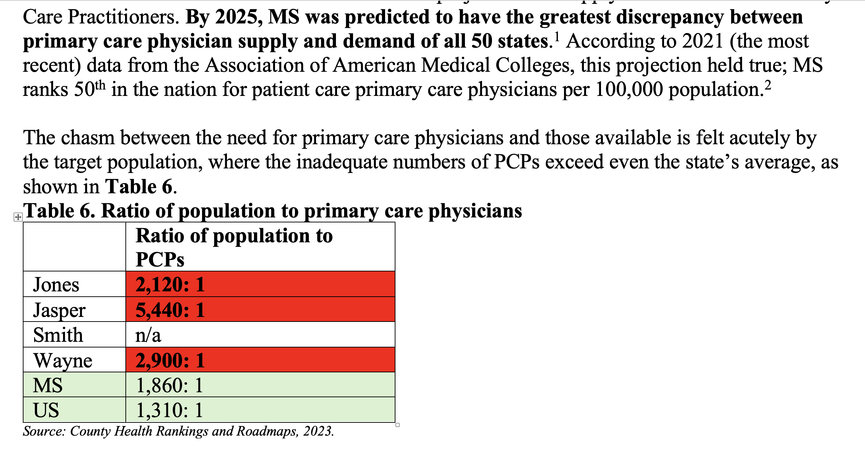
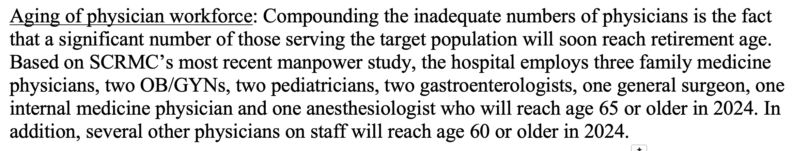
Example 1: HRSA Rural Residency Planning and Development proposal from Mississippi applicant
This kind of carefully constructed argument, which embeds institutional knowledge unavailable on the web, is an example of what AI cannot produce.

Slide 55
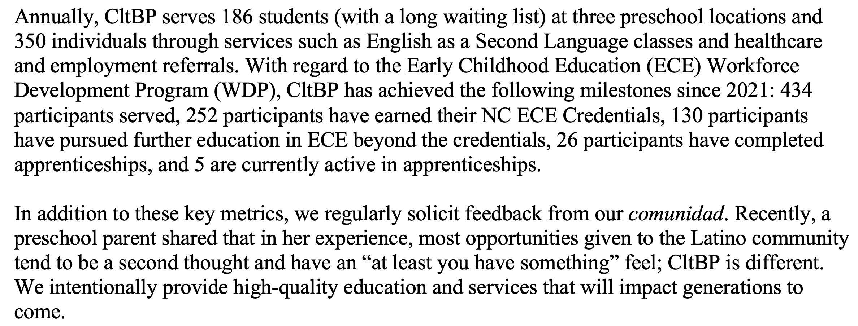
Example 2: Truist Foundation Workforce Development proposal from applicant in Charlotte, NC
This is an example of having strong impact with few words. This narrative had vastly tighter word limits than a federal proposal, but weaving in earned knowledge of the target population gave it an X factor.

Slide 56
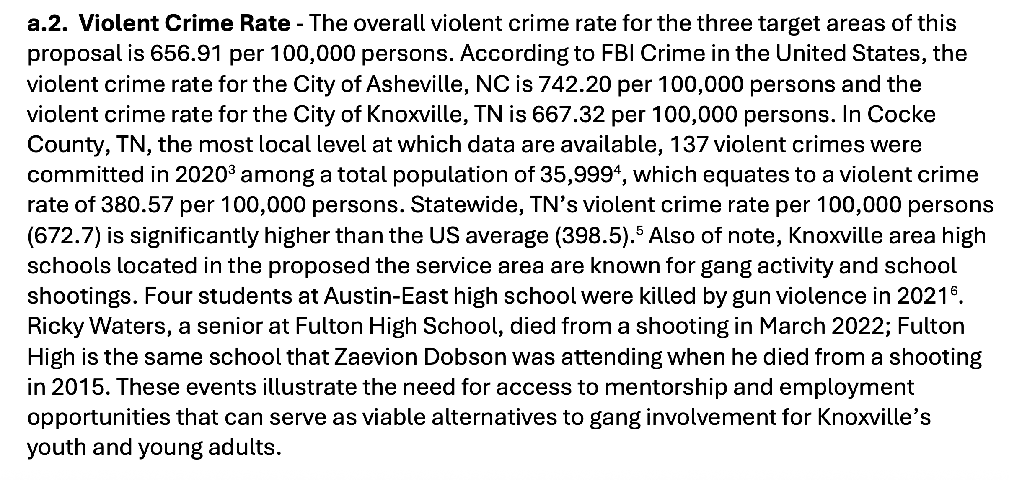
Example 3: Department of Labor Growth Opportunities from applicant in Asheville, NC
This is an example of building a Need section and Project Design that is responsive to a complex history of community violence—a history that AI cannot glean from online sources.

Slide 57
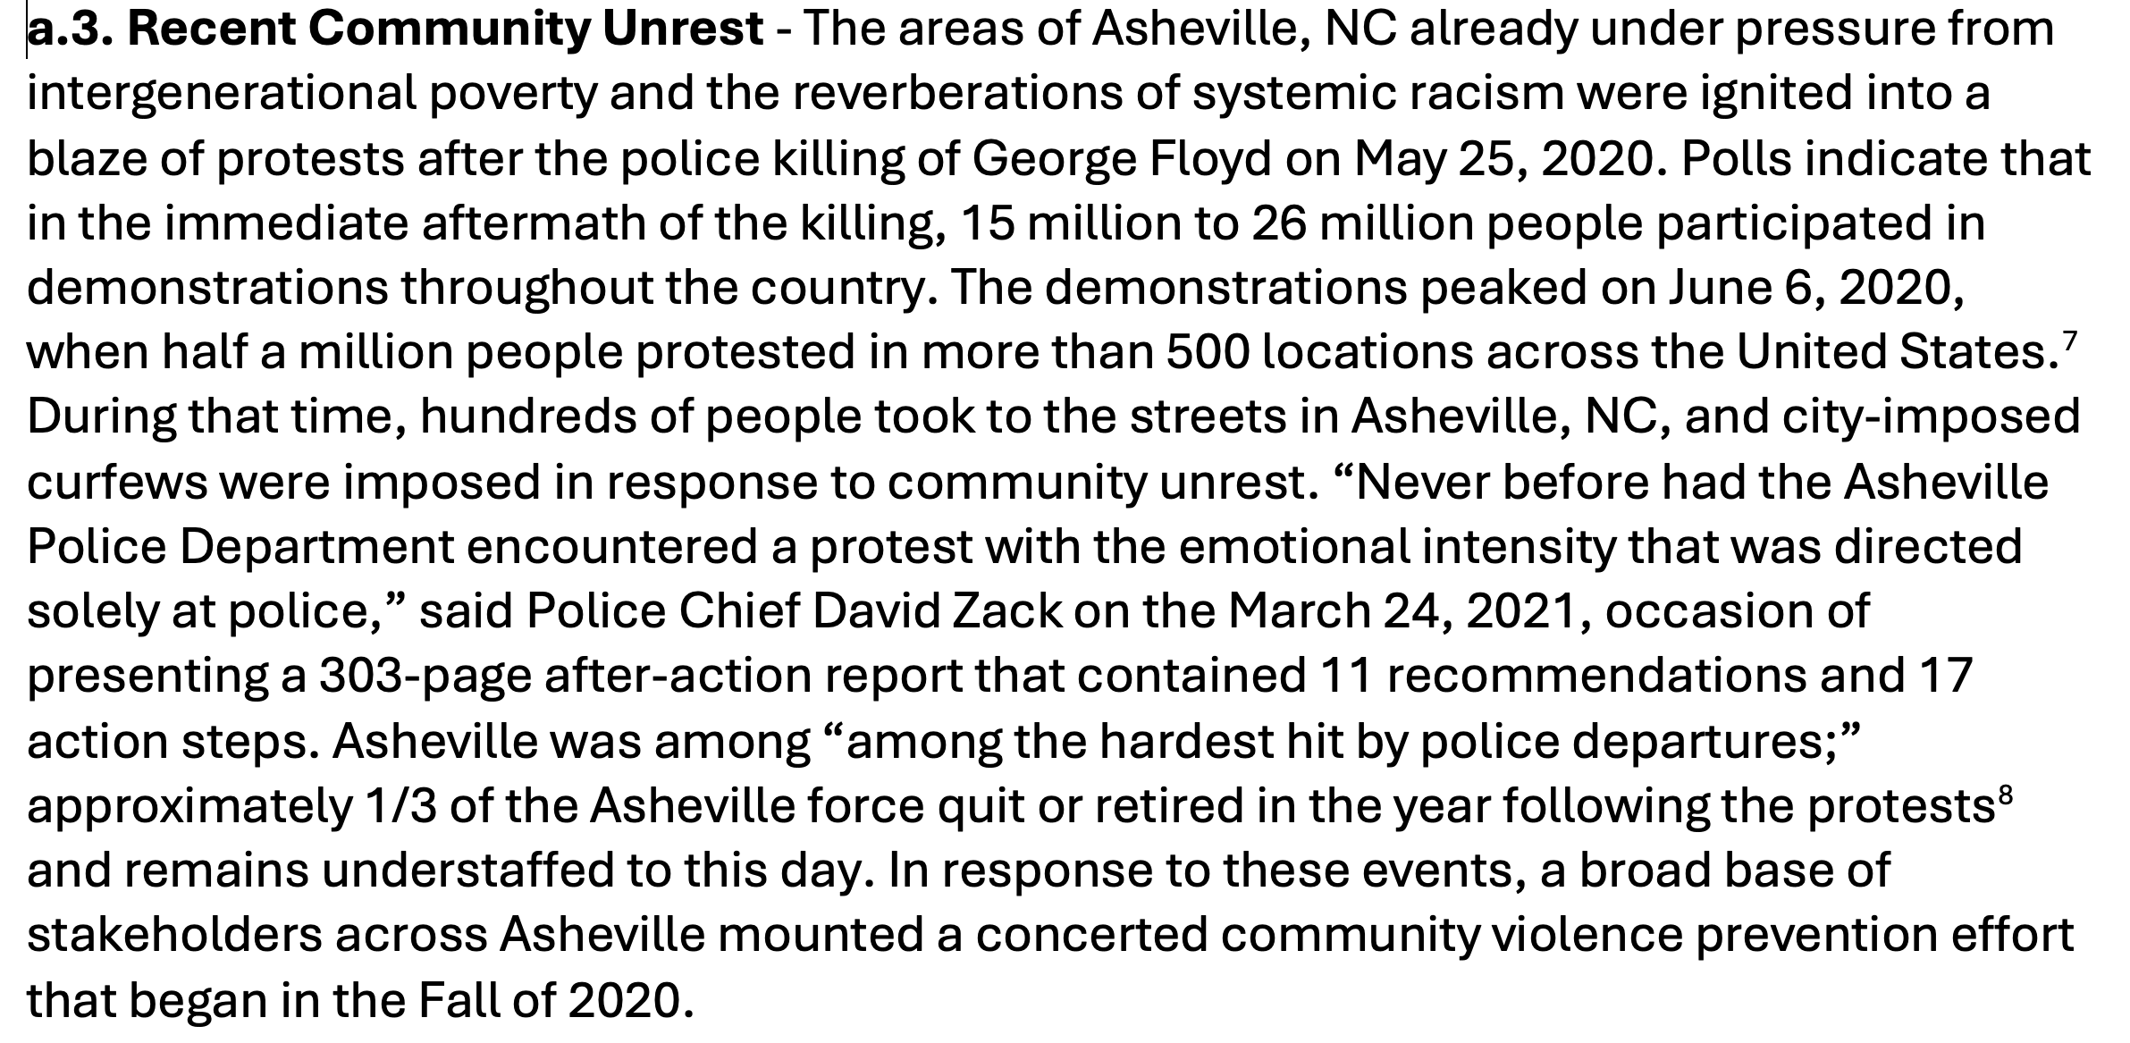
Example 3: Department of Labor Growth Opportunities from applicant in Asheville, NC
This is an example of building a Need section and Project Design that is responsive to a complex history of community violence—a history that AI cannot glean from online sources.

Slide 58
Conclusion: Summary of AI Use in Grant Development
Using AI in grant development does not have to be all or nothing.
Think of AI as your assistant, not a replacement.
It is all about the prompts.
Establish AI policies to ensure clear, shared standards for acceptable AI usage within your organization.
Expect more grantmakers to set clear expectations around the use of AI to ensure ethical and effective use.
Collaborate with other nonprofits to share best practices and keep dialogue open.
How can AI make this “better” rather than how can AI do this for me?

Slide 59
Questions?
IFP Contact Information:
Louise Mathias, Senior Partner
Louise.mathias@innovativefundingpartners.com
(202) 809-3401
Dr. Brian Kelley, Senior Partner
Brian.Kelley@innovativefundingpartners.com
(202) 809-3399

Slide 60
dht.org

