Slide 1


Better Together:
How Strategic Partnerships
Advance Project Impact
June 17th, 2026

Slide 2

Learning Objectives
1. Understand the role of partnerships in strengthening organizational capacity, sustainability, and competitiveness for grant funding
2. Develop familiarity with best practices for establishing effective partnerships for grant funding and beyond
3. Explore examples of key partnerships in successful government grant proposals

Slide 3

About
Innovative Funding Partners
Innovative Funding Partners is a nationally recognized consulting firm that offers a range of services that improve our clients’ ability to achieve sustainable impact in their communities. Highly regarded for an impressive overall grant success rate of 85%, we offer turnkey grant writing and grants management, organizational planning (strategic, operational, sustainability), data-driven decision making and evaluation services, and training and technical support to a diverse client base of nonprofits, city and county governments, and small businesses/start-ups. Our team of over 30 highly experienced consultants has a wide range of subject matter expertise and is exceptionally passionate about helping organizations meet the unique needs of their local communities.

Slide 4
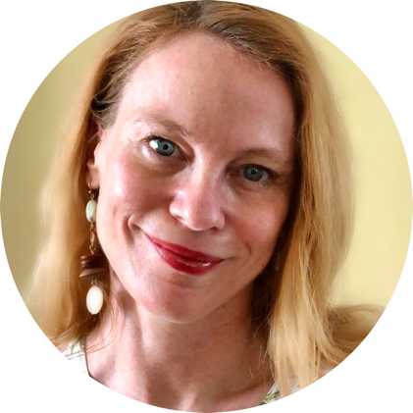
About the
presenters
Louise Mathias, Senior Partner, has over two decades of leadership experience in nonprofit and public entity fund development and organizational planning across multiple sectors, including healthcare, workforce development, education, community development, environmental conservation, housing, and more. Louise has extensive experience in all aspects of fund development, including federal grant writing and management. She has secured and managed funding from agencies such as SAMHSA, HRSA, DOL, USDA, CDC, and ACF, as well as numerous state agencies and private foundations. Her skill set spans the full grants lifecycle, from mission alignment and proposal development to post-award compliance and implementation.
.
3.
Louise Mathias
Senior Partner

Slide 5

About the
presenters
Brian Kelley, Ph.D., Senior Partner, is a widely published scientist and public health expert who supported his own research career through a variety of institutional, regional, and national grants. Dr. Kelley has worked in academia for over two decades and has served a variety of not-for-profit organizations and medical centers as a consultant to help create innovation and secure foundation, city, state, and federal funds to support biomedical research, education, prevention research, and workforce development. He has also served as a grant reviewer for several granting agencies. Dr. Kelley leverages the culmination of these experiences into an authentic and effective approach to grant development for community impact.
.
3.
Brian Kelley, Ph.D.
Senior Partner

Slide 6
What is the Grants Help Desk?
The Grants Help Desk provides technical support to eligible organizations that have questions about a funding opportunity to which they are considering applying, or questions that may arise during the grant development process. The goal is to help make grant applications more competitive and to improve the chances of securing funding outside of Dogwood. Support is provided by IFP.

Slide 7
Nonprofit or municipal government organizations that:
Received grant funding from Dogwood in 2023 – present and are in and serving within the Qualla Boundary and/or the 18 counties of Western North Carolina (Avery, Buncombe, Burke, Cherokee, Clay, Graham, Haywood, Henderson, Jackson, Macon, Madison, McDowell, Mitchell, Polk, Rutherford, Swain, Transylvania, and Yancey)
OR
Have not received grant funding from Dogwood Health Trust but are located in one of the 12 counties most impacted by Hurricane Helene (Buncombe, Yancey, Mitchell, Avery, Henderson, McDowell, Rutherford, Madison, Polk, Burke, Haywood, and Transylvania) and are seeking funding for hurricane relief and recovery efforts.
Have not received support from the Grants Help Desk within the last 30 days
Who is Eligible to Receive Support from the Grants Help Desk?

Slide 8
Eligible:
-Assessing the eligibility/competitiveness of a particular project for a specific grant opportunity
-Answering questions that arise during the grant development process (such as those related to the narrative, budget, forms, attachments, and submission to the funding agency/organization)
-Navigating the complexities of state, federal, and private foundation grant applications
-Guidance on grant management and post-award compliance
Not Eligible:
-Drafting a full narrative
-Creating the project budget, work plan, or logic model
-Performing a comprehensive search of funders that might support a project
What are examples of eligible requests for Grants Help Desk support?

Slide 9
Request a consultation by following this link.
Read more about the Grants Help Desk here.
How do we request Grants Help Desk support?

Slide 10
I. Understand the role of partnerships in strengthening organizational growth, sustainability, and competitiveness for grant funding
Notes:
.
These components illustrate the connection between your planned work and your intended results.
Visual representation, etc. purpose in sharing ,etc.
Start with identifying the impacts and outcomes (relationship to backwards design) then can select the activities

Slide 11
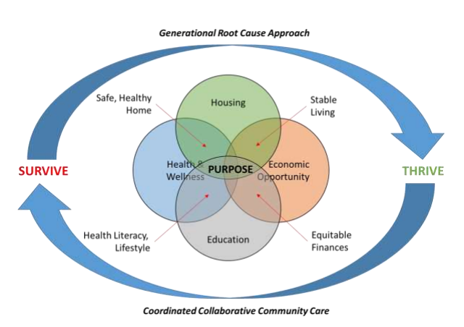
Why Partnerships are Important for Organizational Growth and Strategy
No single organization can be everything to everyone.
Organizations are most effective when they understand their strengths, focus on those areas, and partner with others whose expertise fills gaps.

Slide 12
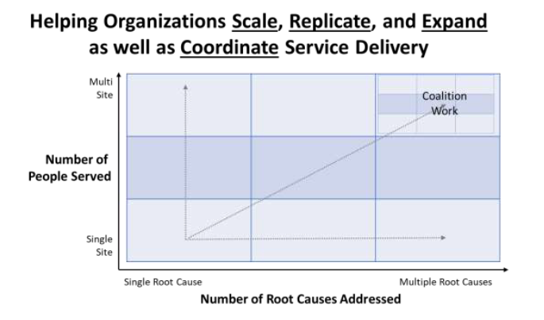
Why Partnerships are Important for Organizational Growth and Strategy
As organizations grow, they often face a choice: expand services internally or collaborate with partners.
Strategic partnerships increase impact without requiring every organization to build expertise in every area.

Slide 13








Most government and foundation funders will ask you to describe your partnerships in a grant narrative
Why Partnerships Matter to Funders

Slide 14

Why Partnerships Matter to Funders
  1. Partnerships demonstrate credibility and capacity—they show that other entities respect your work and attest to your organization’s ability to collaborate effectively.
Many government and large foundation funding opportunities have complex implementation requirements.
Being able to describe your past and current collaboration with partners speaks to your ability to manage large and/or complex projects.

Slide 15
Why Partnerships Matter to Funders
  2. Partnerships demonstrate your organization’s level of connection to/ engagement with the community you serve.
    They can achieve a “force multiplier” effect for your project—showing that you deeply understand the needs of your target population and have considered how other entities that also engage this population can be looped in to increase the positive impact of your project.

Slide 16
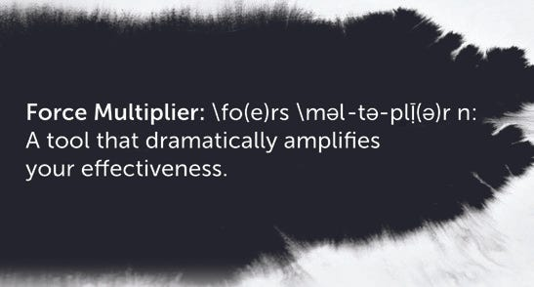
What is a Force Multiplier?

Slide 17

HOW DO WE GET THERE?
A Force Multiplier is a program, a policy, or an approach to a challenge that dramatically increases—or multiplies—effectiveness or impact.
For our discussion, force multiplication is primarily
about community engagement and capacity building.
Force Multipliers allow us the opportunity to exponentially change our environment by working together.
Notes:
When you are trying to reach those in the community to provide assistance, it may make more sense and may be far more efficient to employ the use of force multipliers rather than trying to reach out to each individual that has been affected. (Fema.gov)

Slide 18
Example 1.
    A youth mentoring program that has an established partnership with a behavioral health provider to enable connection to services for youth in need of behavioral health supports.
Mentoring AND Behavioral Health Treatment
for Youth Participants
(i.e., the partnership adds services)
Notes:
When you are trying to reach those in the community to provide assistance, it may make more sense and may be far more efficient to employ the use of force multipliers rather than trying to reach out to each individual that has been affected. (Fema.gov)

Slide 19
Example 2.
    A workforce development program that has an established partnership with a transportation provider to improve participants’ ability to successfully attend job training.
Wraparound Support for Participants
(i.e., the partnership makes services more effective)
Notes:
When you are trying to reach those in the community to provide assistance, it may make more sense and may be far more efficient to employ the use of force multipliers rather than trying to reach out to each individual that has been affected. (Fema.gov)

Slide 20
II. Developing familiarity with best practices for establishing effective partnerships for grant funding and beyond
Notes:
Developing a logic model at the beginning of program planning gives you a framework for charting the links between your program’s resources, activities, and outputs and its intended outcomes. It enables you to evaluate your program once it begins. And it helps you communicate to your stakeholders what you want to accomplish, how you intend to reach your goals, and how you will track your progress.
Logic models represent INTENTION; shows connection between the planned work and what you hope to achieve. THIS is informed by the theory of change.
These components illustrate the connection between your planned work and your intended results.
Visual representation, etc. purpose in sharing ,etc.
Start with identifying the impacts and outcomes (relationship to backwards design) then can select the activities

Slide 21
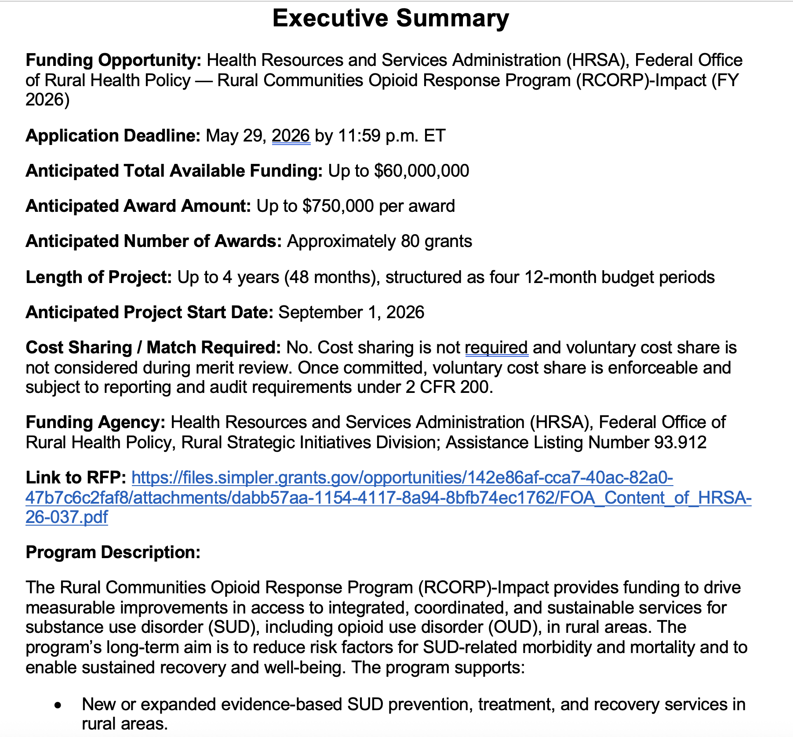
1. Build the groundwork for key partnerships prior to a grant opportunity when at all possible.
  If you need to make first contact for a specific grant opportunity, clearly explain to a potential partner how the grant would benefit their target population and/or their work.
  Send an Executive Summary of the Notice of Funding Opportunity (NOFO) so the potential partner doesn’t have to read the entire NOFO. Also, share your initial thoughts about roles and responsibilities.

Slide 22
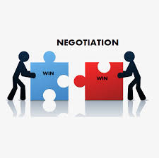
  After sending an Executive Summary, meet in person on over Zoom to discuss key aspects of the grant program and potential project design.
  Discuss the project budget and the partners’ needs during this first conversation. It’s critical to establish expectations early in terms of budget and whether/how much a potential partner would receive if the application is awarded.

Slide 23
2. For government opportunities in particular, read all of the “fine print” about required or recommended partnerships.
This may include a specific number of sectors represented, specific data-sharing requirements, and/or requirements around sharing grant funding
Example: Department of Labor Growth Opportunities for Re-Entry Youth
Applicants must have:
---a violence prevention partner with significant experience in culturally competent outreach to individuals with a high risk of committing violence to interrupt the cycle of violence; and
---regional or local justice system partners that collaborate with violence prevention partners

Slide 24
3. Take a Deliberate Approach to Developing a Budget
If a partner will be contributing staffing or services to the project, you will want to consider a fair allocation of the budget to support their involvement. Recommended steps:
Work with the partner(s) to map out who will be responsible for what. It can be very helpful to have developed a work plan and/or logic model of the project to help guide this meeting.
Have the partner(s) develop a budget for their scope of work.
Reconcile their proposed budget with your own and collaborate to best meet budget restrictions and all partners’ needs.

Slide 25
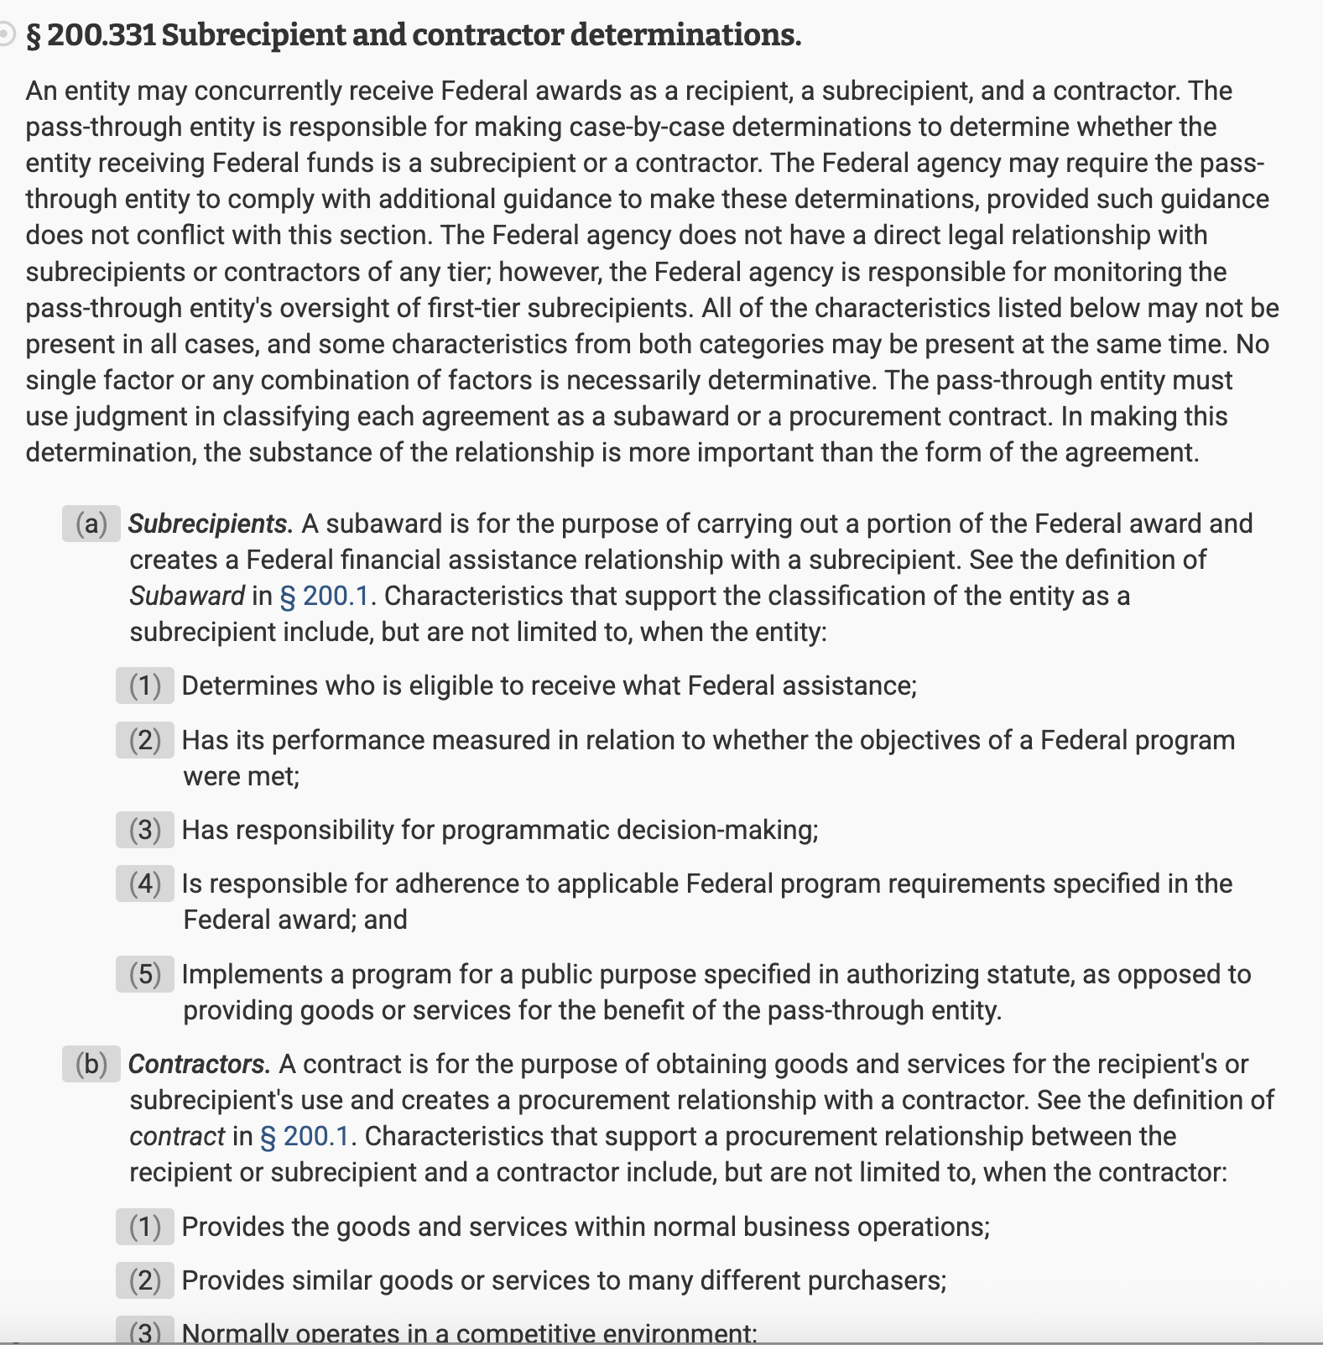
4. Understand the difference between “subaward” and “contract” status
This is an important distinction spelled out in the Uniform Guidance (linked here), which regulates federal grant awards.
Most government and foundation funders follow these guidelines.

Slide 26
    A subawardee helps design or carry out the project, makes programmatic decisions, is responsible for meeting grant objectives, may conduct research, outreach, training, or services central to the award. Subawardees must
      comply with many federal grant requirements, and
      may need to report performance and financial data.
    A contractor is used when purchasing goods or services for the recipient’s own use in carrying out the grant. The contractor:
      provides goods or services,
      operates in a competitive marketplace,
      is not responsible for the grant’s programmatic outcomes,
      is paid for deliverables, and
      generally is not subject to federal program compliance requirements.

Slide 27

    Example: A workforce development nonprofit is launching a new industry-recognized credential pathway program.
Partner 1 is a community college system that will develop and deliver the curriculum necessary for the coursework portion of the pathway. Participant cohorts will be completing coursework throughout the project period. Partner 1 is a subawardee.
Partner 2 is providing consultation to employer partners during the first four months of the project to help them develop modified on-the-job training strategies.
Partner 2 is a contractor.

Slide 28
5. Understand the difference between “Letter of Support,” “Letter of Commitment,” and “Memorandum of Understanding”
  Always defer to the language and definitions in each NOFO/RFA, as these terms are employed differently by different agencies/funders.
  Generally, a letter of support expresses a partner’s support of a project. A letter of support may include language that explains how a partner may be involved in the project’s activities, but it does not bind the partner to any specific actions.
  Generally, letters of commitment and memoranda of understanding are formal expressions of a partner’s involvement in a project. The partner commits to certain activities, roles, and responsibilities, and these are clearly defined in the LOC/MOU. These documents are not legally binding, but if they are retracted upon award, it would reflect poorly on the applicant.

Slide 29
6. Develop familiarity with post-award best practices for managing partnerships
Considering how partners will work together to implement a grant award is critical.
Upon award, develop written policies and procedures that outline expectations for implementation, tracking date, meeting, and reporting.
Train Staff: ensure partners are responsible for their team members’
understanding their roles and responsibilities.
Monitor Compliance: Decide on a meeting cadence (weekly,
monthly, quarterly) for regularly reviewing adherence to policies,
checking project progress, and addressing any challenges.

Slide 30

7. One Last Tip for Securing Strategic Partnerships for Grant Applications:
START EARLY!
  Our many years of experience have taught us that waiting on partner letters and commitments is often the #1 hold up when submitting grant applications.

Slide 31
III. Exploring Examples of Key Partnerships in Successful Government Grant Proposals
Notes:
.
These components illustrate the connection between your planned work and your intended results.
Visual representation, etc. purpose in sharing ,etc.
Start with identifying the impacts and outcomes (relationship to backwards design) then can select the activities

Slide 32
Example #1: Bureau of Justice Assistance Second Chance Act Improving Reentry Education and Employment Outcomes
Goal of the Grant Program:
Improve education attainment and employment outcomes for people in reentry to reduce recidivism.
  Objective 1: Implement strategies to increase educational or employment success for individuals currently incarcerated with 2 years or less before release into the community
  Objective 2: Create a career pathway system or a workforce development network that will implement opportunities for currently incarcerated people with 2 years or less before release into the community.
Notes:
Staffing:
Does your staff have the relevant qualifications?
Are there sufficient FTE allotments in the budget?
Do you need to hire anyone?
Scope: on slide
Timeline: on slide
Budget:
Are other funding sources secure? Can you meet the match requirement (if applicable)? Does your budget include adequate FTEs to carry out your scope of work?
Are your goals achievable given the amount of funding available via this opportunity and the larger project budget
No one wants to be the sole source of funding. What are your other sources? match, in-kind, other funders, etc.)?
External Factors:
“Risks and Challenges” question (HRSA). For example, many supply chain and logistics challenges arose during COVID. Challenges to procurement of equipment and materials. They will want to know that you have a plan for mitigating risks and external factors that could delay or threaten the project.

Slide 33
How Partnerships Strengthened This Application
  The lead applicant had 40 years of experience implementing a wide range of programs to help underserved communities achieve economic advancement. They had a demonstrated track record of successfully implementing and reporting on state grant funding.
  However, the lead applicant needed two partners to successfully achieve the specific objectives of the grant program:
  Partner 1 is deeply embedded within the target population and could utilize its established Community Health Worker model to implement the case management needed for the project
  Partner 2 is a Reentry Council that has access to local correctional facilities and is capable of sharing data on incarcerated individuals, a requirement of the project.

Slide 34
How Partnerships Translated to the Project Budget
  Partner 1 and Partner 2 are subawardees of this project because they are managing critical aspects of project implementation, are responsible for tracking and reporting data, and are integral to the day-to-day and overarching success of the project.

Slide 35
How Partnerships Strengthened This Application
  Summary: Although the lead applicant had proven organizational capacity to manage government funding and the resources to manage this project, it needed partners to mount a convincing argument that it could deeply engage the target population.

Slide 36

Example #2:
USDA Gus Schumacher Nutrition Incentive Program
GusNIP Large Scale Projects (FLSP)
FLSP are designed to create or support large-scale multi-county, territory, statewide, Tribal Nation, and regional incentive programs that increase the purchase of fruits and vegetables by SNAP/NAP participants by providing incentives at the point of purchase.

Slide 37
How Partnerships Strengthened This Application
  The lead applicant for this project is a food systems convener based in Buncombe County that is implementing a Double SNAP program at farmers markets in the area.
  Of the three project partners,
  Two are food systems conveners, each serving a target service area composed of counties not currently served by the lead applicant
  One is a marketing firm

Slide 38
How Partnerships Translated to the Project Budget
  The lead applicant had demonstrated experience implementing a Double SNAP program. They proposed expanding the program by partnering with two other organizations, each of which is deeply embedded in different multi-county service areas. The lead applicant will provide overarching management and technical assistance to the two partners to ensure they successful launch the Double SNAP program in their service areas.
  Therefore, the two food systems partners are subawardees.
  The marketing firm will develop all print and digital materials to advertise and explain the Double SNAP program. They are a contractor.

Slide 39

How Partnerships Strengthened This Application
  The subaward partnerships for this project made sense because they allowed the lead applicant to apply for a large-scale grant that comes with a higher award amount.
  The lead applicant received funding to continue to build out the program in their target service area while scaling the model to several new counties through subawards to the two partners.
  Ultimately, this grant award strengthened the regional food system’s ability to provide locally grown food to more residents across a range of income levels.

Slide 40
Example 3: HRSA Rural Communities Opioid Response Behavioral Health Services
Purpose of the Grant Program:
The Rural Communities Opioid Response Program (RCORP) is a multi-year initiative by the Health Resources and Services Administration (HRSA) aimed at reducing the morbidity and mortality of substance use disorder (SUD), including opioid use disorder (OUD), in high-risk rural communities. The purpose of this program is to advance RCORP’s overall goal by improving access to and quality of SUD and other behavioral health care services in rural communities.

Slide 41
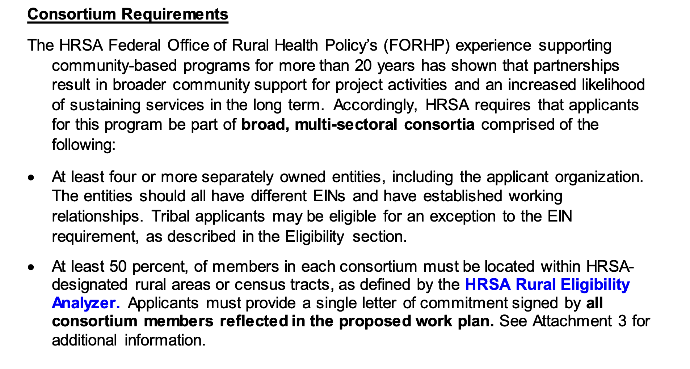
Consortium Requirements for this Opportunity

Slide 42
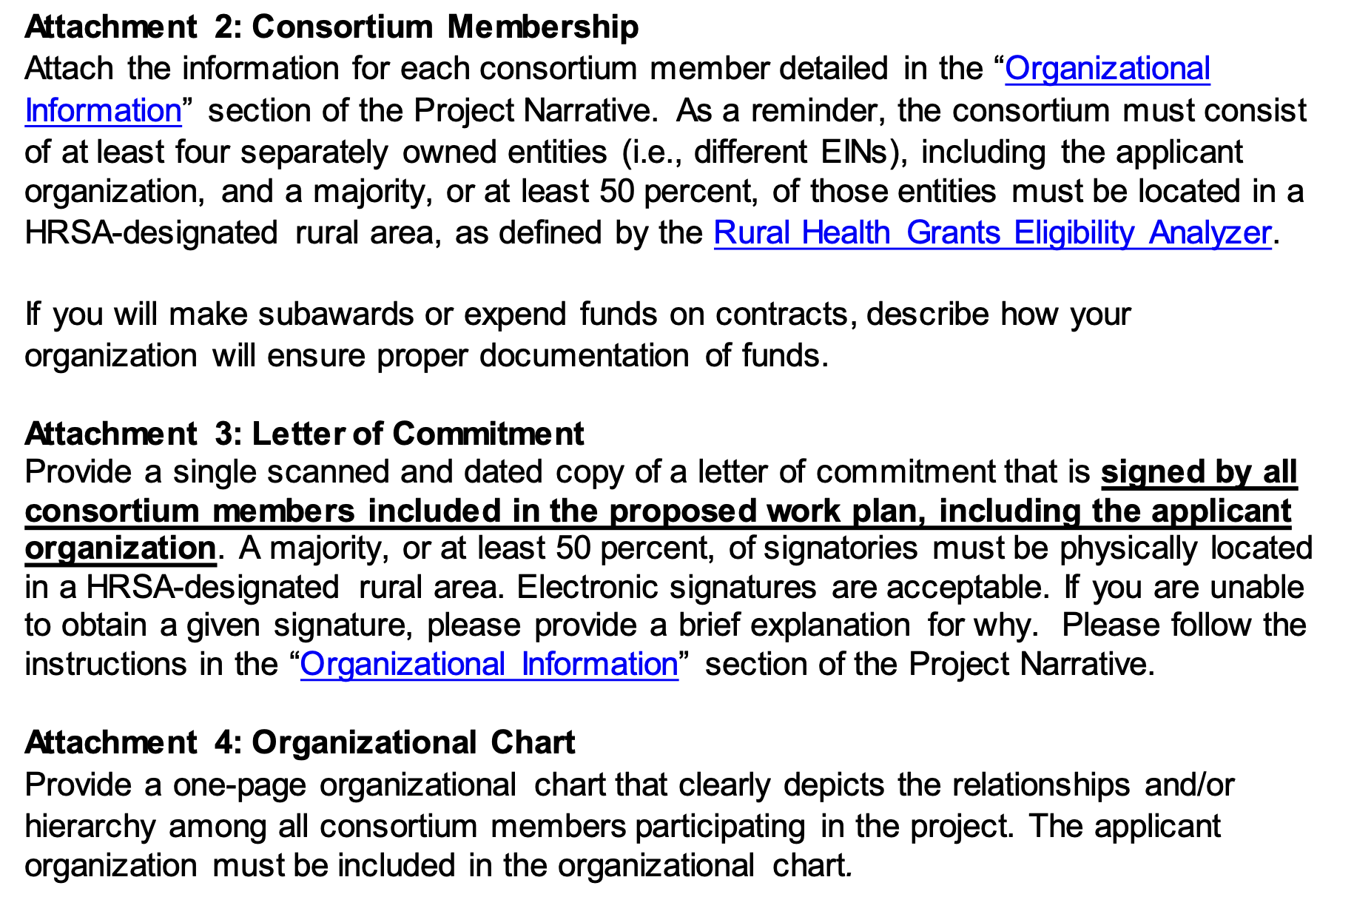
Partner-Related Attachments Required
This is not a letter of support. HRSA wants each partner to detail their role and specific responsibilities in a letter of commitment.
This chart needs to portray the hierarchy/ relationships between consortium members. You would want to identify the lead applicant as the entity with overarching responsibility for the project.

Slide 43
How Partnerships Strengthened This Application
This was an ambitious project led by a rural hospital applicant. They aimed to provide SUD/OUD and behavioral health services to the entire county population, with special focus on adolescents and incarcerated individuals. Therefore, the consortium partners represented:
  A rural hospital (lead)
  The county school system
  The Sheriff’s department
  A local faith-based nonprofit providing peer recovery support services
  Each of these partners was essential to being able to successfully engage the target population and provide high quality services.

Slide 44
How Partnerships Translated to the Project Budget
The consortium partners decided together that the full-time staff hired for this project (a Licensed Clinical Psychologist, a Behavioral Health Therapist, and a Care Coordinator) would be managed by and based at the lead applicant’s campus.
Although the school system and the Sheriff’s office wanted to actively participate in Consortium meetings, they did not want the responsibility of carrying out specific activities, whereas the nonprofit peer recovery support organization wanted to provide comprehensive recovery case management.
Therefore, the budget only included one subaward to the nonprofit peer recovery support partner, which became responsible for providing, managing, and reporting on recovery support for the project.

Slide 45
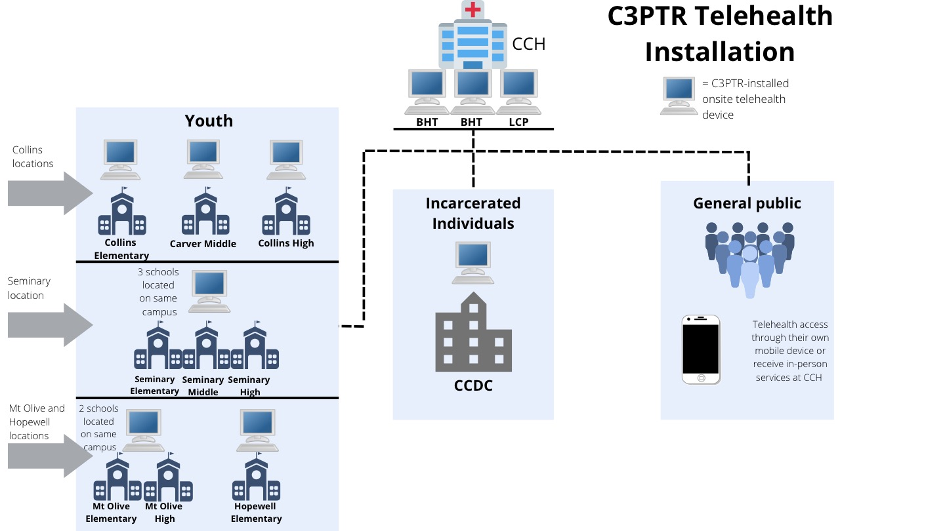
How Partnerships Achieved the Force Multiplier Effect
By engaging cross-sector partners, the lead applicant expanded the number and type of outcomes achievable through the project.
Without the active involvement of the school system or the Sheriff’s Office, the lead applicant would not have been able to demonstrate sufficient traction within the two targeted subpopulations.

Slide 46
Questions?
IFP Contact Information:
Louise Mathias, Senior Partner
Louise.mathias@innovativefundingpartners.com
(202) 809-3401
Dr. Brian Kelley, Senior Partner
Brian.Kelley@innovativefundingpartners.com
(202) 809-3399

Slide 47
dht.org

