Slide 1


Telling the Story of
Western North Carolina:
How to Write a Compelling Needs Section
September 9th, 2026

Slide 2

Learning Objectives
1. Understand the importance of storytelling as a factor distinguishing a winning proposal from a strong one
2. Explore unique elements and themes in WNC that have compelling narrative impact
3. Develop familiarity with sources for information and data that support these themes

Slide 3

About
Innovative Funding Partners
Innovative Funding Partners is a nationally recognized consulting firm that offers a range of services that improve our clients’ ability to achieve sustainable impact in their communities. Highly regarded for an impressive overall grant success rate of 85%, we offer turnkey grant writing and grants management, organizational planning (strategic, operational, sustainability), data-driven decision making and evaluation services, and training and technical support to a diverse client base of nonprofits, city and county governments, and small businesses/start-ups. Our team of over 30 highly experienced consultants has a wide range of subject matter expertise and is exceptionally passionate about helping organizations meet the unique needs of their local communities.

Slide 4

About the
presenters
Carrie Davis, Director of Client Services, has over two decades of experience in multiple areas of nonprofit fund development, including grant writing, grants management, strategic planning, sustainability planning, individual/major giving, and more. Carrie has successfully written foundation, corporate, and government grants to numerous federal agencies. Additionally, Carrie has experience supporting organizations with post-award grants management, including grant reporting (program and financial), submitting post-award amendments, and developing internal policies and controls for managing federal funding. Carrie holds a B.S. in Community Psychology from St. Cloud State University, a Certificate in Editing from the Poynter Institute, a Certificate in Post Award Grants Management from the Grant Professionals Association, and the Grant Professional Certification (GPC).
.
3.
Carrie Davis
Director of Client Services

Slide 5

About the
presenters
Susannah Williams, IFP Senior Grants Consultant, is a grant writer with a proven track record of securing federal and foundation grants across multiple sectors, including health care, workforce development, and education. She has extensive experience in supporting clients’ project design and development to meet complex grant requirements. Susannah has written multiple successful proposals for CDC, HRSA, DOE, DOJ, DOL, and USDA. Susannah holds a B.A. in Political Science from Loyola University Maryland and an M.A. in Political Science from The University of Chicago.
.
3.
Susannah Williams
Senior Grants Consultant

Slide 6
What is the Grants Help Desk?
The Grants Help Desk provides technical support to eligible organizations that have questions about a funding opportunity to which they are considering applying, or questions that may arise during the grant development process. The goal is to help make grant applications more competitive and to improve the chances of securing funding outside of Dogwood. Support is provided by IFP.

Slide 7
Nonprofit or municipal government organizations that:
Received grant funding from Dogwood in 2023 – present and are in and serving within the Qualla Boundary and/or the 18 counties of Western North Carolina (Avery, Buncombe, Burke, Cherokee, Clay, Graham, Haywood, Henderson, Jackson, Macon, Madison, McDowell, Mitchell, Polk, Rutherford, Swain, Transylvania, and Yancey)
OR
Have not received grant funding from Dogwood Health Trust but are located in one of the 12 counties most impacted by Hurricane Helene (Buncombe, Yancey, Mitchell, Avery, Henderson, McDowell, Rutherford, Madison, Polk, Burke, Haywood, and Transylvania) and are seeking funding for hurricane relief and recovery efforts.
Have not received support from the Grants Help Desk within the last 30 days
Who is Eligible to Receive Support from the Grants Help Desk?

Slide 8
Eligible:
-Assessing the eligibility/competitiveness of a particular project for a specific grant opportunity
-Answering questions that arise during the grant development process (such as those related to the narrative, budget, forms, attachments, and submission to the funding agency/organization)
-Navigating the complexities of state, federal, and private foundation grant applications
-Guidance on grant management and post-award compliance
Not Eligible:
-Drafting a full narrative
-Creating the project budget, work plan, or logic model
-Performing a comprehensive search of funders that might support a project
What are examples of eligible requests for Grants Help Desk support?

Slide 9
Request a consultation by following this link.
Read more about the Grants Help Desk here.
How do we request Grants Help Desk support?

Slide 10
I. The importance of storytelling in crafting a winning proposal
Notes:
.
These components illustrate the connection between your planned work and your intended results.
Visual representation, etc. purpose in sharing ,etc.
Start with identifying the impacts and outcomes (relationship to backwards design) then can select the activities

Slide 11
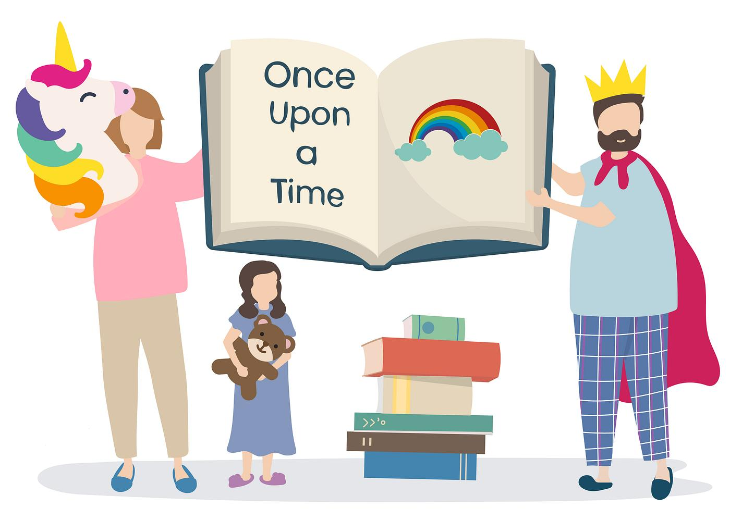
Why Use Storytelling in Grant Proposals?
Organizations must set themselves apart from the rest, especially for potential new funders.
Storytelling creates compelling narratives by bridging logic and emotion.
Most effective in foundation grant proposals, but can be part of government grants too.
A strong story makes your proposal memorable.
When people listen to stories, it releases oxytocin in the brain—the ”feel good” hormone—which increases trust, generosity, and likability.
Convey a community’s unique elements and needs.

Slide 12

The role of the STORY in Foundation Proposals
Grant proposals must inform and inspire.
Remember that you are writing for a real person. Use a more conversational tone.
The reviewers will likely forget facts and figures no matter how impressive they are.
Start with a strong hook; embed the storyline throughout your proposal; highlight how the target population’s story will change if the program is funded.
Use vivid real-life examples, imagery, and powerful quotes, etc.
Align your story with the funder’s values and priorities.
Remember, you are not just asking for money but inviting funders to become part of something meaningful.

Slide 13

The role of the STORY in Government Proposals
A competitive government grant proposals tells a story through data and outcomes.
Reviewers must understand the problem, your solution, and the impact.
A strong Needs section lays out the facts in a logical, convincing way rather than appealing to emotion.
The implementation plan shows and describes how your proposed program will address the community need.
A good story is secondary to fulfilling ALL requirements in the manner prescribed by the agency.
Most scoring criteria is not connected to the story but to the completeness of your responses.

Slide 14

Why Storytelling Matters in Grant Writing
Can significantly enhance the effectiveness of your proposal.
Funders are looking for proposals that convey a clear, engaging, and emotionally resonant narrative.
Storytelling captures the attention of funders and humanizes the proposal and the program.
Stories can help foster a deep connection – increases your chances of funding.
Storytelling also builds trust (sharing success stories or testimonials can help to demonstrate your organization’s capacity and track record).

Slide 15
II. Unique elements and themes in WNC that have compelling narrative impact
Notes:
.
These components illustrate the connection between your planned work and your intended results.
Visual representation, etc. purpose in sharing ,etc.
Start with identifying the impacts and outcomes (relationship to backwards design) then can select the activities

Slide 16
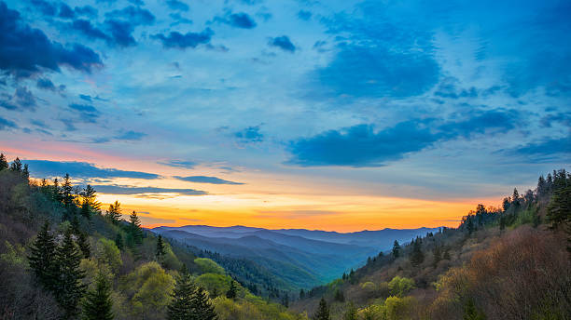
Why Western North Carolina?
When you are developing a grant proposal, keep in mind that the person reading it may have no knowledge or frame of reference for WNC. This is especially true when applying to out-of-state foundations or federal grants. However, even for state or regional funders, the person reading the application may not be well-versed on the region’s background.
“Painting a picture” of the region and your work within it provide a critical opportunity to stand out in the reviewer’s mind.

Slide 17
1. Geographical Context
Where people live in Western North Carolina shapes how they live, and therefore influences the solutions grant proposals need to describe.
Although it is important to emphasize the rural, mountainous characteristics of WNC, try to be even more specific when describing your particular location. This will help a grant reviewer develop a “mental map” of the service area.
Examples of monikers/descriptors:
“Land of the Sky” — Asheville / broader WNC
“The High Country” — Boone, Blowing Rock, Banner Elk and northwest NC
“Land of Waterfalls”— Transylvania County / Brevard
“Gem Capital of the World” — Franklin / Macon County
“Cradle of Forestry” — Pisgah Forest / Transylvania County
“Gateway to the Smokies” — Waynesville / Haywood County

Slide 18

Geographical Context
Include unique details about your service area’s geography to further distinguish the project. Consider mentioning:
Driving time to schools, hospitals, employment agencies
Number of bridges between point A and point B
Elevation
Unique topographical features
If a significant portion of residents travel to other counties for work

Slide 19
Geographical Context
Example: A healthcare project in Highlands/Cashiers
The target population of this project is all residents of the Plateau of Western North Carolina (herein referred to as the Plateau), and surrounding communities in Macon County and Jackson County, North Carolina. The Plateau is a flat upland that stretches through Macon and Jackson counties, 18 miles east to west and 12 miles north to south. Bordered by the Blue Ridge Mountains, the Plateau boasts an average elevation of 4,118 feet. The Plateau is primarily comprised of the townships of Highlands and Cashiers, which are located in Macon County, NC, and Jackson County, NC, respectively.
Importantly, this project’s target population is unique in that its size changes significantly depending on the time of year, due to the Plateau’s status as both a tourist attraction and a secondary-residence for individuals whose primary residence is in Florida, Georgia, and South Carolina. From November through May, which is considered the off-season, the target population’s number will remain as described above, reflecting a total of approximately 8,000 people. However, from June to October, which is considered the season, the combination of tourists, secondary-residence owners, and increased workforce to support the tourism and travel economy result in a significant larger total population of approximately 40,000.
Historically, health care for year-round and part-time residents on The Plateau was delivered first by a private, not-for-profit hospital, Highlands Cashiers Hospital, and then by a large not-for-profit healthcare system, Mission Health. In 2019, however, Hospital Corporation of America (HCA) bought Mission Health and all affiliate hospitals and primary care practices. During the first year of the transition, Highlands and Cashiers lost four of six primary care physicians, none of whom have been replaced. This has resulted in a true health care crisis for the Plateau, which currently has only two primary care physicians serving an estimated 8,000 people from November through May, and an estimated 40,000 people from June through October.

Slide 20
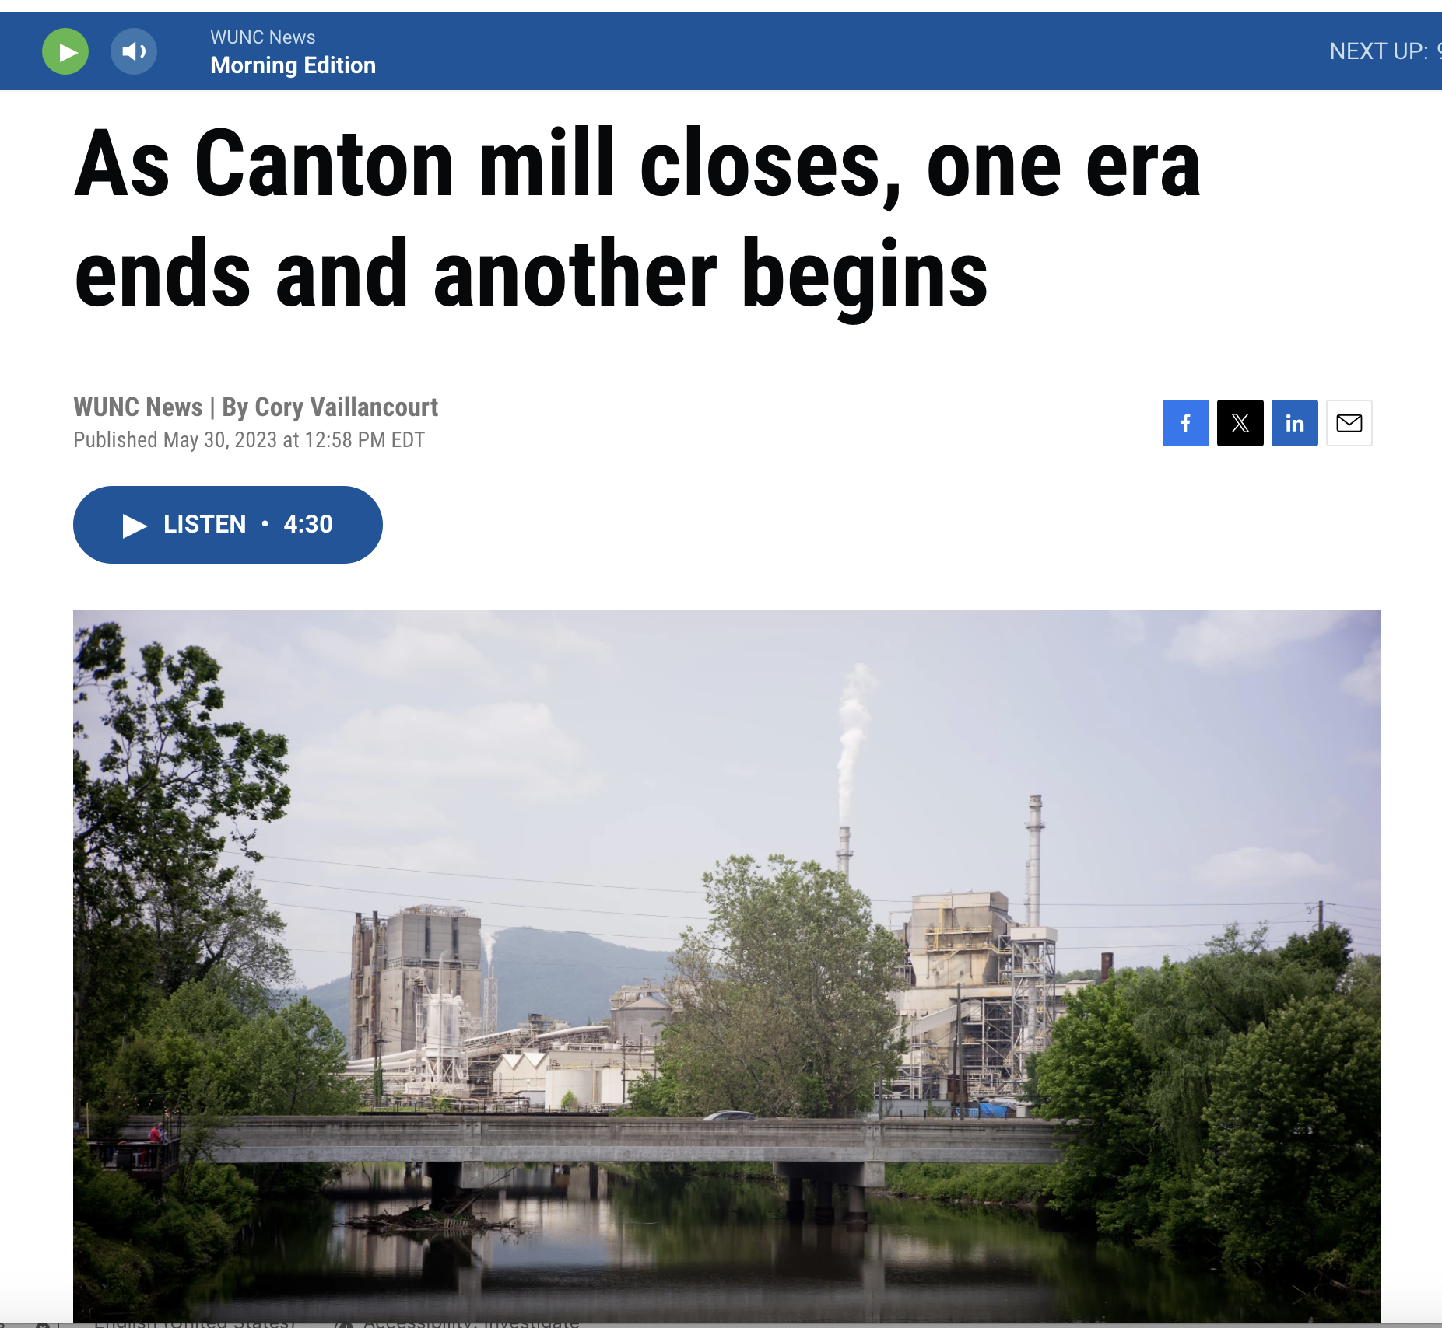
2. Economic Context
For generations, Western North Carolina's economy was built around the land—and natural resource-driven jobs. Over the last 75 years, that economy has shifted dramatically, contributing to widespread health, social, and economic disparities across the region.
.

Slide 21
Economic Context
A. Tobacco farming
The federal tobacco buyout beginning in 2004 ended the region's dependence on tobacco.
Western NC had approximately 7,000–8,000 acres of burley tobacco before 2004; by the early 2020s, only a few hundred acres remained statewide.
The impact was particularly significant in the “NC burley belt”—including Ashe, Alleghany, Avery, Buncombe, Haywood, Madison, Mitchell, Watauga, and Yancey counties.
The Story: An agricultural economy lost one of its most dependable sources of cash income.
B. Textiles filled the gap in North Carolina’s transition from an agricultural economy to a manufacturing economy. However, the rise of globalization, automation, and outsourcing in the 1990s devastated the industry.
Statewide, textile employment fell 85% between 1993 and 2022.
In Western NC, entire communities developed around textile and apparel plants. In the 2000s, manufacturing employment fell dramatically, with outsourcing overseas cited as a primary factor.
The Story: When the mill closed, our community lost its economic anchor.
.

Slide 22
Economic Context
C. Furniture manufacturing was especially important in the broader western/foothills economy, with manufacturing centers extending through places such as Hickory, Marion, Morganton, and Mount Airy.
Between 1993 and 2022, North Carolina furniture employment declined nearly 60% as production moved overseas.
The Story: A region that had turned its forests into furniture—and built entire communities around that industry—lost much of that manufacturing base.
D. Extractive industries
Historically, the region's forests supplied lumber, furniture manufacturers, paper mills and other industries. Over time, mechanization reduced labor needs; manufacturing moved elsewhere; and changing forest-management practices altered the industry.
Mica, feldspar, copper, iron, gold, and other mineral extraction in Western North Carolina also gradually declined in the second half of the 20th century.
The Story: In communities where extractive industries buoyed the economy, residents had to transition from utilizing natural resources to increased tourism and recreation to visit these natural resources.
.

Slide 23
Economic Context: Why Does it Matter?
A mountain community that lost its textile mill, tobacco farms, furniture plant, or mine is not starting from the same place as a rapidly growing community along the I-26 corridor.
Understanding that history helps a funder understand why today's poverty, workforce challenges, educational needs, housing shortages, and health disparities look the way they do.

Slide 24
Economic Context
Example: Proposal for HRSA Rural Health Network Development Planning Application
Transylvania County is a HRSA-designated fully rural community in the Blue Ridge Region of the southern Appalachians. Often called the “Land of Waterfalls,” Pisgah National Forest comprises 60% of the county’s acreage. Significant cultural shifts characteristic of much of the Appalachian region have impacted substance use in the county. Forested terrain historically attracted resource-based industries, requiring a large manual workforce. As economies shifted, these jobs disappeared, resulting in a lack of long-term secure employment opportunities for younger residents. Older, laid-off workers face low incomes and significant physical pain, resulting in Transylvania County having one of the highest opioid dispensing rates in the state.

Slide 25
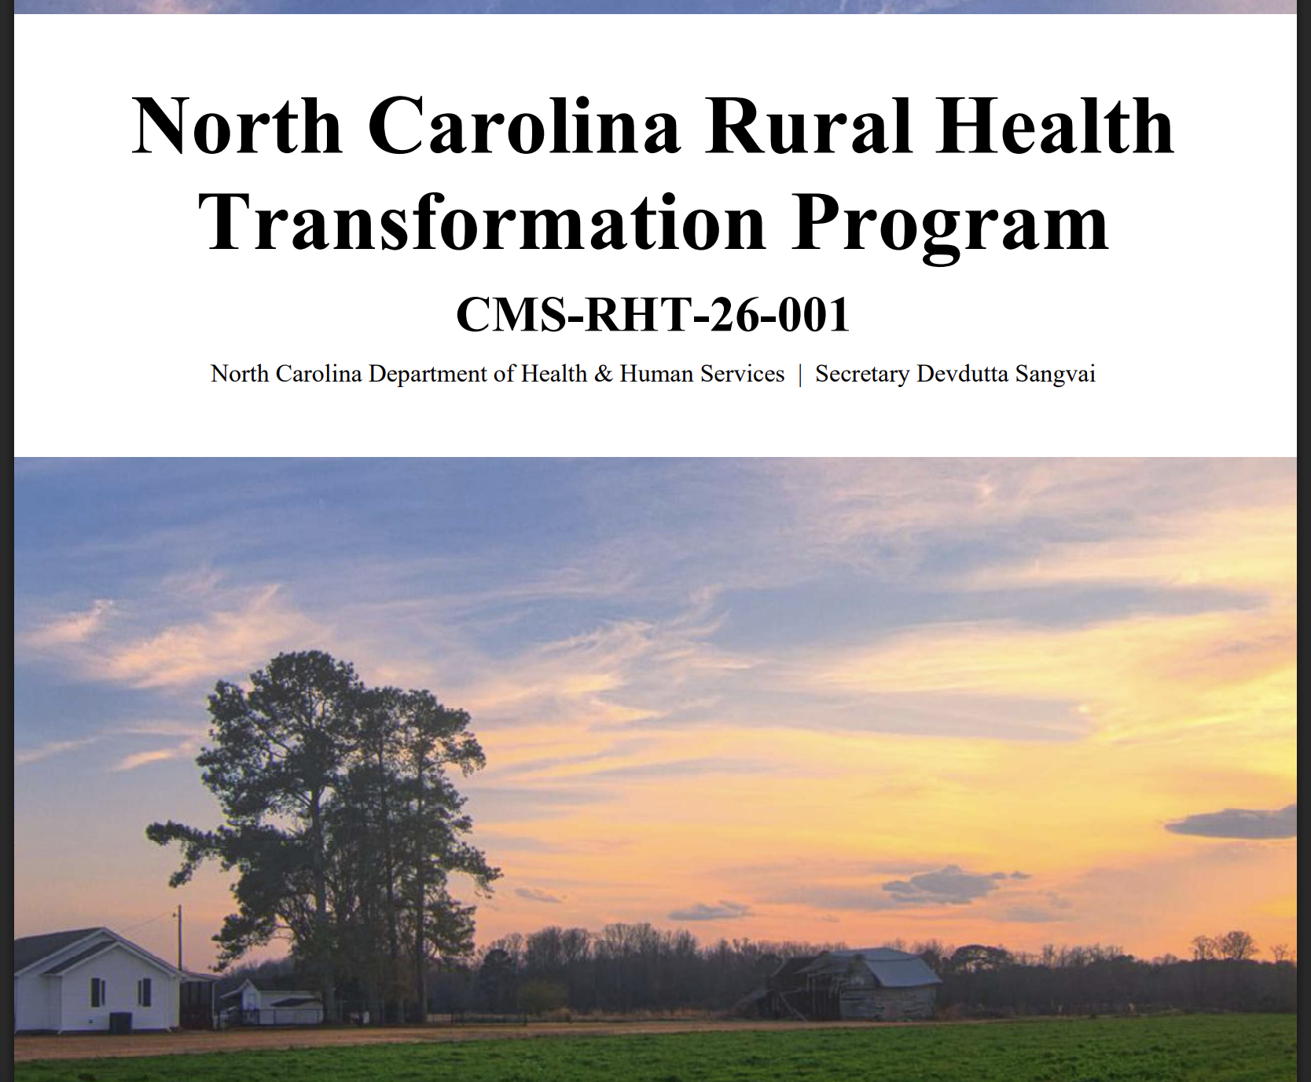
3. Health and Well Being Context
Western North Carolina’s predominantly rural, mountainous geography creates significant barriers to health and well-being:
The terrain can make routine, specialty, emergency, and behavioral health care difficult to access.
The region faces a persistent shortage of health professionals. All 18 WNC counties are designated primary-care Health Professional Shortage Areas, while some counties have no practicing psychiatrists or OB/GYNs.
Rural hospitals are financially vulnerable; hospital closures or conversions can force residents to travel even farther for care.
NC Department of Health and Human Services recognizes the disparities in access to care and health outcomes among residents of rural areas like those across WNC. Its NC Rural Health Transformation Program (NCRHTP) is an attempt to move rural health care in North Carolina toward more integrated, community-based systems of care.

Slide 26
Health and Well Being Context: Why Does it Matter?
Health outcomes in WNC vary dramatically from county to county—and access to care is only part of the story.
10 years
The gap between life expectancy in Swain County (67.2) and the NC average (77.1)
14%
of WNC adults report diagnosed diabetes, compared to 11.8% across NC
37.5%
of Indigenous adults in WNC report diagnosed diabetes
39%
Increase in poor mental health across WNC between 2012-2024
46.5%
of WNC residents surveyed in 2024 said substance use had negatively affected their lives.
When writing a grant proposal, it is critical to explain the depth of these disparities, especially when certain subpopulations (children, incarcerated persons, those marginalized by race/ethnicity) shoulder their burden disproportionately.

Slide 27
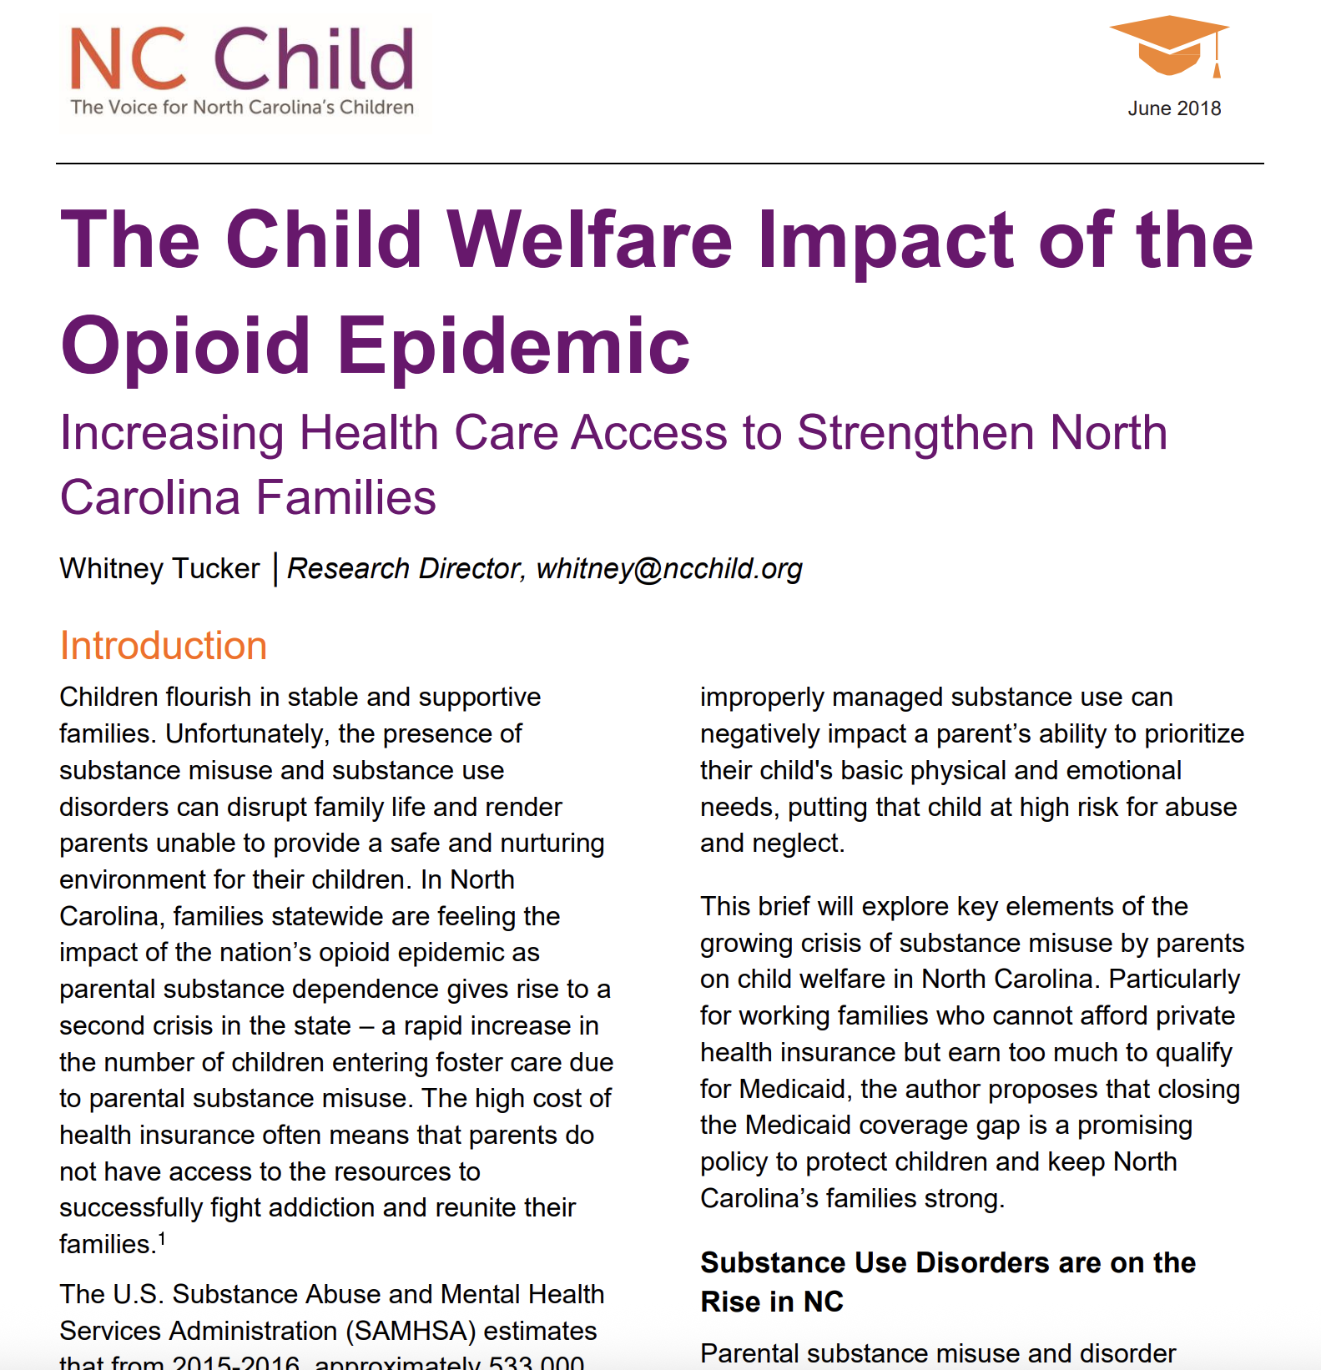
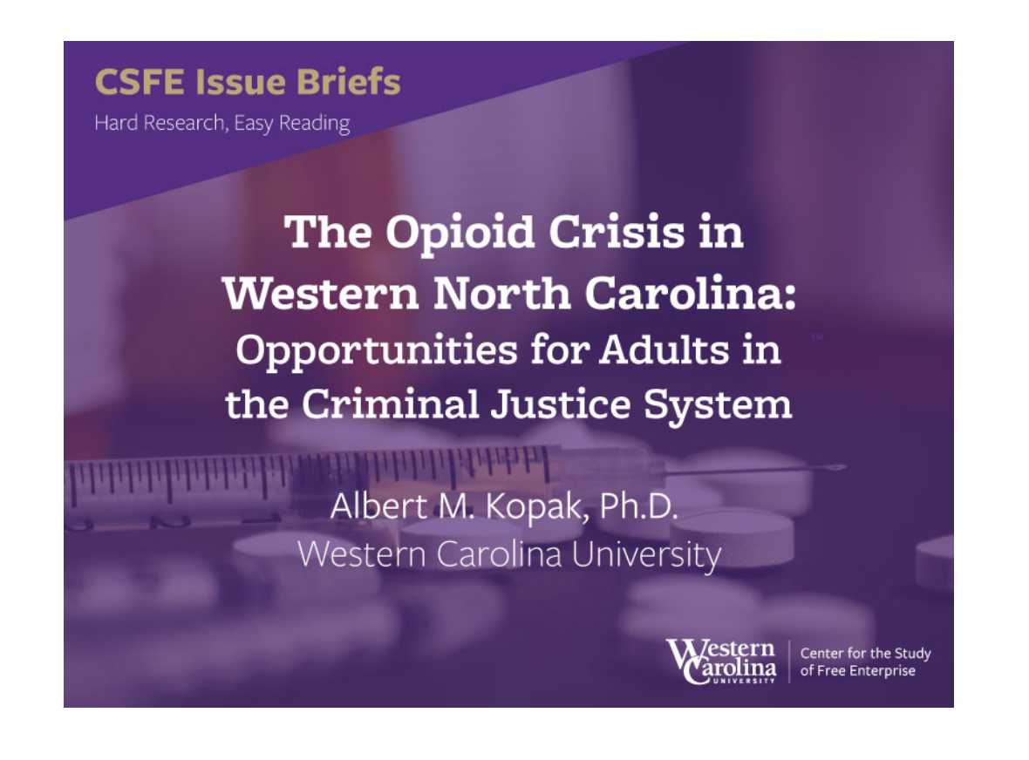
Health and Well Being: The Opioid Crisis
“Opioid-related overdoses remain a primary concern for communities in western North Carolina, but they fail to capture the full extent of the epidemic…”
--Dr. Albert Kopak, Western North Carolina University
As part of the Appalachian region, a hotspot of the national opioid crisis, WNC was hit particularly hard. Some of the region’s counties’ overdose rates were among the highest in the state during the peak of the crisis.
As the impact of the crisis extended well beyond people who overdosed, it is critical to communicate its cascading effects when developing a grant proposal. The epidemic affected families, children, foster care, schools, employers, hospitals, the criminal justice system, and the social fabric of communities.

Slide 28
Health and Well Being: The Opioid Crisis
Example from a SAMHSA application from Madison County:
It is well-established that areas in rural Appalachia have been disproportionately impacted by opioid use; Madison County is no exception. Consequences of OUD peaked for the county in 2015, when the rate of drug overdose deaths per 100,000 was 37.8, compared to 15.6 at the state level. Multiple federal, state, and local initiatives to address OUD helped bring the county’s rate down to 4.6 in 2018. Since then, however, rates have rebounded, reaching a new peak of 46 overdose deaths per 100,000 in 2020, compared to 31.5 across the state. Holler Harm Reduction, an organization based in Madison County, received reports of at least 5 deaths due to opioid overdose and 150 overdose reversals for opioid use in 2022; and at least 2 deaths so far in 2023. Despite this documented prevalence, there was no OUD treatment available locally until July 2019.
Schalkoff, C. A., Lancaster, K. E., Gaynes, B. N., Wang, V., Pence, B. W., Miller, W. C., & Go, V. F. (2020). The opioid and related drug epidemics in rural Appalachia: A systematic review of populations affected, risk factors, and infectious diseases. Substance abuse, 41(1), 35–69. https://doi.org/10.1080/08897077.2019.1635555
NC Opioid Action Plan Dashboard. (2022). Metrics. [Data charts]. Available from https://www.ncdhhs.gov/about/department-initiatives/opioid-epidemic/opioid-action-plan-data-dashboard

Slide 29
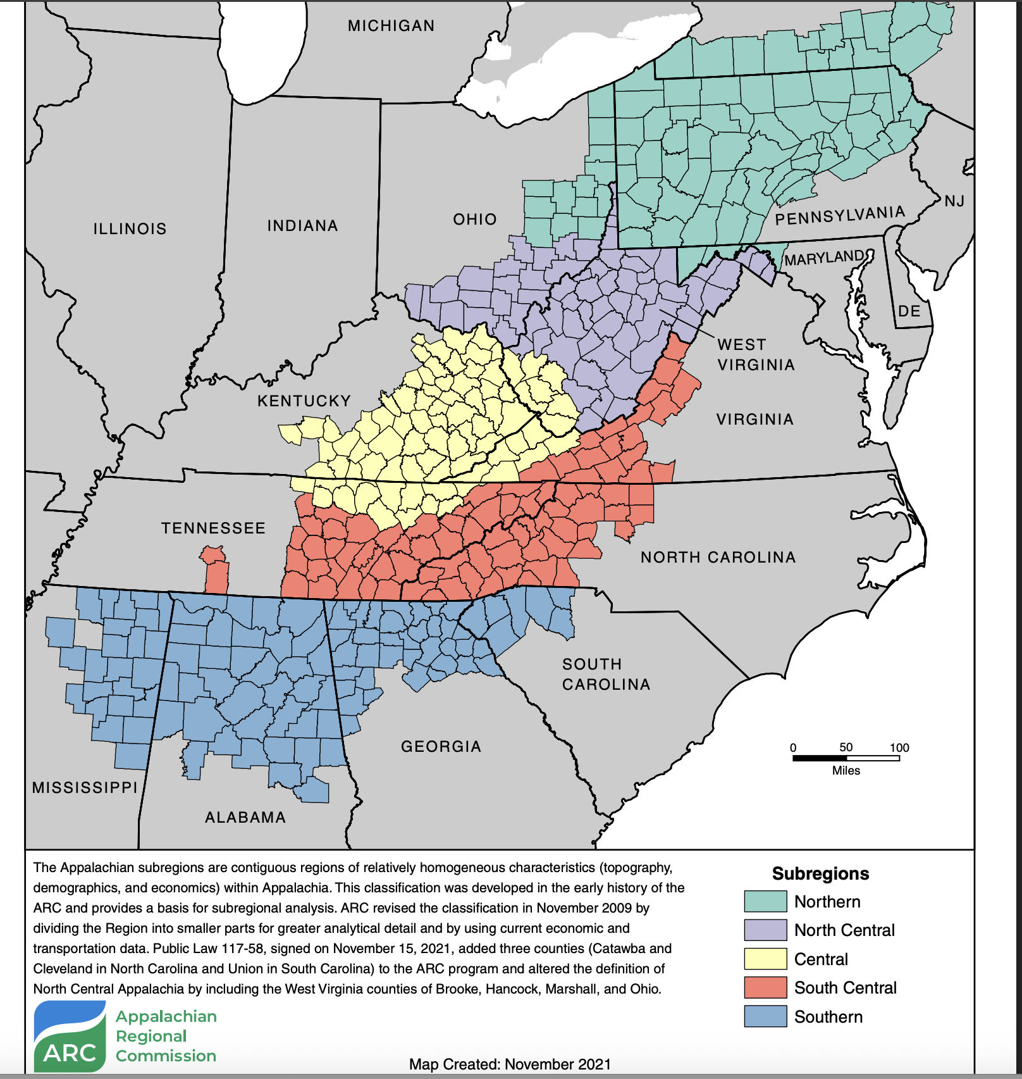
4. Appalachian Cultural Context
In IFP’s years of experience developing grant proposals with organizations in Western North Carolina, we have found discussing the Appalachian cultural context to be a key factor in winning proposals.
Discussing the ways that Appalachian culture influences the resilience and hardships of WNC residents is an incredibly impactful way of bringing your work and your target population to life for a reviewer.

Slide 30
Appalachian Cultural Context
Examples of how Appalachian culture may influence work across sectors:
Appalachian culture tends to be more relational than contractual. That is, whether one feels treated with courtesy and respect moment to moment is more highly valued than the expertise, status, or authority of the outside professional or promised benefits of the program that the outsider proposes.
Being “down to earth” and authentic is more greatly valued than being an expert with credentials.
Caution should be exercised to avoid over-medicalizing social suffering. The question, "What happened to you?," is often more the issue than, "What is wrong with you?"
Traditional Appalachian families have strong boundaries around them, which can be deceptive for outsiders (including healthcare workers) who mistake hospitality for friendship.
Because of the years of external exploitation and stereotyping, Appalachians are slow to tell outsiders about family business. Non-intrusiveness is an expression of respect.
Due to the high rates of trauma and exposure to adverse events through the life cycle, many people consider these events part of life but still exhibit symptoms of trauma-related disorders. Corporal punishment of children and even domestic violence may be considered normative or, sometimes, justifiable according to Biblical scriptures.
See: American Psychiatric Association’s “Working with Appalachian Patients.”

Slide 31
Appalachian Cultural Context
Considerations for incorporating these discussions into a grant proposal:
Because Appalachian culture reinforces distrust of “outsiders,” if your organization is led by long-time residents of the area who have formed deep relationships of trust with your community, emphasize that.
If you will partner with other deeply rooted community organizations, such as churches, discuss how these partnerships will help with engaging your target population.
Explicitly discuss ways in which you have engaged the local population in project planning, implementation, and/or evaluation, and describe this as a strategy to circumvent distrust and “keeping to oneself” in the culture.

Slide 32
Appalachian Cultural Context
Example of weaving in this discussion in proposals:
A significant number of residents have high adverse childhood experience scores (ACEs) (21.2%), which can have long-term effects on mental health; moreover, research shows both ACEs and behavioral health issues are likely underreported in this population, as Appalachian communities typically demonstrate high rates of trauma over the life cycle, thus forming a perception that trauma is just “part of life.” Despite these marked behavioral health needs, there is only one provider of behavioral health services for the entire county. The provider does not accept all forms of insurance and often has a waitlist.
Access to opioid use disorder and behavioral health treatment is further impeded by barriers common in Southern Appalachia, including limited transportation and internet access, and compounded by prevailing Appalachian cultural norms. The people of Appalachia often view mental health services as something that can be dealt with individually.^{xi} “I’ll take care of myself” is a common sentiment in XXXXX County. There is a “lack of trust in health care professionals,” which “underscores the need for community-based initiatives to repair trust.”^{xii}

Slide 33
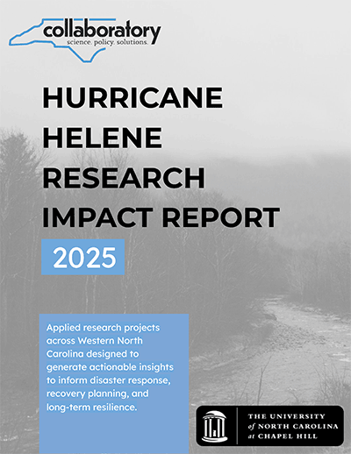
5. Hurricane Helene Context
Given the catastrophic impact of Hurricane Helene, all grant proposals should reference the effects on their target populations, and how long-term recovery will impact an organization’s work.
Consider discussing the impact of:
Severe damage to transportation infrastructure in a rural region
Disruptions in school schedules on students’ stability and academic outcomes
Economic disruptions, including workforce challenges and lost revenue
A traumatic event on behavioral health and substance use

Slide 34
Hurricane Helene Context
Example of discussing impact in a SAMHSA proposal:
Children and adolescents in the service area are recovering from a disaster that disrupted their homes, education, family stability, and sense of safety. Hurricane Helene struck Western North Carolina on September 27, 2024, causing catastrophic flooding, landslides, road failures, utility outages, and widespread damage throughout both counties. In XXX County, XXX Elementary School was damaged beyond continued use, students experienced prolonged changes in school placement and transportation, and the number of students identified as homeless increased from 21 during the 2023–2024 school year to 112 during the following school year.
The disaster’s behavioral health effects have persisted well beyond the initial emergency. A post-Helene community assessment conducted in rural western North Carolina found that more than 40% of surveyed households reported new or worsening anxiety, approximately 30% reported depression and difficulty sleeping, and nearly 60% remained worried that another disaster would affect their home. These effects are especially concerning because children did not experience Helene as an isolated event. The disaster compounded preexisting adverse childhood experiences, family instability, caregiver behavioral health needs, parental substanc euse, and economic hardship.

Slide 35
III. Sources for information and data that support these themes
Notes:
.
These components illustrate the connection between your planned work and your intended results.
Visual representation, etc. purpose in sharing ,etc.
Start with identifying the impacts and outcomes (relationship to backwards design) then can select the activities

Slide 36
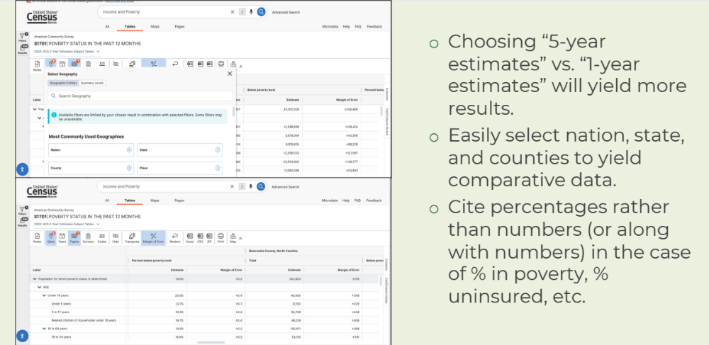
Data.census.gov for demographics, educational attainment, household income and poverty

Slide 37
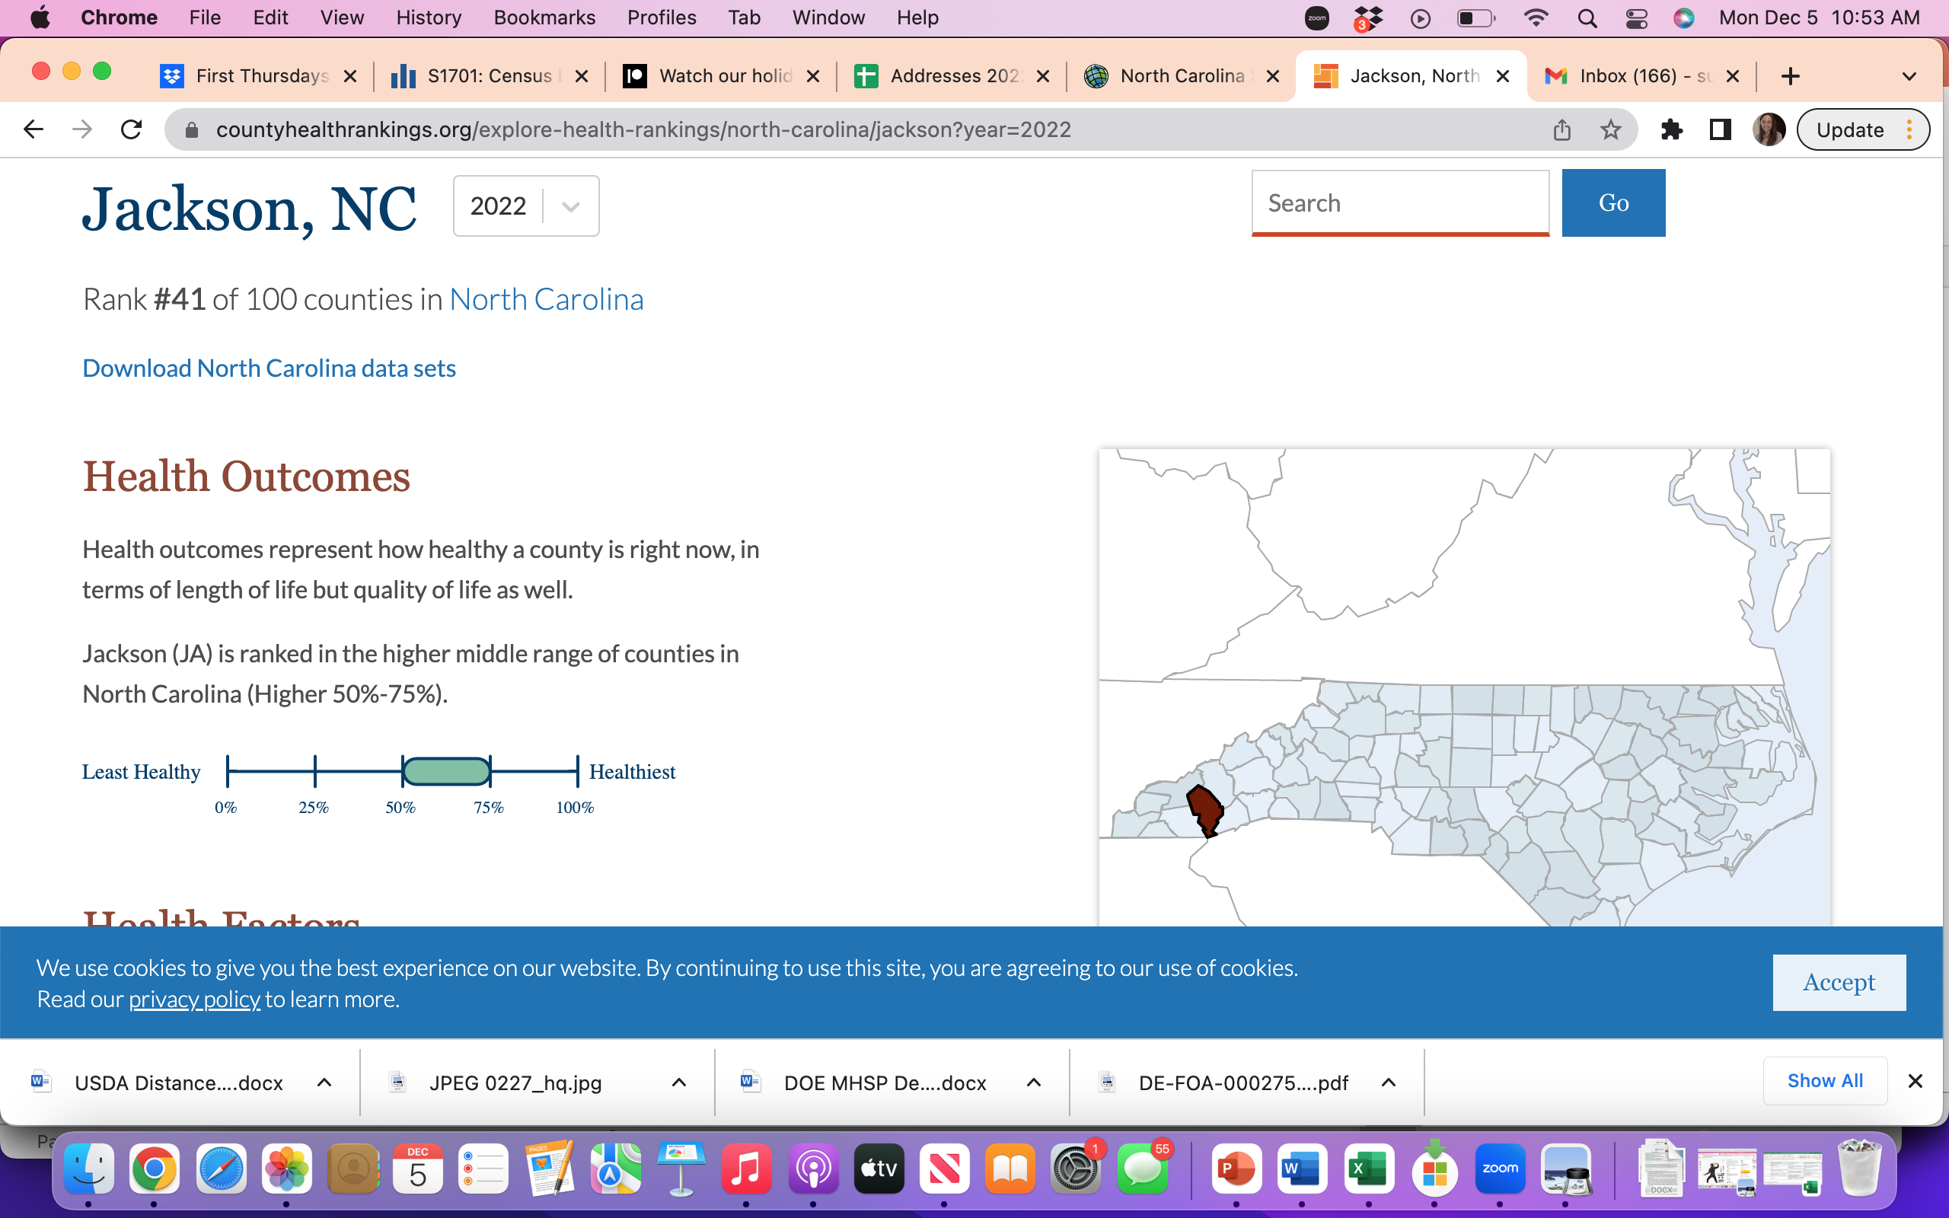

A Key Source for Wide Range of County-Level Indicators: County Health Rankings and Roadmaps
https://www.countyhealthrankings.org/

Slide 38

Key Data Source: WNC Health Network
WNC Health Network collects and curates high-quality regional data to achieve its mission of supporting people and organizations to improve community health and well-being across WNC.
Since 2011, WNC Health Network has collected and provided foundational data for local and regional community health efforts, including:
  Primary Data: WNC Healthy Impact Community Health Survey and WNC Healthy Impact Key Informant Survey
  Secondary Data: Demographic, economic, and social characteristics of the region and morbidity and mortality data
  Maps
  2-1-1 Resource Lists

Slide 39
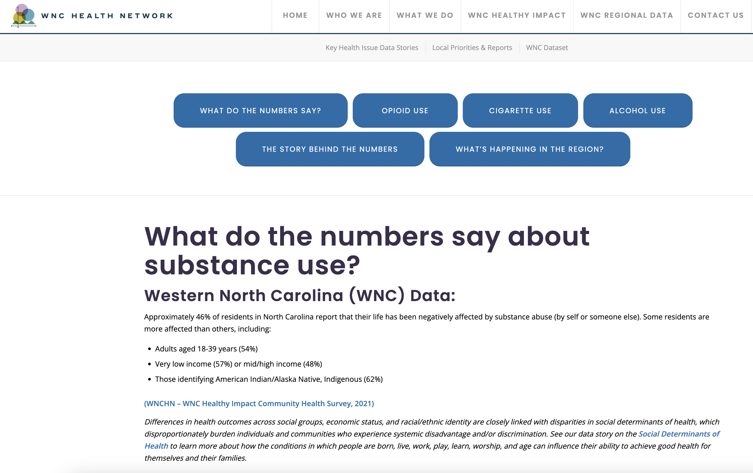
Key Data Source: WNC Health Network
The WNC Health Network site provides a wealth of information on the unique challenges facing WNC, including:
Data stories on key health issues
Access to the publicly available WNC Dataset (in Excel workbook format), for researching 279 indicators across the 18-county region

Slide 40
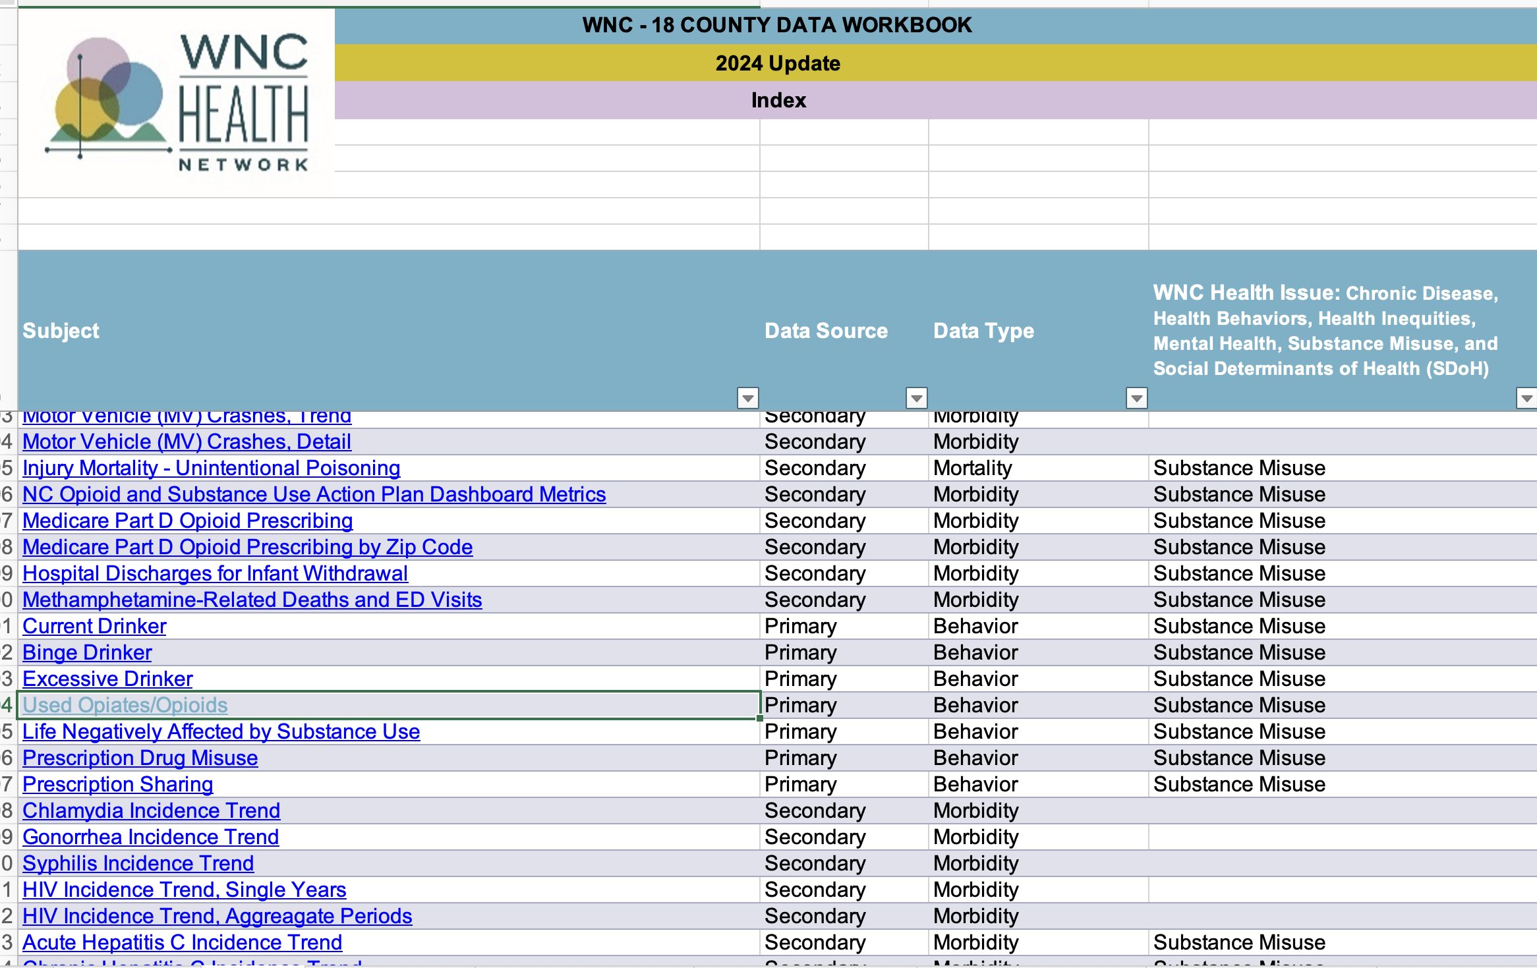
Key Data Source: WNC Health Network

Slide 41
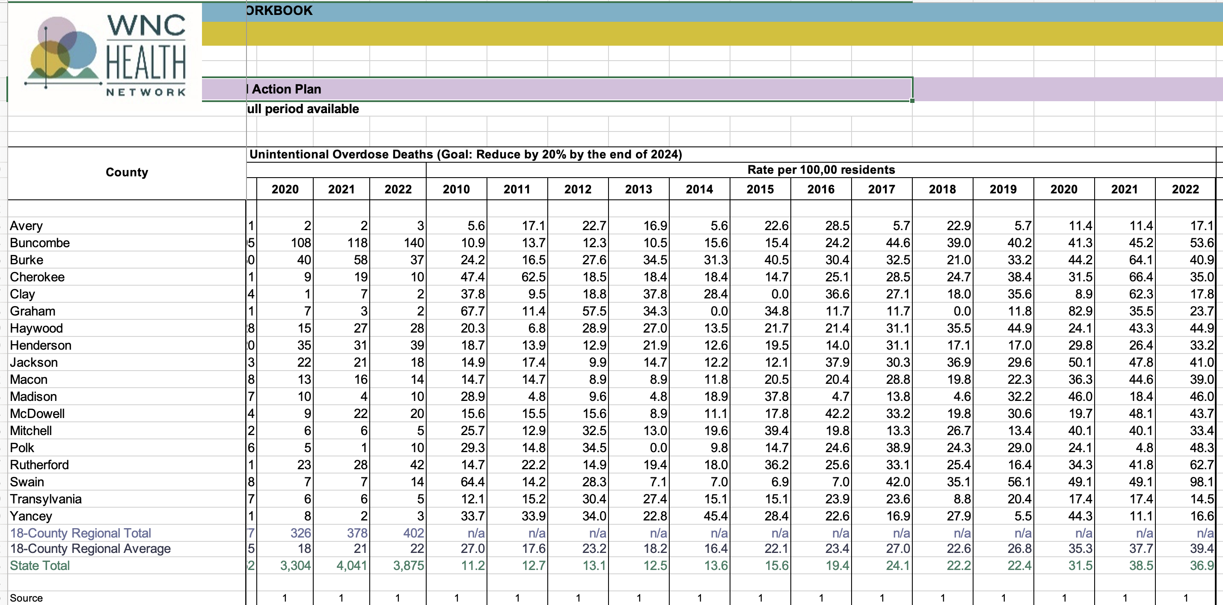
Key Data Source: WNC Health Network
Many key indicators offer data over a ten-year period, allowing users to calculate increases/decreases.

Slide 42
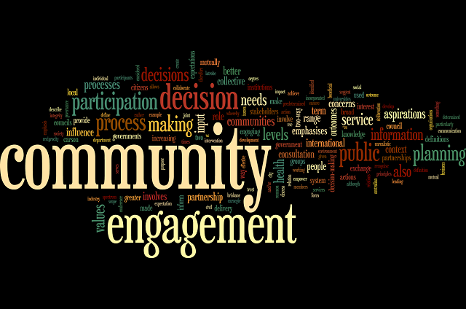
Don’t forget: Utilize Community Health Needs Assessments for more local level data
A strong Need section for any grant proposal should include a discussion of how the target population has been engaged in the determination of need/ development of the project. CHNAs are a good place to start.

Slide 43
What to Look for in CHNAs
What are the top needs and/or priorities identified by the community?
How many community members participated in surveys, focus groups, and/or townhall meetings to provide feedback, and how diverse was the representation?
What historical or cultural influences factor into the challenges facing the community?

Slide 44
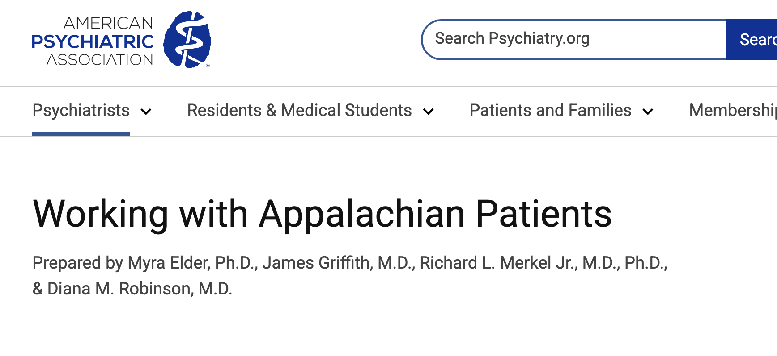
Sources for information on Appalachian culture and best practices for working with Appalachian populations
(links embedded)
Working with Appalachian Patients. American Psychiatric Association.
Appalachian Regional Commission. An Analysis of Mental Health and Substance Abuse Disparities & Access to Treatment Services in the Appalachian Region. Research, Evaluations, Maps, and Data.
“You are not clean until you're not on anything”: Perceptions of medication-assisted treatment in rural Appalachia, International Journal of Drug Policy, Volume 85.

Slide 45
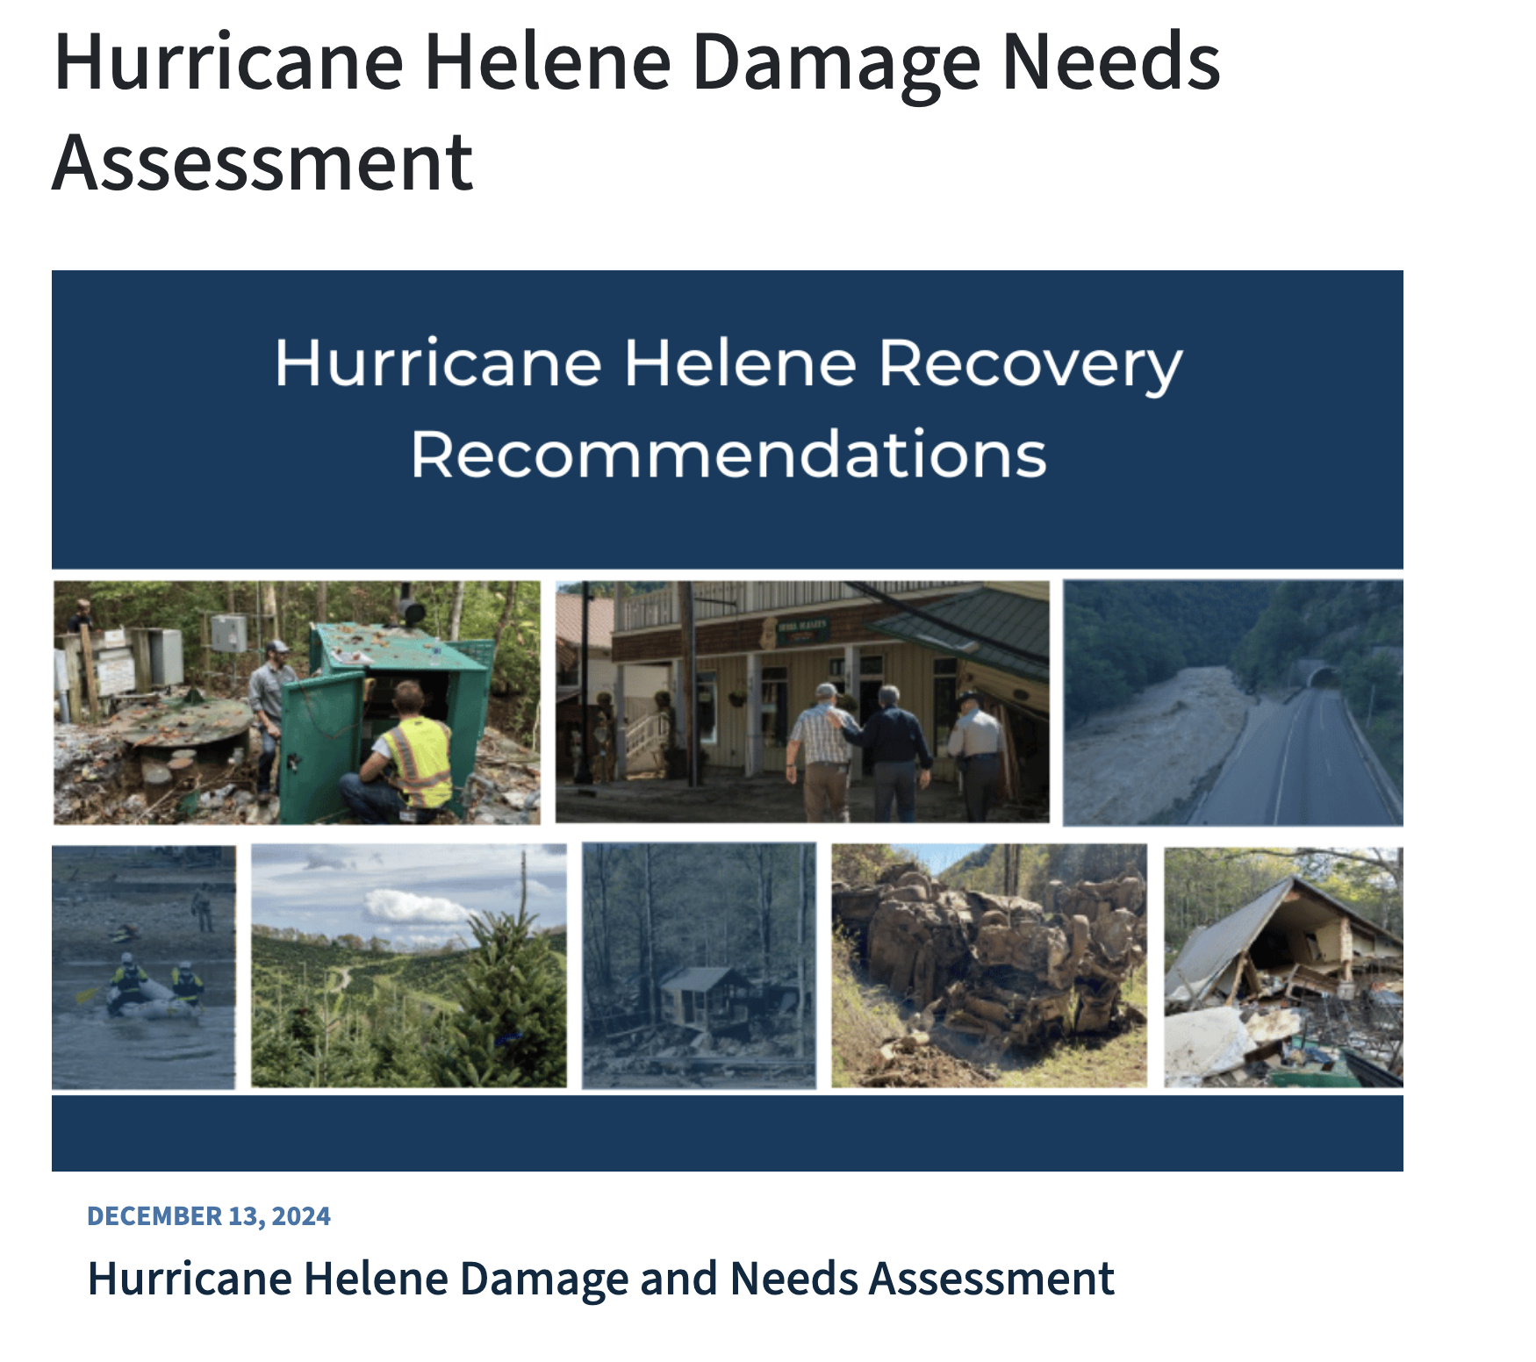
Sources for data on the impact of Hurricane Helene
NC Office of State Management and Budget: Hurricane Helene Damage and Needs Assessment
NC Department of Commerce: Labor Market Impacts of Hurricane Helene: Early Insights from Western North Carolina

Slide 46
Questions?
IFP Contact Information:
Louise Mathias, Senior Partner
Louise.mathias@innovativefundingpartners.com
(202) 809-3401
Dr. Brian Kelley, Senior Partner
Brian.Kelley@innovativefundingpartners.com
(202) 809-3399

Slide 47
dht.org

